Slide 1
Amadeus
An App for Musicians
Informal Design Review
Team 7
Ryuichi Ohhata, Dev Bhatia, James Wasson, Samantha Au, Brandon DeSiata

Slide 2
Proposed Solution
Connect Local Musicians
Showcase Videos
Genre
Instrument
Skill Level
Location
Display Local Shows
Bands + Individuals can enter details of local gigs
Specify genre / setlist
People can follow bands, receive notifications of their shows

Slide 3
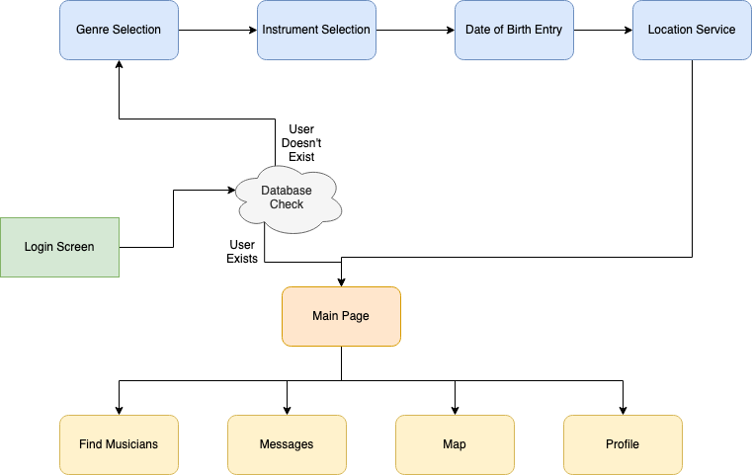
Current Screenflow

Slide 4
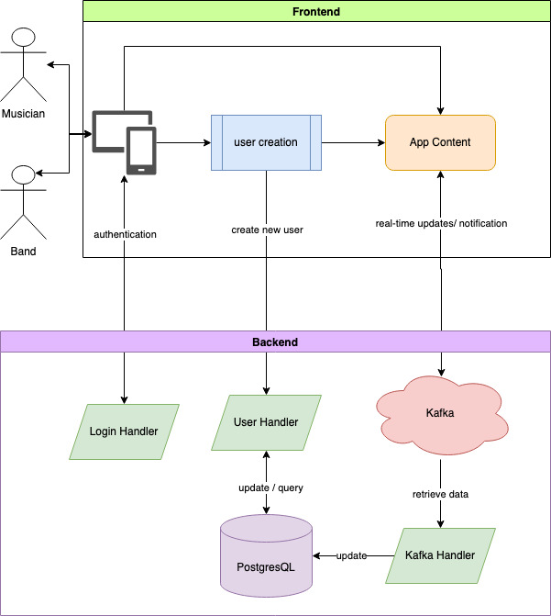
Overall System

Slide 5
Thank You For Watching

