Slide 1
Impact of Weather Conditions on
Fire Occurrence and Damage
in Gangwon Province
Integrated Frequency–Severity Modeling via PCA-based Poisson GLM and Interaction MLR
IMEN 415 | Multivariate Analysis
TEAM 4
류근호 · 이용준 · 이준혁
Korea University, Dept. of Industrial & Management Engineering

Slide 2
Table of Contents
01
Background & Research Questions
02
Data Overview & Preprocessing
03
Exploratory Data Analysis (EDA)
04
Hypothesis 1 — PCA + Poisson GLM (Frequency)
05
Hypothesis 2 — MLR + Interaction (Severity)
06
Conclusions & Implications

Slide 3
01
Background
Yangganjipung, Motivation & Research Questions

Slide 4
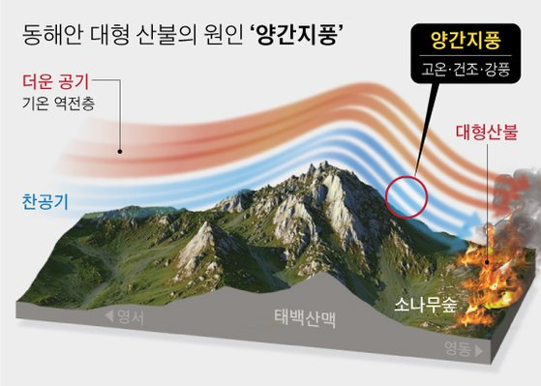

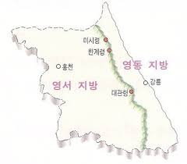
Background
Project Motivation
A team member served in the military in Gangwon and witnessed repeated wildfires and their heavy damage firsthand — this experience motivated the study.
Yangganjipung (Foehn Effect)
Hot, dry wind crossing the Taebaek Mountains into the Yeongdong coast
2019 Goseong fire: ~2,000 ha burned
2022 Uljin–Samcheok fire: ~16,302 ha
→ Does wind affect fire damage differently across the mountain divide?
Research Motivation
Motivated by firsthand accounts of
devastating wildfires witnessed
during military service in Gangwon
Province — inspiring this study.
Notes:
Special Motivation
Witnessed
Fire breakouts
Earth Science
West wind cross 태백 마운틴, it undergoes Foehn Effect. The wind becomes extremely hot, dry and fast.
We hypothesized that this topographical characteristics does more just make wind stronger, it fundamentally changes the ‘nature’ of the fire itself.

Slide 5
Research Questions
Q1 Frequency
Q2 Severity
Do 'composite weather indices (PCA)'
and 'season' significantly predict
daily fire counts?
→ Hypothesis 1
PCA + Poisson GLM
Does the effect of 'wind speed' on
fire damage differ between
'Yeongdong and Yeongseo'?
→ Hypothesis 2
MLR + Interaction Term

Slide 6
02
Data Overview & Preprocessing
Fire & Weather Spatiotemporal Panel

Slide 7
Data Preprocessing | Step 1
Fire Data: Integration & Aggregation by Date × District
10 annual CSV files (2015–2024) unified
Column names standardized across years
Filtered to Gangwon Province only
Aggregated by Date × District:
→ fire count, casualties, property damage
10 files (varying schemas) → Column standardization
→ Gangwon filter
→ Date × District aggregation
R Code — Fire Data Aggregation
fire_list <- lapply(fire_files, function(file) {
df <- read.csv(file, fileEncoding = "CP949", stringsAsFactors = FALSE, check.names = FALSE)
names(df) <- str_replace_all(names(df), "화재발생년월일", "일시")
names(df) <- str_replace_all(names(df), "시·군·구|시_군_구", "시군구")
df[, c("일시", "시도", "시군구", "인명피해소계", "사망", "부상", "재산피해소계")]
})
fire_raw <- bind_rows(fire_list)
fire_agg <- fire_raw %>%
filter(str_detect(시도, "강원")) %>%
mutate(Date = as.Date(parse_date_time(일시, orders = c("Ymd HM","Ymd HMS","Ymd"))),
재산피해소계 = coalesce(to_num(재산피해소계), 0)) %>%
group_by(Date, 시군구) %>%
summarise(화재건수 = n(), 재산피해 = sum(재산피해소계), .groups = "drop")
Notes:
we combined 10 years of
소방청 화재 data
기상청 일기상 data
from 2015 to 2024

Slide 8
Data Preprocessing | Step 2
Weather Interpolation + Spatiotemporal Panel Construction
Weather Missing Data Treatment
Spatiotemporal Panel Construction
1. Linear interpolation (na.approx)
2. Forward fill (na.locf)
3. Backward fill (na.locf, fromLast)
No-rain days: 강수량 = 0 (not NA)
Full grid: Date × 18 districts (expand.grid)
District → Station mapping (7 ASOS)
Left join: weather + fire on grid
→ Non-fire days preserved (count = 0)
R Code — Weather Interpolation + Panel Join
# Weather: station-level missing value interpolation
weather <- weather_raw %>%
mutate(Date = as.Date(Date), 강수량 = coalesce(강수량, 0)) %>%
group_by(지점명) %>% arrange(Date) %>%
mutate(across(c(평균기온, 최고기온, 최저기온, 평균습도, 최대풍속),
~ na.locf(na.locf(na.approx(.x, na.rm=FALSE), na.rm=FALSE),
fromLast=TRUE, na.rm=FALSE))) %>% ungroup()
# Full grid: every (Date × District) combination, including non-fire days
all_dates <- seq(as.Date("2015-01-01"), as.Date("2024-12-31"), by = "day")
full_grid <- expand.grid(Date = all_dates, 시군구 = mapping$시군구)
gangwon_panel <- full_grid %>%
left_join(mapping, by="시군구") %>% # district → station
left_join(weather, by=c("Date","지점명")) %>% # weather data
left_join(fire_agg, by=c("Date","시군구")) # fire data (NA = no fire)
Notes:
With interpolated weather data,
we combined spatial units such as cites,
and temporal units such as days and months to create a 2D tabular dataset

Slide 9
Data Preprocessing | Step 3
Derived Variables for Hypothesis Testing
Variable | Definition | Purpose
건조지수 | 평균기온 − 평균습도/10 | Dryness proxy for PCA
기온교차 | 최고기온 − 최저기온 | Diurnal range for PCA
계절 | 3–5월=봄, 6–8=여름, 9–11=가을, 12–2=겨울 | H1: Spring dummy (IsSpring)
Region | 강릉·동해·속초·삼척·고성·양양 = Yeongdong Others = Yeongseo | H2: Interaction with wind
R Code — Derived Variables
yeongdong <- c("강릉시", "동해시", "속초시", "삼척시", "고성군", "양양군")
gangwon_panel <- gangwon_panel %>% mutate(
화재건수 = coalesce(화재건수, 0), # non-fire days = 0
재산피해 = coalesce(재산피해, 0),
화재발생여부 = ifelse(화재건수 > 0, 1, 0),
건조지수 = 평균기온 - (평균습도 / 10), # dryness index
기온교차 = 최고기온 - 최저기온, # diurnal range
월 = month(Date),
계절 = case_when(월 %in% 3:5 ~ "봄", 월 %in% 6:8 ~ "여름",
월 %in% 9:11 ~ "가을", TRUE ~ "겨울"),
Region = ifelse(시군구 %in% yeongdong, "Yeongdong", "Yeongseo")
)
Notes:
Derived variables
Dryness index, diurnal（다이얼널） temperature range, season, and region.
Especially we grouped~

Slide 10
Preprocessing Result | Final Panel Dataset
Output of the full preprocessing pipeline — ready for EDA and modeling
65,754
Date | District | Region | Avg Temp | Avg Humid | Max Wind | Dry Idx | Fire Count | Damage (KRW) | Season
2015-01-01 | 속초시 | Yeongdong | -4.6 | 31.6 | 6.1 | -7.76 | 6 | 20,158 | 겨울
2015-01-02 | 속초시 | Yeongdong | -2.9 | 30.4 | 11.5 | -5.94 | 4 | 6,062 | 겨울
2015-01-03 | 속초시 | Yeongdong | 1.1 | 32.5 | 7.2 | -2.15 | 0 | 0 | 겨울
2015-03-05 | 강릉시 | Yeongdong | 8.3 | 28.4 | 9.8 | 0.49 | 3 | 15,200 | 봄
2019-04-04 | 고성군 | Yeongdong | 14.2 | 20.1 | 18.3 | 12.19 | 12 | 193,674,022 | 봄
2022-03-04 | 삼척시 | Yeongdong | 8.1 | 25.3 | 15.2 | 5.58 | 8 | 98,532,000 | 봄
Total Observations (Date × District)
21
Variables (Weather + Fire + Derived)
14,548 / 51,206
Fire Days / No-Fire Days (22.1% / 77.9%)
2015–2024
🔴 Large fire events | ⬜ No-fire days (화재건수 = 0 preserved in panel)
Date Range (10 Years, 18 Districts)
Key derived variables: 건조지수 = 평균기온 − 평균습도/10 | 기온교차 = 최고기온 − 최저기온 | Region: Taebaek divide
Notes:
Final constructed panel data
65 thousand observations

Slide 11
03
Exploratory Data Analysis
Response Variables & Regional Comparison

Slide 12
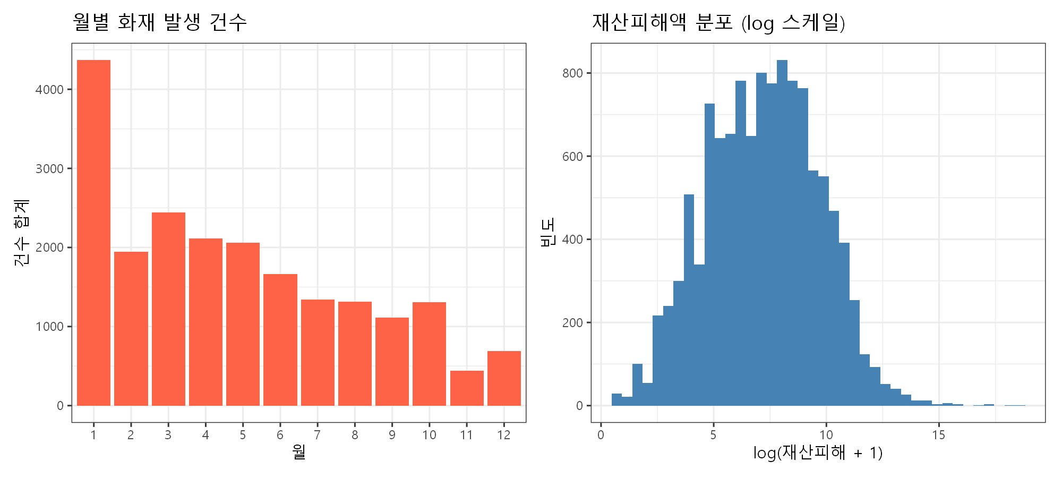
EDA | Response Variable Distributions
→ Key EDA for H1 (Frequency)
→ Key EDA for H2 (Severity)
Monthly Fire Counts (Left)
Fires concentrate in winter–spring (Jan, Mar–May). This confirms the need for a seasonal variable (IsSpring) in the model.
Property Damage Distribution (Right)
Extreme right-skewness: most fires are small, but rare large fires dominate the tail. This justifies log-transformation of damage in H2.
Notes:
It shows an extreme right-skewness(우측 편도)

Slide 13
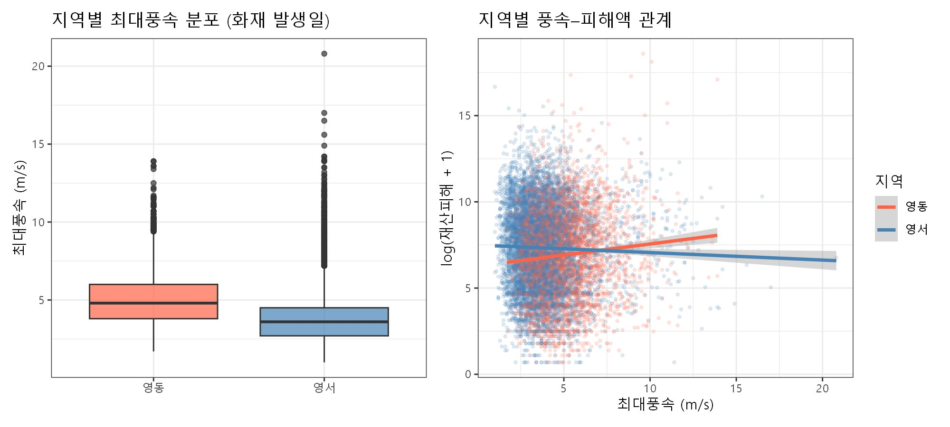
EDA | Yeongdong vs Yeongseo: Wind–Damage Relationship
Wind Speed Distribution (Left): Wind speed itself does not differ drastically between Yeongdong and Yeongseo.
Wind–Damage Relationship (Right): Despite similar wind speeds, the regression slopes diverge — Yeongdong (red) trends upward while Yeongseo (blue) trends downward. This motivates the Wind × Region interaction term in H2.
Notes:
영동 shows upward trend
영서 shows gentle downward trend
This visual evidence made us certain of the need for an interaction term.

Slide 14
04
Hypothesis 1
PCA + Poisson GLM (Fire Frequency)

Slide 15
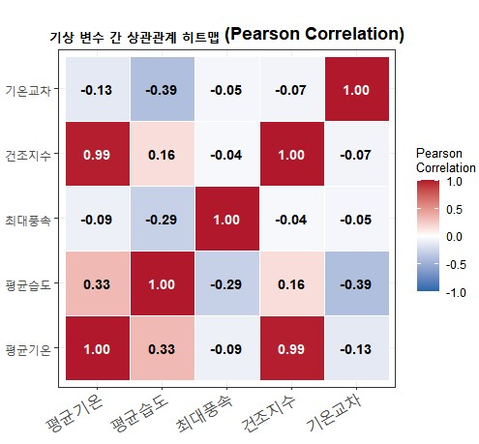
H1 Background |
Multicollinearity Among Weather Variables
Pearson correlation matrix of 5 input variables — justifying the need for PCA
Strong Positive Correlation
Temp ↔ Dry Index: r = 0.99 (near-identical info)
Temp ↔ Humidity: r = 0.33
Negative Correlation
Diurnal Range ↔ Humidity: r = −0.39
Max Wind ↔ Humidity:
r = −0.29
Why PCA?
Correlated inputs
→ unstable coefficient estimates due to multicollinearity
→ Compress 5 variables into 2 independent indices via PCA
Notes:
멀티콜리너리티

Slide 16
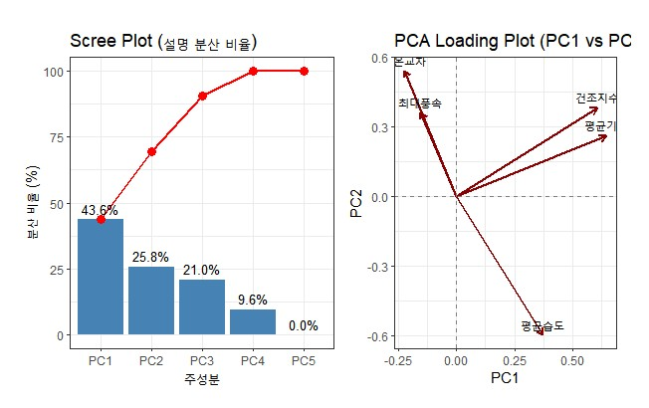
H1 | PCA: Dimensionality Reduction
5 weather variables → 2 independent indices (69.4% variance explained)
PC1: Cold-Dry Index (43.6%)
Temp (+0.646), Dry Idx (+0.608), Humidity (+0.373)
Sign flipped → higher = colder & drier
PC2: Gale-Diurnal Index (25.8%)
Humidity (−0.599), Diurnal Range (+0.543)
Dry Idx (+0.382), Max Wind (+0.363)
Captures volatile weather with local gusts
R Code (from report §2.3.2)
pca_result <- prcomp(panel_df[, pca_cols], center = TRUE, scale. = TRUE)
summary(pca_result) # variance explained per component
round(pca_result$rotation[, 1:2], 3) # PC1, PC2 loadings
# Sign flip: PC1_Index ↑ = colder & drier
panel_df$PC1_Index <- -pca_result$x[, 1]
panel_df$PC2_Index <- pca_result$x[, 2]
Notes:
Diurnal(다이얼널)
explained 70% of the weather variance.

Slide 17
H1 | Model Selection: Logistic → Poisson GLM
Why we switched from binary classification to count modeling
② Final Model: Poisson GLM
① Initial Attempt: Logistic Regression
Model:
Modeled daily fire occurrence (0 / 1)
Tested weather × spring interaction effect
ln(E[count]) = β₀ + β₁·PC1 + β₂·PC2 + β₃·IsSpring
Hypothesis:
H₀ : β₁ = β₂ = β₃ = 0
✗ Reason 1: Interaction Not Significant
Hₐ : at least one βᵢ ≠ 0
PC1 × IsSpring interaction p-value = 0.673
→ Spring risk does not amplify bad weather
e^β = rate ratio (% change in expected daily count)
Y = daily fire count (0, 1, 2, …)
✗ Reason 2: Cannot Capture Multiplicity
R Code (from report §2.3.3)
1 fire/day = 10 fires/day → both coded '1'
Loses critical information about fire intensity
# Logistic — interaction p = 0.673 (not sig.)
logit_init <- glm(factor(화재발생여부) ~
PC1_Index * IsSpring + PC2_Index,
family = binomial, data = panel_df)
# Poisson — models daily fire COUNT
poisson_model <- glm(화재건수 ~
PC1_Index + PC2_Index + IsSpring,
family = poisson(link = "log"), data = panel_df)
Notes:
Trial-and-Error
Whether the fire ‘occurred or not’
This failed to capture multiplicity risk
Which targets the actual counts of occurrences of fire.

Slide 18
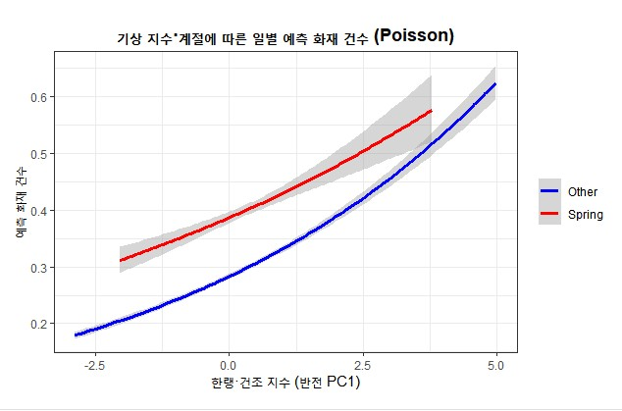
H1 | Poisson GLM: Results & Hypothesis Test
H₀ Rejected — All three predictors significantly increase daily fire count (all p < 0.001)
Variable | β | e^β | Effect (+1 unit) | p-value
PC1 (Cold-Dry) | +0.158 | 1.171 | +12.5% fire count | < 2e-16
PC2 (Gale-Diurnal) | +0.206 | 1.228 | +22.8% ★ Largest | < 2e-16
IsSpring (Spring) | +0.092 | 1.097 | +9.6% (indep. of weather) | 1.55e-08
PC2 at Storm-Level (+3 SD)
e^(3×0.206) = e^0.618 ≈ 1.85
→ fire count increases ~85% vs. a normal day
⚠ Dispersion ratio = 2.32 (overdispersion detected) → p-values may be optimistic; negative binomial comparison needed
Spring as Independent Risk Factor
Even with weather controlled, spring alone adds +10%
→ human factors (hikers, crop burning), not weather amplification
Notes:
All indices were highly significant
PC2 shows substantial impact
If the index rises by about 3 SD -> fire frequency increases by 8５%
Independent seasonal effect for spring also shows ａｂｏｕｔ 10% of fire frequency increases

Slide 19
05
Hypothesis 2
MLR + Interaction (Fire Severity)

Slide 20
H2 | Hypothesis & Preprocessing Method
Foehn-driven wind–damage interaction in Yeongdong vs Yeongseo
Hypothesis & Model
① Log Transformation of Damage
Model:
Right-skewed distribution (from EDA) → OLS assumptions violated LogDamage = log(재산피해 + 1)
→ e^β interpreted as % change in damage per 1 m/s wind
LogDamage = β₀ + β₁·Wind + β₂·Region
+ β₃·(Wind×Region) + β₄·Temp + β₅·Humid + ε
Hypothesis:
② Cook's Distance Outlier Removal
H₀ : β₃ (interaction) = 0
Extreme damage events unrelated to weather (e.g., arson, high-value facilities) Threshold: 4/N → 11,823 → 11,298 rows
Improves stability of regression estimates
Hₐ : β₃ ≠ 0 (Foehn amplifies damage in Yeongdong)
β₃ = differential wind effect of Yeongdong over Yeongseo
R Code (from report §2.4.2 — {r h2-prep})
fire_base <- gangwon_panel %>%
filter(재산피해 > 0, complete.cases(최대풍속, 평균기온, 평균습도)) %>%
mutate(LogDamage = log(재산피해 + 1), Region = factor(Region, levels = c("Yeongseo","Yeongdong")))
mlr_pre <- lm(LogDamage ~ 최대풍속 * Region + 평균기온 + 평균습도, data = fire_base)
cooksd <- cooks.distance(mlr_pre); thr <- 4 / nrow(fire_base) # threshold: 4/n
fire_cleaned_df <- fire_base[!is.na(cooksd) & cooksd <= thr, ]

Slide 21
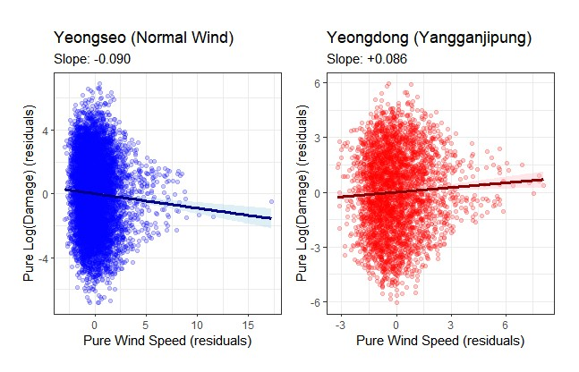
H2 | Partial Regression: Pure Wind–Damage Effect
Controlling for temperature & humidity via residualization before the interaction test
FWL Theorem
Regress Wind and LogDamage
each on Temp & Humidity
→ residuals = pure wind effect
(temp/humidity noise removed)
Yeongseo slope = −0.090
Wind ↑ → Damage ↓ (suppression)
Yeongdong slope = +0.086
Wind ↑ → Damage ↑ (amplification)
Topography fundamentally alters the physical properties of the wind.
R Code (from report §2.4.3 — {r partial-reg})
add_partial <- function(df) {
df$Wind_Pure <- residuals(lm(최대풍속 ~ 평균기온 + 평균습도, data = df)) # pure wind
df$Damage_Pure <- residuals(lm(LogDamage ~ 평균기온 + 평균습도, data = df)) # pure damage
df }
slope_yd <- coef(lm(LogDamage ~ 최대풍속 + 평균기온 + 평균습도, data=yeongdong_df))[["최대풍속"]]
slope_ys <- coef(lm(LogDamage ~ 최대풍속 + 평균기온 + 평균습도, data=yeongseo_df))[["최대풍속"]]
Notes:
Partial regression plot
Negative slope
Positive slope
영서 -> intriguing(흥미로운) -> defied standard intuition
This was the exact moment we proved with data that topography fundamentally alters the physical properties of the wind.

Slide 22
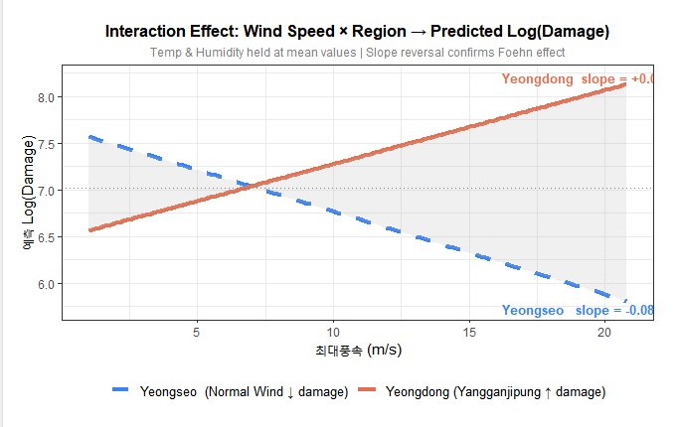
H2 | MLR Interaction: Results & Hypothesis Test
H₀ Rejected — Wind × Region interaction is statistically significant (p < 0.001)
Term | Coef. | p-value
Wind (Yeongseo base) | −0.089 | < 0.001
Wind × Yeongdong ★ | +0.168 | < 0.001
Yeongdong slope (net) | +0.079 | —
Slope Reversal — Key Finding
Yeongseo: −0.089 → wind suppresses damage
Yeongdong: +0.079 → Foehn wind amplifies damage
exp(0.079) ≈ 1.082 → +1 m/s = +8.2% damage
+10 m/s stronger → damage increases ×2.2
Adj. R² = 0.025
(low, but expected — purpose is interaction testing, not prediction)
Terrifying nature of Yangganjipung(양간지풍)
Notes:
We didn’t stop here
Interaction between wind speed & topography also exists
This is the true, ｔｈａｔ ｓｈｏｗｓterrifying nature of Yangganjipung.

Slide 23
06
Conclusions & Implications
Findings, Engineering Impact & Limitations

Slide 24
Conclusions
Q1 Frequency → H₀ Rejected
Gale-Diurnal Index (PC2) is the strongest predictor (+23% per unit)
Spring adds ~10% baseline risk independent of weather (human factors)
Poisson GLM captures multiplicity that logistic regression cannot
Q2 Severity → H₀ Rejected
Wind × Region interaction is significant (p < 0.001)
Yeongseo: wind suppresses damage (−0.089); Yeongdong: amplifies (+0.079)
Confirms the differential terrain effect of the Foehn wind
Notes:
Every 1 SD increases in this index -> daily no. of fire occurrence increases by 23%
Spring acts as an independent risk factor
The impact of wind speed on financial damage significantly depending on the region

Slide 25
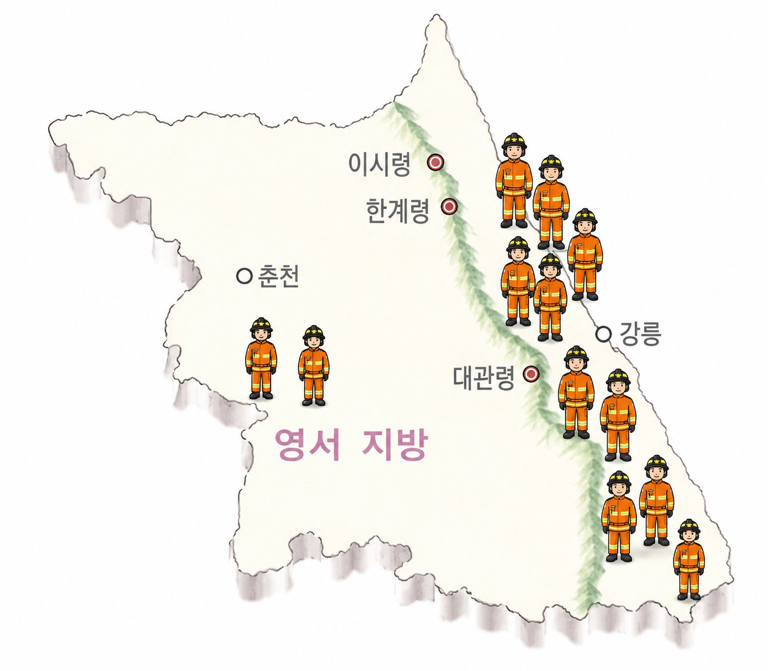
Conclusions | Engineering Implications
How the findings translate into disaster management strategy
01
Early Warning System (H1 — Frequency)
Add PC2 (Gale-Diurnal Index) as a supplementary alert trigger — stronger predictor than humidity alone (+23%) Spring season → activate always-on patrol & mountain entry control regardless of weather conditions
(+10% baseline risk)
02
Asymmetric Resource Allocation (H2 — Severity)
During high-wind alerts, do NOT distribute firefighting resources
evenly (1/n) across Gangwon Pre-position resources in Yeongdong (Gangneung·Sokcho·Goseong·Yangyang) Scale deployment size by predicted damage multiplier: exp(β × Δwind speed)
03
Combined Frequency × Severity Strategy (H1 + H2)
When PC2 (high gale-diurnal risk) co-occurs with strong wind in Yeongdong
→ both frequency and severity risks are elevated simultaneously
→ joint risk index guides dynamic cross-deployment of regional fire forces
Notes:
propose a dynamic resource allocation matrix
Essentially, a joint risk index that guides the dynamic cross-deployment of regional fire forces.

Slide 26
Conclusions | Limitations & Future Work
Acknowledging the boundaries of this study
L1
Missing Human Behavioral Factors
Spring's +10% baseline risk was attributed to hikers and crop burning, but no actual visitor count or burning incident data was included as a covariate. Future work could quantify this human component directly.
L2
No Forest & Terrain Variables
Property damage is also driven by conifer density, slope gradient, and distance to fire stations.
These spatial covariates were unavailable, which limits the explanatory power of H2 (Adj. R² = 0.025).
L3
Poisson Overdispersion
Dispersion ratio = 2.32 — the Poisson model's variance assumption is violated, making standard errors optimistic.
A negative binomial regression comparison is recommended as a robustness check.
L4
Low R² in MLR (H2)
Adj. R² = 0.025 reflects that property damage is driven by many factors beyond weather.
The model is designed to test the interaction effect, not to predict damage magnitude.
Notes:
The true significance of this research lies in quantitatively proving how topography amplifies the scale of disasters in complex multivariate weather conditions.

Slide 27
Thank You
Q & A
류근호 · 이용준 · 이준혁
Korea University | IMEN 415 Multivariate Analysis

