Slide 1
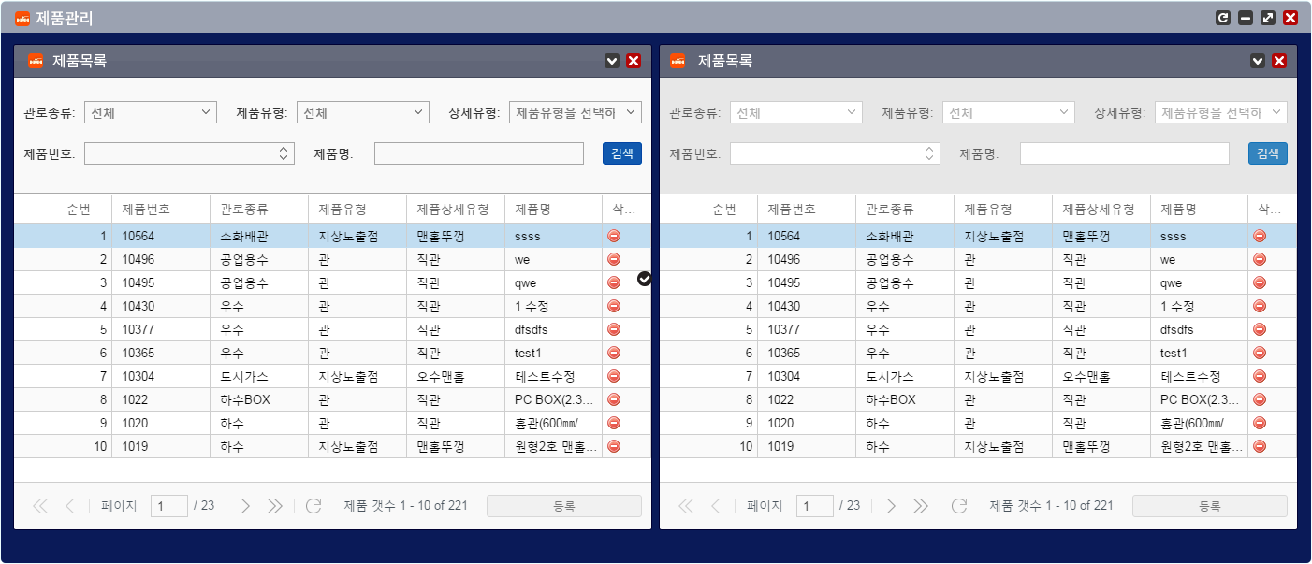
Opacity (alpha) : 0%
BG Color : #616678
Line Color: #44495b
Opacity (alpha) : 40%
BG Color : #04173d
Opacity (alpha) : 0%
BG Color : #f9f9f9
LineColor:#aaaaaa
Opacity (alpha) : 0%
BG Color : #e7e7e7
Opacity (alpha) : 0%
BG Color : #f9f9f9
Line Color :#cecece
Opacity (alpha) : 0%
Color : #0a1a58

