Slide 1

Bruce
Week 1

Slide 2
What I has done
set up testRPC
set up truffle.js, run through initiate, migrant and test.
set up Ethereum wallet and link to test net(Ropsten), deploy contracts on the test net successfully, run and debug contracts.
test and debug smart contracts on Remix.

Slide 3
What I has done(Cont’d)
First two lessons in cryptozombies.
data types, typecasting and struct
operator and string comparison
function and modifier
event listener
other stuff in the lessons

Slide 4
What I has done(Cont’d)
A tutorial about Solidity literal syntax
fallback function
self-destruct function
payable modifier
array operation
struct and mapping
Enumeration
study via reading and understanding comprehensive cases/real projects

Slide 5
What I am working on:
Read through Solidity documentation to check if there are any parts I had missing
Personal Objectives:
Finish reading Solidity documentation
Practice automated testing code with Truffle.js (Mocha.js)

Slide 6


Problem 1
Create 2-D array?
Java/C
Solidity

Slide 7
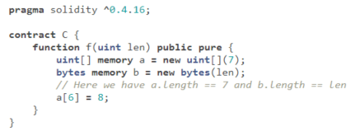
Problem 2 Array
What is this 7 stands for?
uint[] arrayName = new uint[](7);
uint[] arrayName = uint[7] //Why not?

Slide 8
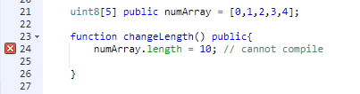
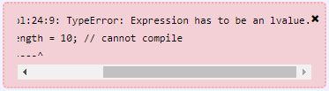
Problem 2 Array
Fixed-sized array – cannot reassign length

Slide 9

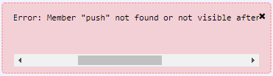
Problem 2 Array
Fixed-sized array – cannot push new element

Slide 10
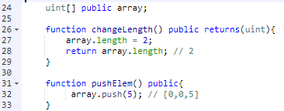
Problem 2 Array
Dynamically-sized array – allow to change length and push elements

Slide 11
Problem 2 Array
uint[] arrayName = new uint[](7);What is this 7 stands for?
It is the length of the new array.
The new array is a dynamically-sized array initialized with 7 elements.
All initialized elements are all zeros. It looks like this: [0, 0, 0, 0, 0, 0, 0]
What’s the difference between this and uint[7]?
Uint[7] is a fixed-sized array, you cannot change length or push new element to it.
How to put it into practice?
Just a faster way to create an array with several 0 in it……

Slide 12
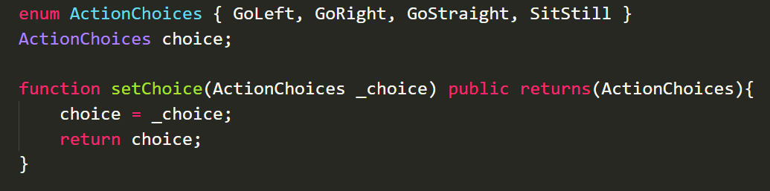
Problem 3
In what case do you use enumeration?
0
1
2
3

Slide 13
Problem 4
What does msg.value mean? People never set this value before using it. I have wrote some contract to test this value, but it seems like in different contracts it has different values.
It can be set some where?

Slide 14
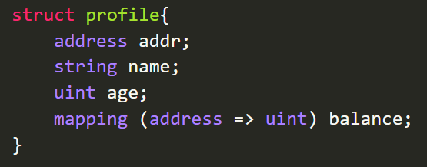

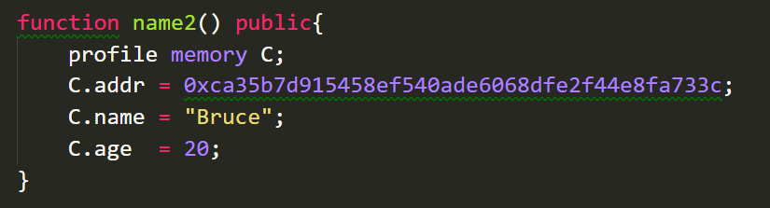
Problem 5
How do you initiate an struce?

Slide 15
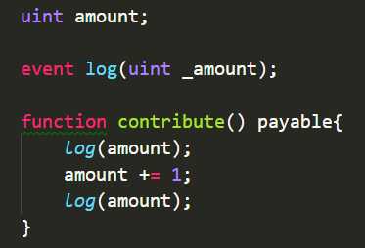
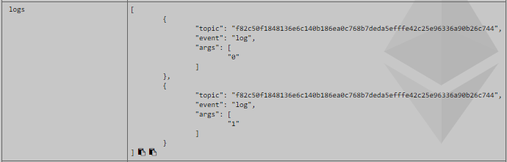
Problem 6
What is event used for?
Log recording
Trigger other function(Like front-end etc)

Slide 16

Problem **
Struct array
struct Campaign{
uint goal;
}
mapping (uint => Campaign) public campaigns;
//Campaign[] public campaigns;

