Slide 1

Visualizing Mortgage Backed Securities Pre-Financial Crisis
Ellen Honganen, Kurt Probe, and Ross Yudkin
Notes:
Introduce the group
Tell them briefly about our project

Slide 2
Project Overview
Goals
Provide visualizations of one of the supposed drivers of the 2008 financial crisis
Compare visualization results to the information we’ve been taught in Finance classes
Data
2008 US Bureau of Labor Statistics Employment Figures
Sampling of 2007-2008 Mortgage Backed Securities Data from SEC.gov
Notes:
More analytical than functional (not a recycled project from another class)
Motivation:
Hear a lot about the 77¢ females earn compared to a man’s $1. It is an important issue that gets a lot of media coverage, but it seemed odd to us and we wanted verification.
Talk about finding and preparing data
Talk about what tools we used for which tasks

Slide 3
Definition of Terms and Variables
Mortgage Backed Security
Financial Instrument secured by a mortgage or a collection of mortgages
LTV
Loan-To-Value Ration(ORIG_BAL / Home Value)
CLTV
Combined-Loan-To-Value Ratio (ORIG_BAL + Other Outstanding Liens on the House) / Home Value
ORIG_RATE
Original Interest Rate (%)
ORIG_BAL
Original Loan ($) Value
ORIG_TERM
Months of Loan Term
Notes:
More analytical than functional (not a recycled project from another class)
Motivation:
Hear a lot about the 77¢ females earn compared to a man’s $1. It is an important issue that gets a lot of media coverage, but it seemed odd to us and we wanted verification.
Talk about finding and preparing data
Talk about what tools we used for which tasks

Slide 4
Definition of Terms and Variables
FICO
Credit Rating
OCCUPANCY
OO (Owner Occupied)
IO (Investor Owned)
SH (Second Home)
TYPE
ARM (Adjustable Rate Mortgage)
FIX (Fixed Rate Mortgage)
Notes:
More analytical than functional (not a recycled project from another class)
Motivation:
Hear a lot about the 77¢ females earn compared to a man’s $1. It is an important issue that gets a lot of media coverage, but it seemed odd to us and we wanted verification.
Talk about finding and preparing data
Talk about what tools we used for which tasks

Slide 5
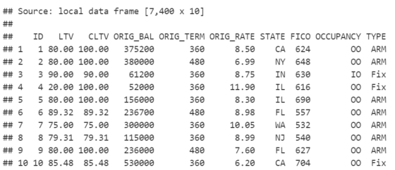
The Data
Example Mortgage Data Table:

Slide 6
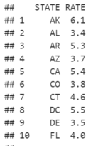
The Data
Example Unemployment Data:

Slide 7
Data Wrangling
Data Wrangling
Group By
Filter
Arrange
Spread
Gather
Cume Dist
Mutate
Inner Join
Left Join
Select
Summarise
Min
Max
Mean
Count

Slide 8
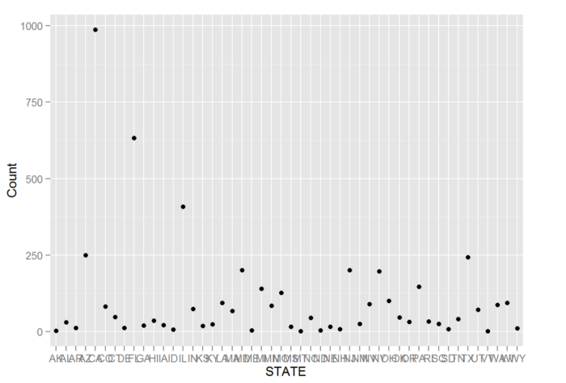
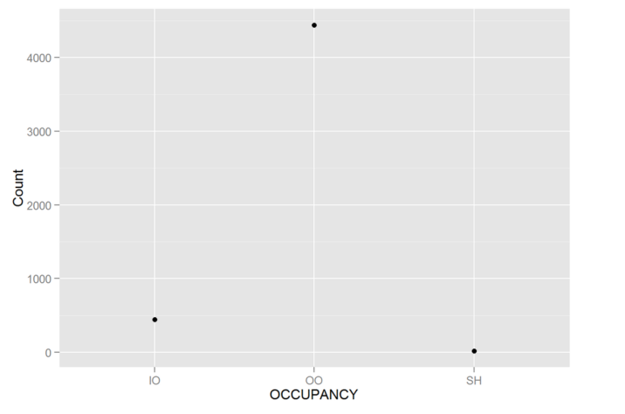
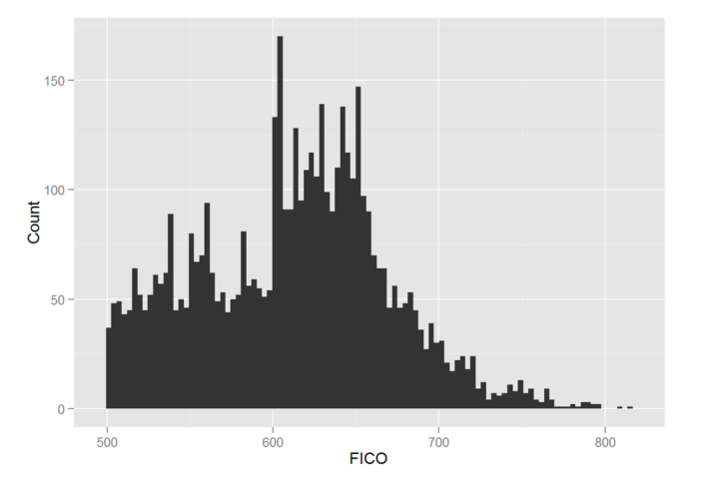
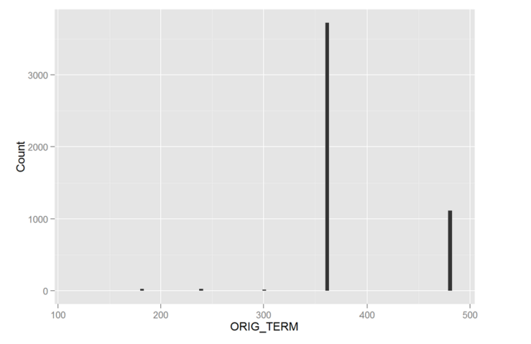
Results & Visualizations

Slide 9
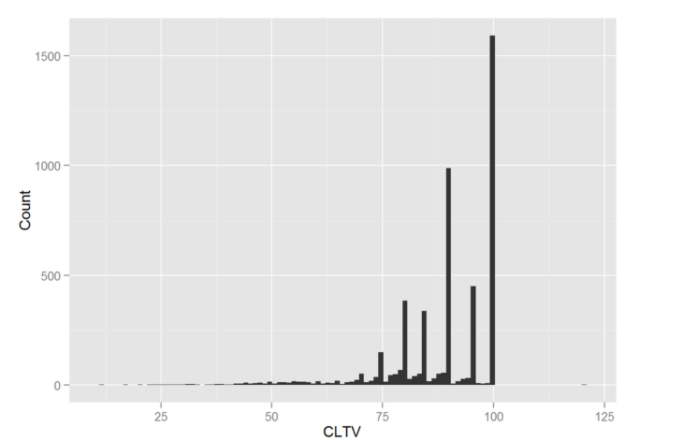
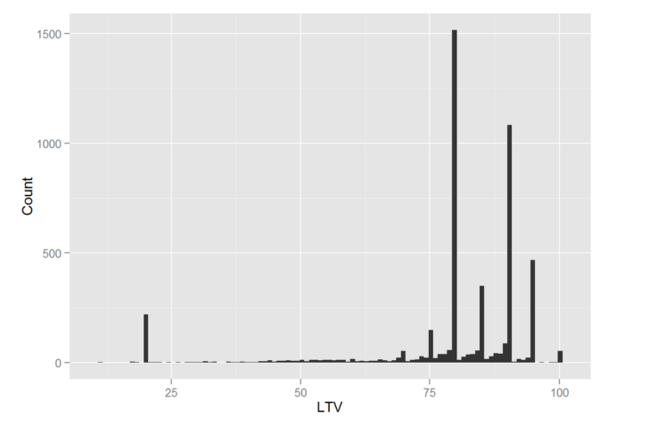
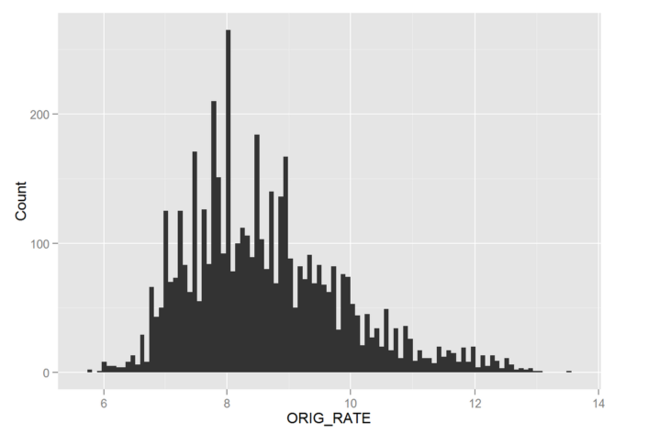
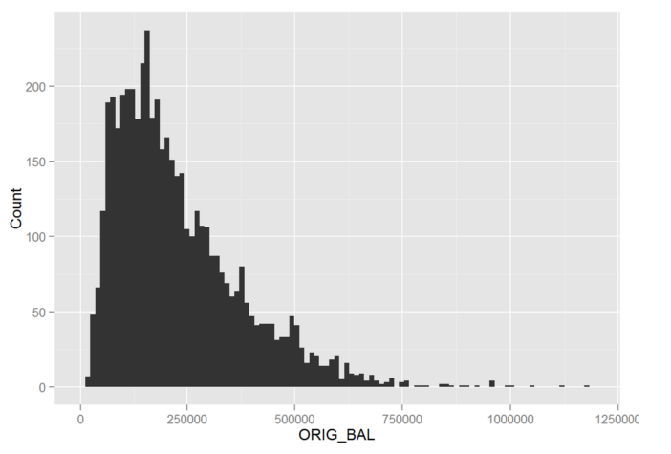
Results & Visualizations

Slide 10
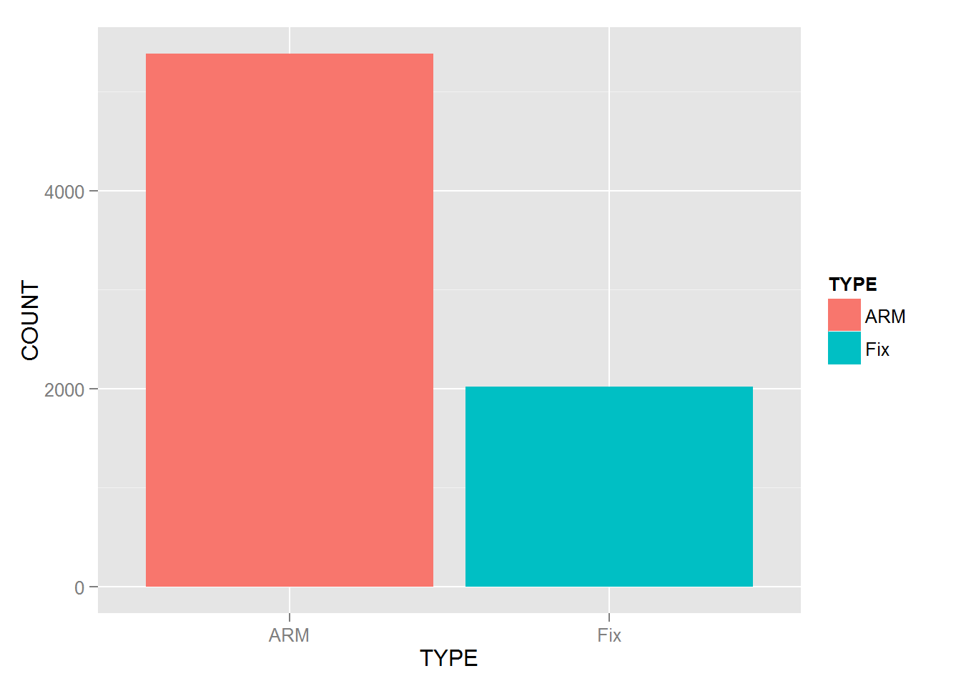
Results & Visualizations

Slide 11
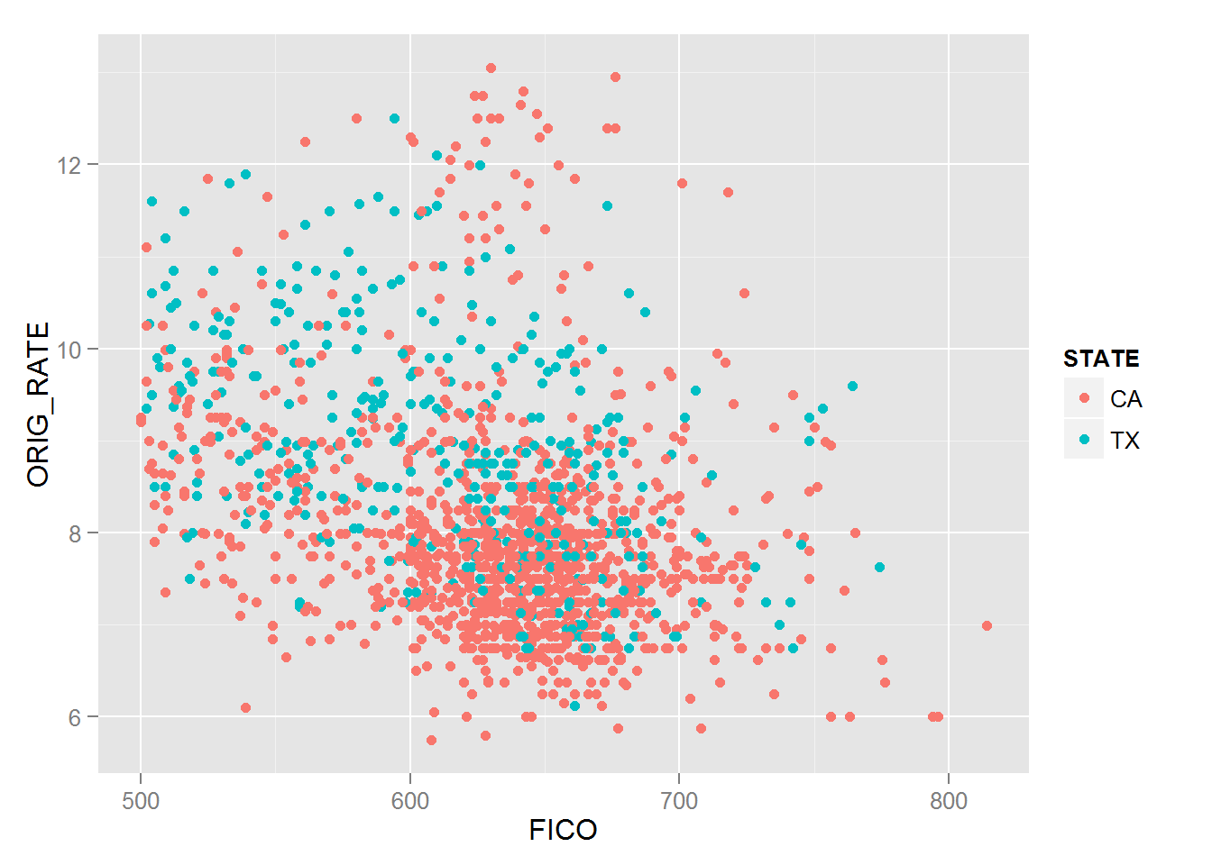
Results & Visualizations

Slide 12
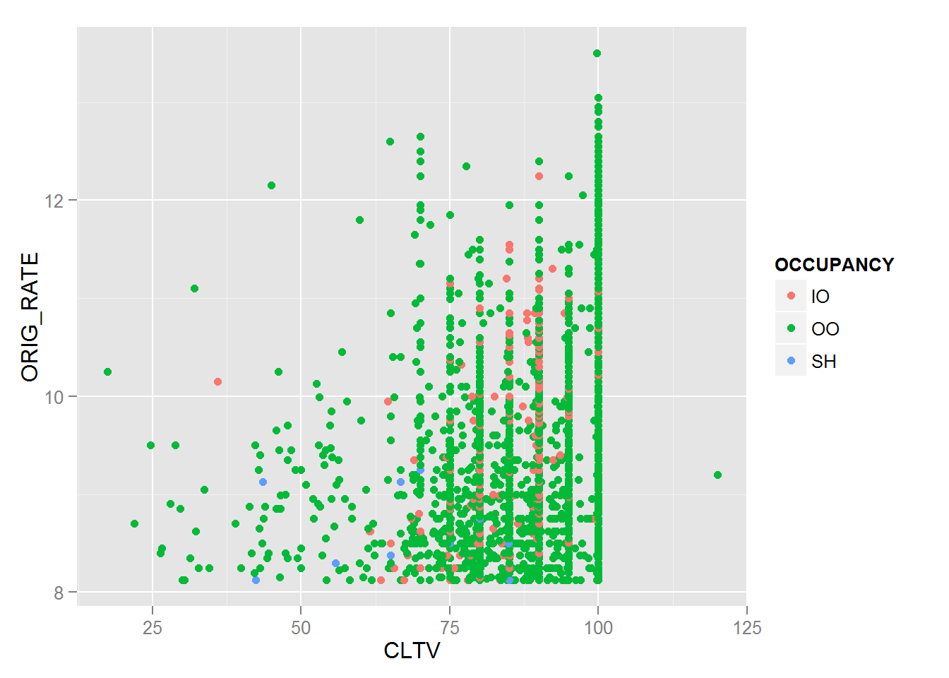
Results & Visualizations

Slide 13
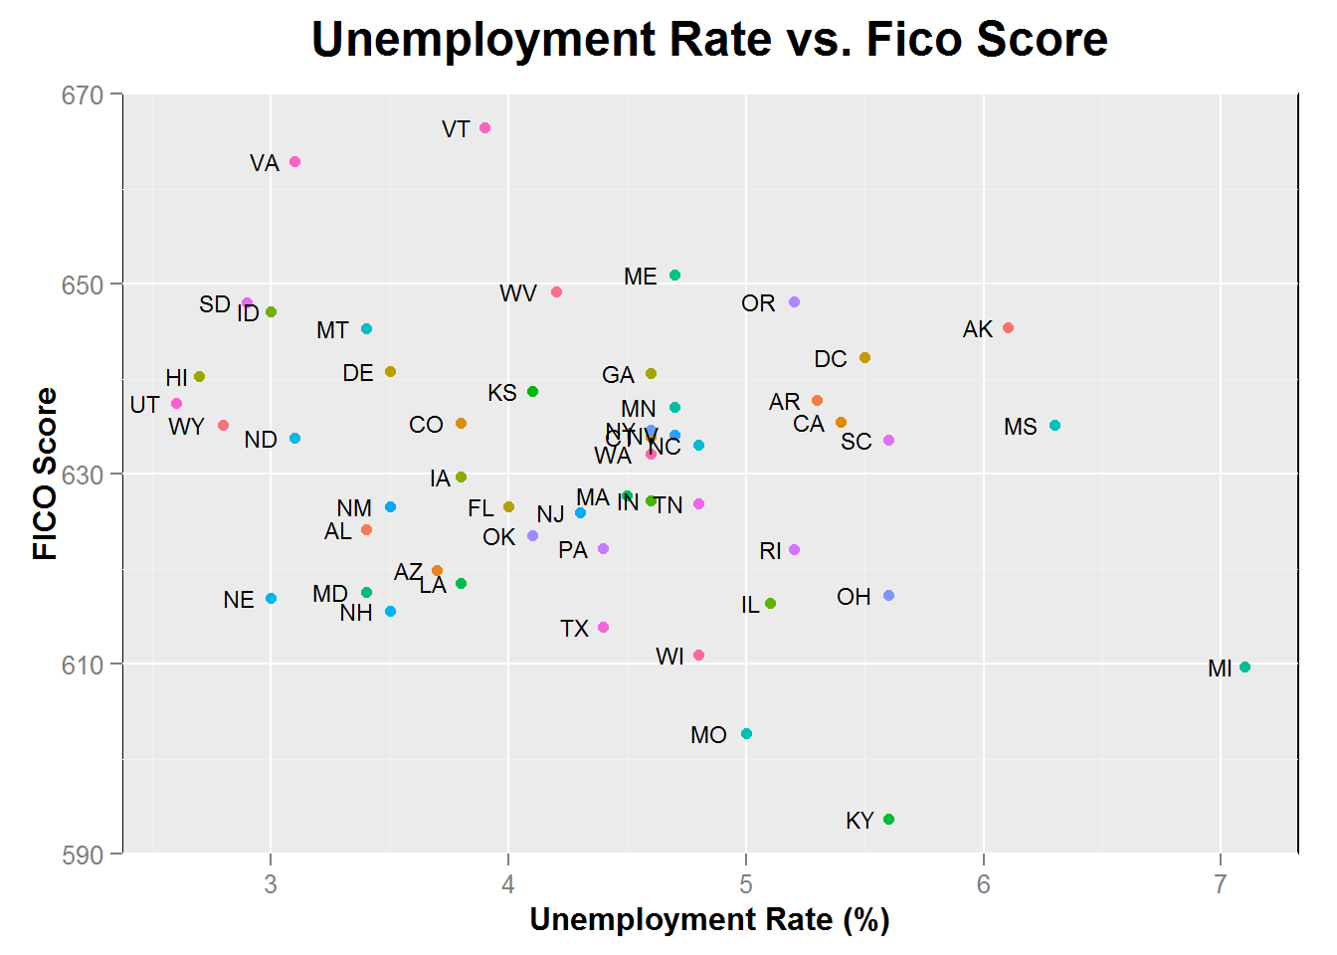
Results & Visualizations

Slide 14
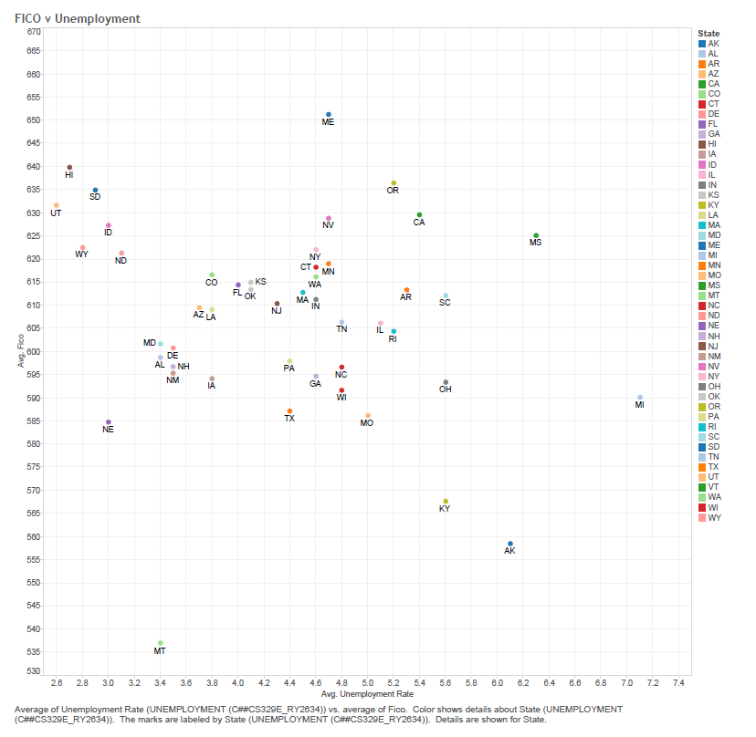
Results & Visualizations

Slide 15
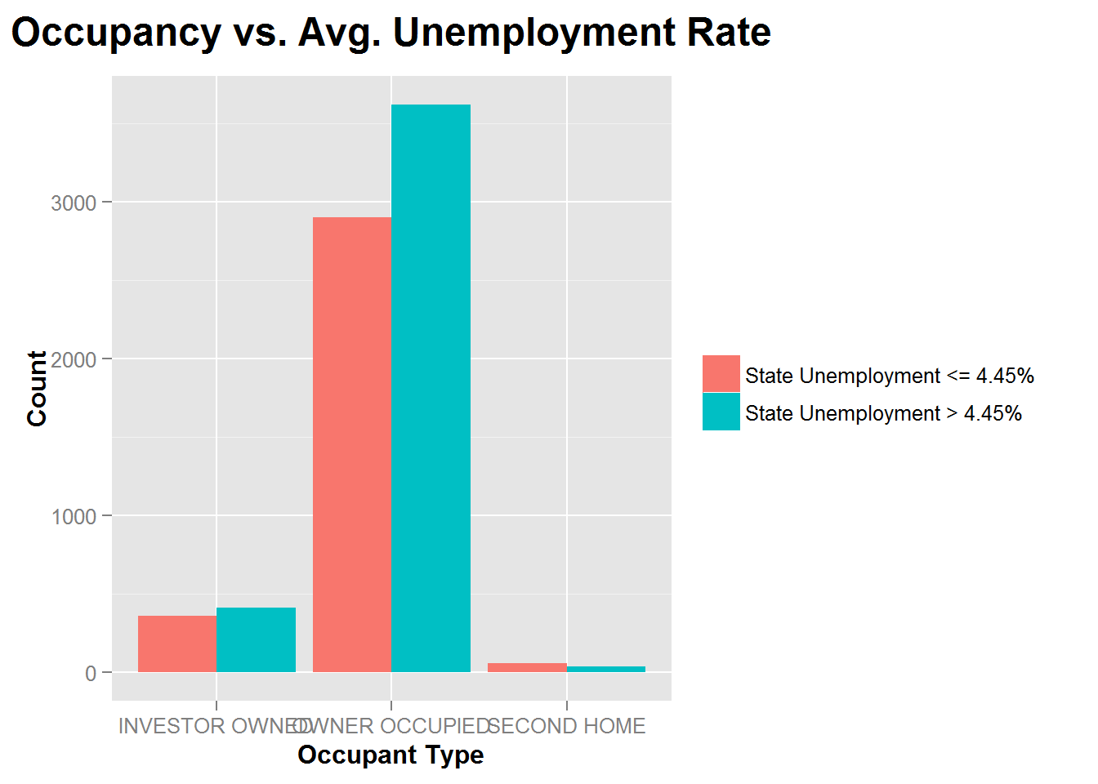
Results & Visualizations

Slide 16
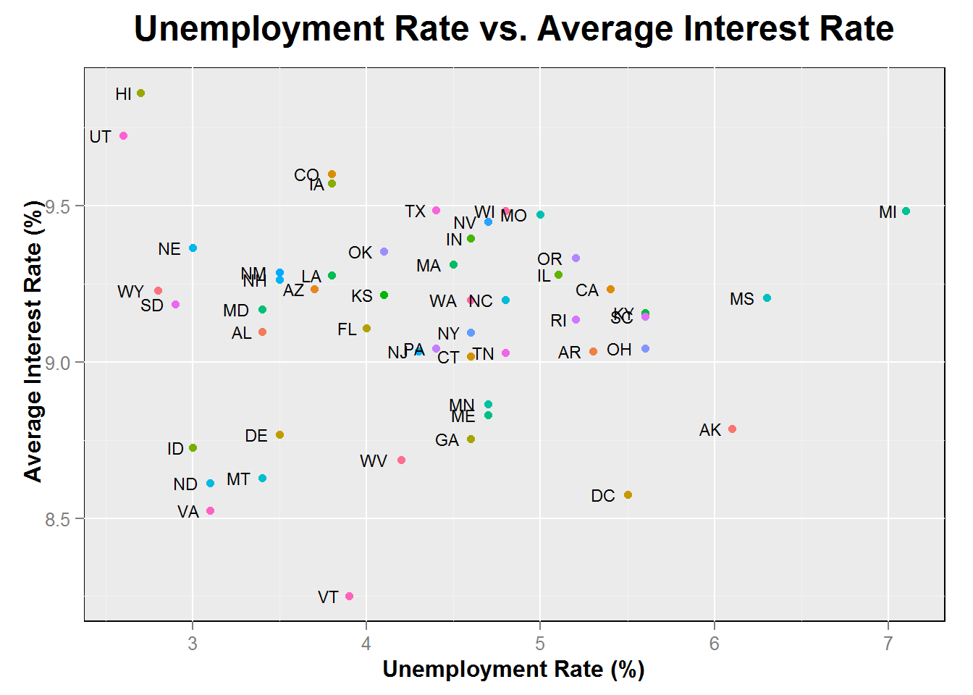
Results & Visualizations

Slide 17
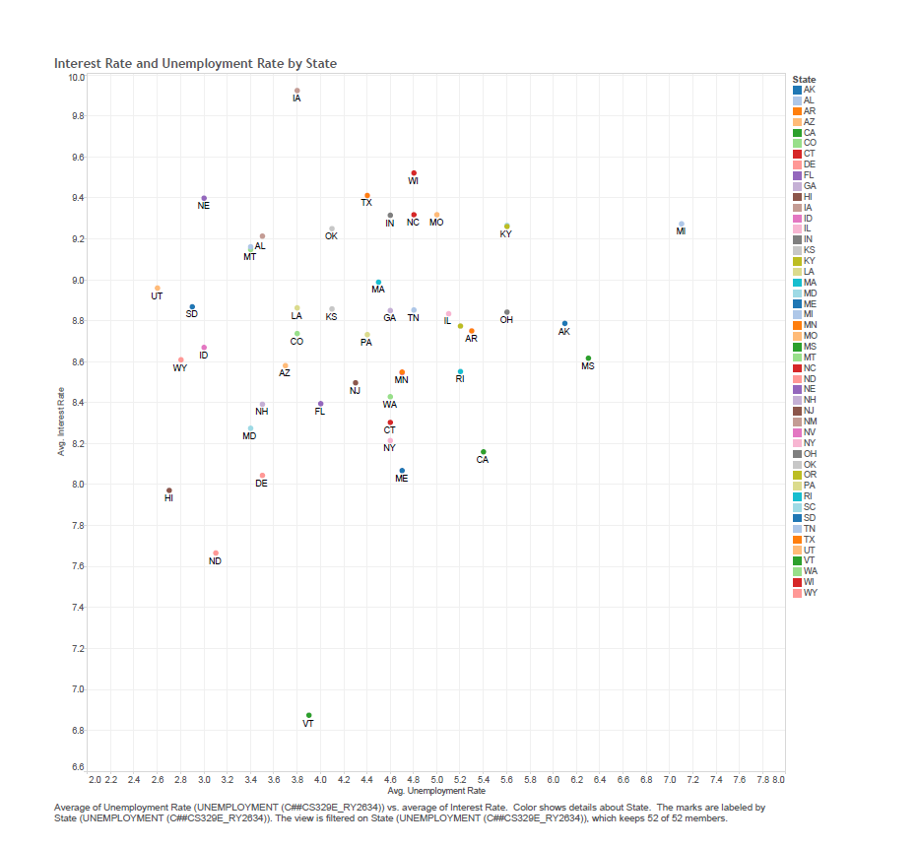
Results & Visualizations

Slide 18
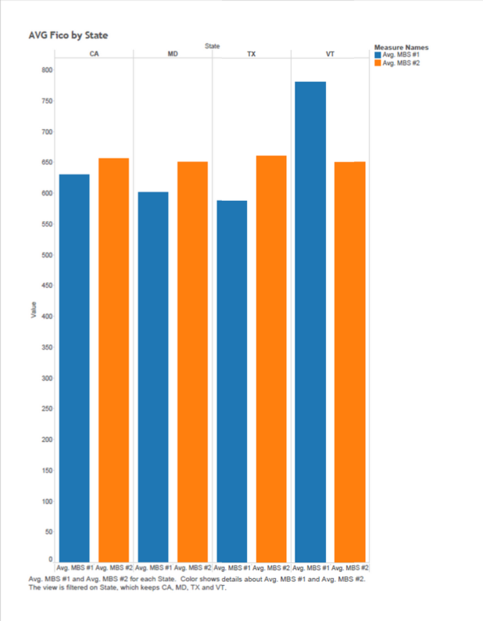
Results & Visualizations

Slide 19
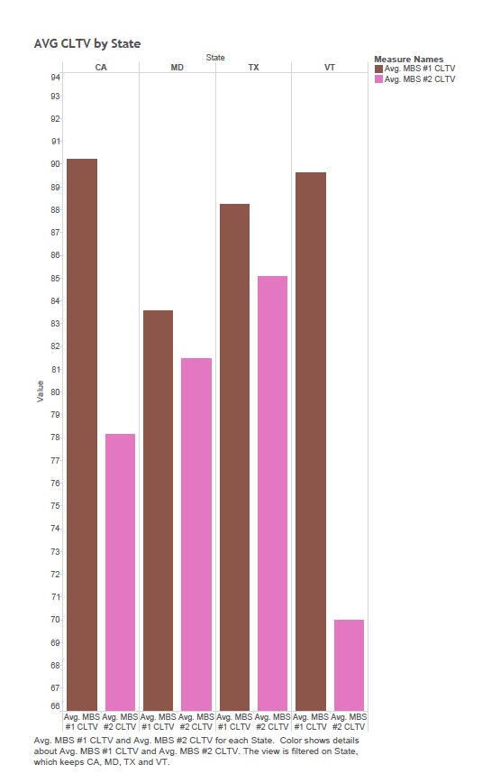
Results & Visualizations

Slide 20
Questions?

