Slide 1

The Significance of Minna No Ouchi’s Existence
▮ Current state of child poverty in Japan
Do you know about state of poverty among Japanese children?
In 2018, the child poverty rate in Japan was 13.5%, or about 1 in 7 children.
In addition, 48.1% of single-parent households are said to be in a state of poverty, which is about 1 in 2 households.

Slide 2
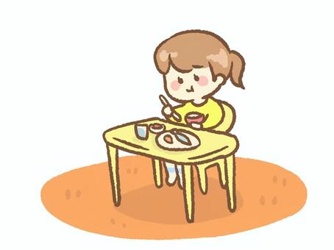
This situation is said to be the worst among developed countries.
▮ Current state of solitary eating in Japan
Do you know solitary eating?
Solitary eating literally means eating alone, without family members or friends.
According to a survey, the percent of children eating dinner alone on weekdays is
1.6% for elementary school students and 3.7% for junior high school students.
At first glance it may seem like a small number, but when you look at the raw numbers, there are about 100,000 elementary school students and about 120,000 junior high school students that eat alone.
When we combine the two together, we can see that about 220,000 students are spending dinner alone nationwide.

Slide 3
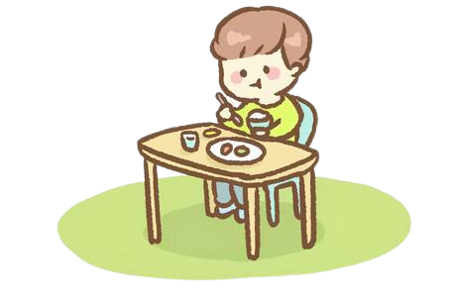
Is it only children who often eat alone?
Of course not.
According to a survey of elderly people aged 60 to 84, 11.6% of men and
19.6% of women eat alone every day.
There are so many people who have no choice but to eat alone due to various reasons such as being single, divorced, or widowed.
▮ So what is the “Minna No Ouchi” that we are aiming for?
Our goal is to create a “Minna No Ouchi” where everyone can easily get together and spend time around the dining table, regardless of differences such as gender, age, nationality, and background!

Slide 4
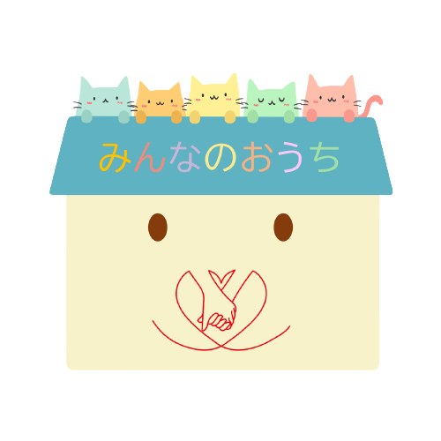
I want not only children who are unable to eat as much as they want, but also adults who nowadays eat alone due to various reasons such as poverty to spend some time around the dining table with others!
If you usually spend time eating alone, it becomes difficult to communicate with people. But if there is a place nearby where you can sit around the table with others and have more chances to communicate, it would be much better than spending time eating alone!

Slide 5
