Slide 1
Popular Fashion Trends in Japan
Group Class Presentation
Ryuhei
Teacher Jef – 10:30 - 11:15

Slide 2
What is a Fashion Trend?
• Fashion trends are popular styles of clothes and accessories.
• They change over time and are influenced by:
- Celebrities
- Social media
- Culture
- Seasons

Slide 3
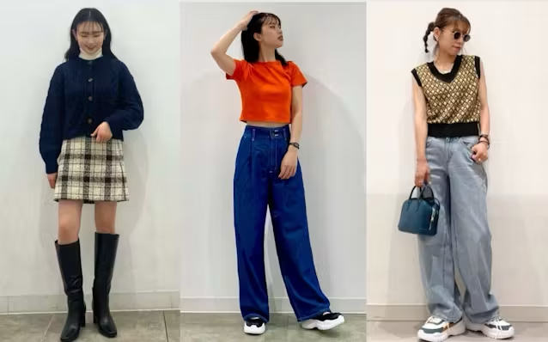
Examples of Trends in Japan
• Y2K Fashion
→ Low-rise jeans, crop tops, shiny accessories (Ref: Vogue Japan)

Slide 4
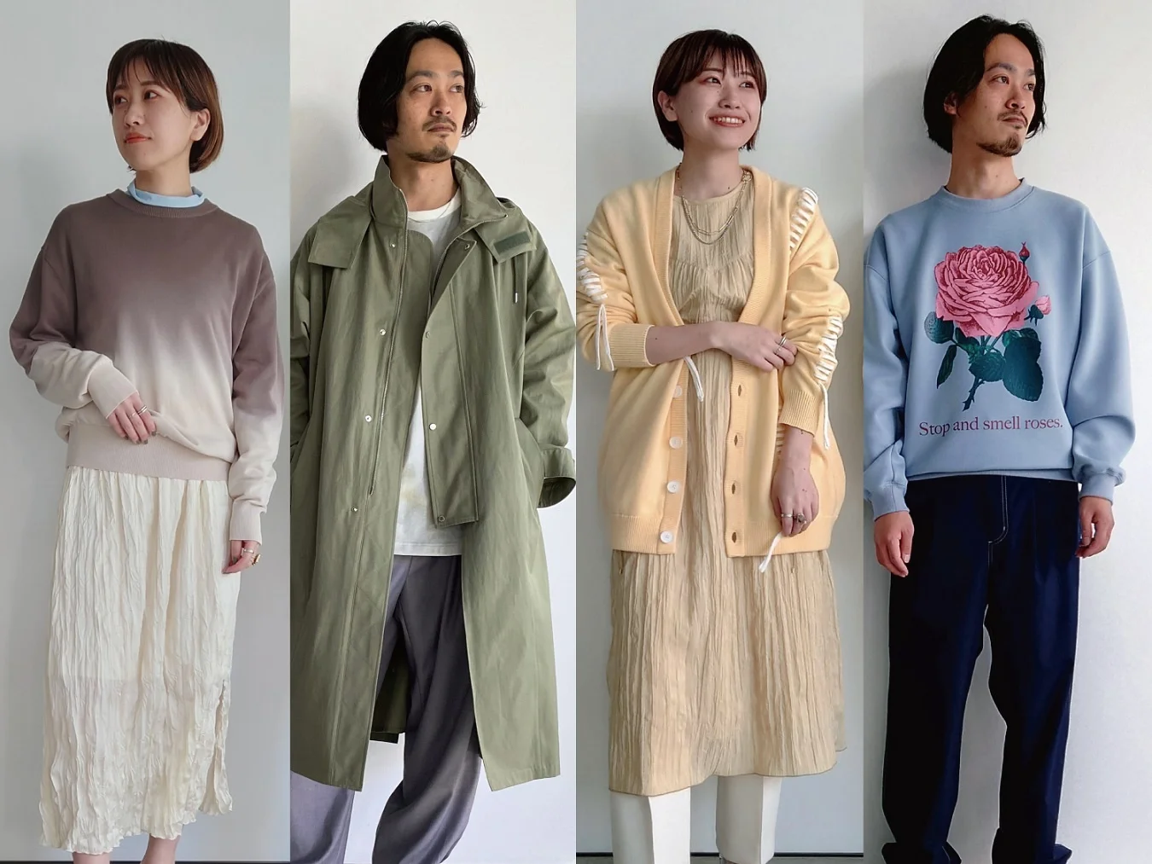
Examples of Trends in Japan
• Genderless Fashion
→ Clothes not based on gender (Ref: The Japan Times)

Slide 5
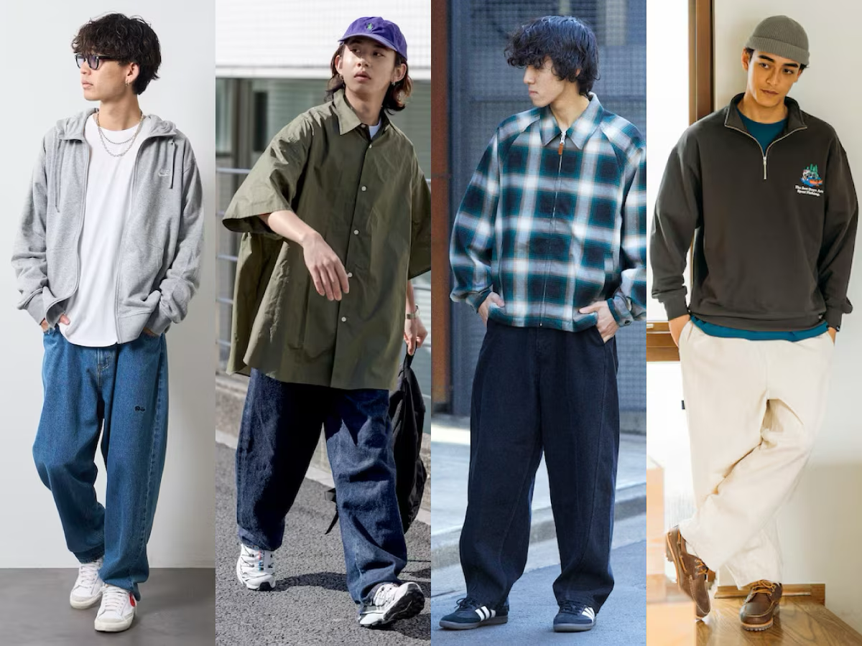
Examples of Trends in Japan
• Streetwear
→ Oversized hoodies, sneakers (e.g., BAPE)

Slide 6
My Opinion
• Japanese fashion is creative and unique.
• I like genderless fashion because it gives freedom of choice.
• Fashion helps people express themselves.

Slide 7
Questions for You
• What fashion trends are popular in your country?
• Do you follow trends or create your own style?
• Have you ever tried Japanese fashion?

Slide 8
Conclusion
"Fashion fades, only style remains the same." – Coco Chanel
→ Trends may change, but your style is forever!

