Slide 1


Private Security Guard Practical Test
KOREA SECURITY ASSOCIATION (ss112)
Notes:
Today's topic is Private Security Guard Practical Test. Specifically about five test parameters.

Slide 2

Self-Introduction
Job Description
Etiquette Protocols
Tactics, Firearms(Equipment)
Physical Fitness
Notes:
The contents are as follows.
Self-Introduction
Job Description
Etiquette Protocol
Tactics, Firearms
Physical Fitness

Slide 3
1. Self-Introduction
Write and Announce a self-introduction letter
Introduce yourself at the venue and provide information on matters to be careful and cooperate with the event.
(Examples)
Self-Introduction(clearly)
- I am a safety team leader 000, in charge of security for today's event.
Notice
- Attention, please. It is about the precautions regarding security for today’s event.

Slide 4
2. Job Description
Write and Announce job descriptions
Write and announce the security service definition, principles, and so on.
(Examples)
Security service : all safety activities for the protection of the life and property of a person eligible for security service, including the protection from, or the removal of, dangers to his/her health and the vigilance, patrol, and safeguard in a specific area;
Types of weapons : firearms, knives, explosives devices, and so on

Slide 5
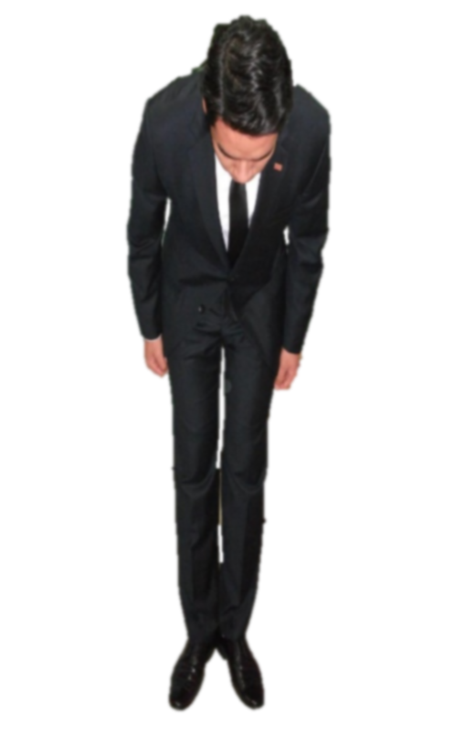
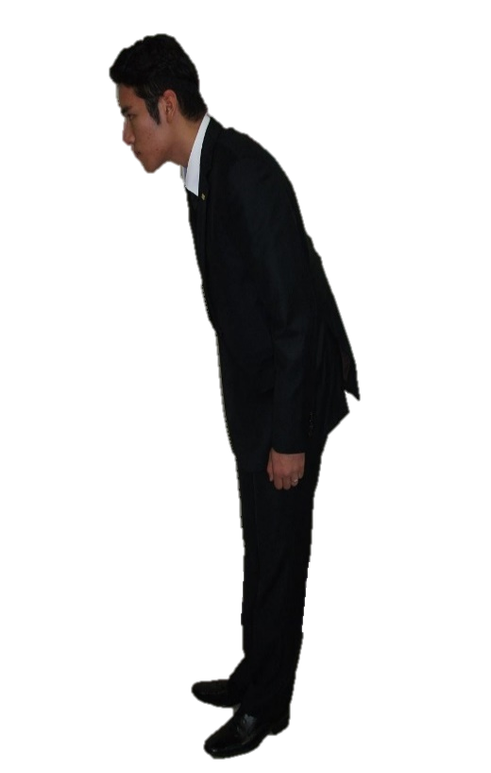
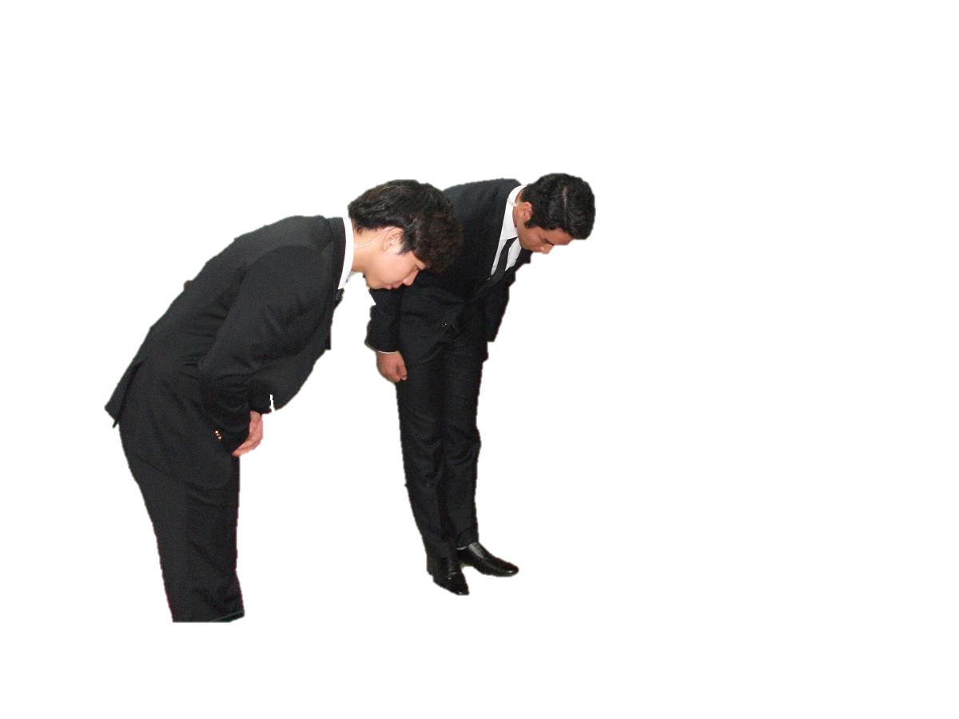
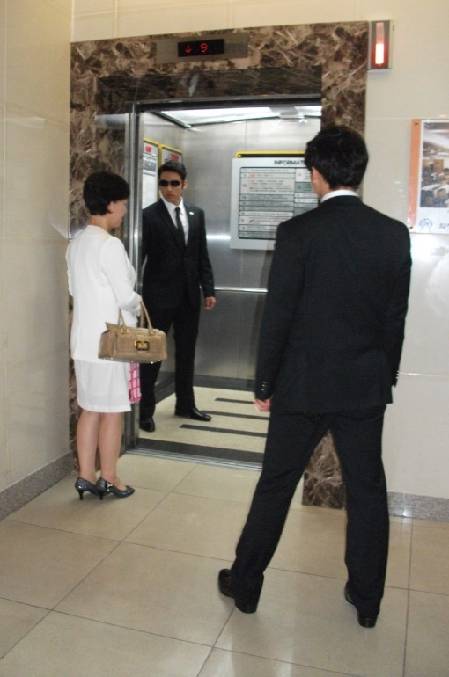
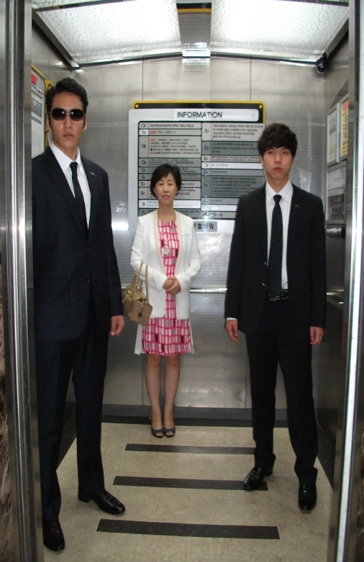
3. Etiquette Protocols
Write and Announce etiquette protocols
Write and announce about the escorting emergency, security guard formation, route selection, and planning.

Slide 6
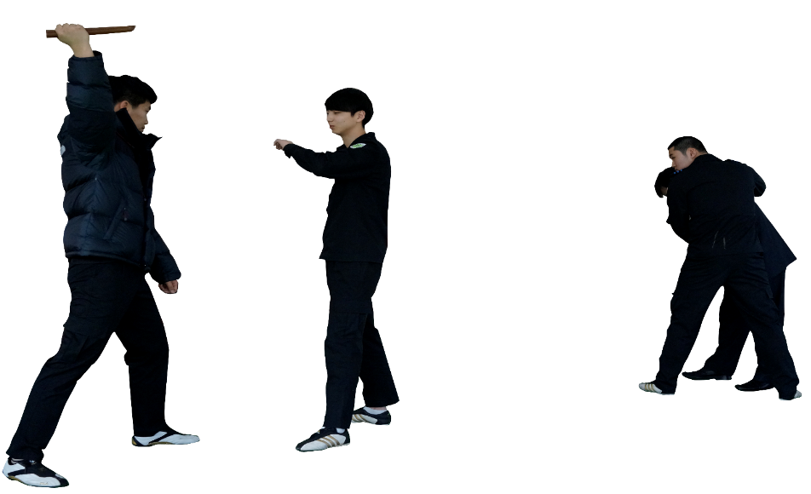
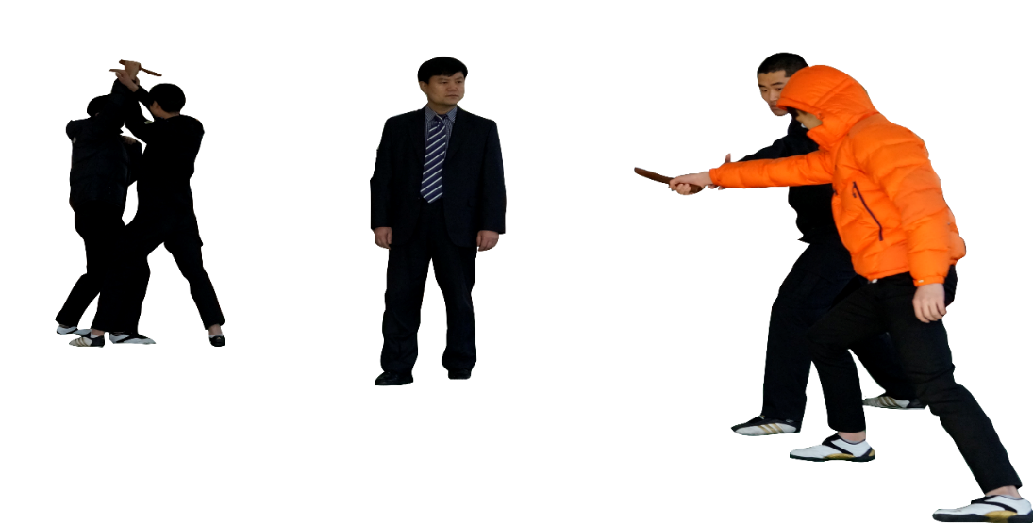
4. Tactics, Firearms(Equipment)
Test security guard tactics, equipment, and firearms
In case of an attack, test security guard tactics and firearms
Responding to fire and Protecting clients against all types of violence (physical attacks, armed attacks, kidnapping, assassination, explosive weapon attacks, and so on)

Slide 7
5. Physical Fitness
Test physical fitness(degree of disability) for 1 minute
Measure running, sit-ups, push-ups, standing long jump, and side-steps
(예시)
Men | Women
100m Sprint (sec) | 100m Sprint (sec)
Sit-ups (num/1 min) | Sit-ups (num/1 min)
Push-ups (num/1 min) | Push-ups (num/1 min)
Standing long jump (meters) | Standing long jump (meters)
Side-steps (num/1 min) | Side-steps (num/1 min)

Slide 8
Thank you

