Slide 1



E-MAZAO - THE STORY
E-mazao is a supply chain solution that aggregates the relationships and operations between farmers with their respective associations while managing their relationship with surrounding stakeholders. The solution does this through a series of connected platforms appropriate for each stakeholder in real time communication. This note will provide a general overview of this synergy.

Slide 2
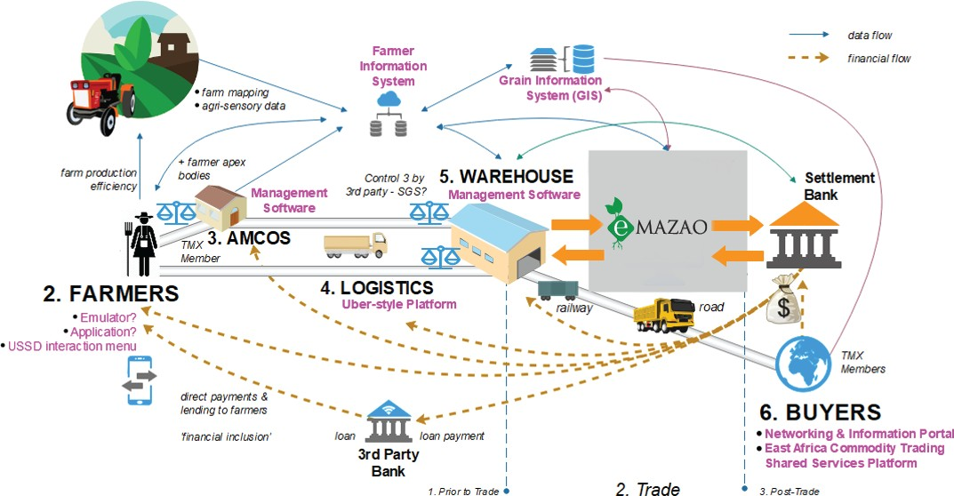

THE SOLUTION

Slide 3
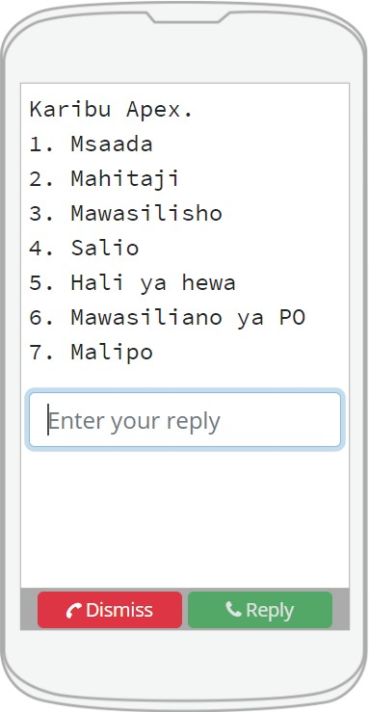
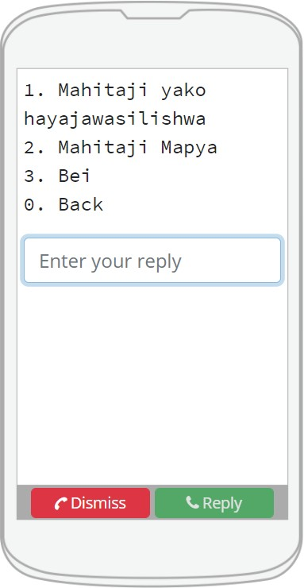
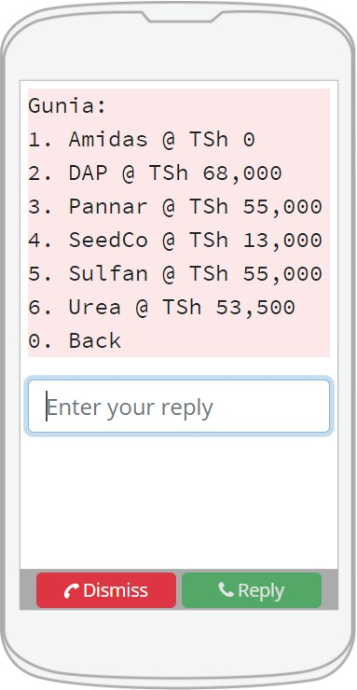



FOR FARMERS - USSD
Majority of the small holder farmers not having access to smartphones makes ussd the best approach towards their inclusiveness. Through a USSD Menu, farmers are able to do the following;
Track their crops upon submission for auction
Check sales records
Apply for loans
Pay for storage, insurance or any other value added services
Receive their sales payments through mobile money
Interact with associations without regular timely visits
Receive educational information

Slide 4
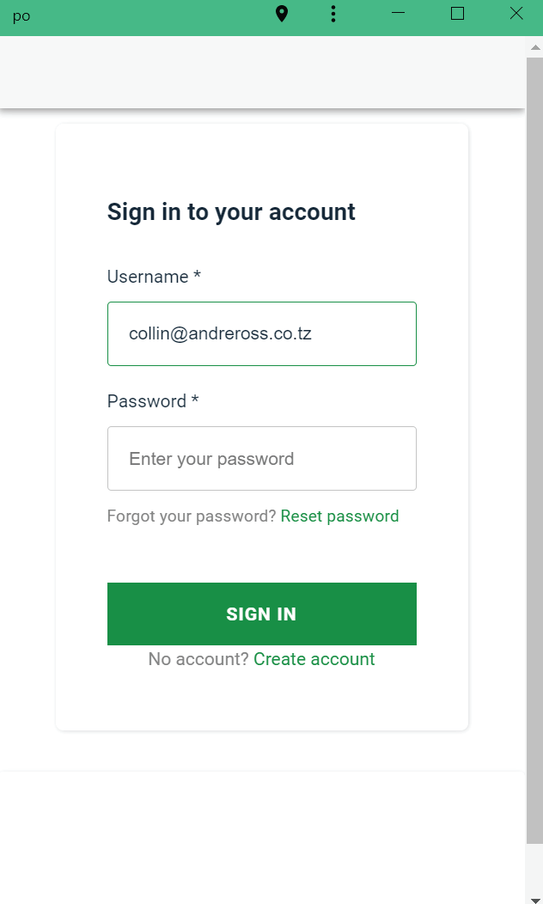
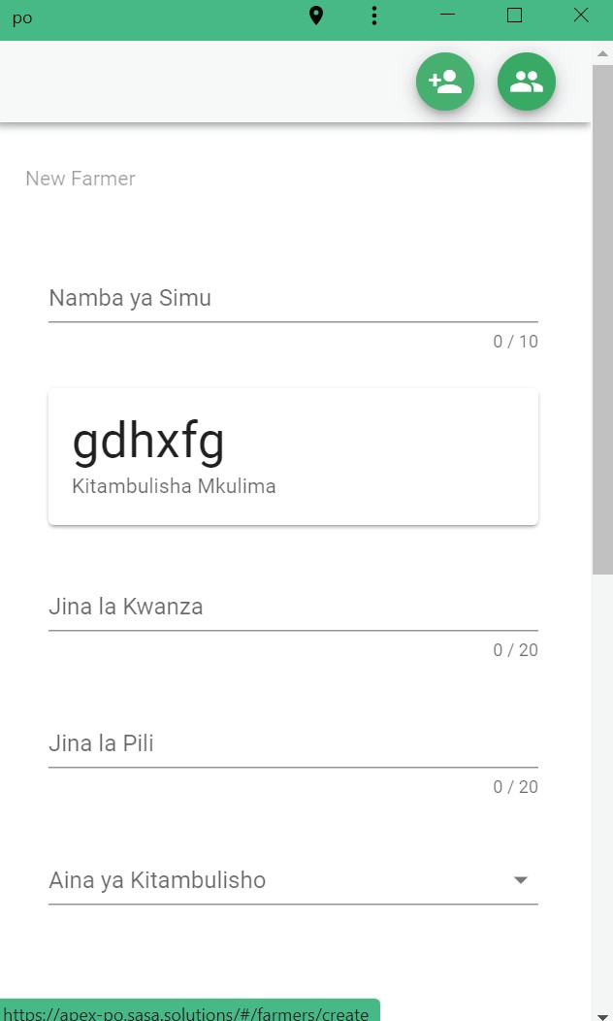
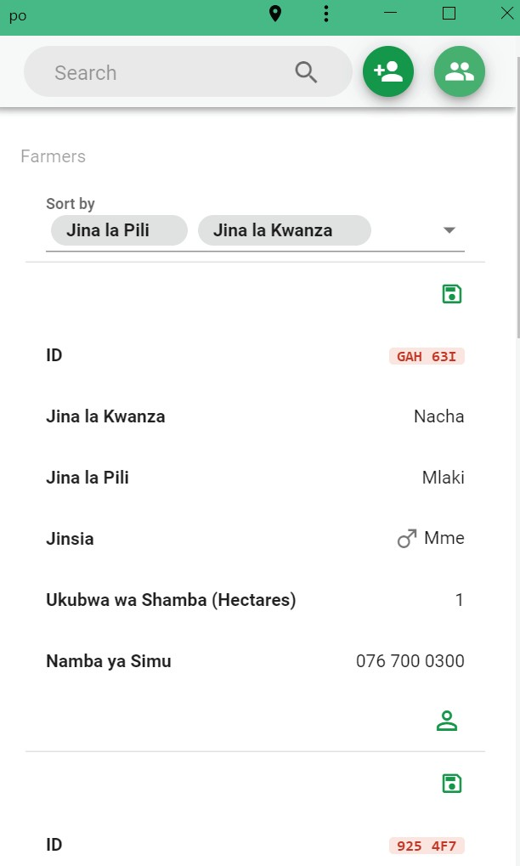


FOR AMCOS/PRODUCER ORGANISATIONS
- TABLET APPLIATIONS
These being the ﬁrst line of defence connecting farmers to the outside world and vice versa, E-mazao equips AMCOS workers with
tablets and an applications that allows them to do the following;
Farmer registration. Personal details, Contact details, Photo, farm coordinates e.t.c
Input Crop delivery information. Quantity, Grade and generation on unique identiﬁer.
Farmer ordered Input approval.
Communication to Farmers.
Report Generation

Slide 5
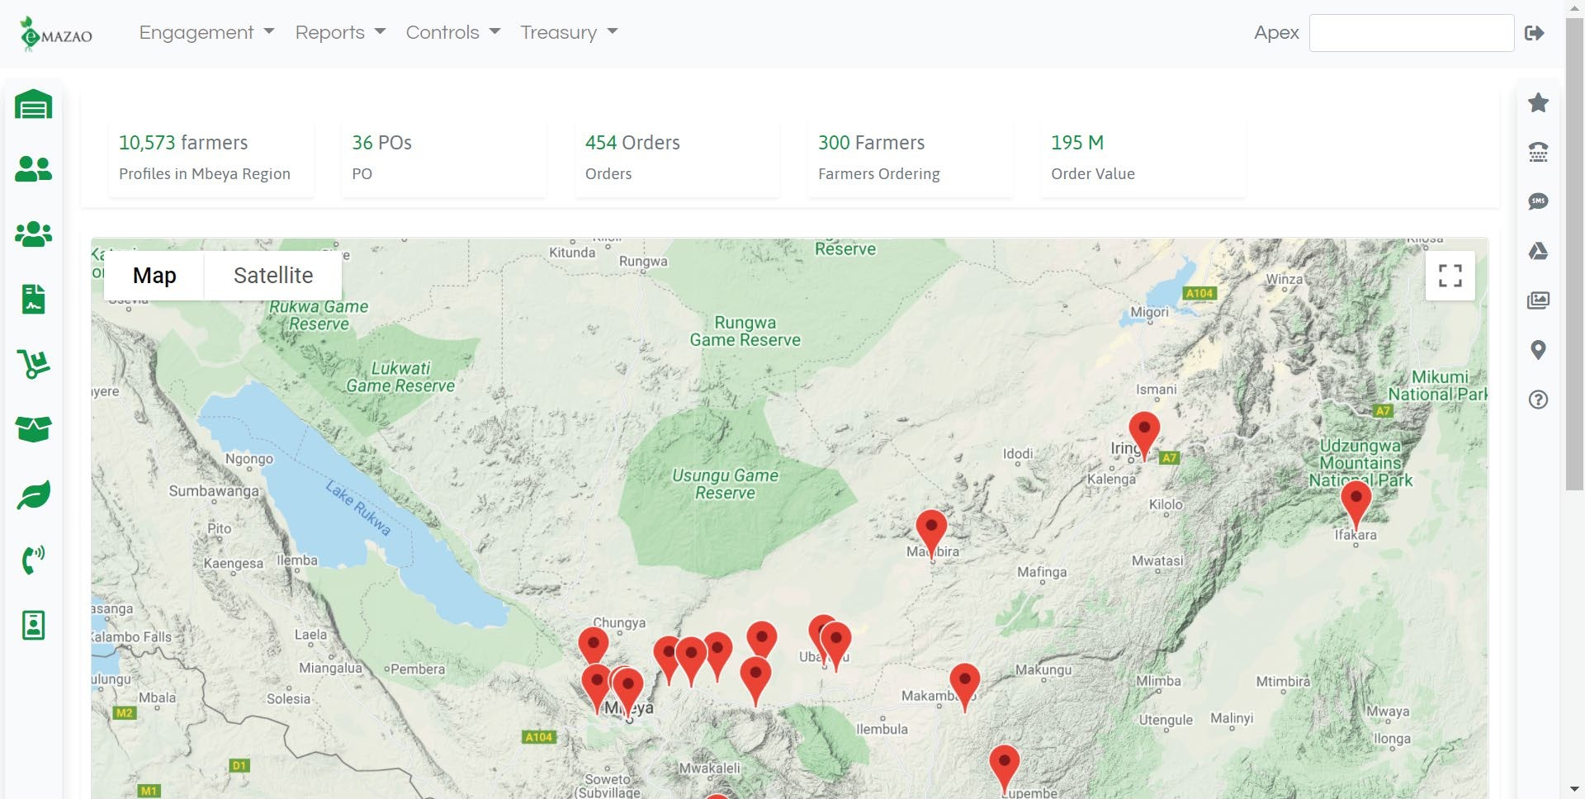
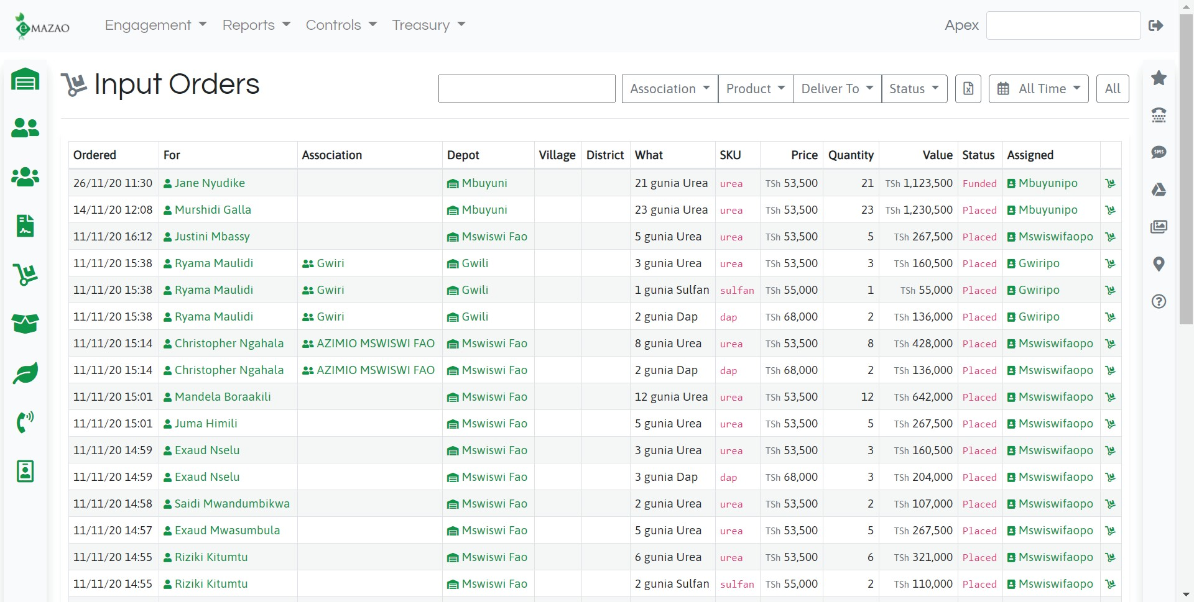
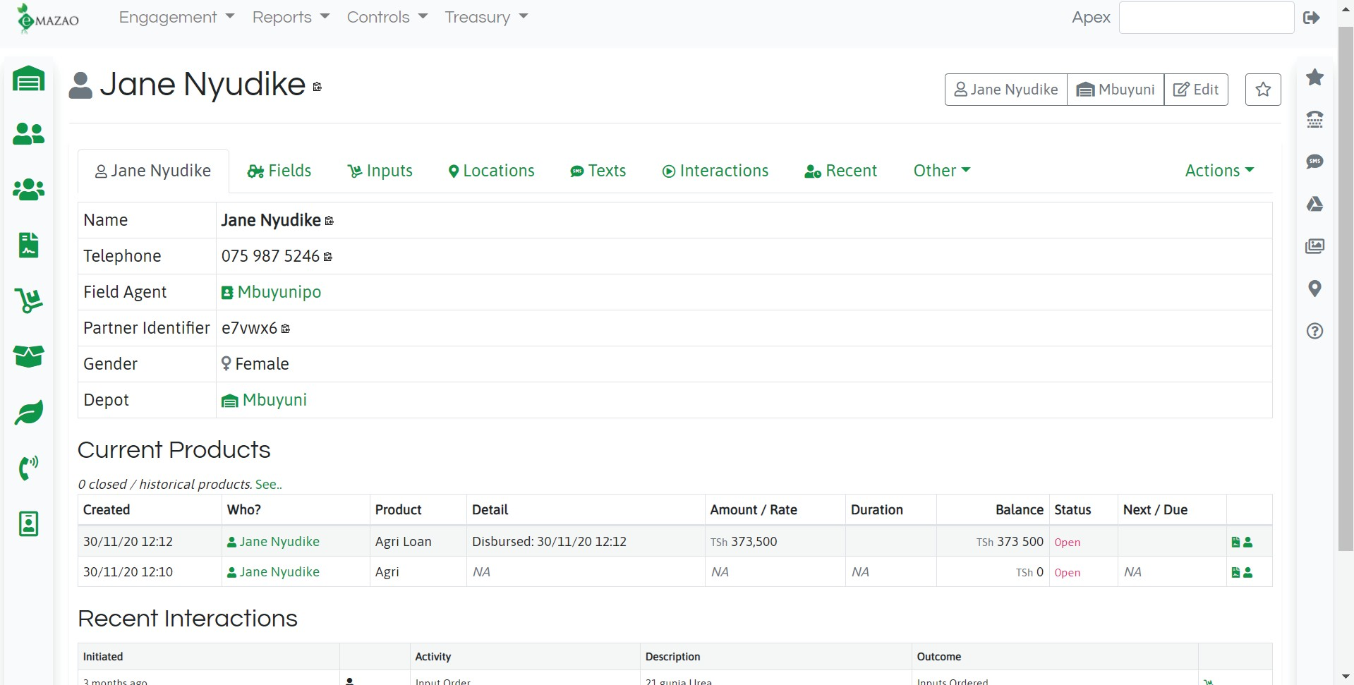
FOR THE ASSOCIATION - THE ADMINISTRATION PORTAL
As the central engine. The admin’s portal receives all information fed by all stakeholders and plays the biggest role in managing all the relationships such as;
Registration of new AMCOS
Loan Approvals
Approving buyers
Report management and sharing
Farmer payment disbursements
Storage facilitation
Logistics
Onboarding value added services. i.e Insurance companies, MFI’s

Slide 6
FOR OTHER STAKEHOLDERS
Other stakeholders such as Buyers, Input providers and Crop Insurance companies get operating platforms through web and mobile app to operate with information only relevant to them.
VALUE PROPOSITION
Access to Data: Access of data of all the farmers, information of the farms and the crop they farm and deliver.
Input products: Accurate and true numbers of farmers and the amount of input products they need.
Transparency: The whole transaction from the farmers’ delivery to ﬁnal payment can be tracked and managed.
Education: Can educate farmers and disseminate information to farmers and will know in real time how much crops are delivered and with the farms data project future crops harvests.
Attract the next generation: Introduction of technology will appeal to young people from the communities to pursue farming.
Accuracy: Ensure farmers receive the exact amount they are due from buyers along the value chain
Platform: Users will have real-time capabilities and access to generate reports through the E-Korosho platform customized to its requirements
Reach: Mobile network agnostic. Any handset type owned by the farmer can work - no downloads or data needed.
Simplicity: Farmers facing solution that is simple. Simple dial to a USSD short code e.g. *150*98# on any phone to get started.
Don’t need internet access or expensive smartphones
Education: System enables education and dialog between stakeholders
Goals for ecosystem: Transparency, real time reporting, ability to shaping behaviour, market insight.
Access can be proved to anyone, no need to download an App Training easier and most Tanzanian can easily navigate USSD

