Slide 1
Stack

Slide 2
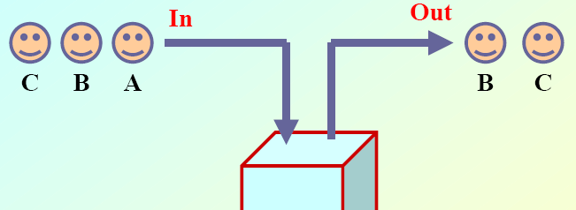
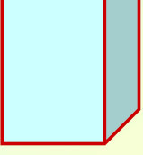
Introduction to Stacks
A Stack is a data structure with which stores the elements in the reverse order.

Slide 3
Introduction to Stacks
Using stack we can perform the following operations:
  Add data, one item at a time, Push
  Access the data item on the top (other data items are hidden from view), Top
  Remove and discard the data item on the top, thus exposing the next item which now becomes the top item, Pop.
The order in which data in added ("pushed"), accessed and removed ("popped") is LIFO (last in, first out).
This is different from a queue, in which it's FIFO (first in, first out).
Stacks can be implemented based on arrays or linked lists.

Slide 4
Applications of stacks
Reversing Data: We can use stacks to reverse data. (example: files, strings). Very useful for finding palindromes.
Backtracking : Stacks can be used to backtrack to achieve certain goals.
Function calls: Perhaps the most important application of stacks is to implement function calls. Most compilers implement function calls by using a stack.

Slide 5
Applications of stacks
Arithmetic expression evaluation:
  An important application of stacks is in parsing.
  In high level languages, infix notation cannot be used to evaluate expressions.
  A common technique is to convert a infix notation into postfix notation, then evaluating it.
Java bytecode is interpreted on (virtual) stack based processor.

Slide 6
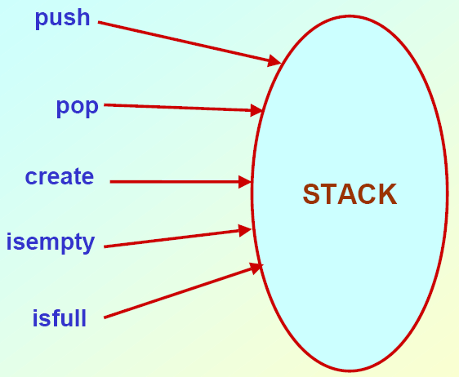
Operations on Stack

Slide 7
Functions for stack operations
Assume:: stack contains integer elements
void push (stack *s, int element);
/* Insert an element in the stack */
int pop (stack *s);
/* Remove and return the top element */
void create (stack *s); /* Create a new stack */
int isempty(stack *s); /* Check if stack is empty */
int isfull(stack *s); /* Check if stack is full */

Slide 8
Implementation of stack
In the array implementation, we would:
  Declare an array of fixed size (which determines the maximum size of the stack).
  Keep a variable which always points to the “top” of the stack.
  Contains the array index of the “top” element.
In the linked list implementation, we would:
  Maintain the stack as a linked list.
  A pointer variable top points to the start of the list.
  The first element of the linked list is considered as the stack top.

Slide 9
Declaration
#define MAXSIZE 100
int st[MAXSIZE];
int top;

Slide 10
Stack Creation
void create ()
{
top = -1;
}
Top is a pointer holds the recently inserted element within it.

Slide 11



Pushing an element into the stack
(Array)
PUSH

Slide 12
Pushing an element into the stack
(Array)
void push (int element)
{
if (top == (MAXSIZE-1))
{
printf(“\n Stack overflow”);
exit(-1);
}
else
{
top ++;
st[top] = element;
}
}

Slide 13
Popping an element from the stack (Array)
POP

Slide 14
Popping an element from the stack (Array)
int pop ()
{
if (top == -1)
{
printf(“\n Stack underflow”);
exit(-1);
}
else
{
return (st[top--]);
}
}

Slide 15
Checking for stack empty
int isempty()
{
if (top == -1)
{
printf(“Stack is empty”);
return 1;
}
else
  return (0);
}

Slide 16
Checking for stack full (Array)
int isfull()
{
if (top == (MAXSIZE–1))
{
printf(“Stack is full”).
  return 1;
  }
else
  return (0);
}

