Slide 1
Evaluation of postfix using stack
Scan for the given postfix expression from left to right, one element at a time.
Check whether it is an operand or an operator.
If it is an operand then push the element in to stack and if it is
an operator then pop the two element from the stack. Apply the given operator on them and then push back the returned result in to the stack.
Repeat the step 1 to 3 until the whole postfix expression comes to the end.
Pop the element from the stack which should be the only element in the stack and return it from the function as the result of the expression

Slide 2


Slide 3
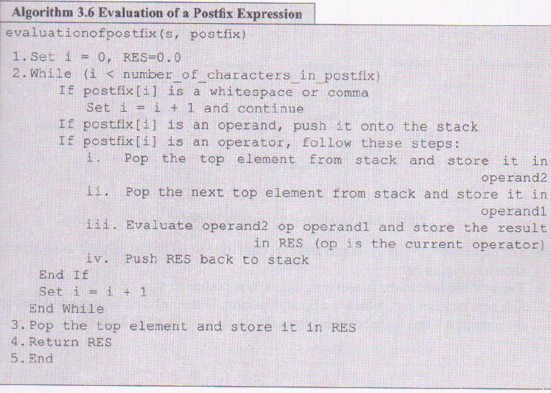

Slide 4
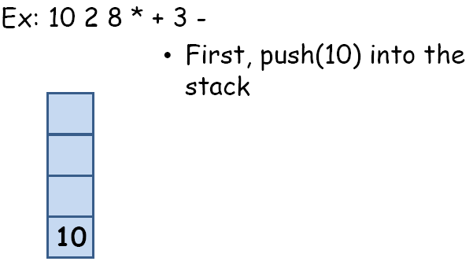
Evaluation of postfix expression

Slide 5
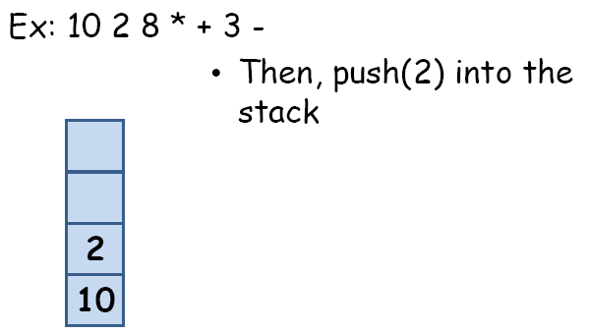
Evaluation of postfix expression

Slide 6
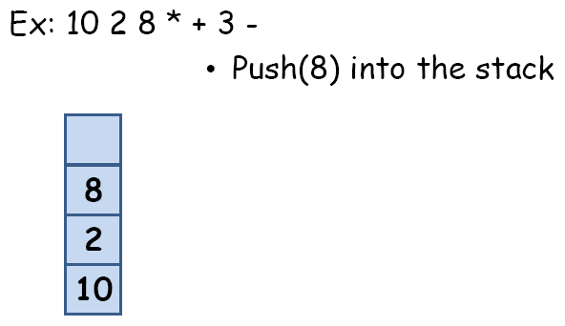
Evaluation of postfix expression

Slide 7
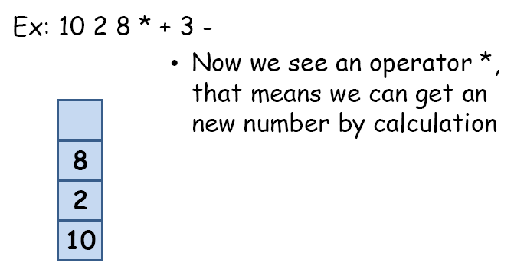
Evaluation of postfix expression

Slide 8
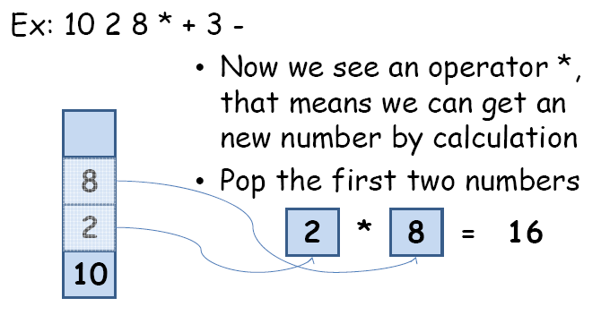
Evaluation of postfix expression

Slide 9
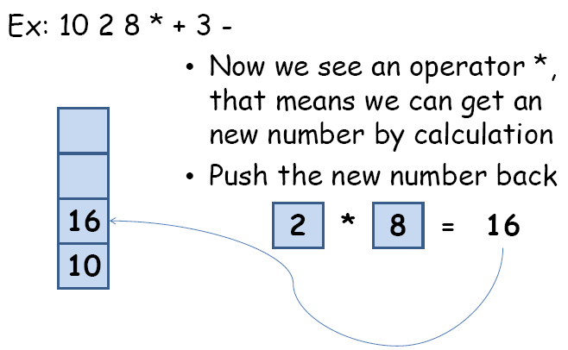
Evaluation of postfix expression

Slide 10
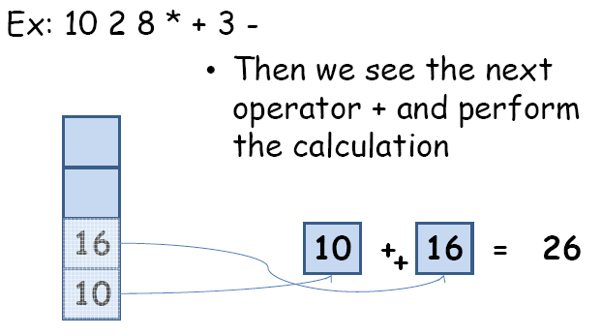
Evaluation of postfix expression

Slide 11
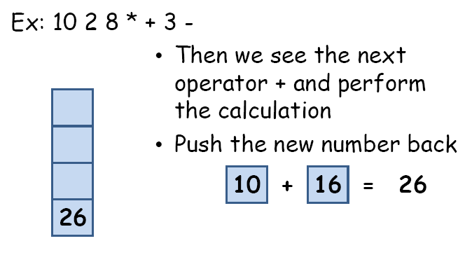
Evaluation of postfix expression

Slide 12
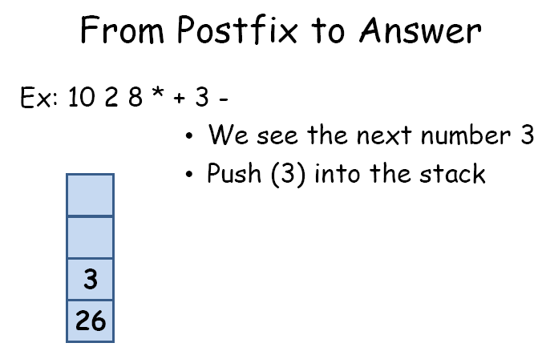
Evaluation of postfix expression

Slide 13
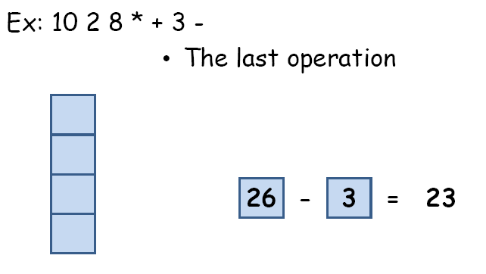
Evaluation of postfix expression

Slide 14
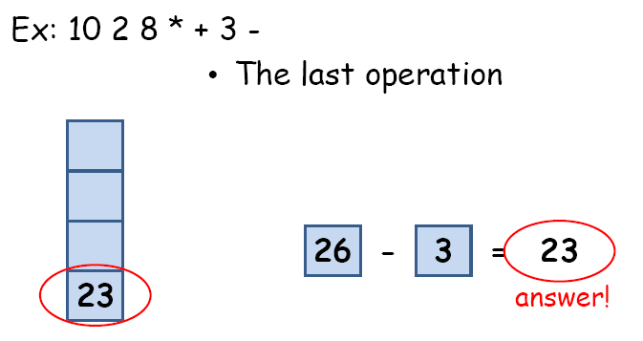
Evaluation of postfix expression

Slide 15
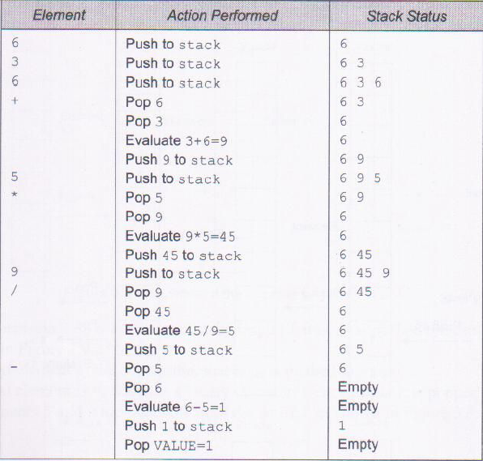
STEP WISE EVALUATION OF 636+5*9/-

Slide 16
Balancing parenthesis
Start with empty stack of currently open brackets
Process each char of an expression String
If it is an opener, push it on the stack
If it is a closer, check it against the top stack element
  If stack empty, or not a matching bracket:
    not balanced, so return false
  Otherwise, it matches: pop the opener
If stack is empty at the end, return true
If not empty, then some bracket unmatched: false

