Slide 1
Prefix evaluation

Slide 2
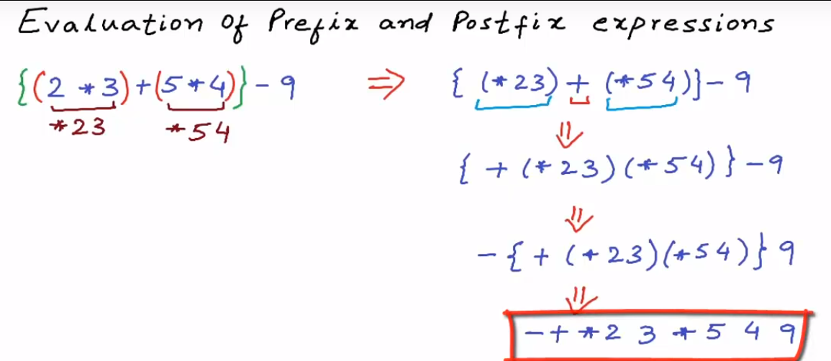

Slide 3
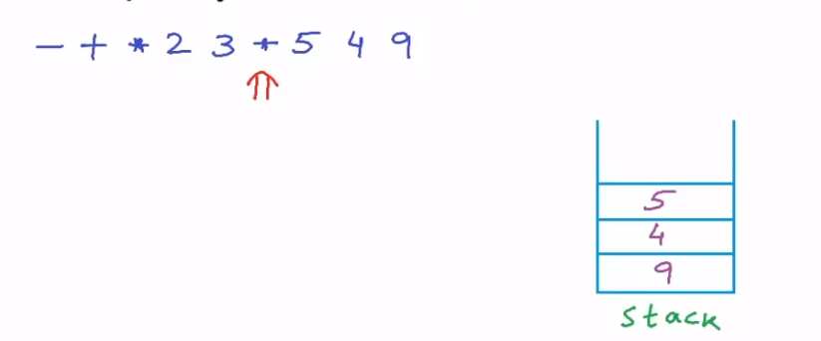
Scan from right to left
First operand is TOS (where as second operand is TOS in Postfix evaluation)

Slide 4
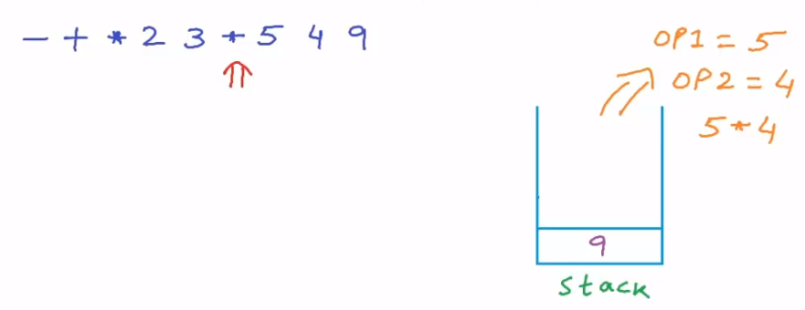

Slide 5
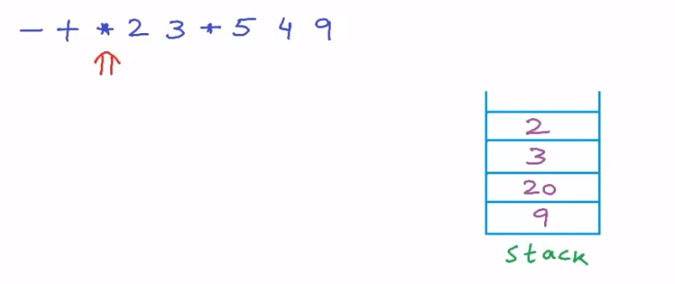

Slide 6
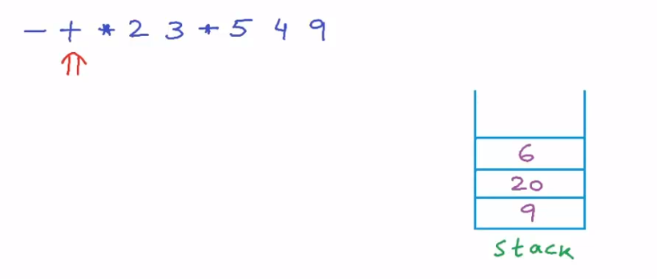

Slide 7
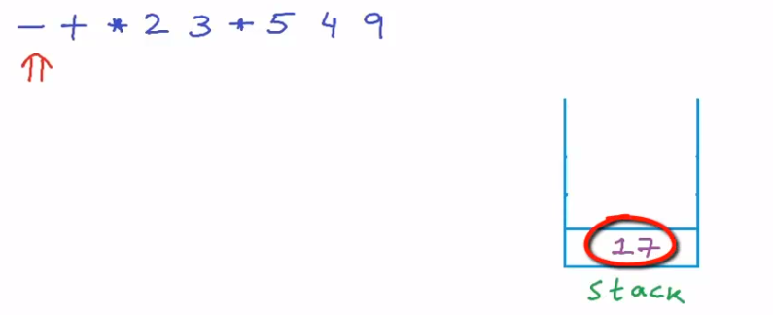
Final Answer after performing prefix evaluation

