Slide 1
Queues

Slide 2
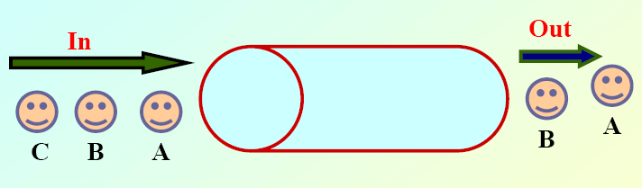
A First-in First-out (FIFO) List
A Queue is "an abstract data type in which elements are added to the rear and removed from the front; a 'first in, first out' (FIFO) structure."
The main difference between a queue and a stack is that elements in a queue are put on the bottom and taken off the top

Slide 3
Applications of queue
In general, queues are often used as "waiting lines".
In operating systems, for controlling access to shared system resources such as printers, files, communication lines, disks and tapes.
A transactional queue is one that only contains transactional messages, which are messages sent within a transaction.

Slide 4
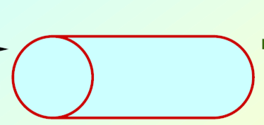
Terms in queue
Front:- Points the oldest element in the queue
Rear:- Points the recent element inserted in the queue
Front = -1; queue is empty
Rear = Max; Queue is full
Front Rear

Slide 5
Creating a queue in using array
Declare a array and variable front and rear.
  Int q[100]; int front,rear;

Slide 6
Insert an element in to queue
Check for the condition whether queue is full or not, if so print “queue overflow” and exit the program
  Rear = max
Input the element to be added into the queue from the user
Increment the rear.
Assign the element to the array
  q[rear] = element

Slide 7
Code to insert / ENQUEUE
insert()
{
int element
if (rear==MAX-1)
printf("Queue Overflow\n");
else
{
if (front==-1) /*If queue is initially empty */
front=0;
printf("Input the element for adding in queue : ");
scanf("%d", &element);
rear=rear+1;
q[rear] = element ;
}

Slide 8
Delete an element from the queue
Check for the condition whether queue is empty or not, if so print “queue underflow” and exit the program
  Front = -1
Increment the front.

Slide 9
Code to delete
del()
{
if (front == -1 || front > rear)
{
printf("Queue Underflow\n");
return ;
}
else
{
printf("Element deleted from queue is : %d\n", queue_arr[front]);
front=front+1;
}
}/*End of del() */

Slide 10
Traverse the queue
Check whether queue is empty or not. If so print “Queue underflow” and exit the program
Loop from front pointer till the rear pointer and print the elements in the array

Slide 11
Code to traverse
display()
{
int i;
if (front == -1)
printf("Queue is empty\n");
Else
{
printf("Queue is :\n");
for(i=front;i<= rear;i++)
printf("%d ",queue_arr[i]);
}
}/*End of display() */

