Slide 1
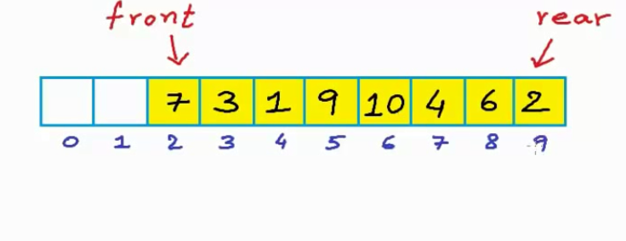
Circular queue – Why we go for that?

Slide 2
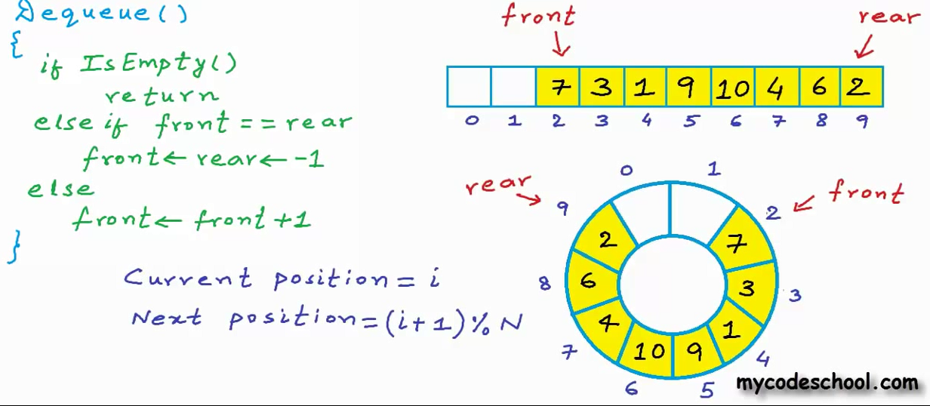

Slide 3
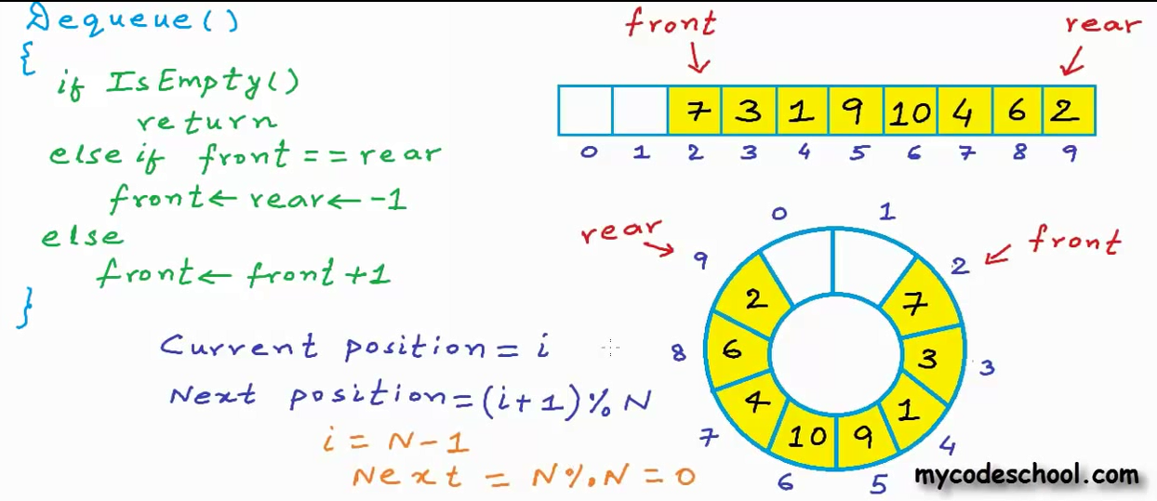

Slide 4
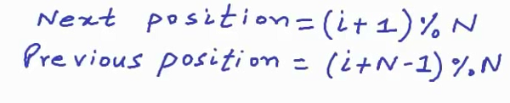
Next and previous position in a circular queue
Current position is i

Slide 5
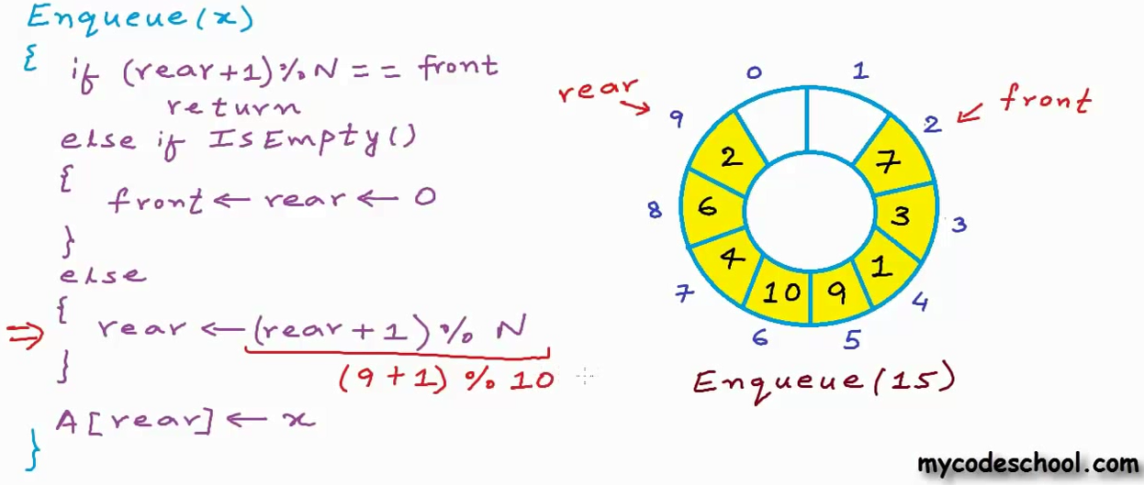
Adding elements into circular queue

Slide 6
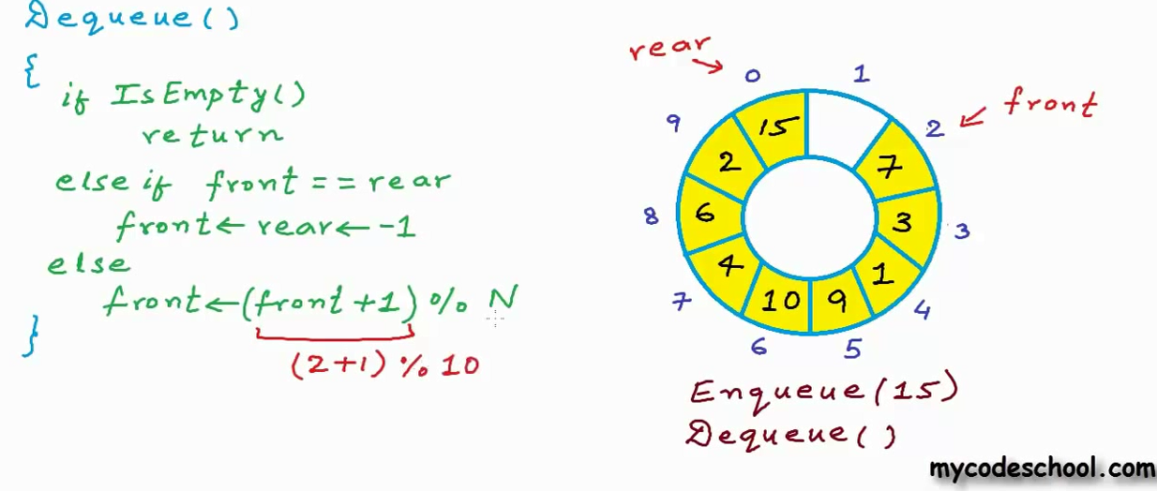
Deleting elements from cirucular queue

Slide 7
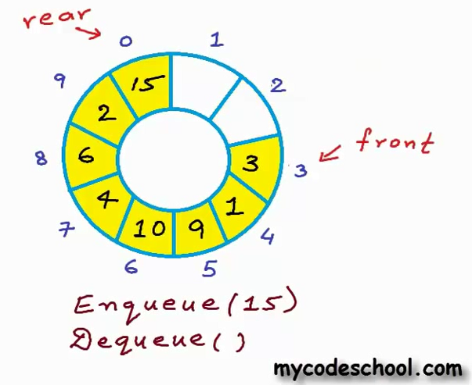
After deletion operation

Slide 8
What is the condition for IS EMPTY circular queue?
Any change when comparing ordinary queue
Any answer
Think otherwise I will give it in next session

Slide 9
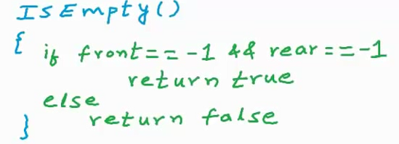
Is Empty function

