Slide 1
SINGLY linked list
Advantages over array
No need to mention maximum Bound.
Dependent only to internal memory of computer.
Memory space is reused after free up process.

Slide 2
Structure of SLL
Data part
Address or Link or next part
Head one
Structure definition

Slide 3
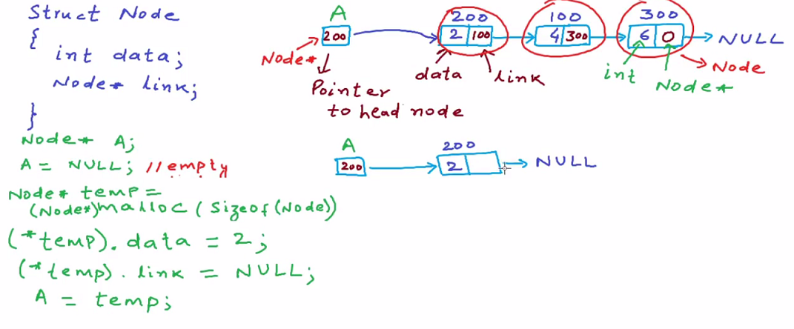
Singly Linked List

Slide 4
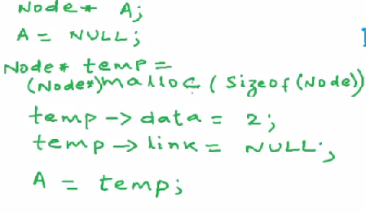
Alternate syntax for accessing data and link in SLL

Slide 5
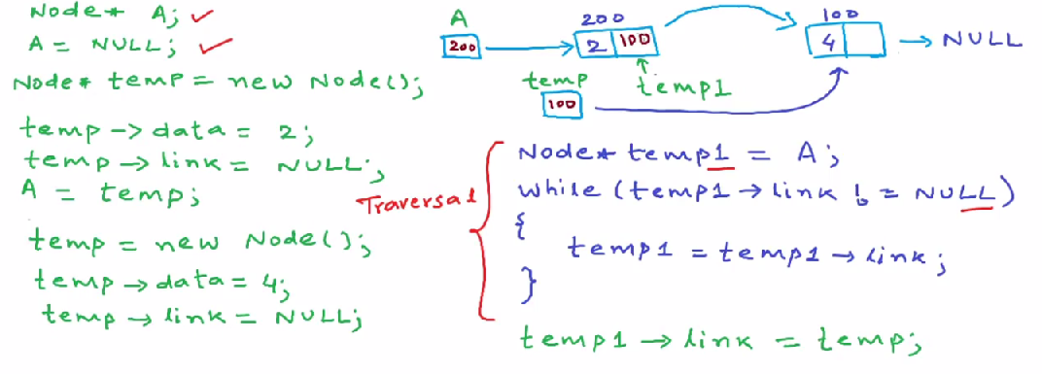
Further adding of nodes

Slide 6
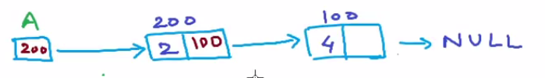
We have two nodes in the singly linked list

Slide 7
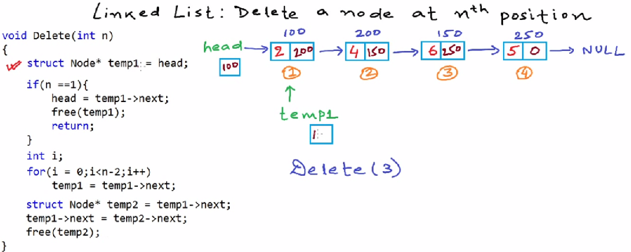

Deletion of a node

Slide 8
Note
The deletion code will work for deleting nodes at any position.
Also Try the following as a home work
Inserting a node between two nodes
Inserting a node at the beginning
Deleting a node other possibilities

