Slide 1
INTRODUCTION
Dr.T.YUVAPRIYA
ASSISTANT PROFESSOR
SELECT

Slide 2
EEE1019-Foundations of Electrical and Electronics Engineering
COURSE OBJECTIVES
1.To teach the simple problem of DC and AC circuits.
2.To provide the knowledge of digital systems.
3.To study the important concepts of electronics.

Slide 3
Expected Course Outcome:
Solve simple DC circuits using mesh and nodal analysis.
Describe the RLC components with sinusoidal sources.
Perform the various network theorems.
Design of combinational circuits and synthesis of logic circuits.
Formulate the sequential logic circuits.
Utilize the basic concepts of semiconductor devices and circuits.
Discuss the overview of communication engineering.
Design and Conduct experiments, as well as analyze and interpret data

Slide 4
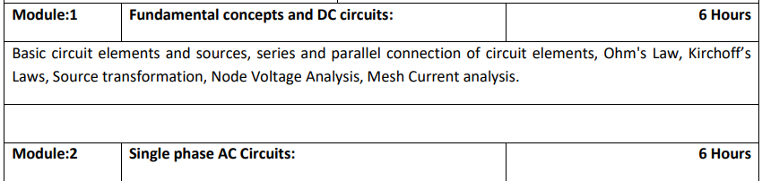
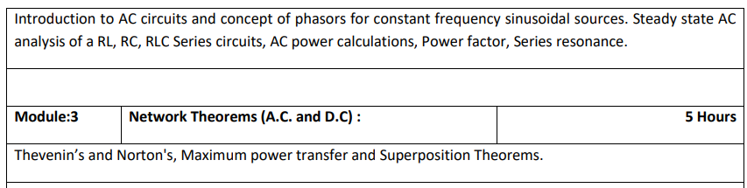

Slide 5
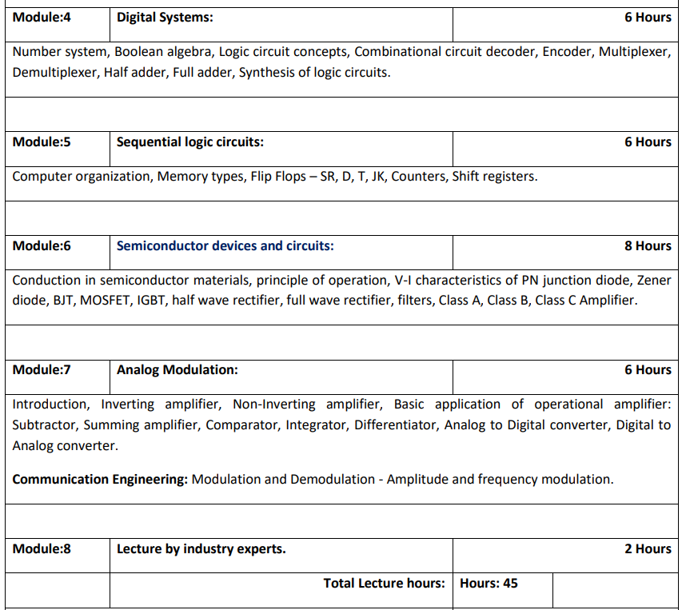

Slide 6
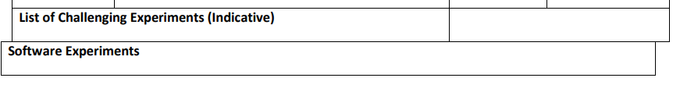
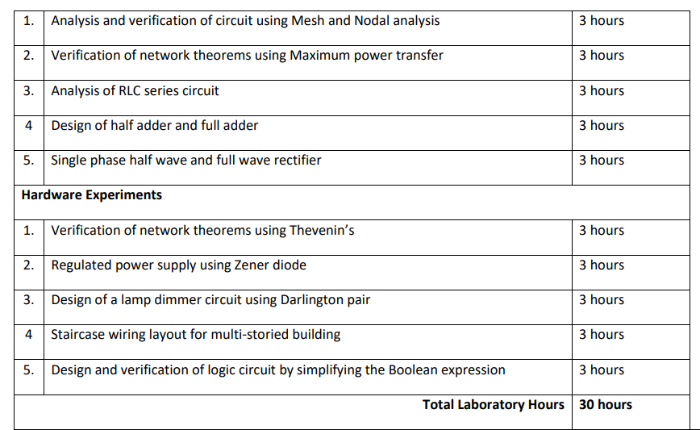

Slide 7
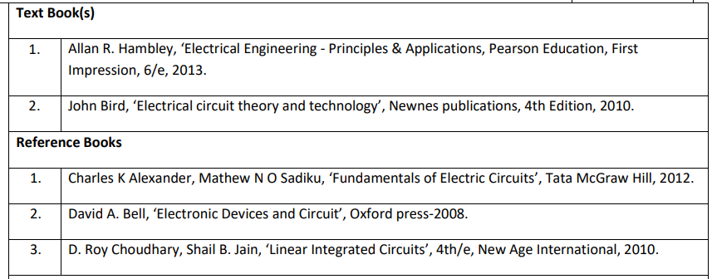

Slide 8
INTRODUCTION
In electrical engineering, we are often interested in communicating or transferring energy from one point to another.
To do this requires an interconnection of electrical devices.
Such interconnection is referred to as an electric circuit, and each component of the circuit is known as an element.
An electric circuit is an interconnection of electrical elements.

Slide 9
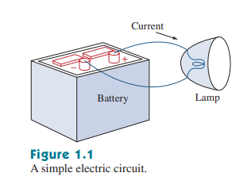
ELECTRIC CIRCUIT
A simple electric circuit is shown in Fig. 1.1.
It consists of three basic elements: a battery, a lamp, and connecting wires.
Such a simple circuit can exist by itself; it has several applications, such as a flashlight, a search light, and so forth.

Slide 10
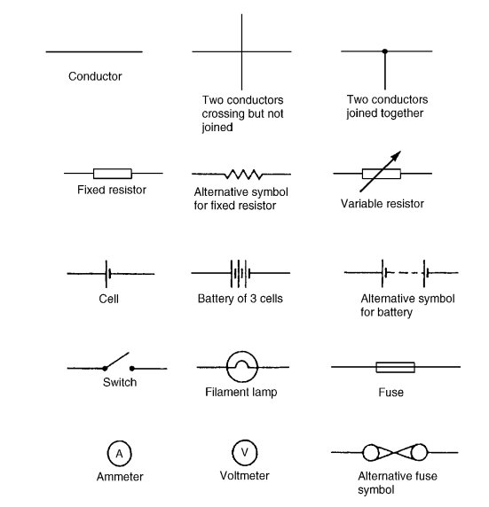
Standard symbols for electrical components

Slide 11
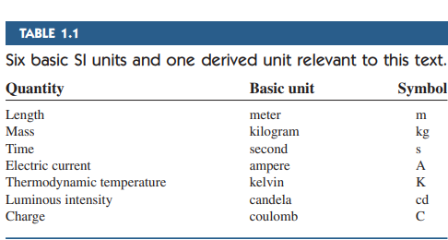
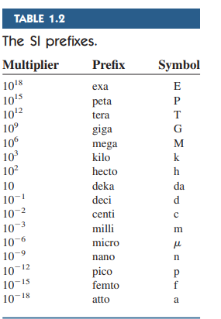
SYSTEM OF UNITS
One great advantage of the SI unit is that it uses prefixes based on the power of 10 to relate larger and smaller units to the basic unit.
Table 1.2 shows the SI prefixes and their symbols.
For example, the following are expressions of the same distance in meters (m): 600,000,000 mm 600,000 m 600 km

Slide 12
Charge
The unit of charge is the coulomb (C) where one coulomb is one ampere second. (1 coulomb = 6.24 x 10^18 electrons).
The coulomb is defined as the quantity of electricity which flows in a given point in an electric circuit when a current of one ampere is maintained for one second.
Thus, charge, in coulombs Q = It
where I is the current in amperes and t is the time in seconds.

Slide 13
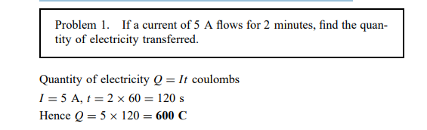

Slide 14
CURRENT
When a conducting wire (consisting of several atoms) is connected to a battery (a source of electromotive force), the charges are compelled to move;
positive charges move in one direction while negative charges move in the opposite direction.
This motion of charges creates electric current. It is conventional to take the current flow as the movement of positive charges.
That is, opposite to the flow of negative charges, as Fig. 1.3 illustrates.

Slide 15
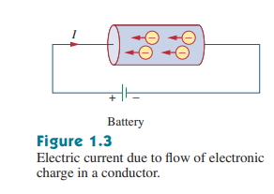
This convention was introduced by Benjamin Franklin (1706–1790), the American scientist and inventor.
Although we now know that current in metallic conductors is due to negatively charged electrons, we will follow the universally accepted convention that current is the net flow of positive charges.
Thus, Electric current is the time rate of change of charge, measured in amperes (A)

Slide 16
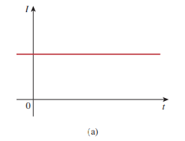
DC CURRENT
If the current does not change with time, but remains constant, we call it a direct current (dc).
A direct current (dc) is a current that remains constant with time.
By convention the symbol I is used to represent such a constant current

Slide 17
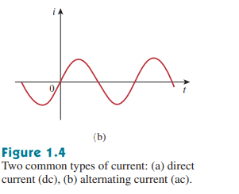
AC CURRENT
A time-varying current is represented by the symbol i.
A common form of time-varying current is the sinusoidal current or alternating current (ac).
An alternating current (ac) is a current that varies sinusoidally with time.
Such current is used in your household to run the air conditioner, refrigerator, washing machine, and other electric appliances.

Slide 18
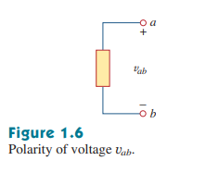
Voltage
To move the electron in a conductor in a particular direction requires some work or energy transfer.
This work is performed by an external electromotive force (emf), typically represented by the battery in Fig. 1.3.
This emf is also known as voltage or potential difference.
Voltage (or potential difference) is the energy required to move a unit charge through an element, measured in volts (V).

Slide 19
Force
The unit of force is the newton (N) where one newton is one kilogram metre per second squared.
The newton is defined as the force which, when applied to a mass of one kilogram, gives it an acceleration of one metre per second squared.
Thus, force, in newtons F = ma where m is the mass in kilograms and a is the acceleration in metres per second squared.
Gravitational force, or weight, is mg, where g = 9.81 m/s^2

Slide 20
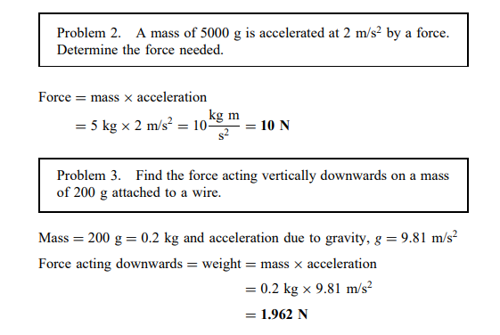

Slide 21
WORK
The unit of work or energy is the joule (J) where one joule is one newton metre.
The joule is defined as the work done or energy transferred when a force of one newton is exerted through a distance of one metre in the direction of the force.
Thus work done on a body, in joules W = Fs where F is the force in newtons and s is the distance in metres moved by the body in the direction of the force.
Energy is the capacity for doing work

Slide 22
POWER
The unit of power is the watt (W) where one watt is one joule per second.
Power is defined as the rate of doing work or transferring energy.
Thus, power in watts, P = W/t where W is the work done or energy transferred in joules and t is the time in seconds.
Thus energy, in joules, W = Pt

Slide 23
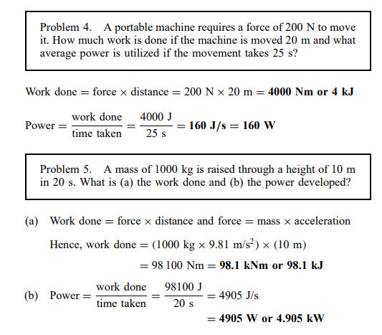

Slide 24
Circuit Elements
An element is the basic building block of a circuit. An electric circuit is simply an interconnection of the elements.
Circuit analysis is the process of determining voltages across (or the currents through) the elements of the circuit.
There are two types of elements found in electric circuits: passive elements and active elements.

Slide 25
An active element is capable of generating energy while a passive element is not.
Examples of passive elements are resistors, capacitors, and inductors.
Typical active elements include generators, batteries, and operational amplifiers.
Our aim in this section is to gain familiarity with some important active elements.
The most important active elements are voltage or current sources that generally deliver power to the circuit connected to them.

Slide 26
There are two kinds of sources: independent and dependent sources.
An ideal independent source is an active element that provides a specified voltage or current that is completely independent of other circuit elements
Figure 1.11 shows the symbols for independent voltage sources.
Notice that both symbols in Fig. 1.11(a) and (b) can be used to represent a dc voltage source, but only the symbol in Fig. 1.11(a) can be used for a time-varying voltage source.

Slide 27
Similarly, an ideal independent current source is an active element that provides a specified current completely independent of the voltage across the source.
That is, the current source delivers to the circuit whatever voltage is necessary to maintain the designated current.
The symbol for an independent current source is displayed in Fig. 1.12, where the arrow indicates the direction of current i.

Slide 28
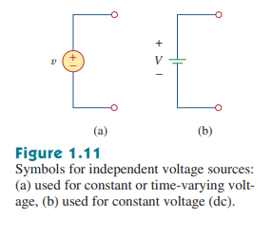
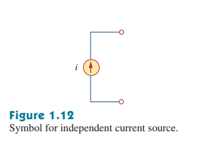

Slide 29
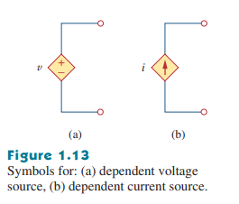
Dependent sources
An ideal dependent (or controlled) source is an active element in which the source quantity is controlled by another voltage or current
Dependent sources are usually designated by diamond-shaped symbols, as shown in Fig. 1.13.
Since the control of the dependent source is achieved by a voltage or current of some other element in the circuit, and the source can be voltage or current, it follows that there are four possible types of dependent sources, namely:
1. A voltage-controlled voltage source (VCVS).
2. A current-controlled voltage source (CCVS).
3. A voltage-controlled current source (VCCS).
4. A current-controlled current source (CCCS).

Slide 30
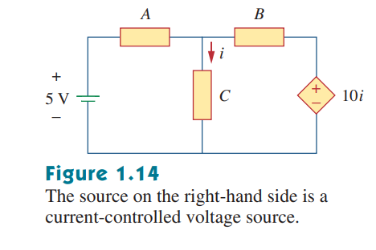
Dependent sources are useful in modeling elements such as transistors, operational amplifiers, and integrated circuits.
An example of a current-controlled voltage source is shown on the right-hand side of Fig. 1.14, where the voltage of the voltage source depends on the current i through element C.
Students might be surprised that the value of the dependent voltage source is 10i V (and not A) because it is a voltage source.
The key idea to keep in mind is that a voltage source comes with polarities in its symbol, while a current source comes with an arrow, irrespective of what it depends on.

