Slide 1
BASIC CIRCUIT ELEMENTS
Dr. T.YUVAPRIYA
ASSISTANT PROFESSOR
SELECT

Slide 2
Resistance
The opposition offered by a substance to the flow of electric current is called its resistance.
Since current is the flow of free electrons, resistance is the opposition offered by the substance to the flow of free electrons.
This opposition occurs because atoms and molecules of the substance obstruct the flow of these electrons.

Slide 3

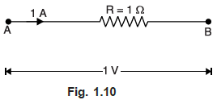
Unit of resistance
The practical unit of resistance is ohm and is represented by the symbol Ω.

Slide 4
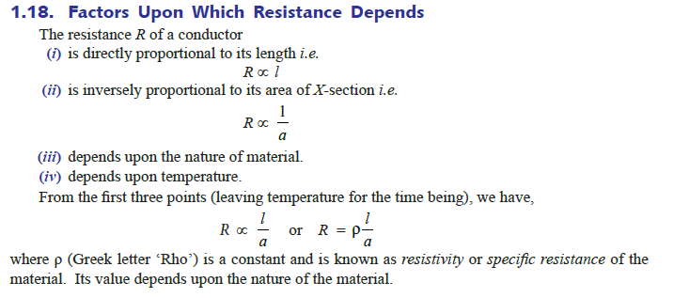

Slide 5
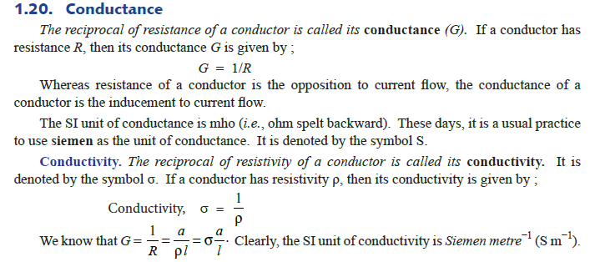

Slide 6
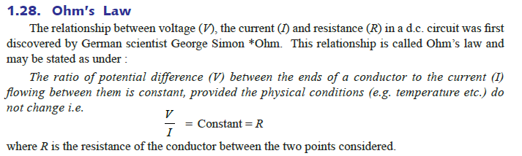

Slide 7
The direction of current i and the polarity of voltage v must conform with the passive sign convention, as shown in Fig. 2.1(b).
This implies that current flows from a higher potential to a lower potential in order for .
If current flows from a lower potential to a higher potential, . Since the value of R can range from zero to infinity, it is important that we consider the two extreme possible values of R.

Slide 8
An element with is called a short circuit, as shown in Fig. 2.2(a). For a short circuit V=iR=0 showing that the voltage is zero but the current could be anything.
In practice, a short circuit is usually a connecting wire assumed to be a perfect conductor.
Thus, A short circuit is a circuit element with resistance approaching zero

Slide 9

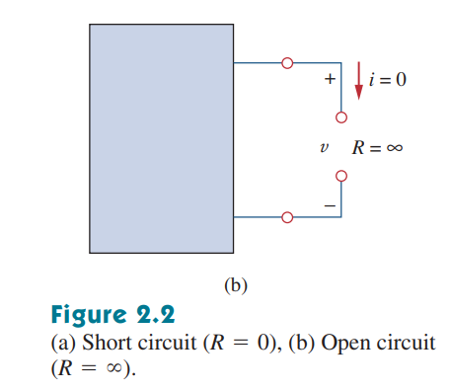
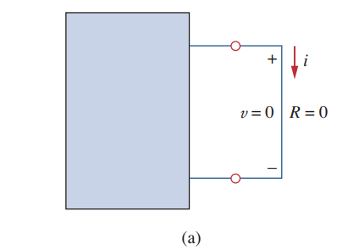
Similarly, an element with is known as an open circuit, as shown in Fig. 2.2(b). For an open circuit
indicating that the current is zero though the voltage could be anything
An open circuit is a circuit element with resistance approaching infinity

Slide 10
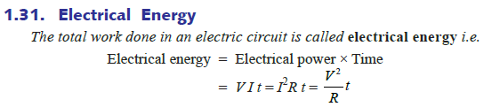
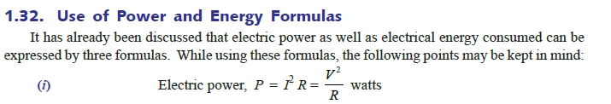

Slide 11

This property (i.e. inductance) is due to the self-induced e.m.f. in the coil itself by the changing current.

Slide 12
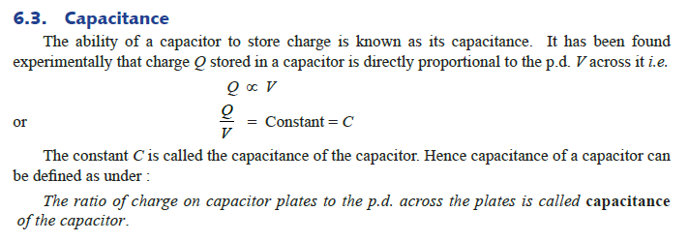

Slide 13


