Slide 1
SERIES AND PARALLEL CIRCUITS
Dr. T.YUVAPRIYA
ASSISTANT PROFESSOR
SELECT

Slide 2
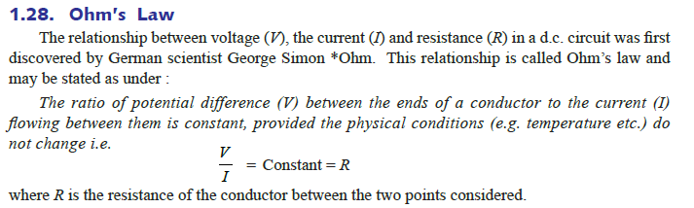

Slide 3
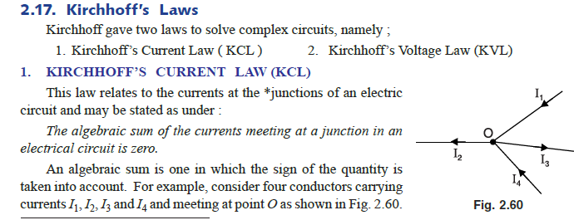

Slide 4
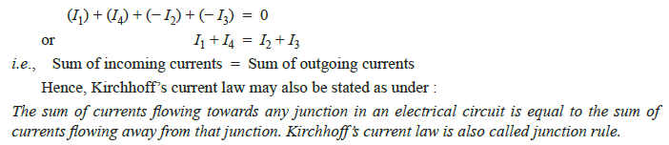

Slide 5
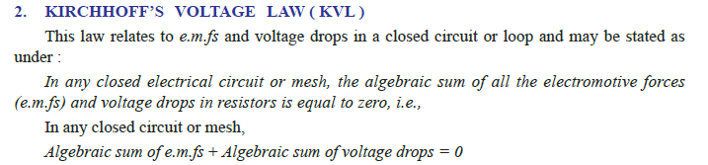

Slide 6
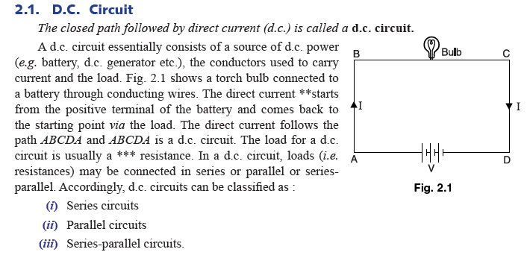

Slide 7
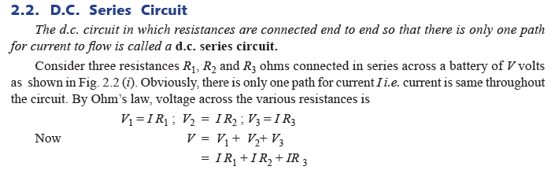

Slide 8
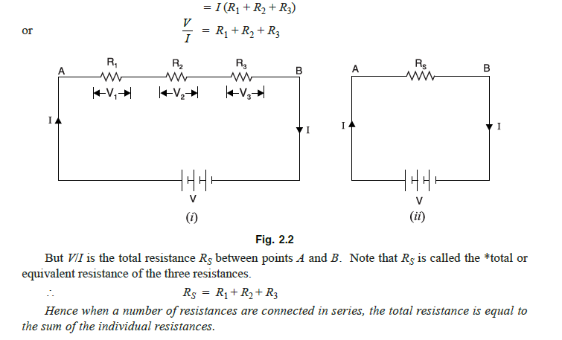

Slide 9
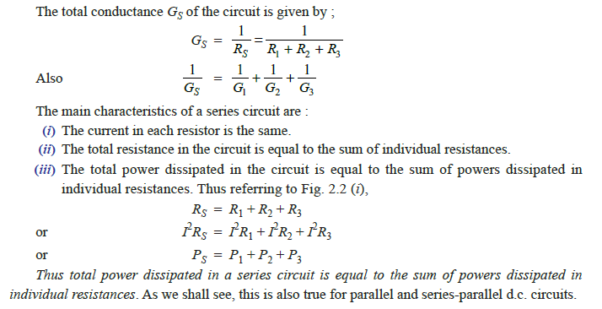

Slide 10


Slide 11
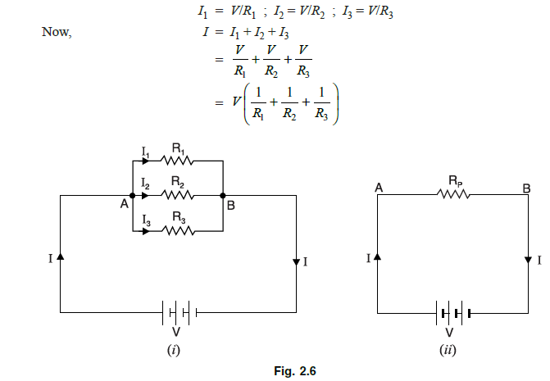

Slide 12
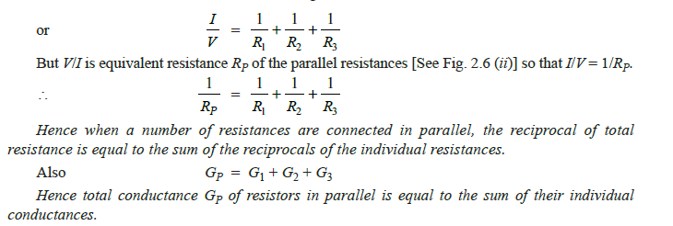

Slide 13
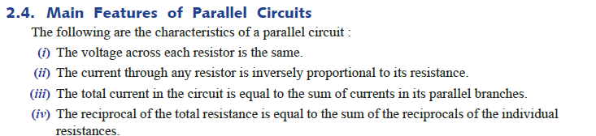

Slide 14
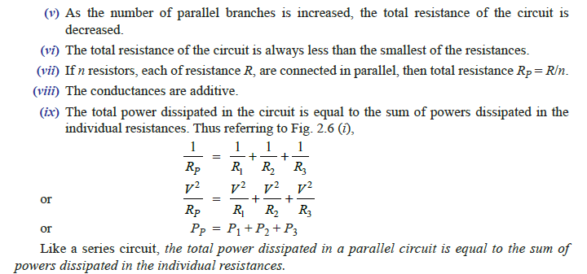

Slide 15
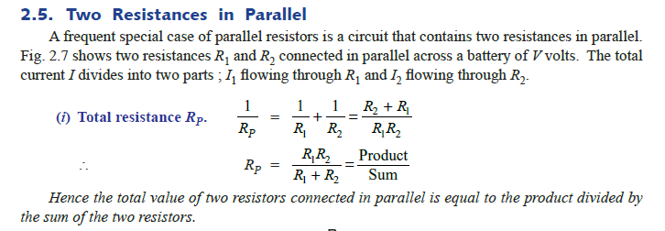
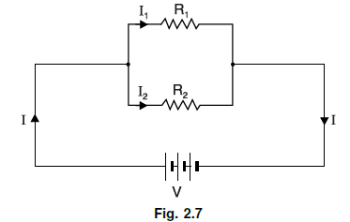

Slide 16
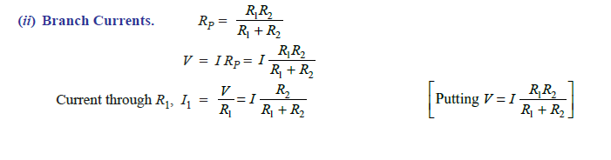


Slide 17
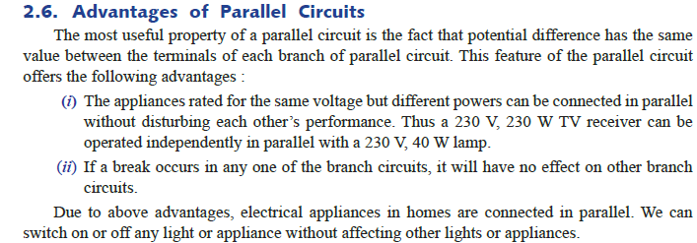

Slide 18
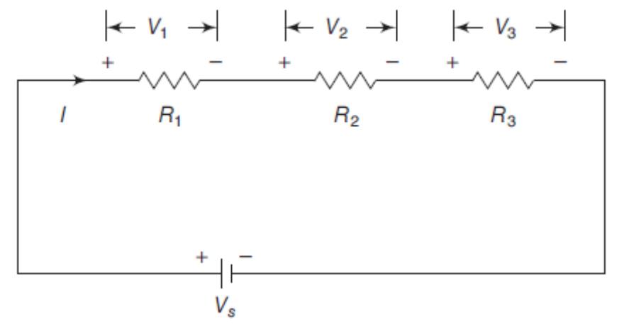
1.4 SERIES CONNECTION
The equivalent resistance of any number of resistors connected in series is the sum of the individual resistances
Two or more circuit elements are said to be in series if the identical current flows through each of the elements
R_{eq}= R₁+R₂+R₃
Notes:
Dr.S.ALBERT ALEXANDER

Slide 19
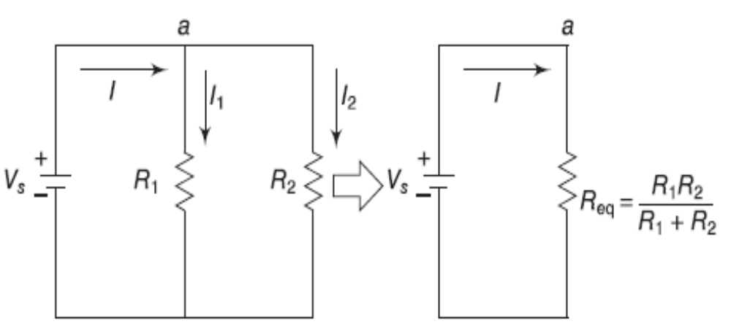
1.4 PARALLEL CONNECTION
The equivalent resistance of two parallel resistors is equal to the product of their resistances divided by their sum
The voltage remains the same across all the elements connected in parallel
Notes:
Dr.S.ALBERT ALEXANDER

Slide 20
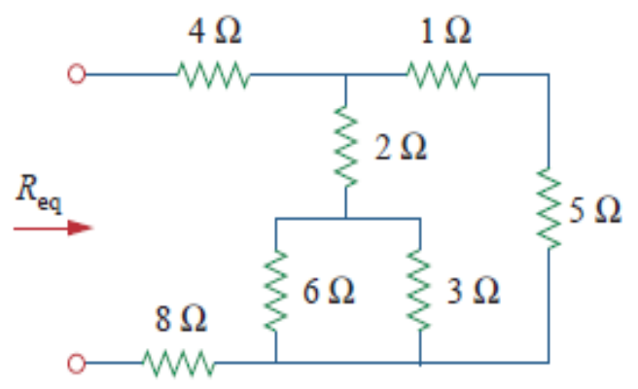
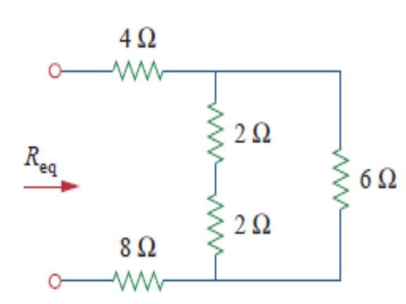
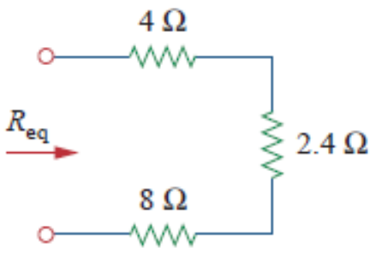
EXERCISE
Find R_{eq} for the circuit shown in the figure.
SOLUTION:
Parallel: 6Ω || 3Ω =18Ω/ 9Ω =2Ω ; Series: 1Ω+5Ω=6Ω
14.4 Ω
Notes:
Dr.S.ALBERT ALEXANDER

Slide 21
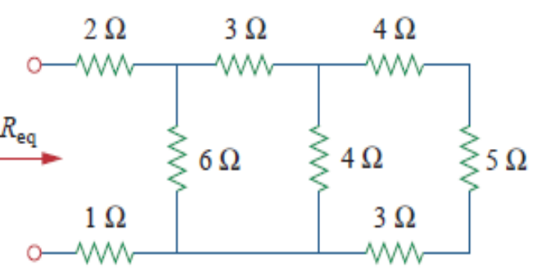
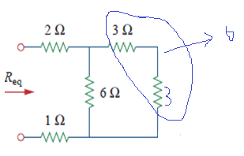
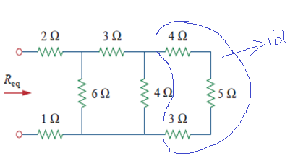
EXERCISE
Find R_{eq} for the circuit shown in the figure.
SOLUTION:
Series: 4Ω+5Ω+3Ω=12Ω; Parallel: 4Ω || 12Ω =3Ω
2+(6||6)+1=6Ω
Notes:
Dr.S.ALBERT ALEXANDER

Slide 22
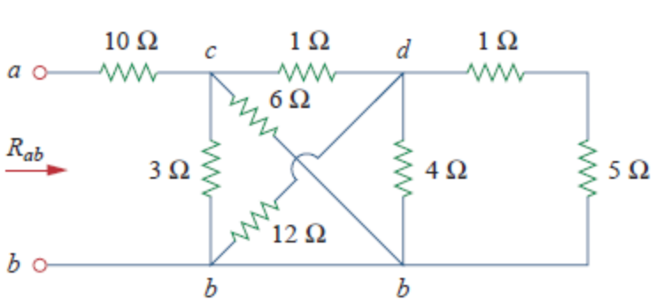
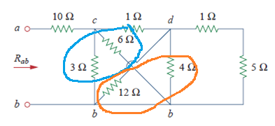
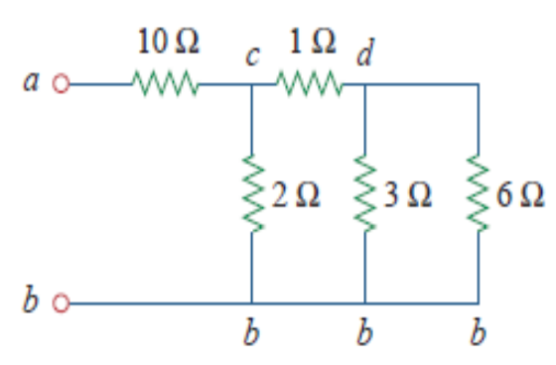
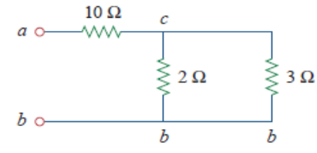
EXERCISE
Find R_{eq} for the circuit shown in the figure.
SOLUTION:
Parallel: 6Ω||3Ω (c,b) and 12Ω||4Ω (d,b)
(3||6)+1=3Ω
11.2Ω
Notes:
Dr.S.ALBERT ALEXANDER

Slide 23
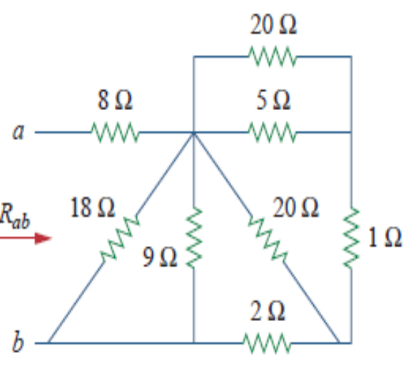
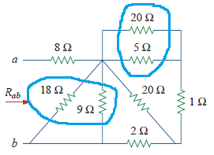
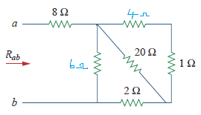
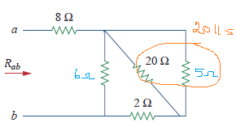
EXERCISE
Find R_{eq} for the circuit shown in the figure.
SOLUTION:
Parallel: 18Ω||9Ω and 20Ω||5Ω
=(20||5)+2||6=3Ω
=8Ω+3Ω=11Ω
Notes:
Dr.S.ALBERT ALEXANDER

Slide 24
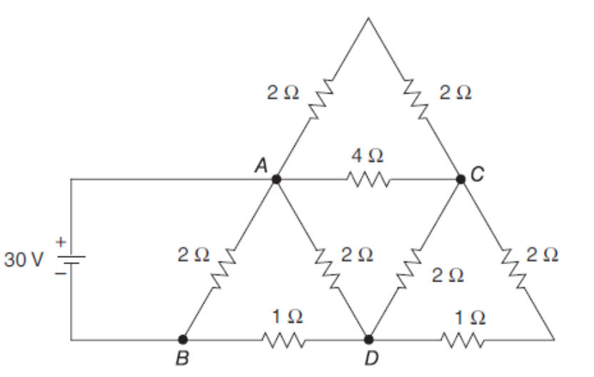
Find R_{eq} for the circuit shown in the figure.

Slide 25
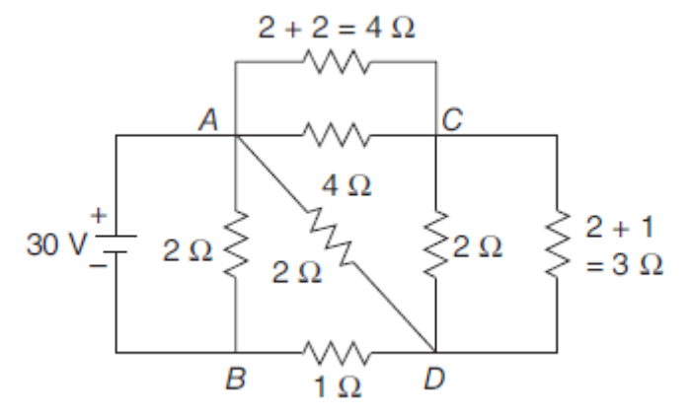
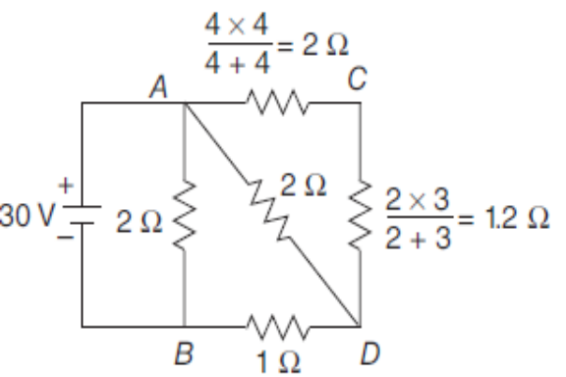
EXERCISE
Find R_{eq} for the circuit shown in the figure.
SOLUTION:
2+1.2= 3.2
3.2||2= 1.23
1.23+1=2.23
2.23||2=1.054Ω
Notes:
Dr.S.ALBERT ALEXANDER

Slide 26
1. Two filament lamps A and B take 0.8 A and 0.9 A respectively when connected across 110 V supply. Calculate the value of current when they are connected in series across a 220- V supply, assuming the filament resistances to remain unaltered. Also find the voltage across each lamp

Slide 27

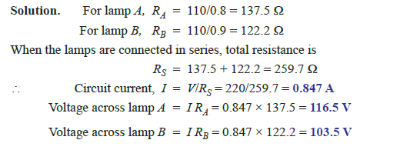

Slide 28
2. A 100 watt, 250 V lamp is connected in series with a 100 watt, 200 V lamp across 250 V supply. Calculate (i) circuit current and (ii) voltage across each lamp. Assume the lamp resistances to remain unaltered.

Slide 29
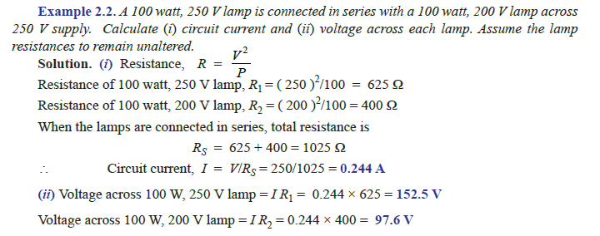

Slide 30
3. Two coils connected in series have a resistance of 18 Ω and when connected in parallel have a resistance of 4 Ω. Find the value of resistances

Slide 31
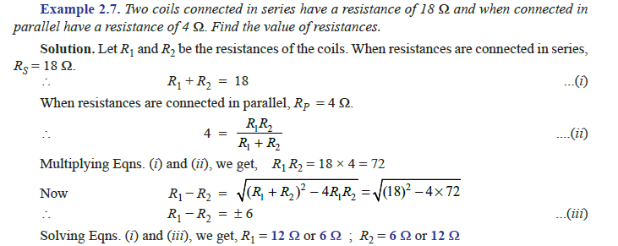

Slide 32
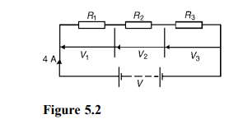
4. For the circuit shown in Figure 5.2, determine (a) the battery voltage V, (b) the total resistance of the circuit, and (c) the values of resistance of resistors R1, R2 and R3, given that the p.d.’s across R1, R2 and R3 are 5 V, 2 V and 6 V respectively.

Slide 33
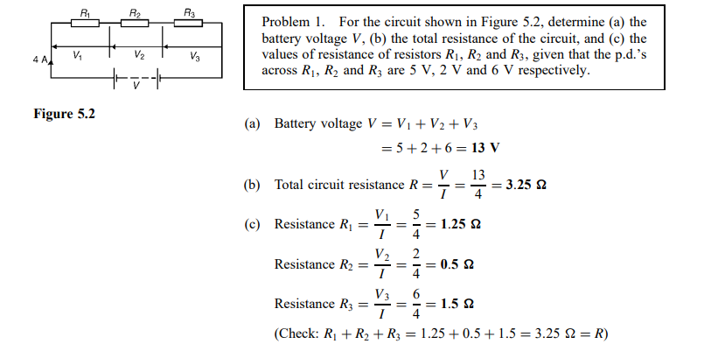

Slide 34
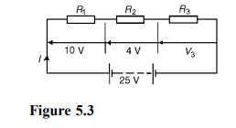
Problem 5. For the circuit shown in Figure 5.3, determine the p.d. across resistor R3. If the total resistance of the circuit is 100 , determine the current flowing through resistor R1. Find also the value of resistor R2

Slide 35
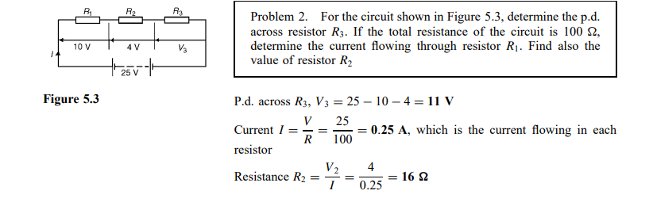

Slide 36
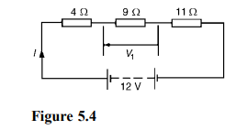
Problem 3. A 12 V battery is connected in a circuit having three series-connected resistors having resistances of 4 , 9 and 11 . Determine the current flowing through, and the p.d. across the 9 resistor. Find also the power dissipated in the 11 resistor.

Slide 37
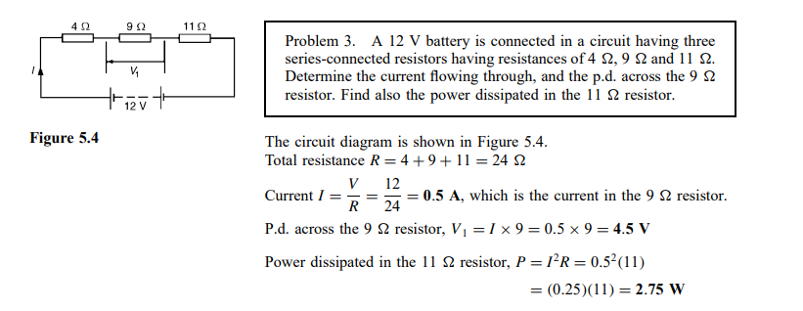

Slide 38
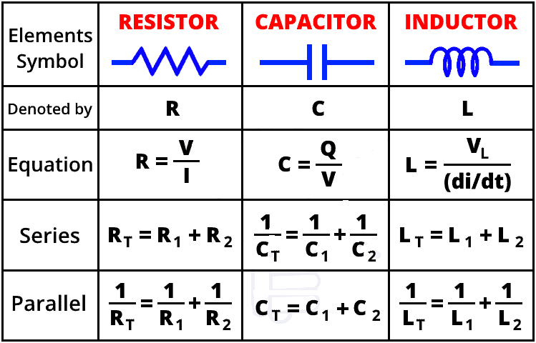
SUMMARY
Notes:
Dr.S.ALBERT ALEXANDER

