Slide 1
KIRCHHOFF’S LAW
T.YUVAPRIYA
ASSISTANT PROFESSOR
SELECT

Slide 2
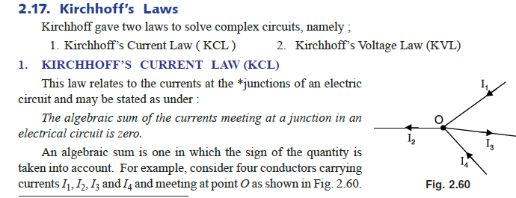

Slide 3
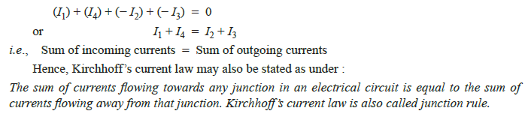

Slide 4
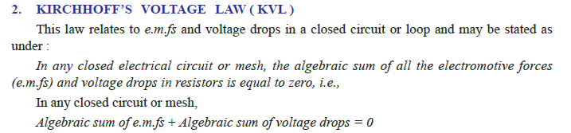

Slide 5
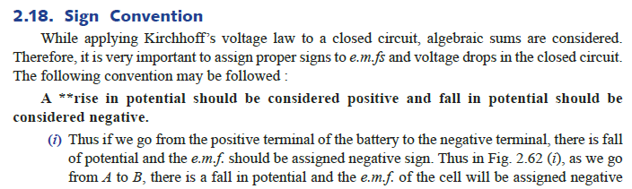

Slide 6
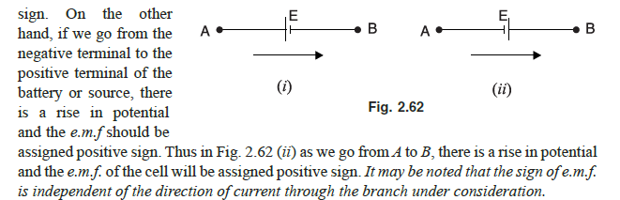

Slide 7
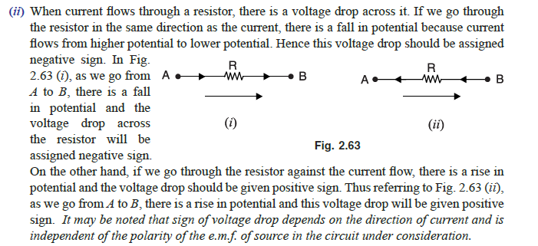

Slide 8
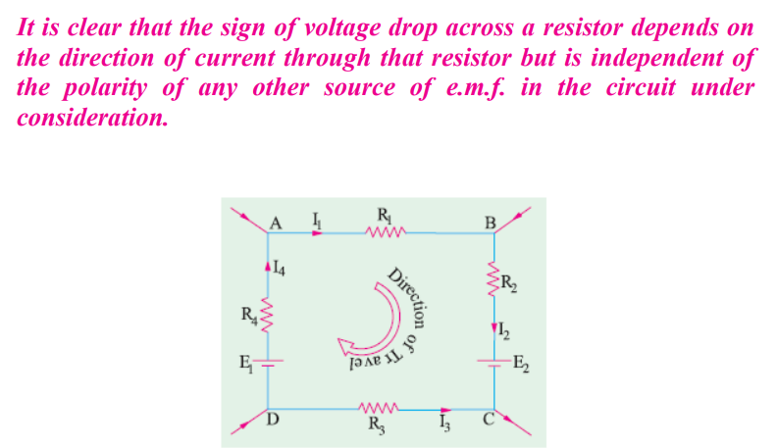
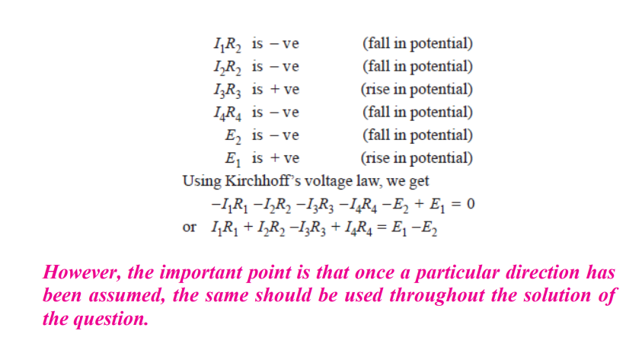

Slide 9
Network Terminology
(i) Linear circuit.
A linear circuit is one whose parameters (e.g. resistances) are constant i.e. they do not change with current or voltage.
(ii) Non-linear circuit.
A non-linear circuit is one whose parameters (e.g. resistances) change with voltage or current.
(iii) Bilateral circuit.
A bilateral circuit is one whose properties are the same in either direction.
For example, transmission line is a bilateral circuit because it can be made to perform its function equally well in either direction

Slide 10
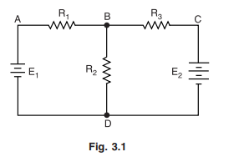
(iv) Active element.
An active element is one which supplies electrical energy to the circuit.
Thus in Fig. 3.1, E1 and E2 are the active elements because they supply energy to the circuit.
(v) Passive element.
A passive element is one which receives electrical energy and then either converts it into heat (resistance) or stores in an electric field (capacitance) or magnetic field (inductance).
In Fig. 3.1, there are three passive elements, namely R1, R2 and R3. These passive elements (i.e. resistances in this case) receive energy from the active elements (i.e. E1 and E2) and convert it into heat.

Slide 11
(vi) Node.
A node of a network is an equipotential surface at which two or more circuit elements are joined.
Thus in Fig. 3.1, circuit elements R1 and E1 are joined at A and hence A is the node. Similarly, B, C and D are nodes.
(vii) Junction.
A junction is that point in a network where three or more circuit elements are joined. In Fig. 3.1, there are only two junction points viz. B and D.
That B is a junction is clear from the fact that three circuit elements R1, R2 and R3 are joined at it.
Similarly, point D is a junction because it joins three circuit elements R2, E1 and E2.

Slide 12
(viii) Branch.
A branch is that part of a network which lies between two junction points.
Thus referring to Fig. 3.1, there are a total of three branches viz. BAD, BCD and BD.
The branch BAD consists of R1 and E1 ; the branch BCD consists of R3 and E2 and branch BD merely consists of R2.
(ix) Loop.
A loop is any closed path of a network.
Thus in Fig. 3.1, ABDA, BCDB and ABCDA are the loops.

Slide 13
(x) Mesh.
A mesh is the most elementary form of a loop and cannot be further divided into other loops.
In Fig. 3.1, both loops ABDA and BCDB qualify as meshes because they cannot be further divided into other loops.
However, the loop ABCDA cannot be called a mesh because it encloses two loops ABDA and BCDB.
(xi) Network and circuit.
Strictly speaking, the term network is used for a circuit containing passive elements only while the term circuit implies the presence of both active and passive elements.
However, there is no hard and fast rule for making these distinctions and the terms “network” and “circuit” are often used interchangeably

Slide 14
(xii) Parameters.
The various elements of an electric circuit like resistance (R), inductance (L) and capacitance (C) are called parameters of the circuit. These parameters may be lumped or distributed.
(xiii) Unilateral circuit.
A unilateral circuit is one whose properties change with the direction of its operation. For example, a diode rectifier circuit is a unilateral circuit.
It is because a diode rectifier cannot perform rectification in both directions.
(xiv) Active and passive networks.
An active network is that which contains active elements as well as passive elements.
On the other hand, a passive network is that which contains passive elements only.

