Slide 1
CRISPR: The Revolutionary Gene Editing Tool
Name: Ruturaj Mundhe
Register Number: 22MIS0159

Slide 2
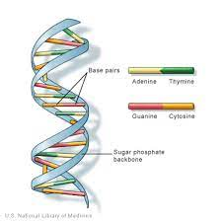
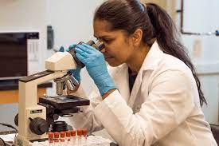
introduction
CRISPR is a revolutionary gene editing tool that has the potential to change the way we think about genetic disorders and diseases. This presentation will take a closer look at CRISPR, its history, and its potential applications.
Notes:
Hello, Everyone. CRISPR is a revolutionary gene editing tool that has
the potential to change the way we approach the field of genetic engineering. In this presentation, we will take a closer look at CRISPR, its history, and its potential applications. It was discovered by 2 scientists Emmanuelle Charpentier and Jennifer A. For this discovery, they won the Nobel prize in Chemistry in the year 2020.

Slide 3
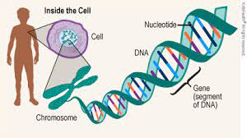
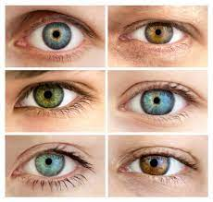
What are genes?
The basic unit of heredity passed from parent to child. Genes are made up of sequences of DNA and are arranged, one after another, at specific locations on chromosomes in the nucleus of cells. They contain information for making specific proteins that lead to the expression of a particular physical characteristic or trait, such as hair colour or eye colour, or to a particular function in a cell.
Notes:
From the smallest single-celled
organism to the largest creatures on earth, to the largest creatures on earth,
every living thing is defined by its genes. The DNA contained in our genes
acts like an instruction manual for our cells. With recent advancements
in gene editing tools, scientists can change an organism’s fundamental
features in record time. CRISPR is the fastest, easiest,
and cheapest of the gene editing tools. But how does it work? and what can it
do?

Slide 4
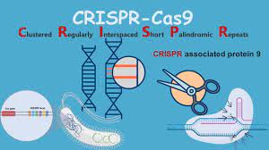
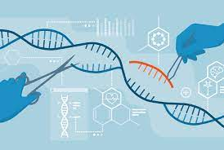
Understanding CRISPR
CRISPR (Clustered Regularly Interspaced Short Palindromic Repeats) is bacteria's naturally occurring defence mechanism. It allows the bacteria to identify and destroy invading viruses. Scientists have harnessed this mechanism to create a powerful tool for editing genes.
Notes:
CRISPR stands for(Clustered Regularly Interspaced Short Palindromic
Repeats) it is a bacteria's naturally occurring defence mechanism.
It allows the bacteria to identify and destroy invading viruses.
Scientists have harnessed this mechanism to create a powerful tool
for editing genes.

Slide 5
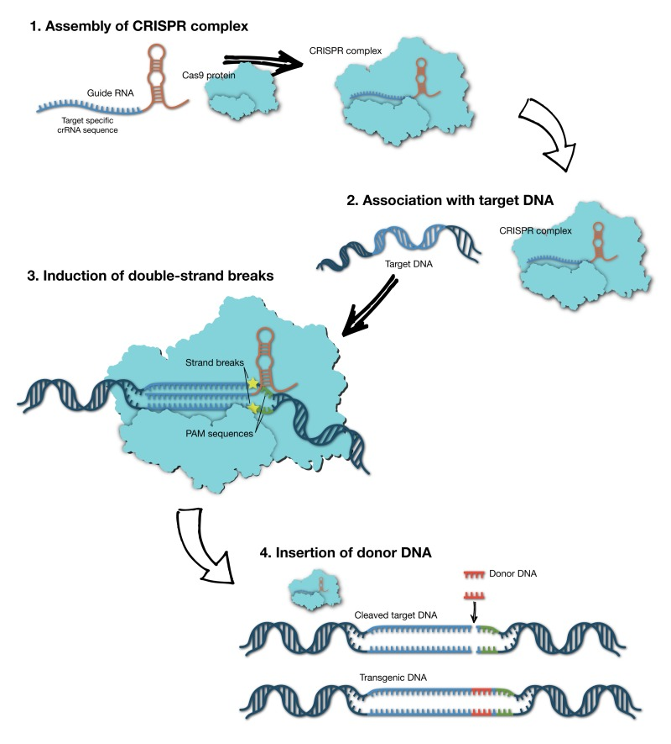
The crispr mechanism
CRISPR works by using an enzyme called Cas9, which acts as a pair of molecular scissors. The Cas9 enzyme is guided to a specific location in the DNA by a small RNA molecule called the guide RNA. Once the Cas9 enzyme reaches its target, it cuts the DNA at that location. This cut allows scientists to insert, delete, or modify specific genes.
Notes:
CRISPR works by using an enzyme called Cas9 which acts as a pair of molecular scissors. The Cas9 enzyme is guided to a specific location in the DNA by a
small RNA molecule called the guide RNA. Once the Cas9 enzyme
reaches its target, it cuts the DNA at that location. This cut
allows scientists to insert, delete, or modify specific genes according to their requirements.

Slide 6

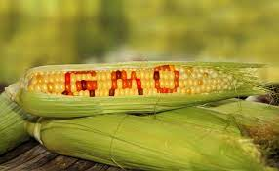
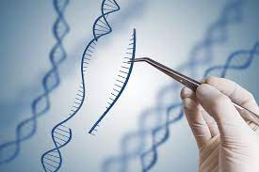
Applications of crispr
]Some of the potential applications of this technology include:
Treating genetic disorders such as cystic fibrosis and sickle cell anaemia
Developing new therapies for cancer and other diseases
Creating genetically modified crops that are resistant to pests and diseases
Improving the efficiency of livestock breeding

Slide 7
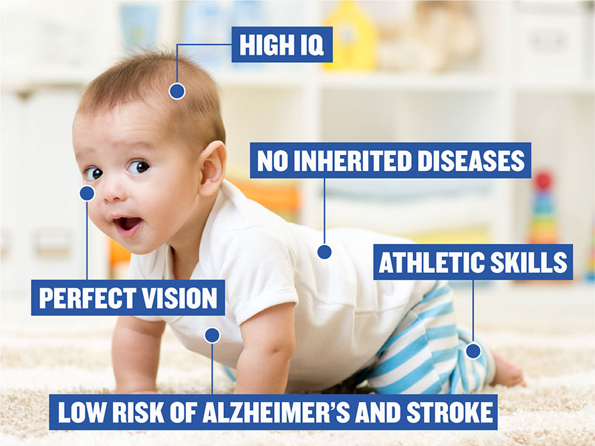

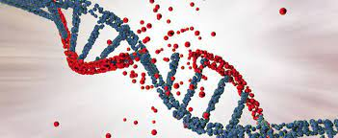
Ethical Implications of crispr
CRISPR has the potential to greatly impact medicine and agriculture, but it also raises significant ethical considerations. Some of the concerns include:
The potential for creating "designer babies"
The possibility of unintended consequences
The possibility of unequal access to the technology
Notes:
CRISPR has the potential to greatly impact medicine and agriculture, but it also raises significant ethical considerations. Some of the concerns include:
1)The potential for creating "designer babies": CRISPR has the potential
to allow scientists to edit the genetic makeup of embryos. This raises
concerns about creating "designer babies" with specific traits and
characteristics that are deemed desirable.
2)The possibility of unintended consequences: As with any new technology,
there is a risk that CRISPR could have unintended consequences.
For example, scientists may accidentally edit the wrong gene,
leading to unexpected health problems.
3)The possibility of unequal access to technology:
CRISPR is a powerful and potentially expensive technology.
There is a concern that access to CRISPR may be limited to certain
individuals or groups, creating an unequal distribution of the
benefits of the technology.

Slide 8


The future of crispr
While there are important ethical considerations to take into account, the potential benefits of CRISPR are too great to ignore. The future of CRISPR is exciting and holds great promise for improving human health and agriculture.
Notes:
While there are important ethical
considerations to take into account, the potential benefits of
CRISPR are too great to ignore. The future of CRISPR is exciting
and holds great promise for improving human health and agriculture.
Thank You.

