Slide 1
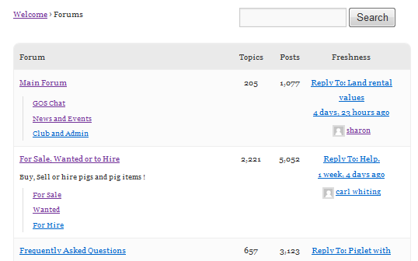
1
5
4
15
3
3
3
2
3
3
5
6
9
13
14
1
7
11
10
8
1
12
2

Slide 2
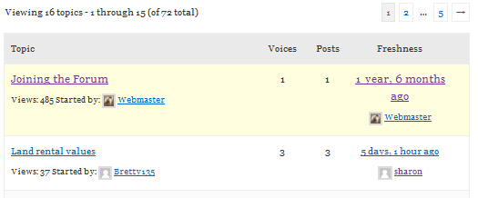


2
21
2
2
2
12
10
11
1
13
13
13
13
15
3
4
9
2
2
20
8
14
17
7
18
19
5
6
7
16
6

Slide 3
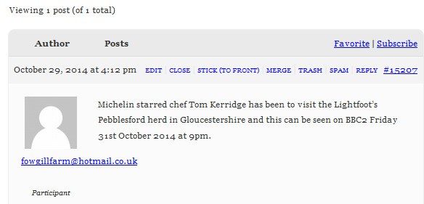


This box is styled in Topics Index 10, 11 & 12
10
10
5
2
11
17
18
8
19
16
6
23
1
7
15
3
9
12
4
13
14
21
22
20

Slide 4


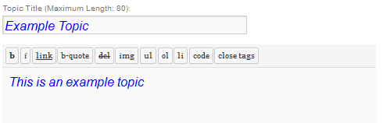
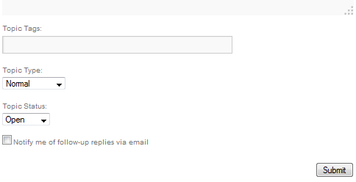
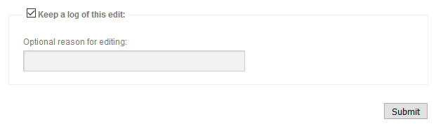
10
12
16
1
3
2
4
2
9
3
2
1
3
18
11
2
1
1
6
1
7
8
5

Slide 5
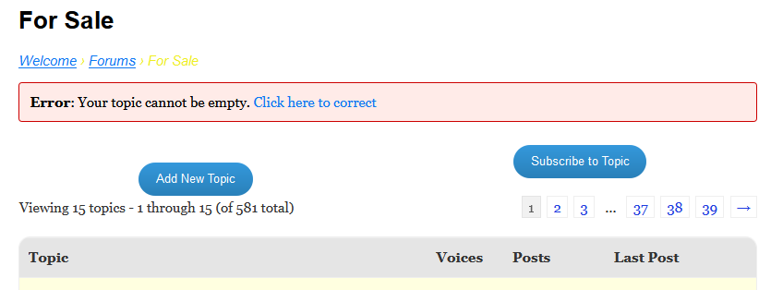
17

Slide 6
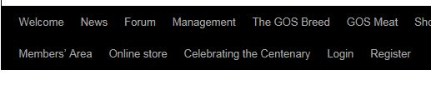


Slide 7
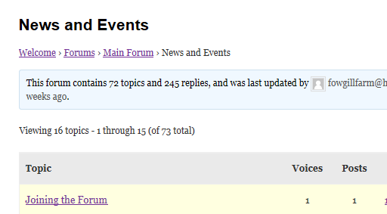
Home
Root
Current
Breadcrumbs

Slide 8
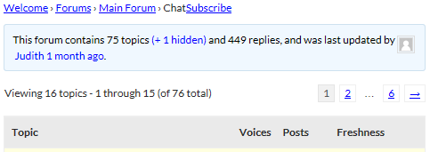
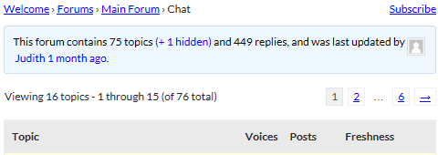

Slide 9
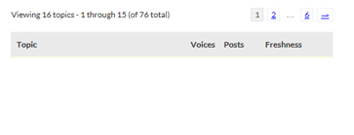

Slide 10

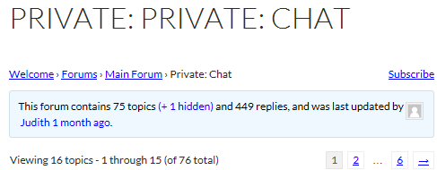
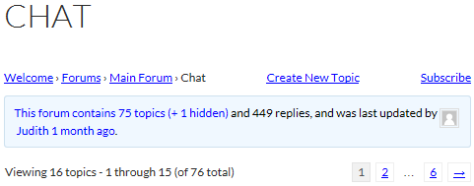

Slide 11
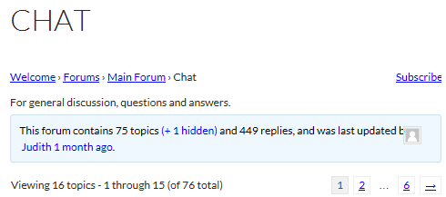
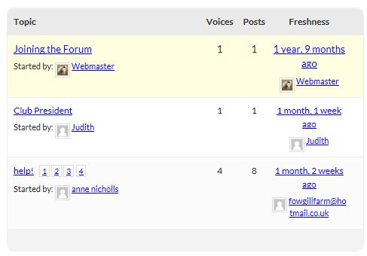

Slide 12
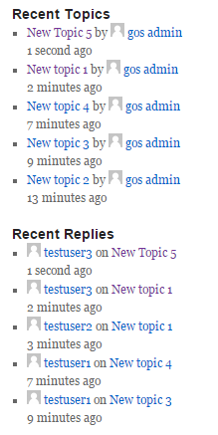
Original topic author always shown
Repeated topics for multiple replies

Slide 13
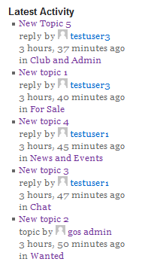

Slide 15
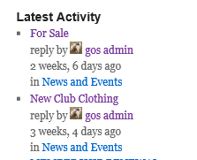
1
2
3
4
5
3
6
7
8

Slide 16
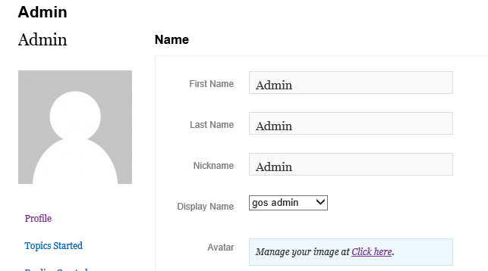
1
2
4
3
The url this links to

Slide 17
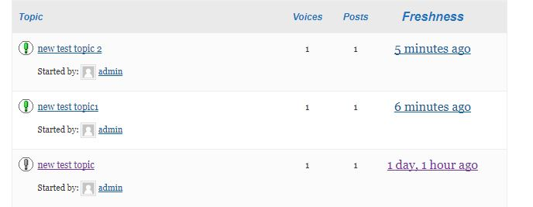
1
2

Slide 18
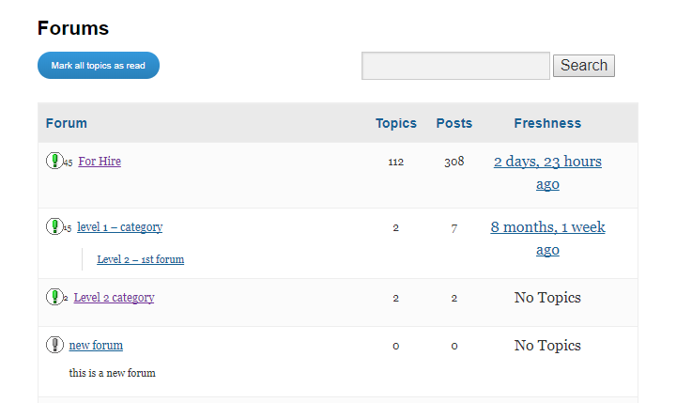
4
3
1
2

Slide 19
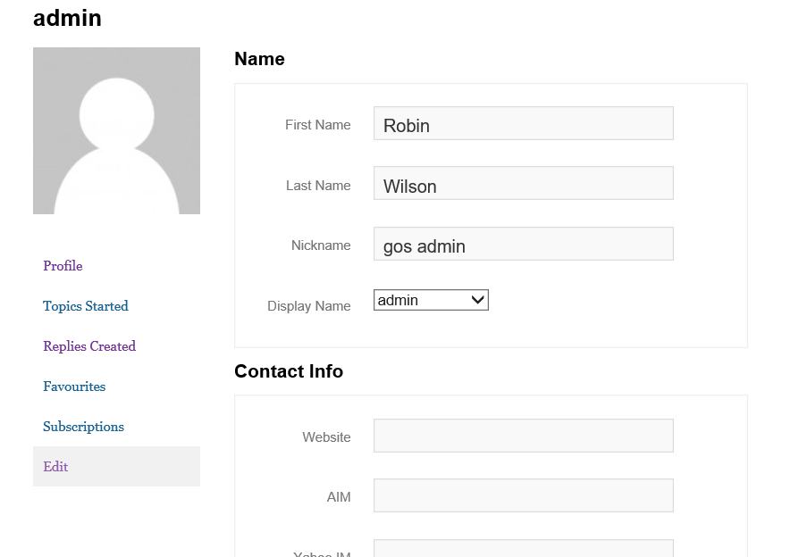
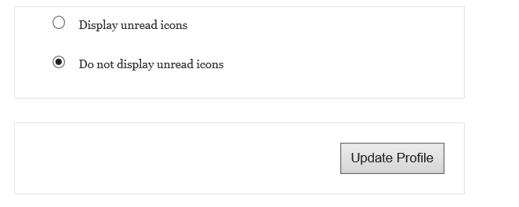
5

Slide 20
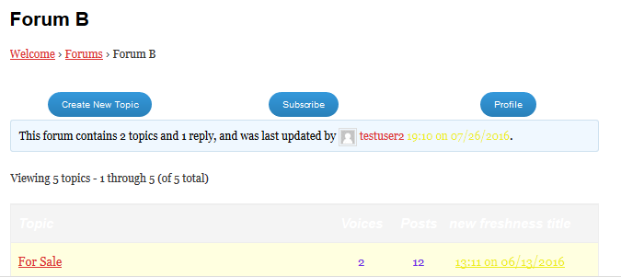

Slide 21
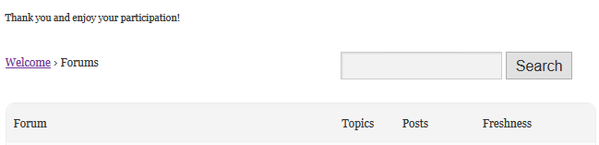
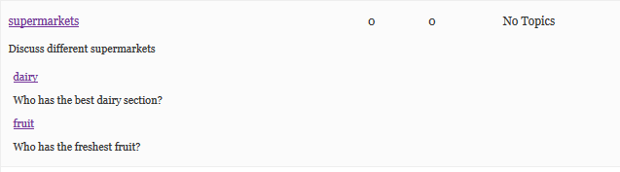

Slide 22
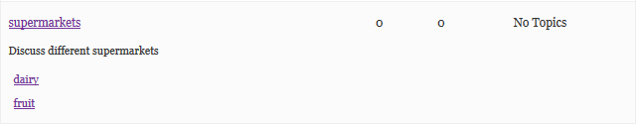

Slide 23


1
2
4
5
3
6
7

Slide 24
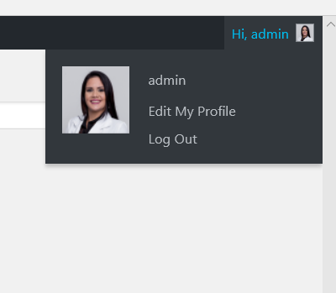
6

Slide 25
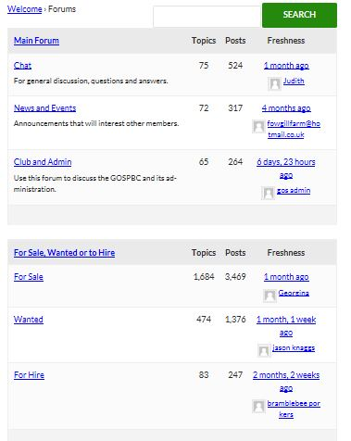
Category
Forums with
above category as parent

Slide 26
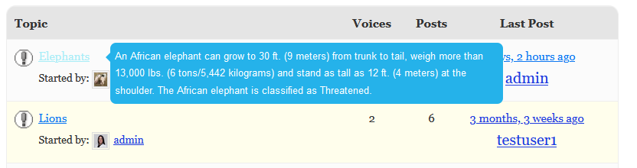
Cursor hover on title
Topic content appears

Slide 27
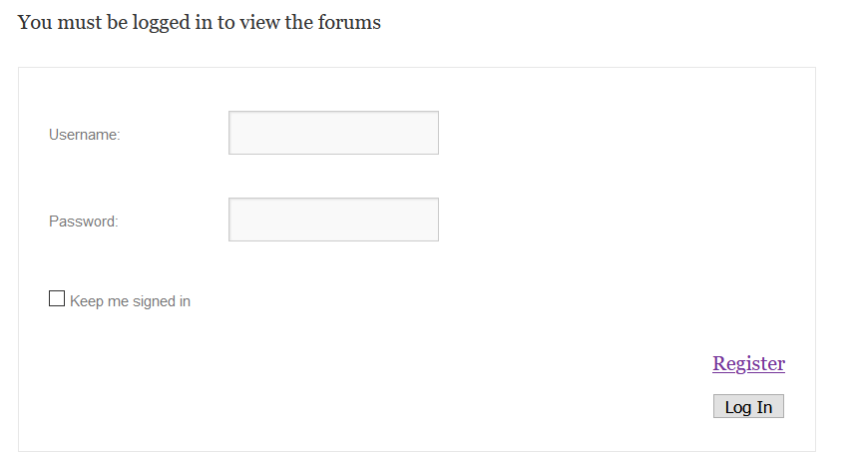
Message
Not Logged in
Logged in

