Slide 1
PROJECT O · CHALLENGE 1 — DEPOSIT BREAKDOWN & IMPROVEMENT
Exchange O —
Deposit Reconciliation Engine
Closing the gap between “your transaction went through” and “your collateral is tradable.”
Ryu Matsumoto
SUBMISSION · 3-MINUTE WALKTHROUGH
LIVE ON ARBITRUM SEPOLIA
7 REAL TESTNET TRANSACTIONS
WORKING POC, NOT MOCKUPS
1 / 9

Slide 2
01 — BREAKDOWN
The deposit journey today: 8 steps, one blind spot
KOL link → tradable collateral. Every step has an owner and a real completion test.
01
02
03
04
05
06
07
08
Arrive via KOL link
Sign in
Identify funding source
Get funds + gas on Arbitrum
Approve token spend
Submit deposit tx → receipt
Collateral reflected on Hyperliquid
User sees “ready to trade”
attribution can silently drop
method may not match where funds sit
“which wallet has the money?”
no gas token on the destination chain
defaults to unlimited allowance
receipt ≠ usable funds — the trap
real delay, zero visibility today
silence reads as failure → re-deposit
KOL → PROJECT O
USER + PRIVY
USER
USER + BRIDGE / CEX
USER + CONTRACT
USER + PROVIDER
EXTERNAL PROVIDER
PROJECT O
THE FRICTION ZONE
A receipt is not credited collateral. Today steps 6→8 are silent — so “still bridging,” “no gas,” and “failed” all look identical. Users assume failure and re-deposit.
STEPS 2 · 3 · 7 CAN EACH BE A DIFFERENT WALLET — NOTHING LABELS WHICH IS WHICH
SUBMISSION.MD §1
2 / 9

Slide 3
02 — PRIORITISATION
Why this is the single biggest friction point
Not one of several equally-good options — four independent reasons.
01
The brief itself names it
02
Documented in the wild
“Complete only when tradable collateral is reflected — not when a receipt is issued.”
Third-party “deposit stuck” guides exist. Their first instruction: “do not send a second deposit.”
03
Hits exactly this audience
04
It causes financial harm
Korean CEX withdrawers, KOL-referred, mobile — least equipped to read ambiguous silence.
Duplicate deposits cost real money. Cosmetic friction only costs conversion.
Considered and rejected as the primary fix: sponsored gas (infra beyond PoC, and the gap remains) · wallet unification (explicitly out of scope — label, don’t merge) · cutting funnel steps (no real data — that would be a guess).
3 / 9

Slide 4
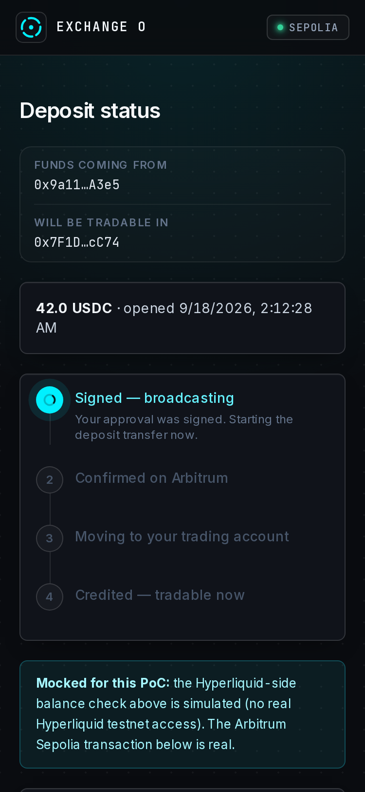
03 — THE FIX
Deposit Reconciliation Engine
A real backend state machine — persistent records, not a UI illusion.
SIGNED
→
CONFIRMED_ONCHAIN
→
BRIDGING
→
CREDITED
STALLED_NO_GAS
STALLED_TIMEOUT
AMBIGUOUS
CREDITED needs both sides to agree: the real on-chain receipt read via RPC (never trusting the client) and the Hyperliquid balance signal.
Disagree past the window → flagged AMBIGUOUS for investigation. Never a forever-spinner, never a silent retry.
Duplicate-deposit block: a second deposit for the same wallet + amount while one is in-flight is refused with a link to the live status. Verified on testnet — HTTP 409.
LIVE STATUS TRACKER · REAL APP
4 / 9

Slide 5
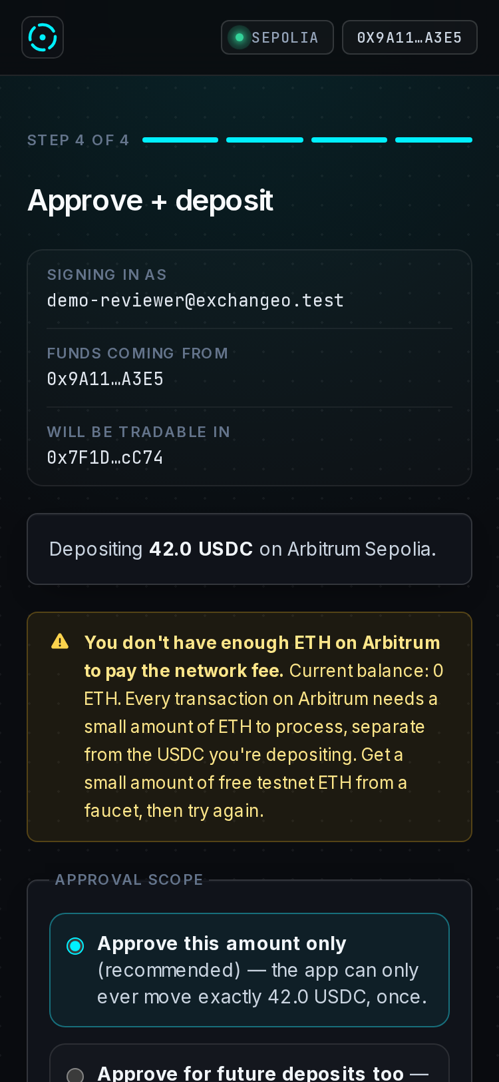
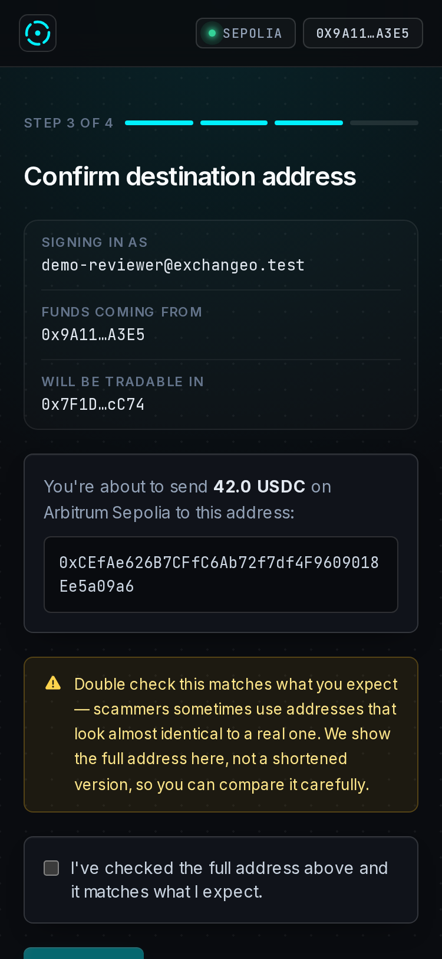
04 — FIVE UX LAYERS
One root cause, five surfaces
Not five unrelated patches — every layer attacks state opacity.
LAYER 01
LAYER 02
LAYER 03
LAYER 04
LAYER 05
Exact-amount approval
Plain-language failures
Full address confirmation
Wallet-role labelling
KOL disclosure
Unlimited allowance is opt-in and honestly labelled — never the default.
“You don’t have enough ETH to pay the network fee” — zero crypto background assumed.
Never truncated, with an explicit lookalike-address warning. Address poisoning is real.
“Signing in as / Funds coming from / Will be tradable in” — never a bare “your wallet.”
Persistent, compliance-grade: Exchange O is independent — the decision is yours alone.
All five ship in the live PoC. The approve screen alone carries three of them — roles, plain-language gas failure, and approval scope — on one mobile viewport.
5 / 9

Slide 6
05 — WALKTHROUGH
The review step, screen by screen
Captured from the deployed PoC on Arbitrum Sepolia — narrated over stills, not clicked live.
DEPLOYED POC
https://projecto-blond.vercel.app
Real Next.js app, real wallet connection, real Arbitrum Sepolia transactions. No real funds involved.
STEP 3 — FULL ADDRESS, NEVER TRUNCATED
WALLET ROLES: SIGNING IN / FUNDING / TRADABLE
STEP 4 — APPROVAL DEFAULTS TO THIS AMOUNT ONLY
PLAIN-LANGUAGE GAS FAILURE, WITH THE FIX
STEP 3 · CONFIRM ADDRESS
STEP 4 · APPROVE + DEPOSIT
6 / 9

Slide 7
06 — EVIDENCE
Real transactions. Not simulated.
Every hash below is confirmed on Arbitrum Sepolia and independently verifiable.
1 — approve(relayer, 25.000000) · signed by the user block 309873172 · success
0xc110d16ae895b7bc9ec8483c6c788a3967f072b16eaaeb0964d46b6f1a3f6022
2 — transferFrom(user, relayer, 25.000000) · signed by the relayer block 309873206 · success
0xbaf69d4752b4f1e3a54614e71a1eb25b0c7b553bb829c5a8a5111df1e513e723
verify → https://sepolia.arbiscan.io/tx/<hash>
7
0.0
409
real confirmed transactions — none invented
allowance left after transfer — exact-amount scoping, proven
duplicate deposit blocked before any new tx was attempted
MOCK ERC-20 WITH IDENTICAL USDC SEMANTICS — CIRCLE’S FAUCET NEEDS AN API KEY. LABELLED, NOT HIDDEN.
TESTNET-EVIDENCE.MD
7 / 9

Slide 8
07 — MEASUREMENT
How we’d know it worked
PRIMARY METRIC
% of deposits reaching CREDITED without a re-deposit attempt or a support contact
Targets the two named failure modes directly — not a generic conversion rate this fix only influences.
GUARDRAILS — MUST NOT REGRESS
Time-to-CREDITED p50 / p90
AMBIGUOUS rate
Duplicate-block rate
A rising p90 is an infrastructure signal, not a UI one.
Rising means reconciliation genuinely disagrees more often. Investigate — don’t extend the timeout.
A spike means the status UI isn’t reassuring users fast enough about their first deposit.
Not available, and not invented: real funnel drop-off, support-ticket volume, and the true production time-to-credit distribution. The brief withholds them by design.
8 / 9

Slide 9
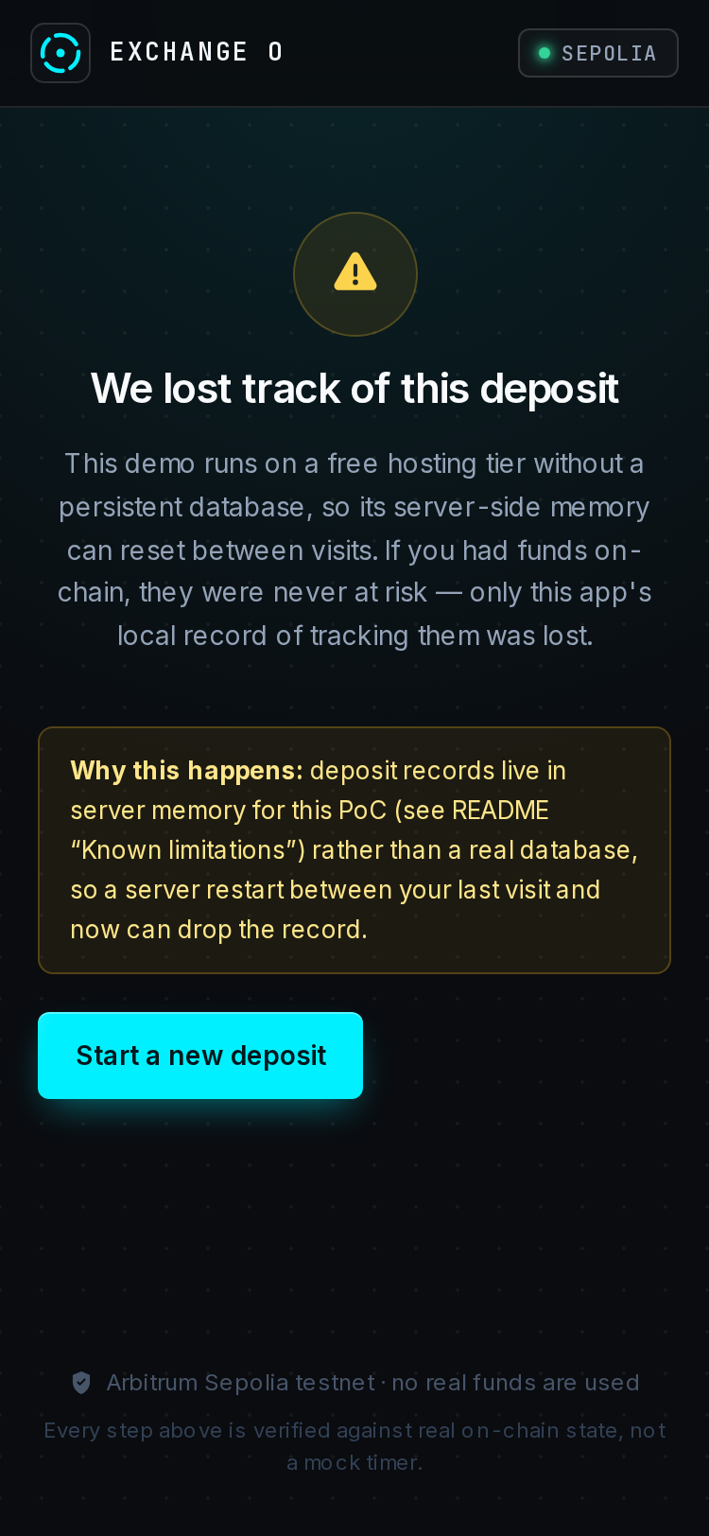
08 — HONEST CLOSE
What’s mocked, and what’s next
KNOWN LIMITATIONS
BEFORE PRODUCTION
• No real database — in-memory store; record loss observed live, not theorised
• Hyperliquid credit is a timer, not a real balance read
• Mock ERC-20, not Circle testnet USDC
• Mocked login; no human MetaMask click-through yet
• External store — fixes lookups and cross-instance duplicate blocking
• Real Hyperliquid balance integration
• Re-verify the live deposit rail — the legacy bridge is deprecated
• Calibrate AMBIGUOUS thresholds on real bridging latency
• Sponsored gas for the no-ETH dead-end
Every mock is labelled in the UI itself — including the failure screen when the PoC loses its own record.
LIMITATION, SURFACED HONESTLY
RYU MATSUMOTO · PROJECT O CHALLENGE 1
PROJECTO-BLOND.VERCEL.APP
9 / 9

