Slide 1
Implementation and Evaluation of Soft-Error Resilient Method for OASIS Network-on-Chip
Ryunosuke Murakami
Adaptive Systems Laboratory
Supervised by Professor Yuichi Okuyama
Notes:
Hello, everyone. I’m Ryunosuke Murakami, Adaptive systems laboratory. My supervisor is Prof. Yuichi Okuyama. My thesis title is “ ”. Please let me start my presentation.

Slide 2
OUTLINE
Background
Motivation
Research goal
Approach
Evaluation results
Conclusion
Notes:
Here is the outline of my presentation.
First I’ll introduce the background and issues. Then motivation and research goal.
Followed by presentation of my approach and evaluation.
Lastly, I will conclude with a summary.

Slide 3
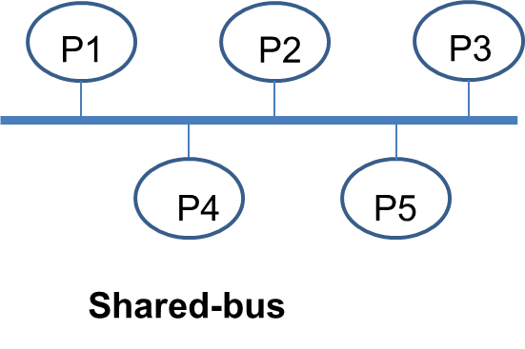
Background
System-on-Chip
Major communication backbone is shared-bus
low scalability
no parallelism
long wire problem
Demand for Many-core system is increasing
Problems
Efficient global interconnect is necessary
Notes:
In Many/Multi-core System-on-Chips(MSoCs) architecture, global interconnects is the major performance bottleneck. Major and modern backbone architecture is shared-bus. Although it has simple structure, high extensibility and low area cost, it suffers from some limitations.
For example,
Low scalability: Practical number of cores is only up to tens of cores.
No parallelism: shared bus allows only one communication at a time.
Long wire Problem: The longer wires become when many cores attached, the more delay increase due to long path and capacitance.
Therefore, efficient global interconnect is necessary for future many-core based system architecture.
Low scalability: communication between master and slave is only one communication at a time. So, when cores numbers increase, latency also increase.

Slide 4
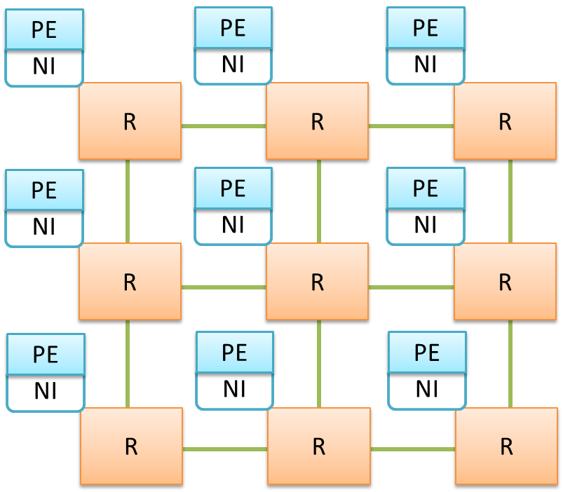
Network-on-Chip
Suitable for next generation Many-core SoC
Scalable and reusable
Data access is parallel
Low power consumption
PE: Processing element
R: Router
NI: Network interface
Network-on-Chip
Notes:
Network-on-Chip(NoC) is an efficient communication backbone of next generation Many core based SoC. NoC paradigm offers more scalability than conventional shared bus interconnects and allows more processing elements to be efficiently integrated into a SoC. Processing elements are connected via a packet switched communication network. This figure shows 3x3 network size, mesh topology Network-on-Chip.
(memo)
Reusable: By changing interconnects between modules, we can change SoC system.
Lower power consumption:

Slide 5
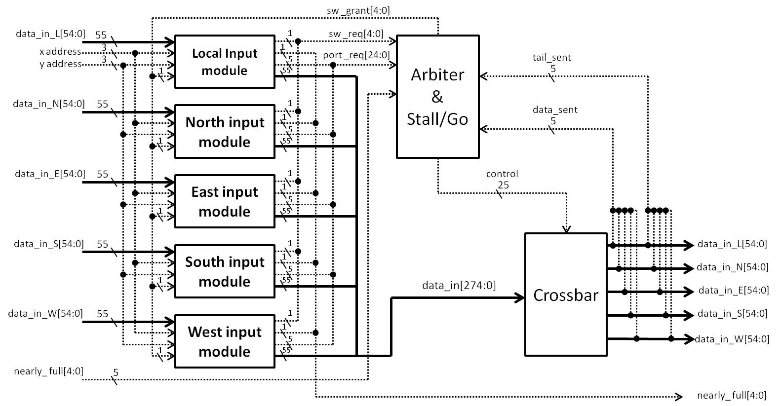
OASIS Network-on-Chip
1st stage: Buffer Writing
2nd stage: Next port routing(NPC)
& Switch allocation(SA)
3rd stage: Data forwarding
1st stage
2nd stage
3rd stage
1st stage:
BW(Buffer writing):
Receive data and store
2nd stage:
NPC(Next port computing):
Calculate next-out put port
SA(Switch allocation):
Arbitrating input ports to output ports
3rd stage:
CT(Crossbar traversal):
Route ports from input ports to output ports
Target is Multi / Many-core system
Notes:
OASIS-NoC system is targeted for safety critical embedded applications. This figure shows LAFT(Look-Ahead-Fault-Tolerant) based OASIS NoC’s architecture. There are 3 pipe-line stages, buffer-writing, next port computing, switch-allocation and crossbar-traversal. Routing Algorithm is Look-Ahead Routing Algorithm: it precompute the next router’s out port in previous node.
Forwarding mechanism is Wormhole. This is suitable for large packet size data.
Target of OASIS NoC architecture is multi / many core based system.
(merit)
Look Ahead: it precompute the next router’s out port in previous node.
Forwarding method is wormhole: In this way, packets are divided into flits(header, payload, tail).The header has information of source and destination, so it’s calculated by routing and other flits follow the path. This is suitable for large packet size data.

Slide 6
Motivation
As device scale shrinks,
on-chip interconnects are becoming a critical bottleneck
Scaling of supply voltages
Increasing wire density
Faster clock rates
Transient faults
- Data corruption
- Crosstalk noise
- Jitter problem
No error protection
Performance degrade
System crash
Soft-error resilience is critical problem
Notes:
(note) In deep submicron technology(DSM), device shrinks towards nanometer scale and wires become unreliable. Several problem occurs in on-chip interconnects. Scaling of supply voltage, increasing wire density and faster clock rates. These problem cause data corruption, crosstalk noise and jitter problems. Hence, these transient error leads to performance degradation or system crash. In this research, providing on-chip interconnects resilience from transient error is focused.
(memo)
Scaling of supply voltage: when the metal space is resistance become higher, higher voltage is needed to function.
Faster clock rates: as device shrink, wire become shorter. Faster clock cause jitter problem.

Slide 7
Research goal
Provide resilience transfer from soft-errors
Data corruption
Error correcting code(ECC) is suitable
Single error correction, double error detection(SECDED)
Achieve high level error protection
with little performance degradation
and small power overhead
Notes:
Research goal is Achieve high level error protection with little performance degradation and small power overhead.
To achieve this, we have to provide resilience transfer from soft errors. Single error correction, double error detection was adopted as Error-correcting-code. This way can correct errors efficiently. On the following slides, I’ll explain about details of this ECC method.

Slide 8
SECDED
Process quickly, however ability is not high
1 bit error case: correct error
2 bit error case: just detect error
Intended for safety-critical applications
Error = | syndrome_bit;
One_error = Error & (^ syndrome_bit);
Double_error = Error & ! (^ syndrome_bit);
Optimal minimum-odd-weight column SECDED
written in verilogHDL
Notes:
SECDED is an error protection method widely used to increase computer memory reliability. This method is based on Hamming code, and it can detect or correct error occurred on data signals. In the case of 1 bit error, this method can correct the error by inverting the corresponding bit. In the case of 2 bit errors, the method only detects the error. SECDED can process quickly, however error correction ability of SECDED is not high. In this research, Optimal-minimum-odd-weight column SECDED is adopted, because this way is better in hardware implementation than conventional SECDED due to optimization of parity-check-matrix comprising. This method is intended for time critical safety applications.

Slide 9
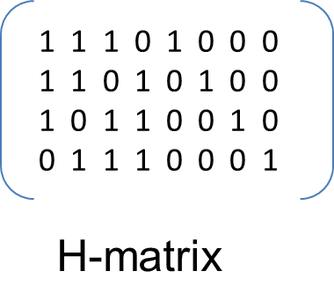
SECDED modules
H-matrix: contains relationship of parity-check and syndrome
Parity-check bits: code for error check
Syndrome bits: specify error (0, 1, 2-bit error)
1 1 1 0 1 0 0 0
1 1 0 1 0 1 0 0
1 0 1 1 0 0 1 0
0 1 1 1 0 0 0 1
Encoder
Noise corrupts Data
Decoder
data_in
code_word
data_out
H-matrix
Generate
parity-check bits
Calculate syndrome bits
to Detect / Correct
Notes:
I’ll explain about error protection using SECDED.
Although H-matrix in this research is actually (35,28)-size, (8,4)-size H-matrix is used for simple explanation on following slides. This figure contains 2 block diagrams, encoder and decoder module. When data is input into encoder module, parity-check bit is generated for error check and attached to the data. Error injection may happen on transfer way.
Code data is decoded in decoder module by calculating syndrome bit and then correct or detect error.

Slide 10

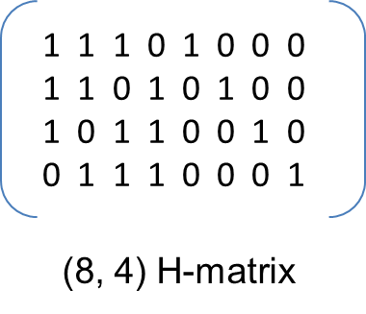




Encoding
Parity check bits
Data: 1 0 1 1
Code: 1 0 1 1 0 0 1 0
Notes:
Encoder module generates the parity check bits by using H-matrix. (*1), See the line that has 1’s in check bit (*3) and then XOR the data that has 1’s in H-matrix. (*2)After check bits are generated like this, (*2)code word is obtained by attaching code to data.

Slide 11





Decoding - no error case
Syndrome bits
Code: 1 0 1 1 0 0 1 0
No error occurred
Notes:
For decoding, we have to generate syndrome bits that monitor check bit and data bit. (*3)By examining this, XOR check bit and data bits, we could know error occurring. (*1)Syndrome is obtained by calculating check bit again and compare the pre-calculated result. (*3) When all syndrome bits are “0”, it means no-error.

Slide 12



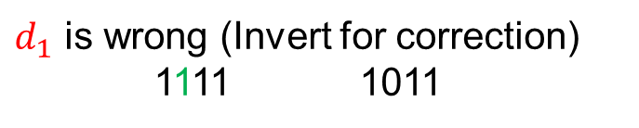
Decoding - single error case
Wrong Code: 1 1 1 1 0 0 1 0
Notes:
In one error case, (*1)syndrome bits contains 1’s in result. (*1)We can know which bit was corrupted by comparing the syndrome bits and column of H-matrix. (*1)When data has single error, (*1)column of syndrome bits and column of H-matrix is match. (*1)Error correcting is done by inverting the specified error bit in data.

Slide 13



Decoding - double error case
Wrong Code: 1 1 1 0 0 0 1 0
Mismatch: just detect
Notes:
(*)In double error case, (*3)syndrome bits doesn’t match the column of data bit. However, (*1)we can know error happened. Multiple even errors are also treated as double error.

Slide 14
Implementation
R
R
Implemented 2x2 and 3x3 OASIS router
Implemented ECC module and integrated into Router
[Simulation]
data transfer 100times with error-injection
Verified function of ECC modules
PE
NI
R
XOR
R
Error injection
Notes:
To investigate the router performance and reliability, PE and NI is not included. In this research, 2x2 and 3x3 network size OASIS NoC was implemented, SECDED encoder and decoder was implemented in router. Simulation was conducted by flitizing data manually in test-bench module. Retransmission and redundant pipeline techniques will be implemented in future work.

Slide 15
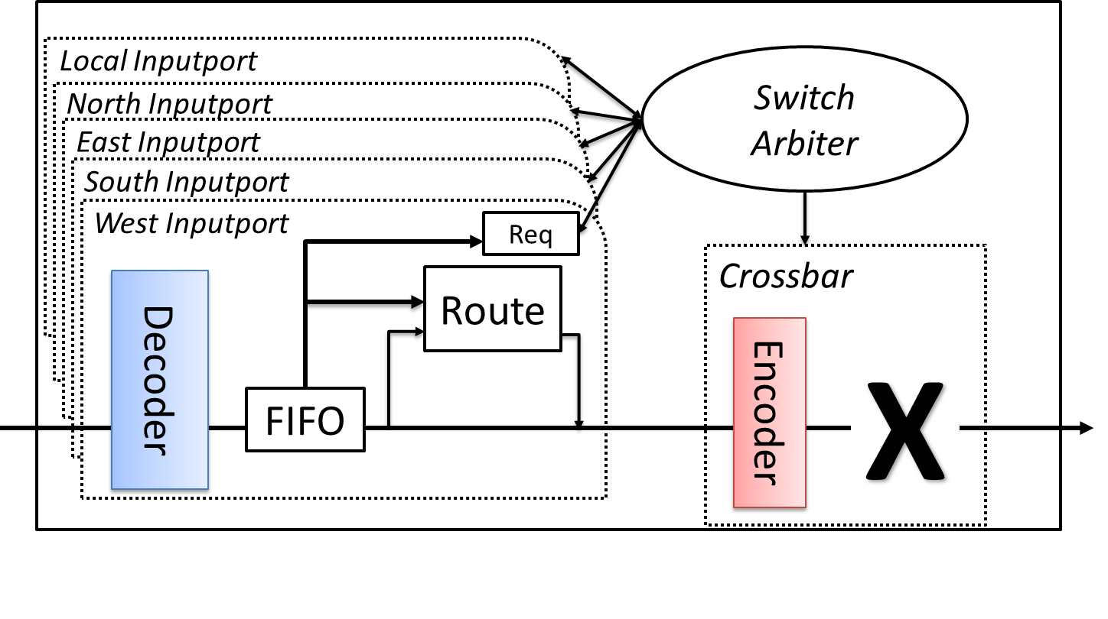
Implementation - Router
Flit format
Code
Payload
Destination
Next port
Tail
34
27
12
6
1
0
C
P
D
NP
T
C
P
D
NP
T
C
Notes:
This picture shows router architecture. Decoder and encoder was implemented in input port and crossbar module. (*1)Before storing data into FIFO buffer, (*1) data is decoded. After SA & NPC calculation, (*1)data goes to CT. Before forwarding to the next node, (*1) data is encoded. And then, (*2)output data.

Slide 16
Evaluation results (Hardware complexity)
Design tools
- Software Quartus II 13.0 sp1
- Device: Stratix IV: EP4SGX530NF45C3
 | 2x2 |  | 3x3
 | Original | SER | Original | SER
Area - ALUTs (usage /424,960) | 1,748 (1%) | 2,881 (1%) | 5,790 (1%) | 8,913 (2%)
- Registers (usage /424,960) | 2,060 (1%) | 2,074 (1%) | 5,702 (1%) | 5,709 (1%)
Notes:
This figure shows Hardware complexity of OASIS NoC, 2x2 and 3x3 network size respectively.
Area utilization of ALUTs and registers slightly increased.
As SECDED module was implemented as combinational logic, ALUTs increased a little and registers were nearly the same.
Fmax (MHz) –{Original, SER}
2x2 - 262.19, 210.66
3x3 - 217.91, 189.43

Slide 17
Hardware complexity
Operation Frequency: 160MHz
0.005%
0.009%
Notes:
Power consumption was calculated by Power Play Power Analyzer tool.
SER means Original OASIS + ECC module. In 2x2 network size, 0.005% increased. In 3x3 size, 0.008% increased. These overhead are also small.

Slide 18
Conclusion
Implemented SER-OASIS NoC
Organized 2x2 and 3x3 network size
Implemented ECC module and integrated
Evaluated hardware complexity
Achieved error protection mechanism with small power and area overhead
Recover from 1-bit error and detect 2-bit error
Small area and power overhead

Slide 19
Future work
Implement retransmission mechanism for double error detection case
Implement Auto-repeat-request(ARQ) module and modify flow control
Achieve soft-error-resilient-algorithm(SERA) that can resolve error in logical corruption
Additional pipeline for redundant calculation
Implement compare and rollback module
Notes:
To achieve higher error protection mechanism, there are 2 approaches as future work.

Slide 20
Thank you for your attention!
Notes:
Thank you for your attention!

