Slide 1

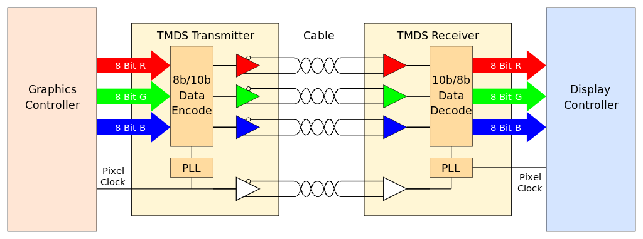
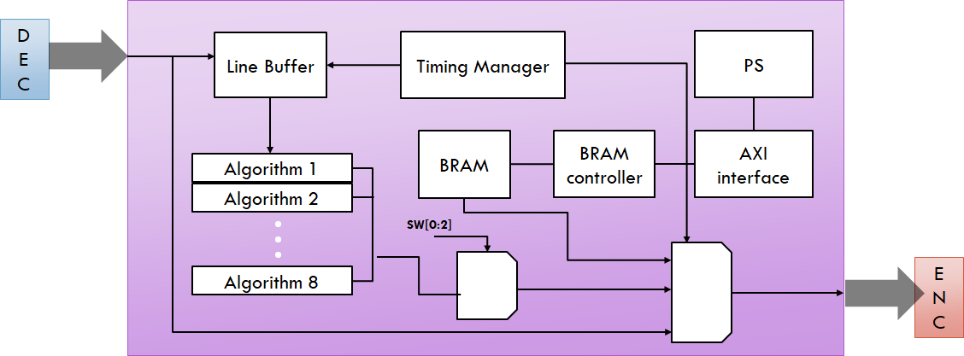
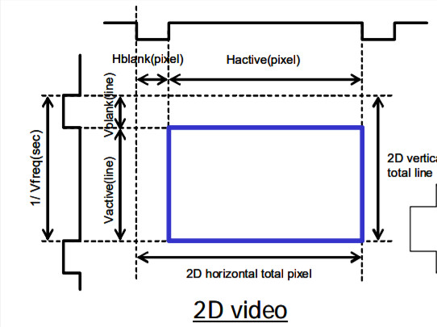
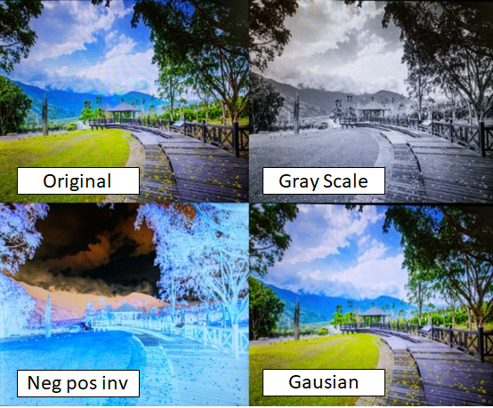
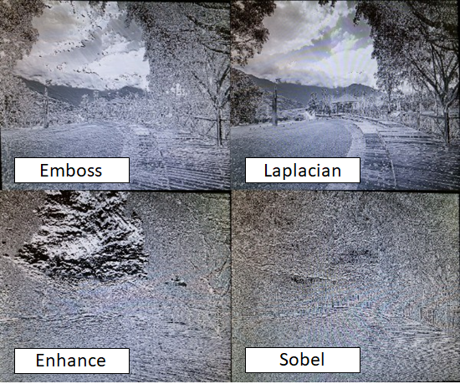
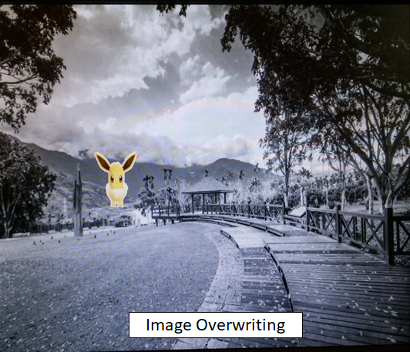
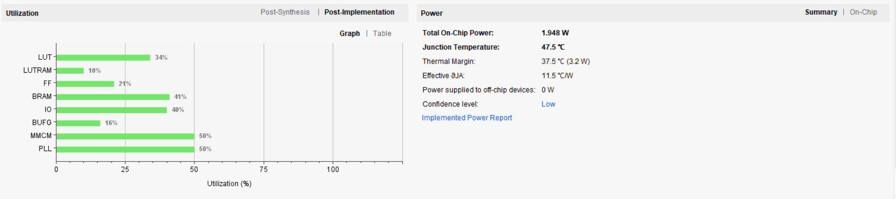
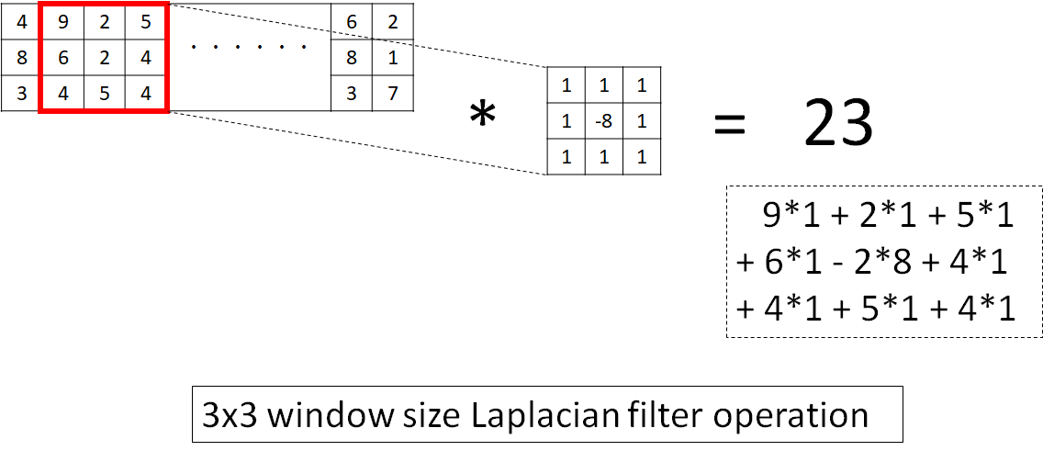
Real Time Image Process
Ryunosuke Murakami
murakar@rose-hulman.edu
Kuangyi Lu
luk@rose-hulman.edu
Rose- Hulman Institute of Technology
ECE530
Software and Hardware Co-Design with Zybo
Instructor: Jianjian Song
ECE Department
TMDS Video Format
Overview of System
Line Buffer
Store pixel data into memory cell
memory cell size 1280
4 lines of memory module is used
3 lines for img process algorithm
1 line for storing ongoind pixel
Each line buffer rotates when its memory cell is full stored.
Data output is controlled with video active signal
Hsync indicate line end
Vsync indicate frame end
PL Design
Image Process Algorithms
TMDS Timing Manager
TMDS image processing system was designed with verilog HDL with
4 line line Buffer
Image Processing algorithm
TMDS Timing Manager
Manage current position of output
count Horizontal address with pixel clock from TMDS
count Verical address with active of Horizontal Synchronization pulse
Current position will be reser with Vertical Synchronization pulse
Pixel wise and Window wise algorithms were implemented
3x3 filter (Convolution operation) was applied
Applied Algorithms
Gray Scale:
Color to balck and white
Neg Pos Inv:
Invert luminance
Gausian filter:
smoothing effect (σ=1.3)
Emboss filter:
emphasize emboss outline
Laplacian filter:
Edge detection
Sobel filter:
Edge detection + emboss
PS Function
Image overwrite function was implemented, which display image data stored in BRAM
Zynq PS write image data into BRAM via SDK
AXI 4 interface is used to connect Zynq PS and BRAM via BRAM controller module
BRAM
Image data is stored from SDK
can change contents without synthesizing
Connected with both PS and PL module
PS connection: via AXI interface
PL connection: Image Process

