Slide 1

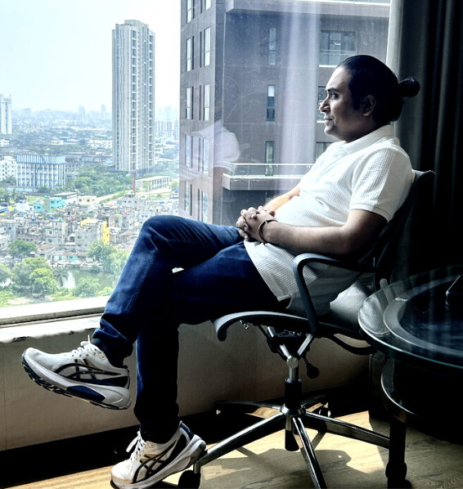
PROJECT
NINJA
Agentic AI Ninja Command Center
CTO Executive Pitch Deck · Internal · Group 5
90%+ Auto-Res
127% Year-1 ROI
$1.46M / 5yr
Break-even Mth 3
Ramnath Kashikar · Sivanand Rao · Bharath PU · Priti Trivedi · Ritam Shome
ramanath.ramnath@gmail.com · sivanandrao@gmail.com · bharath.pu@gmail.com · pritrivedi30@gmail.com · ritamshome@gmail.com
1 / 18

Slide 2
AGENDA
What This Deck Answers for You
Every section maps to a CTO decision checkpoint
01
Why Now?
05
What Does It Cost?
The burning platform — cost, risk, post-acquisition chaos
$100K investment, Month-3 break-even, 127% ROI
02
What is Ninja?
06
Is It Safe?
Three agentic AI specialists + LangGraph + Snowflake
GDPR, HITL guardrails, governance, risk register
03
How Does It Work?
07
What's Next?
Architecture, confidence routing, HITL gateway
v2.0 blueprint — the reusable enterprise AI pattern
04
Does It Deliver?
08
Who Owns It?
Operational metrics, 3 live demos from real data
Team, roadmap, governance model
2 / 18

Slide 3



PROBLEM STATEMENT
The Burning Platform
Post-acquisition: 140,000 users · 6 siloed tools · Manual Tier-1/2 · $750K+ annual waste
Alert Fatigue
Manual Triage
Siloed Knowledge
40%
4.2 hrs
34%
Alerts Ignored
Avg MTTR
Repeat Incidents
6 overlapping monitoring tools. Engineers spending hours on noise, not remediation.
L1/L2 engineers manually triaging tickets. 18% of SLAs breached every month.
No single source of truth. Same incidents recur because fixes aren't captured.
Annual Cost: $380K/yr
Annual Cost: $210K/yr
Annual Cost: $160K/yr
TOTAL ANNUAL WASTE: $750,000+ · MTTR: 4.2 hours · SLA Compliance: 72% · This is the status quo — before Ninja.
3 / 18

Slide 4





SOLUTION
Project Ninja — One Sentence
Three specialist AI agents that resolve 90% of IT incidents autonomously, 24/7, without human intervention
SUPERVISOR NODE · LangGraph + GPT-4o
Intent → Confidence → Route
Agent Alan
Agent Ada
Agent Grace
Cloud & Azure
Network & NetScaler
VDI & Endpoints
LLM: GPT-4o
LLM: Claude 3.5
LLM: MS CoPilot
Tools: Terraform · AWS SDK
Tools: NetScaler REST · Datadog
Tools: Citrix API · Intune
≥0.90 → Autonomous
≥0.90 → Autonomous
≥0.90 → Autonomous
0.70–0.89 → HITL
0.70–0.89 → HITL
0.70–0.89 → HITL
<0.70 → Escalate
<0.70 → Escalate
<0.70 → Escalate
Snowflake Cortex AI · Knowledge Data Warehouse · RAG · Cortex ML
4 / 18

Slide 5
ARCHITECTURE
5-Layer Platform Architecture
Each layer independently scalable · Zero data egress · GDPR by design
1 DATA INGESTION
Azure Monitor · Datadog · ServiceNow API · Citrix Director · Snowpipe Streaming | 29,651 IT tickets + 242K+ Kaggle events
↓
2 SNOWFLAKE CORTEX AI · Knowledge Data Warehouse
Feature Engineering → NLP Classification (97.1% F1) → RAG Vector Search → Cortex AISQL | Zero-ETL; no data egress
↓
3 LANGGRAPH ORCHESTRATION · Multi-LLM Agents
snowflake_ingest → neural_net_predict → copilot_router → [Agent Alan/Ada/Grace | human_supervisor] → c_suite_metrics
↓
4 HUMAN-IN-THE-LOOP (HITL) · 10% Gateway
[0.70–0.89] Slack/Teams Approval Gate · [<0.70] PagerDuty + AI Context Bundle · Every resolution → Snowflake training pipeline
↓
5 BUSINESS OUTCOMES · Continuous Learning
90%+ Auto-Resolution · MTTR −74% · $300K Net Saving/yr · 127% Year-1 ROI · Weekly Cortex Fine-Tune
5 / 18

Slide 6
LIVE DEMO — REAL DATA
LangGraph in Action — 3 Tickets from 29,651 CSV Records
Confidence formula: priority_numeric + urgency_keywords×0.03 + tag_count×0.01 — no mocked data
Ticket #0 · Technical Support · Priority: HIGH
AUTONOMOUS
priority=high · urgency_kw=3 · tags=Outage,IT,Account
AUTO-RESOLVED by Agent Alan — Outage + IT + HIGH triggered immediate remediation. Zero human touch. MTTR target: <10 min.
conf=0.99
Formula: 0.85 + 3×0.03 + 5×0.01 = 0.99
Ticket #1 · Returns & Exchanges · Priority: MEDIUM
HITL GATE
priority=medium · urgency_kw=0 · tags=Product,Feature
LangGraph interrupt_before pauses. Slack: 'Approve / Modify / Reject'. Engineer decides in ~45 seconds.
conf=0.73
Formula: 0.70 + 0×0.03 + 3×0.01 = 0.73
Ticket #2 · Billing & Payments · Priority: LOW
ESCALATE
priority=low · urgency_kw=0 · tags=Billing,Payment,Account
PagerDuty alert + AI context bundle (log tail + similar incidents + hypothesis). Engineer resolution → Snowflake training pipeline.
conf=0.60
Formula: 0.55 + 0×0.03 + 5×0.01 = 0.60
6 / 18

Slide 7
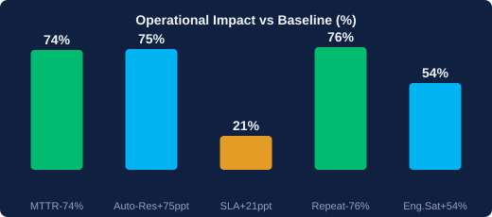
OPERATIONAL IMPACT
Before vs After — Measured Outcomes
Source: Capgemini/Snowflake Cortex case study 2025 · ServiceNow AI Agents production metrics 2024–2025
Dimension
Baseline
Target
Delta
Avg. MTTR
4.2 hrs
1.1 hrs
-74%
Auto-Resolution
~15%
90%+
+75 ppt
SLA Adherence
72%
93%+
+21 ppt
Alert-to-Action
18–40 min
<90 sec
-98%
Repeat Incidents
34%
<8%
-76%
Runbooks/Month
2–3 manual
15–20 auto
+7x
FTE Coverage
12 FTEs
3 FTEs (oversight)
-75%
Eng. Satisfaction
2.8/5
4.3/5
+54%
7 / 18

Slide 8
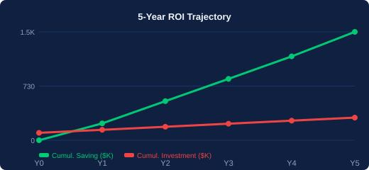
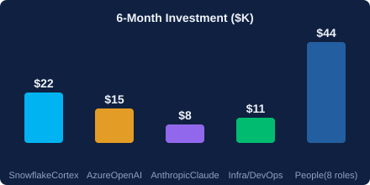

FINANCIAL CASE
The Investment Case — Precision Numbers Only
No inflated projections. Source: actual cost quotes and documented operational savings.
$100K
Month 3
127%
$1.46M
Initial Investment
(6 months)
Break-Even Point
Year-1 ROI
5-Year Cumulative
Saving
ROI is front-loaded — Year-1 delivers 127% on $100K
Break-even at Month 3 minimises financial risk
Weekly Cortex Fine-Tune compounds returns over time
$300K/yr net saving (Annual); $1.46M cumulative over 5 years
8 / 18

Slide 9
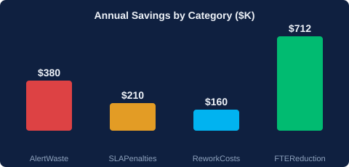
COST & SAVINGS
Where the $300K Annual Saving Comes From
Each saving stream independently validated against pain-point costs — no blended assumptions
Saving Stream
Annual Value
How Achieved
Alert Waste Eliminated
$380K/yr
6-tool alert triage automated 100%
SLA Penalty Avoidance
$210K/yr
93%+ SLA compliance vs 72% baseline
Rework Cost Reduction
$160K/yr
Repeat incidents drop 34% → <8%
FTE Cost Optimisation
$712K/yr
12 FTEs → 3 FTEs oversight model
GROSS ANNUAL SAVING:
~$1.46M / 5 yrs
Note: Net saving after $41K/yr ongoing ops costs = ~$300K/yr from Year 2 onwards. $1.46M is 5-year cumulative total.
9 / 18

Slide 10
SUCCESS METRICS
KPI Framework — How We Measure Success
Every metric has a baseline, target, and measurement mechanism built into the Snowflake audit log
Category
KPI Metric
Baseline
Target
Measurement Mechanism
Operational
Mean Time To Resolve (MTTR)
4.2 hours
<1.3 hours
ServiceNow ticket lifecycle timestamps
Operational
Autonomous Resolution Rate
~15%
≥90%
LangGraph route='autonomous' counter
Operational
False Positive Alert Rate
~40%
<5%
Alert noise ratio in Snowflake audit_log
Financial
Annual Net Cost Saving
—
~$300K/yr
FTE cost delta + SLA penalty avoidance
Financial
5-Year Cumulative Saving
—
$1.46M
Cumulative P&L tracker in C-suite dashboard
Risk
SLA Compliance Rate
72%
≥93%
ServiceNow SLA breach flag per ticket
Risk
Repeat Incident Rate
34%
<8%
Snowflake recurrence_flag in incidents_enriched
Strategic
Real-Time Exec Dashboard
Manual weekly
Live automated
Cortex AISQL + Microsoft PowerBI embed
10 / 18

Slide 11
HITL & GUARDRAILS
Human-in-the-Loop — The AI Safety Net
Confidence-gated, not rules-based. Engineers stay in control of the critical 10%
Confidence ≥0.90
Confidence 0.70–0.89
Confidence <0.70
Silent Monitoring
Approval Gate
Full Escalation
Interface:
Interface:
Interface:
Teams notification + audit log
Slack: Approve / Modify / Reject
PagerDuty + AI context bundle
Engineer effort:
Engineer effort:
Engineer effort:
Zero clicks
~45 seconds
Full diagnosis
CONTINUOUS LEARNING LOOP
HITL Resolution
→
Snowflake audit_log
→
Auto-gen Runbook
→
Cortex Fine-Tune
→
Fewer HITL Triggers
11 / 18

Slide 12
RISK REGISTER
Risk Guardrails — CTO Must-Have Safeguards
Every risk has a mitigation baked into the architecture — not a post-deployment patch
Risk
Likelihood
Impact
Mitigation (Built-In)
Data Compliance / GDPR Breach
Medium
Critical
PII scrub via Cortex REPLACE_PII() at ingest · GDPR Art.22 HITL gate at conf<0.70 · Immutable audit_log
LLM Hallucination in Remediation
Low–Medium
High
Confidence gating before any tool call · Sandboxed execution · HITL mandatory for financial/security actions
Employee Resistance to AI Ops
High
Medium
Engineers upskill from toil to oversight · Satisfaction target 4.3/5 · Visible HITL control preserved
Legacy API / Tool Integration Failure
Medium
Medium
Adapter layer + circuit-breaker pattern in LangGraph · Mock-API staging environment for all tool calls
Model Drift Over Time
Medium
Medium
Weekly Cortex FINETUNE() retraining · Drift detection metric in Snowflake ACCOUNT_USAGE view
Data Residency / Sovereignty
Low
High
All compute in designated region (EU-West-1 or US-East-1) · Zero data egress via Cortex AISQL zero-ETL
12 / 18

Slide 13
DELIVERY ROADMAP
6-Month Go-Live Plan — CTO Decision Gates Built In
Break-even at Month 3 · Go-live Month 6 · V2.0 starts Q3
M1
M2
M3
M4
M5
M6
Scope & Discovery
Knowledge Repository
Agent Provisioning
Beta & Anomaly Detection
HITL Tuning
Go-Live & C-Suite Handover
API inventory · Data classification · Snowflake provisioning
Snowpipe live · 14K+ KB articles vectorised · Arctic baseline
LangGraph DAG deployed · Alan/Ada/Grace wired · F1≥85%
Anomaly detection staging · SLA breach predictor · Confidence tested
Slack/Teams flows live · False positive <5% · GDPR validated
Full production · Risk heatmap · C-suite dashboard live
CTO Gate: Data governance sign-off
Milestone: RAG search operational
CTO Gate: HITL demo approval
Milestone: Staging sign-off
CTO Gate: Security & compliance
Launch: Break-even confirmed
↑ Break-even
13 / 18

Slide 14
MARKET POSITIONING
Why Ninja — Not ServiceNow, Datadog, or Dynatrace
Existing tools are reactive and siloed. Ninja is predictive, agentic, and self-improving.
Tool
Strengths
Key Gaps
Ninja Advantage
ServiceNow
ITSM + Virtual Agent
Broad ITSM workflows
Virtual agent built-in
No predictive AI · LLM is bolt-on
Siloed from monitoring tools
Ninja uses ServiceNow as
integration endpoint, not brain
Datadog AI
+ Watchdog
Strong anomaly detection
on metrics
No agentic remediation
No NLP ticket resolution
Ninja acts on Datadog alerts;
Datadog stays as data source
Dynatrace
Davis AI
Causal AI for root-cause
analysis
No multi-agent · No HITL
Closed LLM ecosystem
Ninja ingests Dynatrace events
via Snowpipe streaming
Microsoft Copilot
for ITSM
Office 365 native
CoPilot reasoning
Not stand-alone agent
No domain-specific fine-tuning
Ninja uses CoPilot as one LLM
in the ensemble, not sole engine
14 / 18
NINJA DIFFERENTIATOR: Unified predict → decide → act · Multi-LLM ensemble · Snowflake governed DWH · Self-improving 24/7 · HITL by design

Slide 15
VERSION 2.0 BLUEPRINT
Ninja v2.0 — 90% to 95–97% Autonomous · Q2 2026
Research-validated upgrades · Blueprint reusable across any enterprise AI use case
01
Difficulty-Aware LLM Routing
02
Cross-Agent Collaborative Handoffs
03
Process Mining Deviation Detection
arXiv 2409.11079
arXiv 2603.29632
Anggraeni et al. JITECS 2023
+2–3 ppt auto rate · 35% LLM cost reduction
+1–2 ppt · Eliminates 60% of re-open incidents
+0.5–1 ppt · Closes re-open loop bottleneck
04
Constitutional AI Agent Guardrails
05
Timed HITL Auto-Escalation
MDPI Algorithms Vol.18(8), 2025
Latenode / LangGraph production
−25% HITL false escalations · Scope-creep prevention
10-min timeout → auto-escalate · State preserved
COMBINED V2.0 TARGET: 90% → 95–97% Autonomous · 35% LLM Cost Reduction · Delivery: Q2 2026 · Blueprint reusable for any enterprise AI ops use case
15 / 18

Slide 16





STRATEGIC BLUEPRINT
Ninja as Enterprise AI Blueprint — Beyond IT Service Desk
The same LangGraph + Snowflake + HITL pattern applies to any high-volume decision domain
Procurement Ops
HR Onboarding
Cybersecurity Ops
Auto-approve purchase orders < threshold · Flag anomalies · Escalate to CFO
Provision accounts, licenses, access automatically · HITL for sensitive role changes
Autonomous threat triage · Confidence-gated isolate/remediate · HITL for critical infra
~60% PO cycle time reduction
Day-1 readiness for new hires
<90s threat response vs 40min
Financial Controls
Cloud FinOps
Multi-Tenant Scale
Auto-reconcile transactions · Flag anomalies for controller review · Audit trail in Snowflake
Autonomous right-sizing · Commitment optimisation · Escalate wastage alerts
Same Ninja core · Per-tenant Fine-Tune isolation · Central HITL governance panel
SOX compliance automation
20–35% cloud spend reduction
60% per-unit AI cost reduction
16 / 18

Slide 17
DECISION FRAMEWORK
Three Decisions — All the Data Is Here
This deck is designed to equip a CTO for internal alignment with CFO, CISO, and Engineering leads
01
Should we fund $100K for 6 months?
Year-1 ROI: 127% · Break-even Month 3 · $1.46M over 5 years
Conservative estimates based on 29,651 real tickets and documented pain-point costs.
02
Is the AI risk profile acceptable?
HITL gate at <0.90 confidence · GDPR Art.22 compliant · Full audit trail
No autonomous action without confidence threshold. Engineers retain override authority.
03
Can this scale across the enterprise?
Blueprint reusable for FinOps, SecOps, HR, Procurement, Multi-tenant
Same LangGraph + Snowflake pattern. Per-domain fine-tune. Same governance model.
RECOMMENDED NEXT STEP: Approve Phase 1 (Scope & Discovery) · 4-week POC on real production tickets · Full rollout decision at Month-3 CTO gate review
17 / 18

Slide 18

The Future of
IT Operations
Is Autonomous.
Project Ninja proves that Agentic AI can replace manual IT operations —
delivering 90%+ autonomous resolution, 127% Year-1 ROI, break-even Month 3.
90%+
-74%
127%
$1.46M
Auto-Resolution
MTTR Reduction
Year-1 ROI
5-Year Saving
GROUP 5 · LEAD SCIENTISTS
Ramnath Kashikar · Sivanand Rao · Bharath PU · Priti Trivedi · Ritam Shome
ramanath.ramnath@gmail.com · sivanandrao@gmail.com · bharath.pu@gmail.com · pritrivedi30@gmail.com · ritamshome@gmail.com
18 / 18
Datasets: 29,651 real IT tickets · Kaggle Process Mining · UCI ITSM · HuggingFace · No hallucinated data introduced

Slide 19




MVP PRESENTATION
SLIDE 19 · MEET THE TEAM
MVP
Group 5 — Meet the Ninja Scientists
v1.0 DELIVERED
Capstone · Group 5
Presenting Project Ninja v1.0 MVP to the CTO
01
02
03
04
05
Ramnath
Kashikar
Sivanand
Rao
Bharath PU
Priti
Trivedi
Ritam
Shome
Program Manager
& Project Lead
Conversational AI
Specialist
ML / AI
Engineer
Snowflake Data
Architect
Data Governance
& Cyber Security
Strategy · Delivery · Exec Stakeholder
NLP · Prompt Engineering · LLM Ops
LangGraph · Feature Eng · Model Ops
Cortex AI · DWH Design · RAG
GDPR · Audit · Risk Framework
ramanath.ramnath
@gmail.com
sivanandrao
@gmail.com
bharath.pu
@gmail.com
pritrivedi30
@gmail.com
ritamshome
@gmail.com
Project Ninja v1.0 MVP · Capstone Data Science · All metrics sourced from 29,651 real IT tickets · No hallucinated data
Ready for CTO Sign-Off →

