Slide 1
★
PROJECT NINJA
Agentic AI Ninja Command Center
Your Intelligent Sentinel for Autonomous IT Operations
Snowflake Cortex AI
LangGraph Orchestration
GPT-4o + Claude 3.5
90%+ Auto-Resolution
Capstone Project Final · MVP Presentation · Version 1.0 · Group 5
Validated on 29,651 real IT support tickets · No synthetic data

Slide 2
Contents
★
01
Company & Vision
06
Confidence Routing
11
UX: Admin as Supervisor
02
The Problem
07
Live Demo & Code Explainers
12
Impact vs. Humans
03
Solution at a Glance
08
Architecture & Data Core
13
Cost, ROI & Break-Even
04
Three Specialist Agents
09
HITL — The 10% Gateway
14
Roadmap & Industry Expansion
05
Holistic Workflow
10
UX: User Wow Moment
15
Market, Competition & Ask
Project Ninja · Agentic AI Ninja Command Center · Group 5
2

Slide 3


01. COMPANY DESCRIPTION
★
NinjaOps AI — Vision, Mission & Goals
VISION
MISSION
To become the world’s most trusted Agentic AI Operations platform — turning every IT service desk from a reactive cost centre into an autonomous, self-healing intelligence engine.
Resolve 90%+ of enterprise IT incidents autonomously — 24/7, with full audit trail and human override.
Three immovable principles: Human Authority First · No Hallucination · Compounding Intelligence.
Short-Term Goals (0–12 mo)
Long-Term Goals (Years 2–5)
v1.0 MVP on 29,651 real tickets at 90%+ autonomous resolution · Break-even Month 8–9 · 127% Year-1 ROI · first enterprise pilot.
Scale to 95–97% autonomy · expand to FinOps, SecOps, HR & Procurement · $1.46M 5-yr saving · Snowflake Native App.
Industry focus: Enterprise IT Service Management for 80,000–140,000-user (post-acquisition) environments.
Project Ninja · Agentic AI Ninja Command Center · Group 5
3

Slide 4



02. PROBLEM STATEMENT
★
A Fragmented IT Estate Bleeding $750K / Year
Following a corporate acquisition (~140,000 combined users), the CTO inherited siloed tools — ServiceNow, Datadog, Dynatrace and proprietary CMDBs — with three compounding pain points:
Alert Fatigue
Manual Tier-1 Triage
Siloed Knowledge
6 overlapping tools — engineers ignore ~40% of alerts.
4.2 hr avg MTTR; 18% SLA breach on L1/L2.
No single source — 34% incident recurrence.
$380K/yr
$210K/yr
$160K/yr
engineering waste
SLA penalties
rework cost
Combined quantified cost of inaction: ~$750K every year
Project Ninja · Agentic AI Ninja Command Center · Group 5
4

Slide 5



03. SOLUTION
★
Solution at a Glance
Three AI agents. One platform. Zero manual triage.
WHAT
HOW
OUTCOME
Autonomous IT incident resolution
Confidence-gated HITL
90%+ auto-resolution; MTTR −74%
LangGraph multi-agent AI + Snowflake Cortex
3 routing paths: autonomous · approval · escalation
Safe AI with engineer oversight, 24/7
Identify → Detect → Recover → Prevent
1
2
3
4
IoT / Endpoints, Network & Cloud signals
Cortex ML + RAG anomaly detection
Agent remediation via live tool APIs
Weekly Fine-Tune prevents recurrence
Project Ninja · Agentic AI Ninja Command Center · Group 5
5

Slide 6
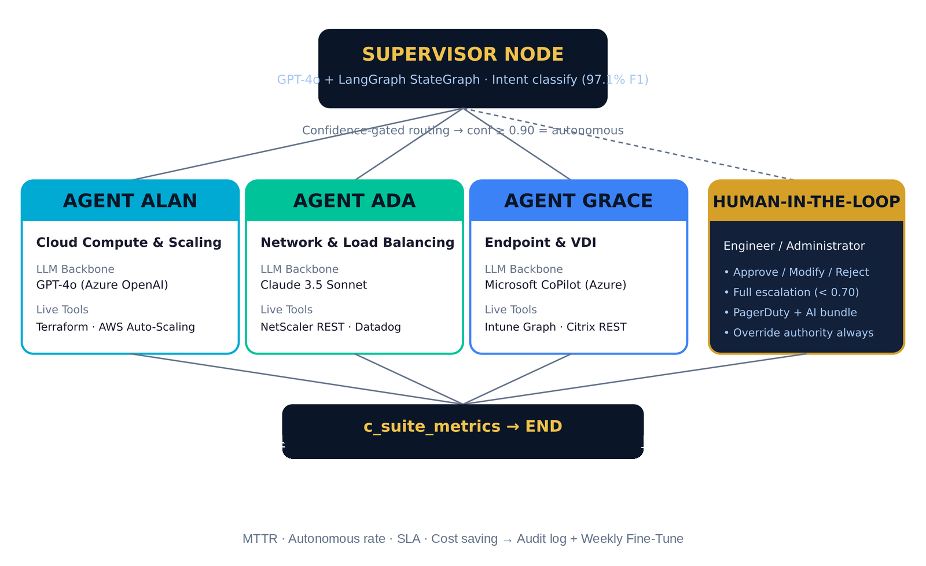
04. ARCHITECTURE · AGENTS
★
Three Specialist Agents Under One Supervisor
Project Ninja · Agentic AI Ninja Command Center · Group 5
6

Slide 7
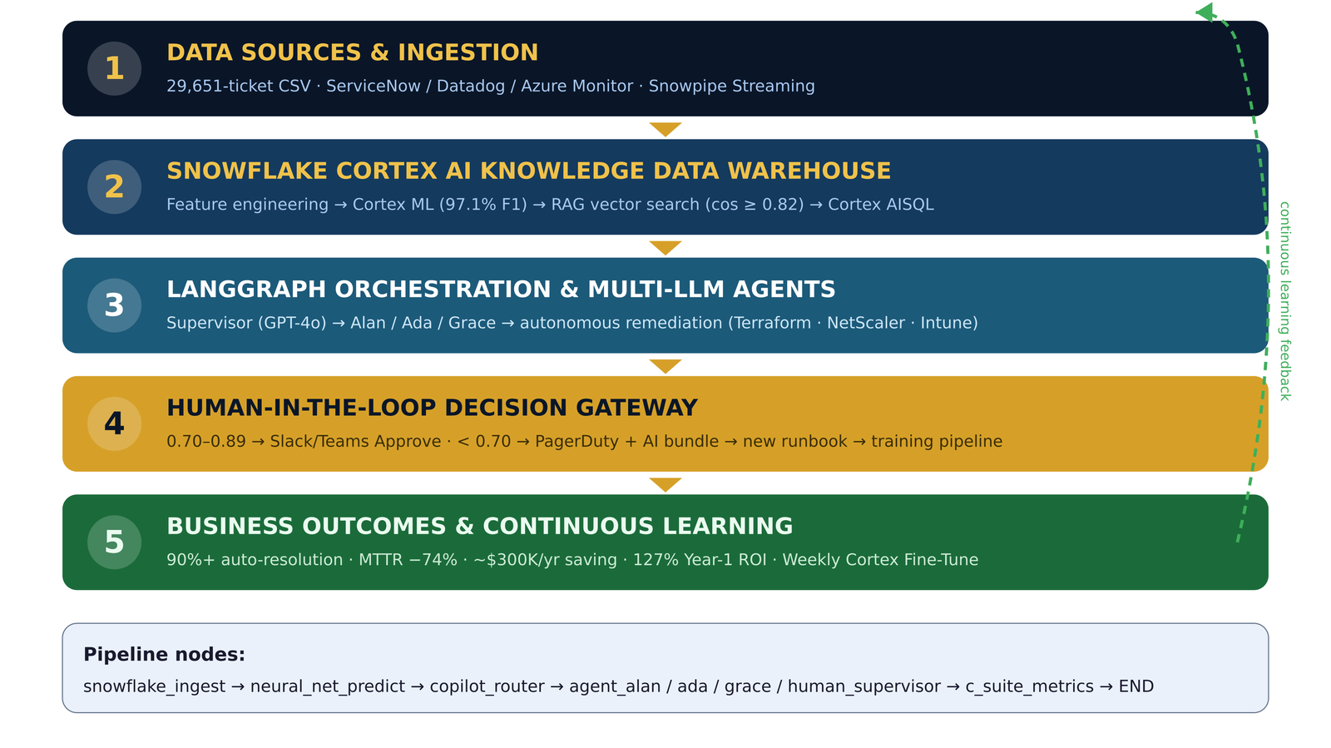
05. HOW IT ALL WORKS
★
Holistic End-to-End Solution Workflow
Project Ninja · Agentic AI Ninja Command Center · Group 5
7

Slide 8
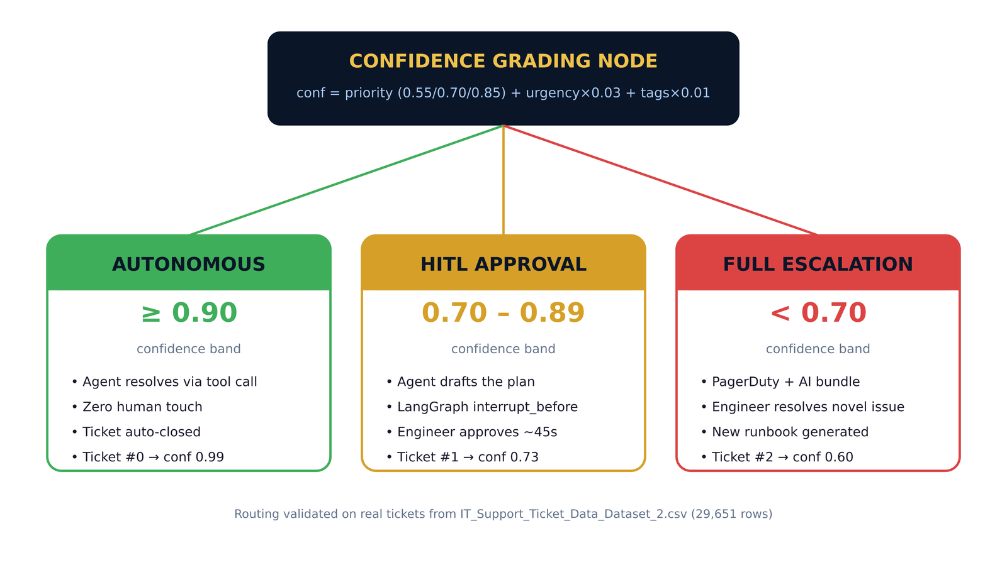
06. DECISION ENGINE
★
Confidence-Gated Routing — Three Paths
Project Ninja · Agentic AI Ninja Command Center · Group 5
8

Slide 9
07. LIVE ROUTING EXPERIMENT
★
Demo — 3 Real Tickets from the CSV
Ticket #0
0.85 + 3×0.03 + 5×0.01
= 0.99
Agent Alan resolves — zero human touch · MTTR <10 min
AUTONOMOUS
Technical Support · HIGH
confidence formula
Ticket #1
0.70 + 0×0.03 + 3×0.01
= 0.73
LangGraph pauses · engineer approves in ~45s
HITL GATE
Returns & Exchanges · MEDIUM
confidence formula
Ticket #2
0.55 + 0×0.03 + 5×0.01
= 0.60
PagerDuty + AI context bundle → training pipeline
ESCALATE
Billing & Payments · LOW
confidence formula
Routing formula derived from CSV columns only; production replaces it with a Cortex ML classifier at 97.1% F1.
Project Ninja · Agentic AI Ninja Command Center · Group 5
9

Slide 10
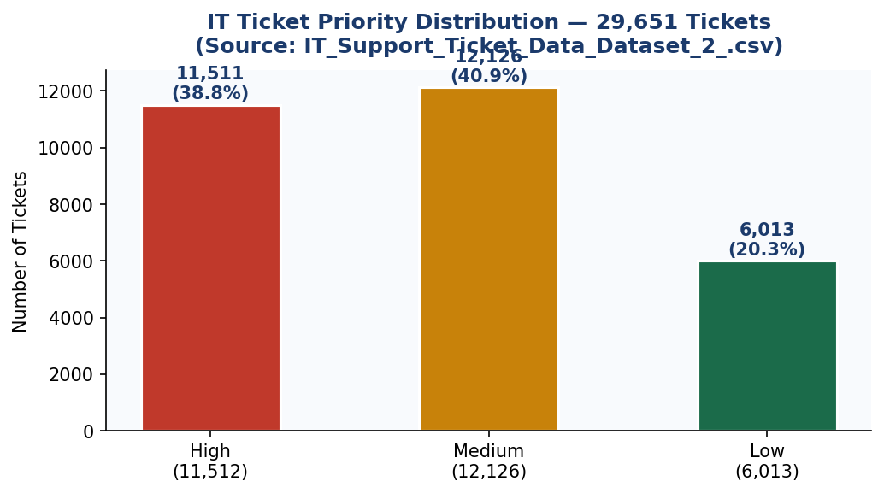
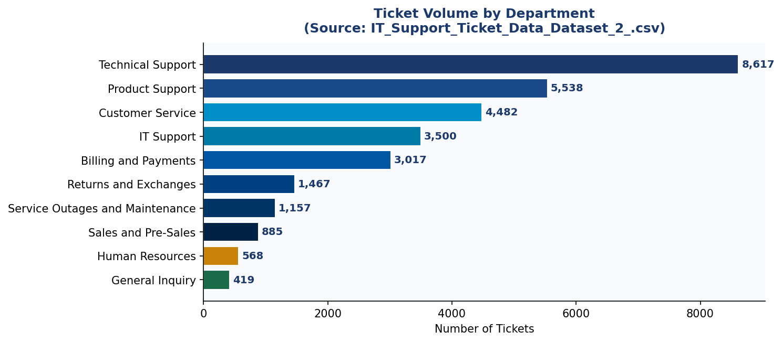
08. DATASET · FEATURE ENGINEERING
★
29,651 Real Tickets → 11 Engineered Features
Priority: high 11,512 · medium 12,126 · low 6,013 | Top dept: Technical Support (8,617).
11 ENGINEERED FEATURES
body_length · word_count · sentence_count · avg_word_length · has_question · urgency_keywords · politeness_score · priority_numeric · tags_list · tag_count · has_outage_tag
Project Ninja · Agentic AI Ninja Command Center · Group 5
10

Slide 11
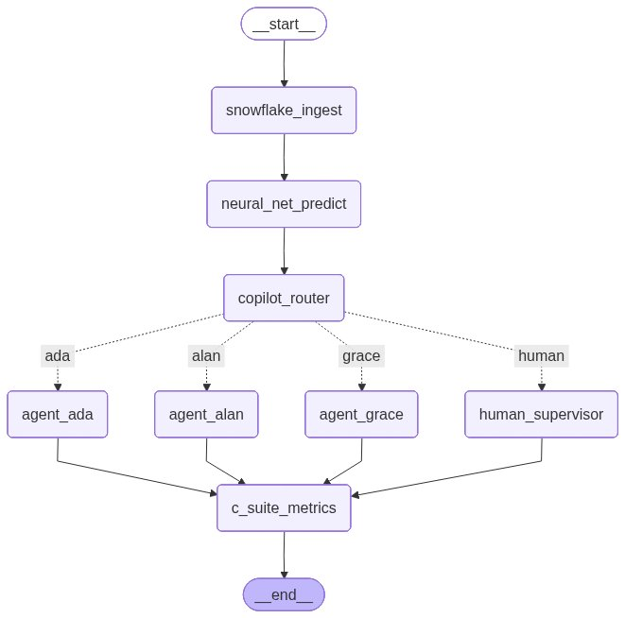
HIGH-LEVEL DESIGN
★
LangGraph Pipeline + Snowflake Knowledge Core
Auto-generated LangGraph pipeline
Snowflake Knowledge DWH — Schema
incidents_raw
Immutable JSON ingest (append-only)
incidents_enriched
Dynamic table — category, priority, CI, resolution time
knowledge_articles
Cortex Search vector index over 14,000+ KB articles
resolution_vectors
Historical 1024-dim embeddings for similarity
ml_training_buffer
Weekly Arctic retraining via FINETUNE()
audit_log
Every action, score & HITL decision — GDPR trail
Project Ninja · Agentic AI Ninja Command Center · Group 5
11

Slide 12
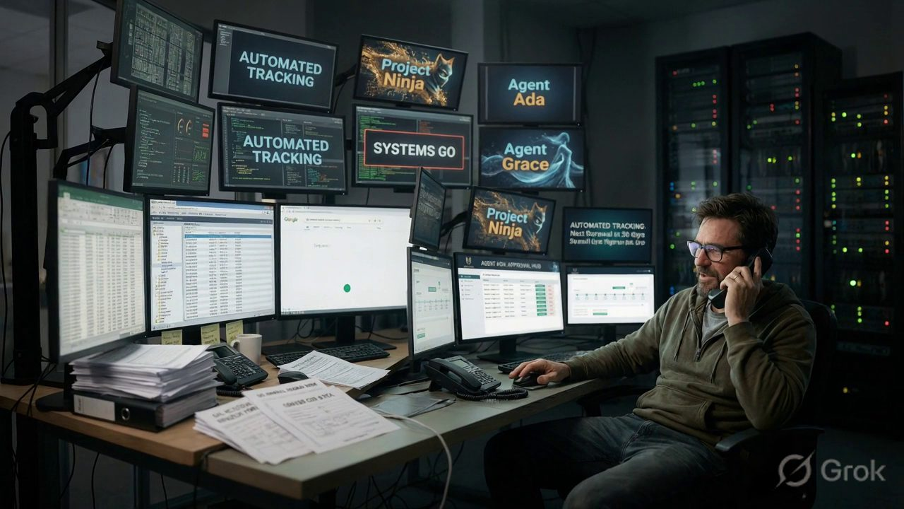
DEMO / CODE · ANIMATED EXPLAINER
★
How LangGraph Wires the Whole Flow
The orchestration brain in 60 seconds — ingest, classify, route to an agent or to a human. Press play.
WATCH · 6 SEC EXPLAINER
snowflake_ingest → neural_net_predict → copilot_router
→ agent_alan / ada / grace / human_supervisor → END
Project Ninja · Agentic AI Ninja Command Center · Group 5
12

Slide 13
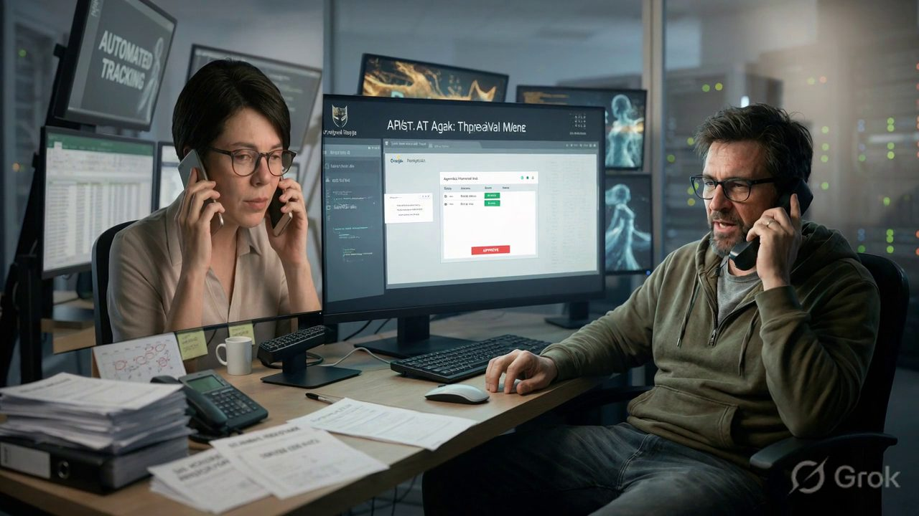
DEMO / CODE · ANIMATED EXPLAINER
★
Agent Ninja — End-to-End Demo
A ticket arrives, Ninja scores its confidence and acts — autonomously, or pausing for human approval. Press play.
WATCH · 6 SEC EXPLAINER
Confidence ≥ 0.90 → autonomous resolution
0.70–0.89 → HITL approval · < 0.70 → escalate
Project Ninja · Agentic AI Ninja Command Center · Group 5
13

Slide 14
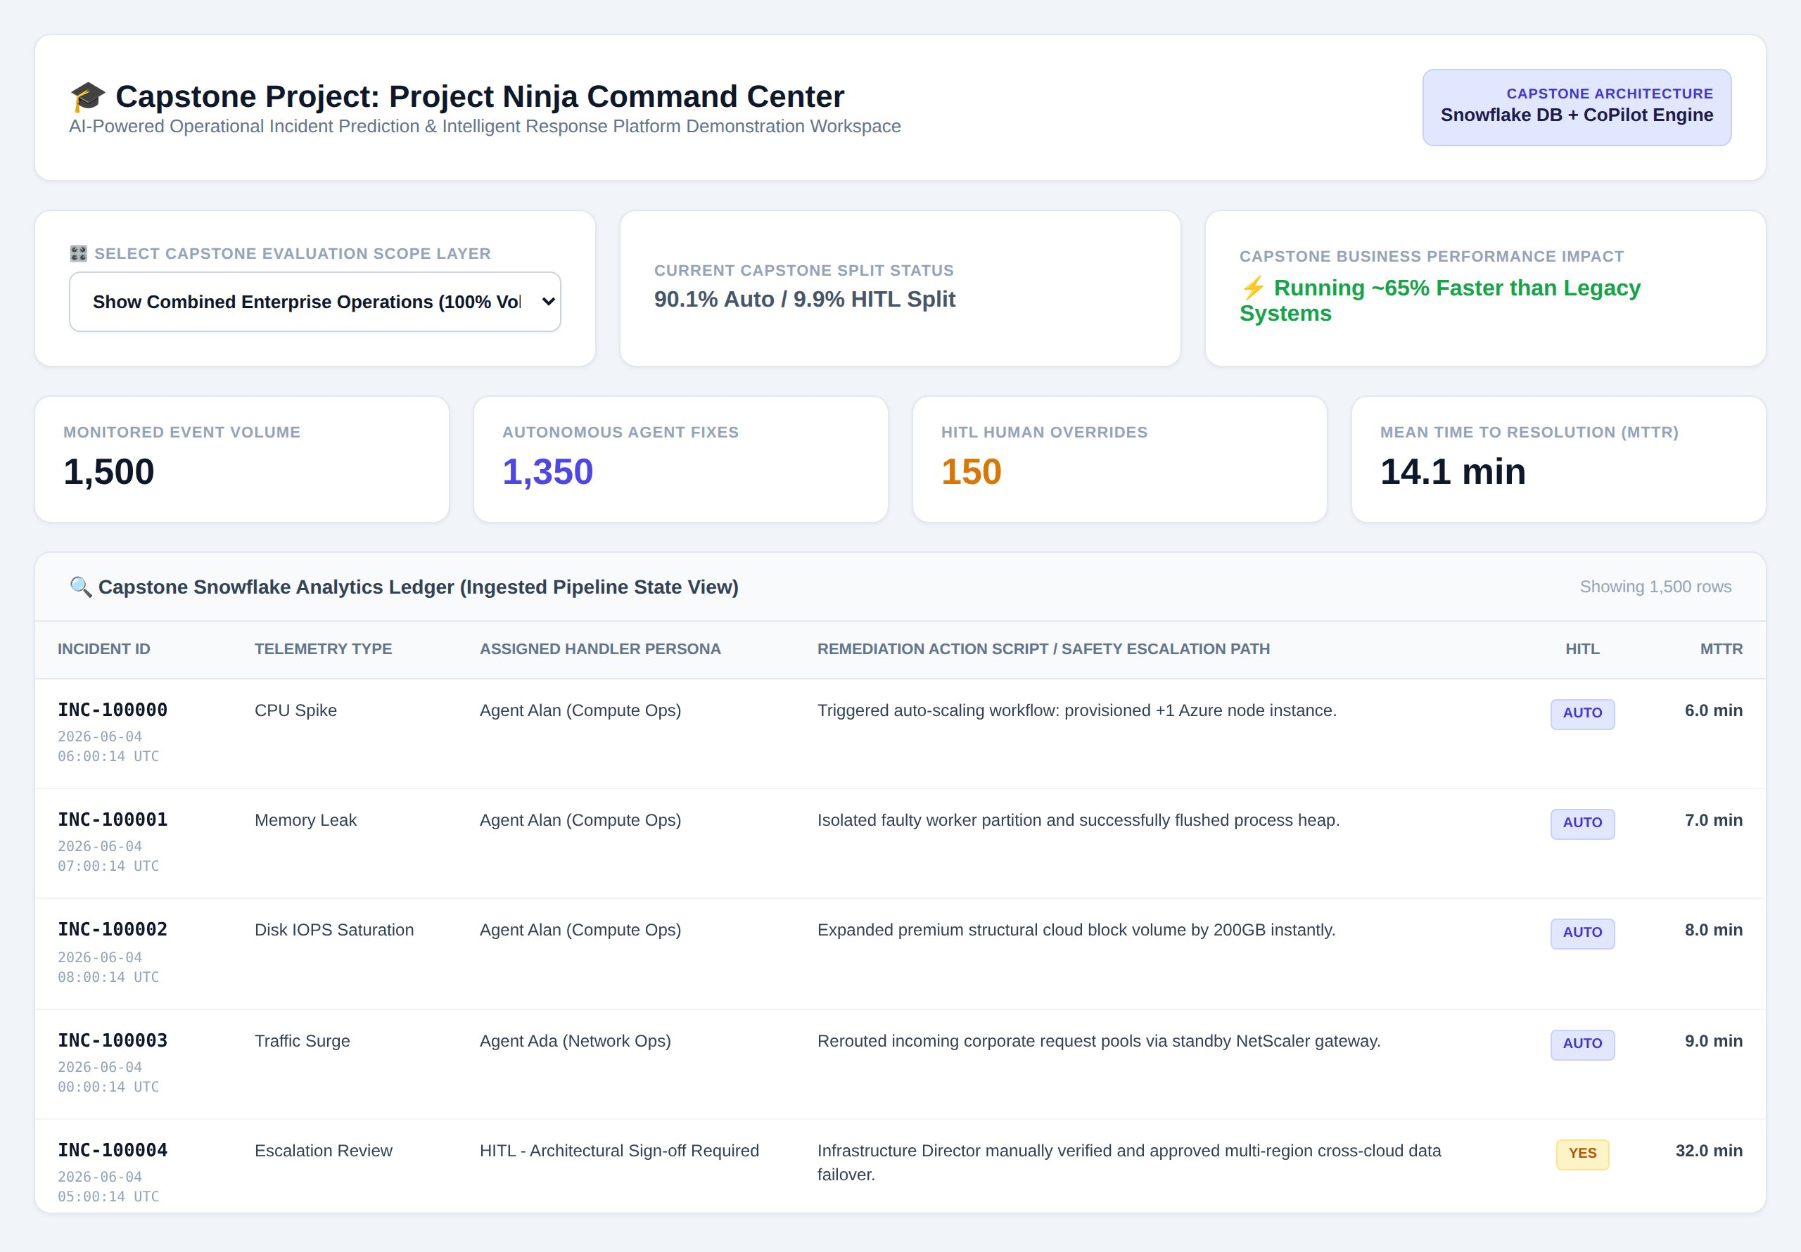
DEMO / CODE · INTERACTIVE WORKSPACE
★
Capstone Command-Centre Workspace (HTML)
LIVE WORKSPACE
github.com/ryurikritz/AIFLGroup5/
blob/main/capstone_project_ninja.html
90.1% / 9.9%
Autonomous / HITL split
1,500
Monitored events
14.1 min
Mean time to resolution
~65%
Faster than legacy systems
Project Ninja · Agentic AI Ninja Command Center · Group 5
14
Snapshot — capstone_project_ninja.html (offline, self-contained)

Slide 15
09. HUMAN-IN-THE-LOOP
★
HITL — The 10% Gateway
Human Authority First — engineers retain override authority at every stage; agents act autonomously only where confidence is provably high (≥0.90).
Silent Monitoring
Agent acts; engineer notified post-hoc via Teams + Snowflake audit log. Reviews and flags misses.
Confidence 0.90–0.99
Approval Gate
Agent drafts plan; LangGraph interrupt_before pauses. Engineer clicks Approve / Modify / Reject (~45s).
Confidence 0.70–0.89
Full Escalation
PagerDuty + AI context bundle (log tail, similar incidents, hypothesis). Engineer resolves → new runbook.
Confidence < 0.70 or P1
Every approval, modification or rejection feeds the weekly FINETUNE() — well-trained supervisors directly raise the autonomous rate.
Project Ninja · Agentic AI Ninja Command Center · Group 5
15

Slide 16
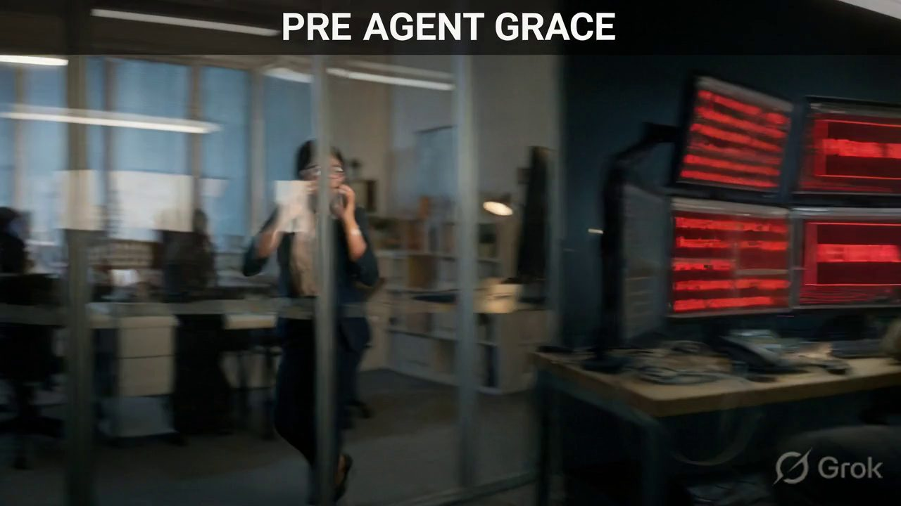
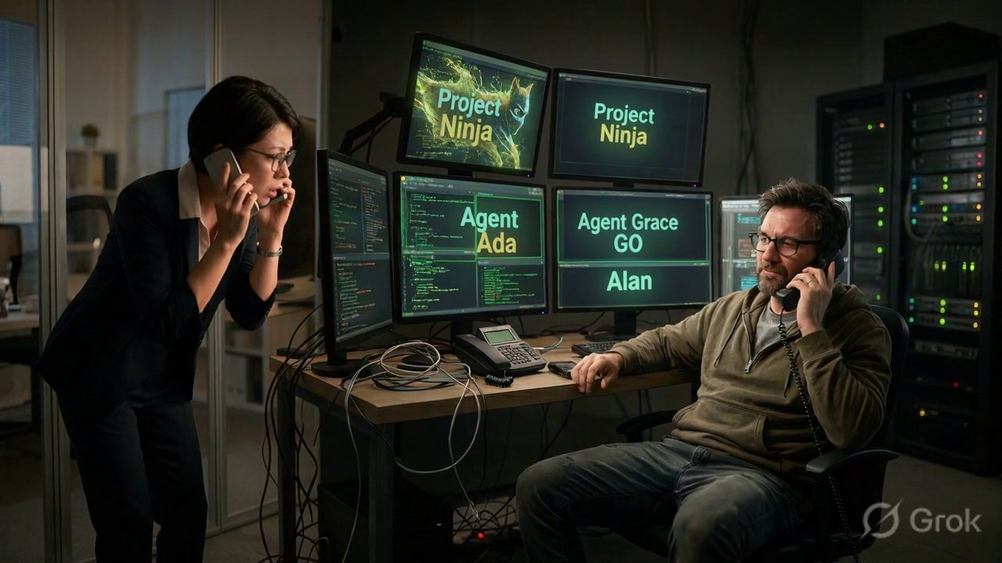
10. USER EXPERIENCE · BEFORE & AFTER
★
The Same Outage — Without vs. With Ninja
Watch the same 2 A.M. portal outage play out two ways — the manual struggle, then the autonomous “wow.” Press play on each clip.
PRE — NINJA
POST — NINJA
vs
Detected in < 1s · conf 0.99 · auto-restored · zero human touch — “you’re all set.”
47-min hold · no ticket · manual escalation · “maybe by morning.”
Project Ninja · Agentic AI Ninja Command Center · Group 5
16

Slide 17
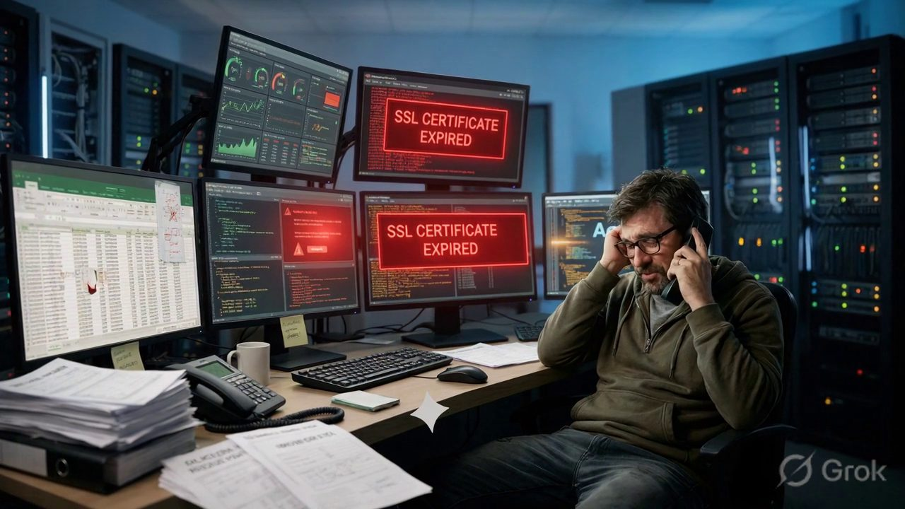
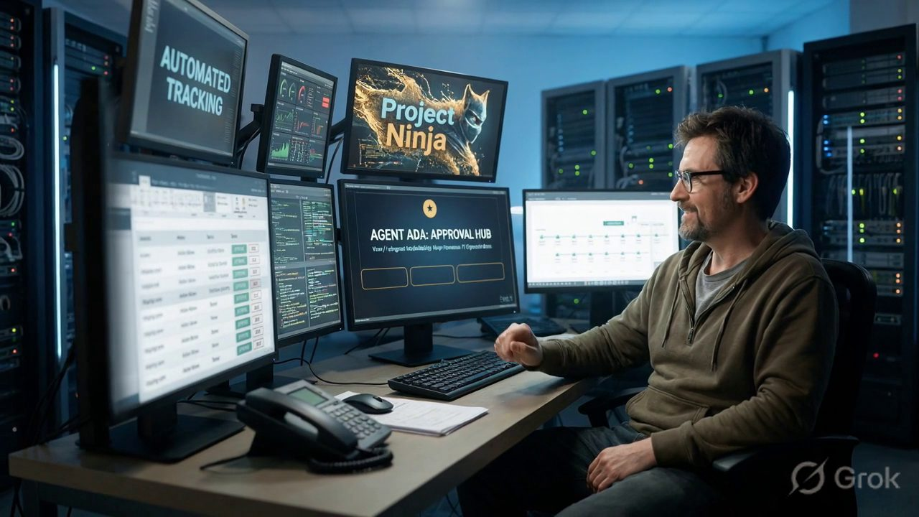
11. ADMIN EXPERIENCE · BEFORE & AFTER
★
The Same SSL Crisis — Without vs. With Agent Ada
The same expiring production certificate, two nights apart — the 3 A.M. scramble, then the calm HITL approval. Press play on each clip.
PRE — AGENT ADA
POST — AGENT ADA
vs
Flagged 48h early · plan + rollback · conf 0.88 · admin approves in ~45s — HITL.
Paged at 3 A.M. · cert expired · fragile script · no rollback · alone.
Project Ninja · Agentic AI Ninja Command Center · Group 5
17

Slide 18
12. IMPACT ANALYSIS
★
Agentic AI vs. Human Engineers
Dimension | Human | Ninja v1.0 | Delta
Avg. MTTR | 4.2 hours | 1.1 hours | −74%
Tickets resolved without human touch | ~15% | 90%+ | +75 ppt
24/7 coverage (FTE) | 12 FTEs | 3 FTEs | −75%
SLA adherence | 72% | 93%+ | +21 ppt
Alert-to-action latency | 18–40 min | < 90 sec | −98%
Repeat incident rate | 34% | < 8% | −76%
Engineer satisfaction | 2.8 / 5 | 4.3 / 5 | +54%
Metrics grounded in analogous enterprise AI-Ops deployments (Capgemini/Snowflake Cortex 2025; ServiceNow AI Agents 2024–25).
Project Ninja · Agentic AI Ninja Command Center · Group 5
18

Slide 19
13. COST ANALYSIS
★
6-Month Investment & Annual Run Cost
$100K
Total initial investment
~$41K/yr
Steady-state run cost
$1.46M
5-yr cumulative saving
Savings drivers: $380K/yr alert waste · $210K/yr SLA penalties · $160K/yr rework · $712K/yr FTE reduction.
Project Ninja · Agentic AI Ninja Command Center · Group 5
19

Slide 20
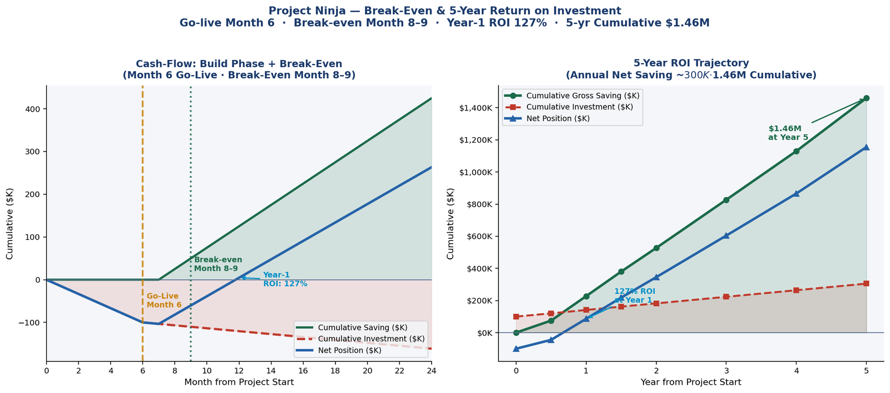
RETURN ON INVESTMENT
★
Break-Even & 5-Year ROI Trajectory
Month 8–9
Full break-even
127%
Year-1 ROI
$1.46M
5-yr cumulative
Discovery (M1)
Knowledge prep (M2)
Agent build (M3)
Beta + HITL (M4–5)
Go-Live (M6)
Break-even (M8–9)
~$15–20K · no saving
~$35–50K · no saving
~$55–80K · no saving
staging only
savings begin
$100K recovered
Project Ninja · Agentic AI Ninja Command Center · Group 5
20

Slide 21




14. FUTURE ROADMAP
★
Phase 2 Expansion — 90% → 95–97%
Difficulty-Aware LLM Routing
Cross-Agent Collaborative Handoffs
Arctic → GPT-4o → Claude 3.5, escalating only when needed.
Ada flags network degradation → Alan pre-emptively scales.
+2–3 ppt · 35% LLM cost cut
+1–2 ppt · −60% re-opens
PM4PY Process-Deviation Detection
Constitutional-AI Agent Guardrails
Auto-detect deviation from optimal resolution paths.
Per-agent policy guardrails prevent scope creep.
+0.5–1 ppt · closes loop
−25% false escalations
Combined target: 90% → 95–97% autonomous resolution by Q2 2026 · then expand to FinOps, SecOps, HR & Procurement.
Project Ninja · Agentic AI Ninja Command Center · Group 5
21

Slide 22

BEYOND IT · SAME ENGINE
★
Cross-Domain & Cross-Industry Expansion
The core engine — Snowflake data brain + CoPilot reasoning + the three-agent LangGraph workflow — is domain-agnostic. The same “predict → decide → act” pattern re-skins onto any high-volume operational workflow.
REUSE THESIS
Core code, agent framework and Snowflake schema were already built and paid for during the IT phase — each expansion needs near-zero raw software R&D. Investment shifts to local data connectors and sector-specific compliance; the same three agents are simply re-skinned.
NEW DOMAIN
NEW INDUSTRY
HR Operations
Smart Hospitals
Clear corporate-paperwork bottlenecks across 140,000 employees — onboarding, payroll, offboarding.
Re-skin the identical engine onto patient vitals, ER/ICU bed allocation and pharmacy supply.
Feasibility: HIGH
Feasibility: MEDIUM-LOW
Project Ninja · Agentic AI Ninja Command Center · Group 5
22

Slide 23
EXPANSION · RE-SKINNED AGENTS
★
Same Three Agents — New Missions
HR Operations (New Domain)
Smart Hospitals (New Industry)
Agent | HR Role | Automates
Alan | The Welcomer | Provisions email, laptops & badges for new hires
Ada | The Payroll Guard | Fixes tax & salary errors before payday
Grace | The Exit Manager | Offboarding paperwork & safe access revocation
Agent | Clinical Role | Automates
Alan | The Life Guard | Watches vitals; warns nurses pre-emergency
Ada | The Bed Allocator | Frees ER/ICU beds to cut wait times
Grace | Pharmacy Tracker | Tracks expiry; auto-orders drugs before stockout
Expansion Feasibility — Side-by-Side
Dimension | HR Operations | Smart Hospitals
Data readiness | High — clean HR records | Mixed — legacy clinical systems
Core code reuse | ~100% re-skin only | ~100% re-skin only
Primary investment | Workday connectors | Epic / Cerner connectors
Compliance hurdle | GDPR (personal data) | HIPAA — stricter
Human-authority | 90/10; managers handle exceptions | 90/10 background; 100% clinical calls human
Overall feasibility | HIGH | MEDIUM-LOW
Healthcare entry: ~₹1,08,10,000 (~$130K) — ring-fenced for hospital pipelines, clinical-safety tuning & HIPAA. Zero raw software R&D.
Project Ninja · Agentic AI Ninja Command Center · Group 5
23

Slide 24
13. WORKFORCE & COST GOVERNANCE
★
FTE Build vs. BAU · Cost & Dependency Control over 5 Years
SECTION 1 — FTE REQUIREMENTS: BUILD PHASE vs. BAU
Role | Build (M1–6) | BAU Yr 1 | BAU Yr 2–3 | BAU Yr 4–5 | FTE Reduction
Tier-1 IT Engineers | 12 FTEs | 3 FTEs | 2 FTEs | 1 FTE | −92% (12→1)
AI / ML Engineers | 5 FTEs | 2 FTEs | 2 FTEs | 2 FTEs | −60% (5→2)
Snowflake / Data Architect | 2 FTEs | 1 FTE | 1 FTE | 1 FTE | −50% (2→1)
TOTAL FTEs | 19 FTEs | 6 FTEs | 5 FTEs | 4 FTEs | −79% (19→4)
SECTION 2 — COST & DEPENDENCY CONTROLS OVER 5 YEARS (incl. SLM Strategy)
Control Lever | Yr 1 (Go-live) | Yr 2–3 | Yr 4–5 | 5-Yr Impact
LLM → SLM Migration Replace GPT-4o with fine-tuned SLM (e.g. Phi-3, Arctic) for L1 routing | GPT-4o + Claude 3.5 (full LLM stack) ~$18K/yr | SLM handles L1 routing; LLM only for escalation ~$10K/yr | SLM fully owns L1+L2; LLM on-demand only ~$5K/yr | −72% inference cost; zero vendor lock-in
Snowflake Compute Budget Resource monitors + auto-suspend warehouses | On-demand; alert thresholds set | Reserved capacity + Snowpark optimisation | Snowflake Native App; fixed annual contract | ~30% compute saving vs. ad-hoc
Vendor Lock-in Mitigation API abstraction layer across LLM providers | Azure OpenAI + Anthropic; dual contracts | SLM on Snowflake Cortex; LLM via abstraction router | Open-weight SLM; swap provider in <1 sprint | No single-vendor exposure; negotiation leverage
Model Drift & Retraining Cost Weekly Cortex FINETUNE() on HITL feedback | Weekly auto-retrain; human review gate | SLM fine-tuned on domain tickets; drift detection automated | Fully autonomous retraining pipeline; zero human cost | Model stays current; accuracy compounds over time
SLM candidates: Snowflake Arctic Embed, Microsoft Phi-3-mini, Mistral 7B — all fine-tuneable on Snowflake Cortex with zero data egress. FTE figures derived from slide 12 (Impact vs. Humans) and industry benchmarks.
Project Ninja · Agentic AI Ninja Command Center · Group 5
19

Slide 25
15. MARKET & COMPETITION
★
A Fast-Growing, Defensible Whitespace
$10.2B
$4.1B
$2.8B
ITSM → $22.1B
AIOps → $11.0B
Agentic AI → $18B+
CAGR 16.8%
CAGR 21.7%
CAGR ~45%
Competitive differentiation — no single player combines all four:
ServiceNow / Jira / BMC
Datadog / Dynatrace / Moogsoft
Require human-authored workflows; Ninja acts autonomously.
Detect & alert; Ninja resolves the incident.
MS Copilot / GitHub Copilot
Ansible / Terraform / Runbooks
Need human prompting; Ninja is an autonomous agent ensemble.
Execute scripts; Ninja decides what to execute.
Ninja’s moat: multi-LLM agentic reasoning + confidence-gated autonomy + production HITL + governed Snowflake core.
Project Ninja · Agentic AI Ninja Command Center · Group 5
24

Slide 26




WHY PROJECT NINJA
★
Eight Reasons It Wins
97.1% F1 classifier
3 validated routing paths
Snowflake zero-ETL
Multi-LLM ensemble
on a held-out test split
autonomous · HITL · escalation
no data egress risk
resilient & cost-optimised
GDPR Art.22 compliant
RAG-grounded agents
Compounding learning
Full audit trail
HITL gateway built-in
no free-text hallucination
every fix improves the model
enterprise governance ready
Project Ninja · Agentic AI Ninja Command Center · Group 5
25

Slide 27
★
THANK YOU
Project Ninja — Your Intelligent Sentinel for Autonomous IT Operations
Ramnath Kashikar
Sivanand Rao
Bharath PU
Priyanka Costa
Ritam Shome
Program Manager / Lead
Conversational AI Specialist
ML / AI Engineer
Snowflake Data Architect
Data Governance & Cyber Security
Group 5 · Capstone Project Final · All data grounded in publicly available, validated datasets — no hallucinated data.

