Slide 1

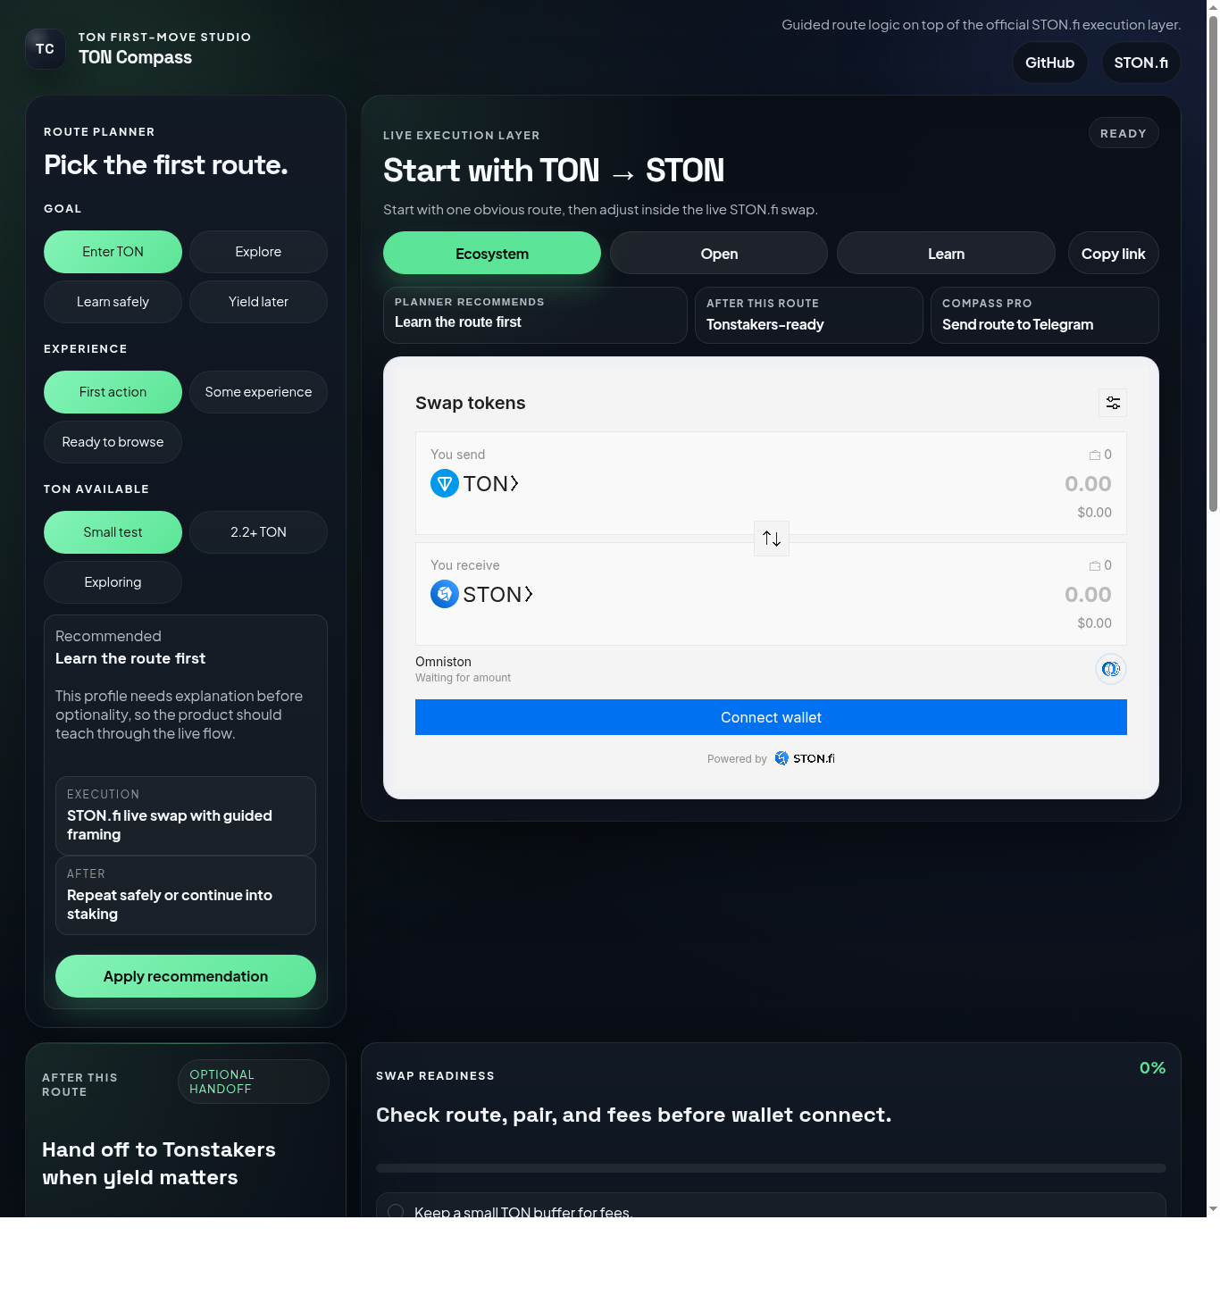
STON.fi VIBE CODING HACKATHON
TON Compass
A guided first-move app for TON DeFi built on top of the official STON.fi execution and data layer.
First TON move. Routed for humans.
Journey Builder, live quote checks, wallet-aware hints, official STON.fi execution, and a Tonstakers-ready continuation.
Live layer
Decision
After
Official STON.fi widget
Live quote + wallet hints
Tonstakers + Telegram
TON Compass | Guided route + live decision layer

Slide 2
PROBLEM
First-time TON users see too much too early.
Wallet connection, gas, slippage, token choice, and swap execution often appear all at once. That is a poor first interaction for a user who just wants one clear starting point.
Raw DEX surface
Trust problem
Drop-off risk
High choice density before the user has context.
The user sees a wallet action before they feel ready.
If the first step feels noisy, the journey ends early.
TON Compass response
Recommend the right route
Slow the user down with readiness checks
Keep execution real via STON.fi
Problem -> product response

Slide 3
PRODUCT FLOW
A small app with a real onboarding sequence.
The product adds just enough structure around the official widget and public data layer to feel like a real TON journey rather than a one-screen embed.
1. Journey Builder
2. Readiness preflight
3. Decision Lab
4. Continuation
Maps user goal, confidence, and TON balance into the recommended first route.
Creates a deliberate pause before wallet connection so the first swap is legible.
Pulls live STON.fi route simulation and wallet-aware hints from official public endpoints.
The real swap stays in STON.fi, then Tonstakers and Telegram keep the journey alive.
Result: a beginner can move from uncertainty -> guided choice -> live quote -> real swap -> TON-native continuation without ever leaving a coherent product surface.
Journey Builder -> Readiness -> Decision Lab -> Continuation

Slide 4
WHY THIS HAS A SHOT
Fast enough to ship. Product-shaped enough to stand out.
The app is small, but it already solves a specific TON onboarding problem with a real integration and a credible growth path.
Real integration
Real product logic
Real continuation
Execution goes through the official STON.fi widget and live protocol quotes come from official public STON.fi endpoints.
Route recommendation, readiness gating, live quote checks, and wallet-aware hints create a reusable onboarding system.
Tonstakers plus Telegram continuity show how this can expand into a broader TON journey instead of stopping at swap.
What reviewers can see immediately
There is a live public URL
There is a public GitHub repo
The app already supports a real user journey plus a live decision layer
The scope is still realistic for a hackathon build
TON Compass is not a swap clone. It is an onboarding and decision product on top of STON.fi.
Strong live demo + clear product logic

Slide 5
TON Compass
Live links
60-second pitch
Live demo
TON Compass is a guided first-move app for TON DeFi. It recommends the right route, adds a readiness layer before wallet connection, checks the route with live STON.fi data, executes through the official STON.fi widget, and then offers a Tonstakers-ready continuation path.
Open live web app
forlearningandcerts.sellsystems.agency:49184/ton-compass
GitHub
Open GitHub repository
That makes it feel like the start of a TON journey, not just another swap clone or widget wrapper.
github.com/ryuriymega/stonfi-hackathon

