Slide 1
DATA ANALYTICS CASE STUDY
Consumer Shopping
Behaviour Analysis
Turning 3,900 retail transactions into insights on purchasing trends,
customer loyalty, and product performance.
PYTHON
POSTGRESQL
POWER BI
GITHUB
End-to-End Analytics Workflow • Python → SQL → Power BI

Slide 2
PROJECT BACKGROUND
Why This Analysis Matters
A national retail organisation wants deeper insight into customer purchasing behaviour to strengthen relationships and improve retention. Buying habits are shifting across customer groups, product categories, and shopping channels — and leadership needs to understand how discounts, product ratings, seasonal demand, and payment preferences shape purchasing decisions and loyalty.
THE BUSINESS QUESTION
“How can consumer shopping data be analysed to identify purchasing trends, improve customer engagement, and support more effective marketing and product decisions?”
Customer groups & demographics
Product categories & seasonal demand
Online vs. in-store channels
Discounts, ratings & payment methods
CONSUMER SHOPPING BEHAVIOUR ANALYSIS
2

Slide 3
PROJECT SCOPE
Objectives & Deliverables
01
02
03
04
05
Data Preparation
Database & SQL
Power BI Dashboard
Report & Presentation
GitHub Repository
Import, clean, and transform raw transaction data in Python.
Build a relational database and query customer behaviour & sales drivers.
Interactive KPIs, demographics, and category visuals with filters.
Summarise methodology, findings, and recommendations for stakeholders.
Well-organised scripts, queries, dashboard file, and documentation.
CONSUMER SHOPPING BEHAVIOUR ANALYSIS
3

Slide 4
THE DATASET
Dataset at a Glance
3,900
18
4
TRANSACTIONS
DATA FIELDS
PRODUCT CATEGORIES
25
50
37
DISTINCT ITEMS
CUSTOMER LOCATIONS
MISSING RATINGS IMPUTED
Fields span three groups: customer demographics (age, gender, location, subscription), purchase details (item, category, amount, season, size, color), and shopping behaviour (discounts, promos, review ratings, shipping type, purchase frequency).
CONSUMER SHOPPING BEHAVIOUR ANALYSIS
4

Slide 5
PYTHON • PANDAS
Cleaning & Preparing the Data
1
Import
2
Audit
3
Clean
Load 3,900 rows with pandas from CSV.
Profile structure with .info() and .describe(); check for nulls.
Impute 37 missing ratings using each category's median.
4
Standardise
5
Engineer
6
Load
Convert headers to snake_case for consistency.
Add age_group and purchase_frequency_days features.
Push the cleaned DataFrame into PostgreSQL via SQLAlchemy.
CONSUMER SHOPPING BEHAVIOUR ANALYSIS
5

Slide 6
METHODOLOGY
From Raw Data to Dashboard
Python
PostgreSQL
SQL Queries
Power BI
Import, clean &
feature-engineer
Structured relational
database
10 analytical queries
on customer behaviour
Interactive dashboard
& KPIs
The cleaned dataset is loaded into a PostgreSQL database, queried with SQL to answer 10 targeted business questions, then visualised in an interactive Power BI dashboard — and every script, query, and file is version-controlled on GitHub.
CONSUMER SHOPPING BEHAVIOUR ANALYSIS
6

Slide 7
SQL INSIGHT 01
Who Drives the Revenue?
HIGH-VALUE DISCOUNT SHOPPERS
839
customers used a discount code yet still spent above the $59.76 average order value.
Male customers generated over 2× the revenue of female customers, while a meaningful share of shoppers are discount-resilient — high spenders regardless of promotions.
CONSUMER SHOPPING BEHAVIOUR ANALYSIS
7

Slide 8
SQL INSIGHT 02
Which Products Win — and Which Rely on Discounts?
TOP 5 BY AVERAGE RATING
TOP 5 BY DISCOUNT RELIANCE
CONSUMER SHOPPING BEHAVIOUR ANALYSIS
8

Slide 9
SQL INSIGHT 03
Does Speed or Loyalty Change Spend?
AVG ORDER VALUE BY SHIPPING TYPE
SUBSCRIBERS vs. NON-SUBSCRIBERS
Customers
Avg Spend
Total Revenue
Subscribed
1,053
$59.49
$62,645
Not Subscribed
2,847
$59.87
$170,436
Non-subscribers generate 73% of total revenue — the subscriber base is small but nearly matches non-subscribers in average spend.
Express shoppers spend only ~$2 more on average — shipping speed barely moves basket size.
CONSUMER SHOPPING BEHAVIOUR ANALYSIS
9

Slide 10
SQL INSIGHT 04
How Loyal Is the Customer Base?
CUSTOMERS BY SEGMENT
REPEAT BUYERS & SUBSCRIPTIONS
Are frequent shoppers more likely to subscribe?
Not Subscribed
2,518
Subscribed
958
Among customers with more than 5 previous purchases, most remain non-subscribers — repeat purchasing alone doesn't drive subscription sign-ups, so loyalty needs a dedicated push.
CONSUMER SHOPPING BEHAVIOUR ANALYSIS
10

Slide 11
SQL INSIGHT 05
Category Performance & Best Sellers
REVENUE BY CATEGORY
#1 BEST SELLER PER CATEGORY
CLOTHING
171
Blouse
orders
ACCESSORIES
171
Jewelry
orders
FOOTWEAR
160
Sandals
orders
OUTERWEAR
163
Jacket
orders
CONSUMER SHOPPING BEHAVIOUR ANALYSIS
11

Slide 12
SQL INSIGHT 06
Revenue Contribution by Age Group
KEY TAKEAWAY
Revenue is remarkably even across age brackets — within an $6,400 spread of one another.
No single generation dominates spend, so age-based campaigns should broaden reach rather than concentrate on one segment.
CONSUMER SHOPPING BEHAVIOUR ANALYSIS
12

Slide 13
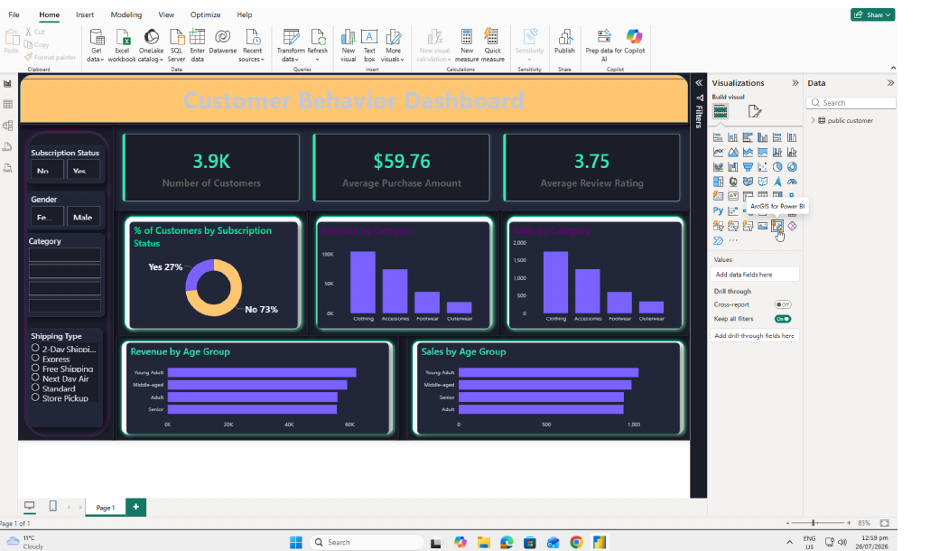
DELIVERABLE
Interactive Power BI Dashboard
KPIs, subscription analysis, category revenue & sales, and age-group insights — all explorable through interactive filters and slicers.
CONSUMER SHOPPING BEHAVIOUR ANALYSIS
13

Slide 14
FINDINGS INTO ACTION
Business Recommendations
1
Grow the Subscriber Base
Promote exclusive, members-only perks to lift the 27% subscription rate.
2
Reward Repeat Buyers
Introduce loyalty incentives that move Returning customers into the Loyal tier.
3
Rebalance Discount Strategy
Weigh the sales lift from heavy discounting against margin impact on reliant items.
4
Spotlight Top Performers
Feature highly-rated, best-selling items like Gloves and Jewelry in campaigns.
5
Target High-Revenue Segments
Focus marketing on Clothing & Accessories buyers and express-shipping users.
CONSUMER SHOPPING BEHAVIOUR ANALYSIS
14

Slide 15
REPRODUCIBILITY
Tech Stack & Repository Structure
PY
SQL
BI
GH
Python / Pandas
PostgreSQL
Power BI
GitHub
GITHUB REPOSITORY
WHAT'S INSIDE
consumer-shopping-behaviour-analysis/
data/customer_shopping_behavior.csv
notebooks/data_preparation.ipynb
sql/customer_behavior_queries.sql
dashboard/customer_behavior_dashboard.pbix
report/analysis_report.pdf
README.md
Full data cleaning & feature engineering notebook
10 documented SQL business-question queries
Editable Power BI dashboard (.pbix) with live filters
PDF report with methodology & recommendations
CONSUMER SHOPPING BEHAVIOUR ANALYSIS
15

Slide 16
Thank You
Explore the full analysis, code, and dashboard on GitHub.
GITHUB
github.com/yourusername/consumer-shopping-behaviour-analysis
LINKEDIN
linkedin.com/in/yourusername
EMAIL
yourname@email.com
CONSUMER SHOPPING BEHAVIOUR ANALYSIS
16

