Slide 1
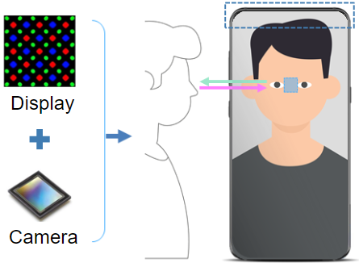
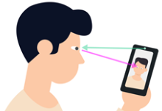
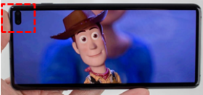

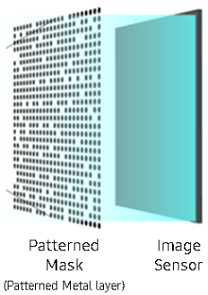
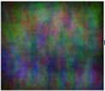

All-in-One Display and Camera Technology
It is a Camera Integrated Display Technology.
Fundamentally, this solution supports bezel less display design. In the teleconference, this solution supports an experience that the remote user's eyes and the viewer's eyes match. When user take a selfie, it provides a mirror effect.
OLED Display Market value is expected $121 billion.
After 1 year, my team will sale patent license to SAMSUNG Electronics and SAMSUNG Display. In near future, my team will make product and device sale to the $121 billion values market.
(Contact: ryuseun@gmail.com, Video: https://youtu.be/-coCBRwK7zA)
Due to camera holes
Immersive distraction
Due to the biased camera position
gaze mismatch
Bezelless design without camera holes, and
fused lensless camera in the center of the display
Sensor Capture image
Pre-Alpha Quality
Beta Quality
Image Processing
After 1 year, Beta Version
license Sales to SAMSUNG Display
Version (period) | Target Goal or Product | Development staff / Required Manpower and Budget | Sales target company / Product
Pre-Alpha (13 Months) (2018.7~2019.7) | Display Integrated Lensless Camera Possibility Verification - Lensless Camera Methodology and Knowhow acquisition - Optimized Lensless Mask Design Complete | UX: camera position and camera interaction SW: Camera Image Processing HW 1, 2: Camera and Display Circuit Control | SAMSUNG Electronics And SAMSUNG Display
Alpha (6 Months) | OLED Display Mask Based Lensless Camera - C model and FPGA Design/Verification/Tuning - Goal: Image Quality PSNR 15(dB), SSIM 0.7 | UX 1: AF, FOV Interaction Design SW 1,2,3: Focuse and FOV control, C Modeling, Camera Quality Tuning, C Modeling HW 1,2,3: FPGA Design, Verification Budget $1 million | SAMSUNG Electronics and SAMSUNG Display required more high quality result (beta version) and noticed an intention to actively purchase of beta version level. Expected Royalty Price: $10 million
Beta (6 Months) | - Goal: Image Quality PSNR 24(dB), SSIM 0.9 - Technology license Sales to SAMSUNG Display
Future | Self-production ‘Camera Integrated OLED Display’ by using Inkjet Printing Method |  | SAMSUNG Electronics, APPLE, SONY, etc 2023 Expected Market Value: $121 billion

Slide 2
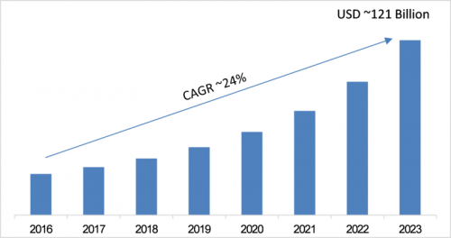

https://youtu.be/-coCBRwK7zA
OLED Display Market
(Market Research Future)
Optimized Lensless Mask Pattern Design
Team Leader "Seun Ryu"
It is a Camera Integrated Display Technology.
Fundamentally, this solution supports bezel less display design.
In the teleconference, this solution supports an experience that the remote user's eyes and the viewer's eyes match.
When user take a selfie, it provides a mirror effect.
OLED Display Market value is expected $121 billion.
After 1 year, my team will sale patent license to SAMSUNG Electronics and SAMSUNG Display. In near future, my team will make product and device sale to the $121 billion values market.
(Contact: ryuseun@gmail.com, Video: https://youtu.be/-coCBRwK7zA)

