Slide 1

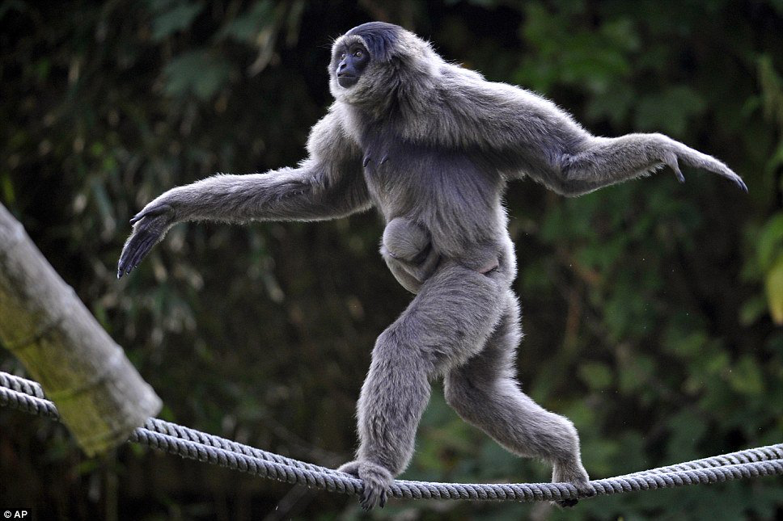
Environmental influence on Musical Preference
RYUICHI HAMAKAWA
STONY BROOK UNIVERSITY

Slide 2
INTRODUCTION
PREVIOUS STUDIES AND LITERATURE REVIEW
simple sound stimuli designing, single breed
RESEARCH QUESTION
does the environmental influence effects the forming of musical preference?
does it influence different species in a same way? (such as primate)
HYPOTHESES
environment has influence on traits such as musical preference in nonhuman social animals.

Slide 3
method
PARTICIPANTS
a group of 5 from each three different no-human primate breeds
MEASURES
two way analysis of variance(anova)
PROCEDURE
12 hrs (sunrise to sunset)
study room with stimuli
measure the mean response time (mean time spent on each location)

Slide 4
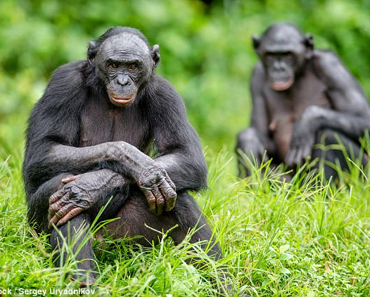

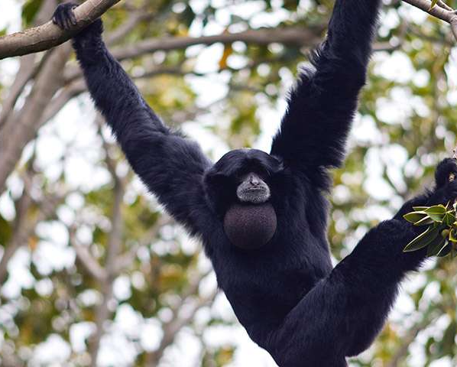
PARTICIPANTS 15 PRIMATES 3 GROUPS OF 5 MEAN AGE : 11.2(SD=1.26) FEMALE>MALE
BONOBO-AFRICA-Djembe
HYLOBATIDAE-CHINA-Qin
SIAMANG-SUMATRA-Gamelan Gongs
a group of 5 from each three different no-human primate breeds

Slide 5
method
PARTICIPANTS
a group of 5 from each three different no-human primate breeds
MEASURES
two way analysis of variance(anova)
PROCEDURE
12 hrs (sunrise to sunset)
study room with stimuli
measure the mean response time (mean time spent on each location)

Slide 6
RESULTS
Figure 1.
Levels of preference for different musical stimuli between nonhuman species

Slide 7
RESULTS
Significant main effect of the stimuli, F(2,12)=x.xx, P<.xx. Each primates group prefered music from the same origin over music from other regions.

Slide 8
DISCUSSION
STUDY IDEA
PROS AND CONS
FUTURE DIRECTIONS

Slide 9
STUDY IDEA
PURPOSE
to test how environmental influence can affect the forming of musical preference in nonhuman primates
ORIGINAL HYPOTHESES
nonhuman primates prefer musical stimuli from their own origins due to the environmental influence in the musical stimulus

Slide 10
PROS AND CONS
PROS (STRENGTHS)
WELL DESIGNED MUSICAL STIMULI
STUDY ROOM WITH MINIMUM ARITIFICIAL OBJECTS
CONS (LIMITATIONS)
ANIMAL STUDY
LACK OF INDIVIDUAL INFORMATION OF EACH SUBJECT (PERSONALITY)

Slide 11
FUTURE DIRECTIONS
PSYCHOLOGY AND MUSIC
ANIMAL STUDY AND TREATMENT
HUMAN CULTURE AND ENVIRONMENT STUDY

