Slide 1


EMOJIFY
Project ID:
CS_013
Submitted by :
Kartik Kumar
17EEBCS302
Mentor:
Mr. Rishiraj Vyas

Slide 2
EMOJIFY
Project ID:
CS_013
Emojify is an application that completes your text by suggesting emojis.
Emojis are low resolution images that are often used with texts to express ourselves better.
This is what we, here at emojify, try to attain.
Your application does all the complicated work behind the hoods by deploying high accuracy deep learning algorithms such a neural nets; so that you, the user, is free of hectic task of selecting the right emoji.

Slide 3
EMOJIFY
Project ID:
CS_013
Tools used
Machine Learning part:
Python, for its ease of use, solid library support and scope.
Jupyter Notebook, because it’s simple, better for visualization and powerful.
UI Part:
Streamlit Python library, for providing web app like interface.

Slide 4
EMOJIFY
Project ID:
CS_013
Introduction to Libraries
emoji
This is an open source library available on github which assigns a name to every emoji which can then be used for sentiment analysis.

Slide 5

EMOJIFY
Project ID:
CS_013
Introduction to Libraries
emoji
This is an open source library available on github which assigns a name to every emoji which can then be used for sentiment analysis.

Slide 6
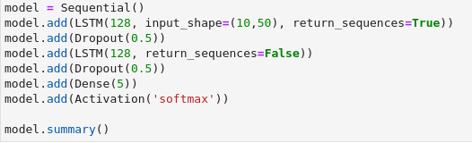
EMOJIFY
Project ID:
CS_013
Introduction to Libraries
tf.keras
Used for building, compiling and training deep neural nets.
Most used library for deep learning tasks.

Slide 7
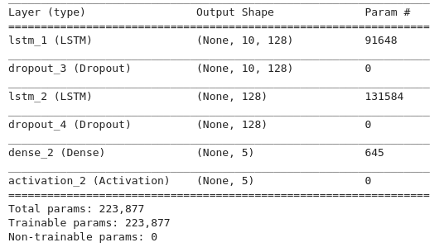
EMOJIFY
Project ID:
CS_013
Introduction to Libraries
tf.keras
Used for building, compiling and training deep neural nets.
Most used library for deep learning tasks.

Slide 8

EMOJIFY
Project ID:
CS_013
Introduction to Libraries
streamlit
For webapp like GUI for the sake of demonstration.

Slide 9
EMOJIFY
Project ID:
CS_013
Final Progress
The prepared model is ready to be sold and fed into any application.
It takes input over a webapp and displays suggested emoji.
I have kept the UI part minimal just for demonstration purposes.

Slide 10
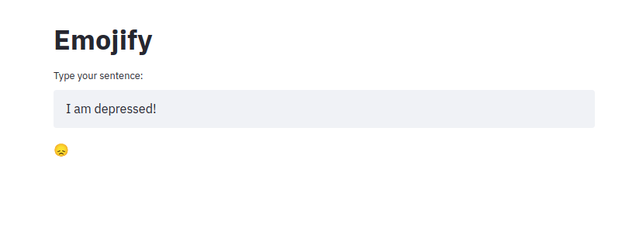
EMOJIFY
Project ID:
CS_013
Final Progress
Final output looks somewhat like this depending on user input:
input
output

Slide 11
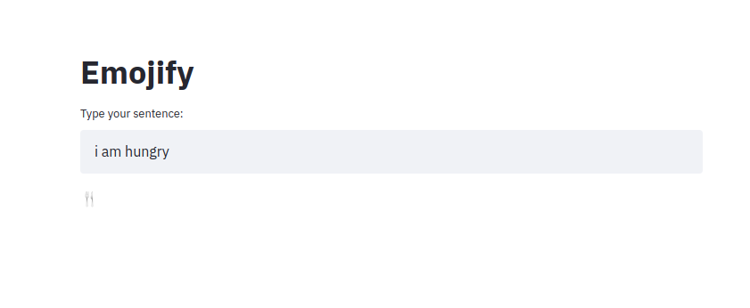
EMOJIFY
Project ID:
CS_013
Final Progress
Final output looks somewhat like this depending on user input:
input
output

Slide 12
EMOJIFY
Project ID:
CS_013
Thank you.

