Slide 1
Advanced eQTL analysis for
identification of regulatory factors and
their target genes
Wenjie Qi, David Filipovic

Slide 2
Background

Slide 3
Regulatory factors
Proteins that affect the expression of other transcripts (mRNA, protein)
The level of transcript production is affected
Can activate and repress protein expression
Interact with elements of transcription machinery
DNA (promoter, enhancer)
Cofactors
RNA polymerase

Slide 4
Regulatory targets
Proteins whose expression is regulated
Most have many regulators
Status of regulators affects regulation (expression)
Active vs. inactive regulators
Expressed vs. non-expressed regulators

Slide 5
eQTL - Expression Quantitative Trait Loci
QTL
Genotypes related to phenotypes
Genomic loci that contribute to (explain) the phenotype
eQTL
Phenotypes are expression levels

Slide 6
Data

Slide 7
Yeast - Model Organism
Inbred
Almost no genetic variation within strains
Well behaved
Will mate
Will produce genetically mixed offspring

Slide 8
Yeast Experiment (Brem and Kruglyak, 2005)
S. Cerevisiae (baker’s yeast)
Total of 112 samples of F1 progeny
Parent strains
BY4716 aka S288c [lab strain]
RM11-1a . [wild isolate strain from a California vineyard]

Slide 9
Microarray Expression Data
Isolated nuclear content split into wells (containing ORF probes)
Each well detects quantities of specific mRNAs present in the cell
One well <=> open reading frame (ORF)
Simultaneous light intensity measurements
Parent strain (635 nm) vs F1 progeny strain (532 nm)
Background intensities subtracted from both
Log2 ratio calculated (parent/progeny)
Total 7084 wells
Only 6611 capture S. Cerevisiae ORFs
Others: control, blanks, etc.

Slide 10
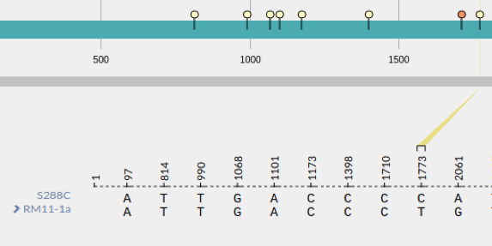
SNP Data
SNPs occurring within Open Reading Frames (ORFs)
Minor and major allele (in terms of frequency)
Haploid organism (two copies of each chromosome)
BB/AB/AA genotypes coded as values: 0/1/2

Slide 11
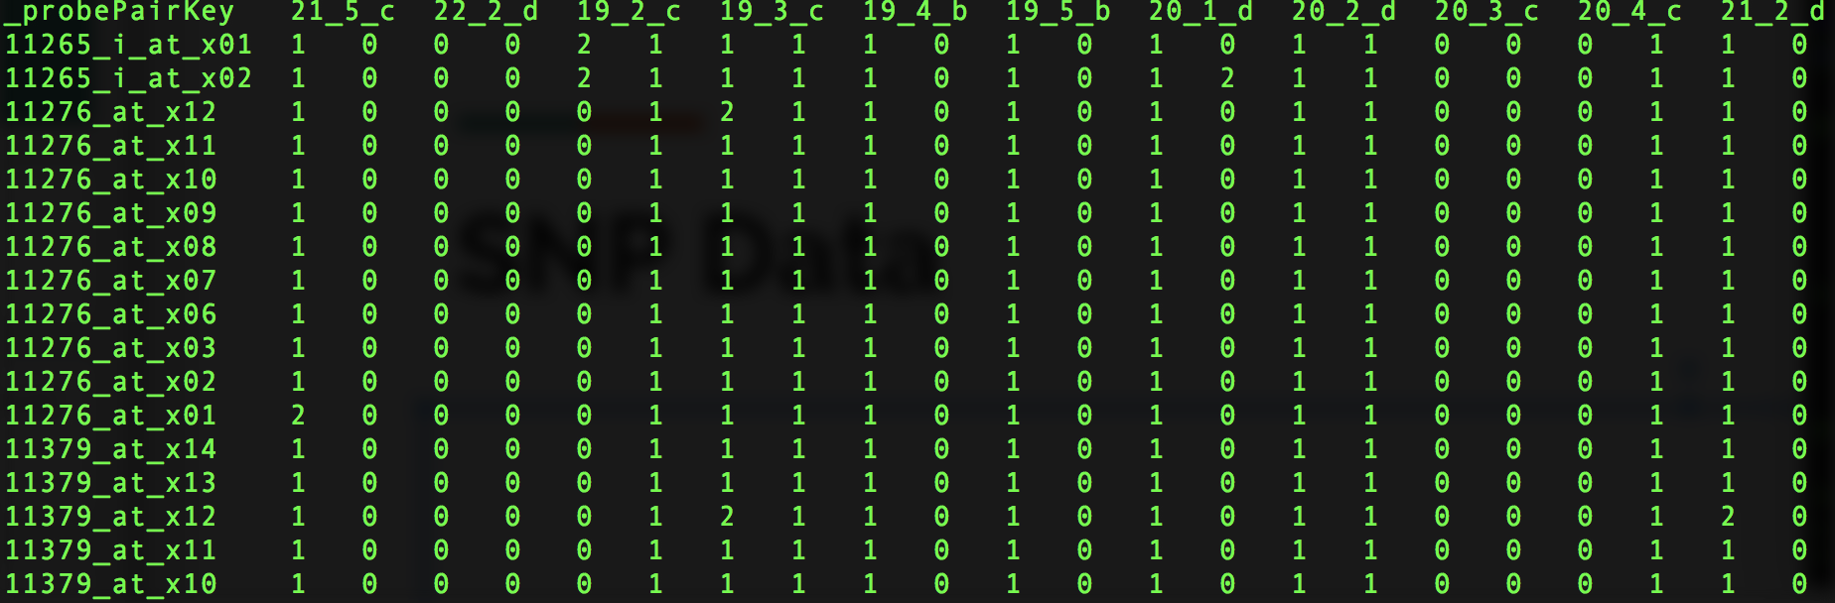
SNP Data

Slide 12
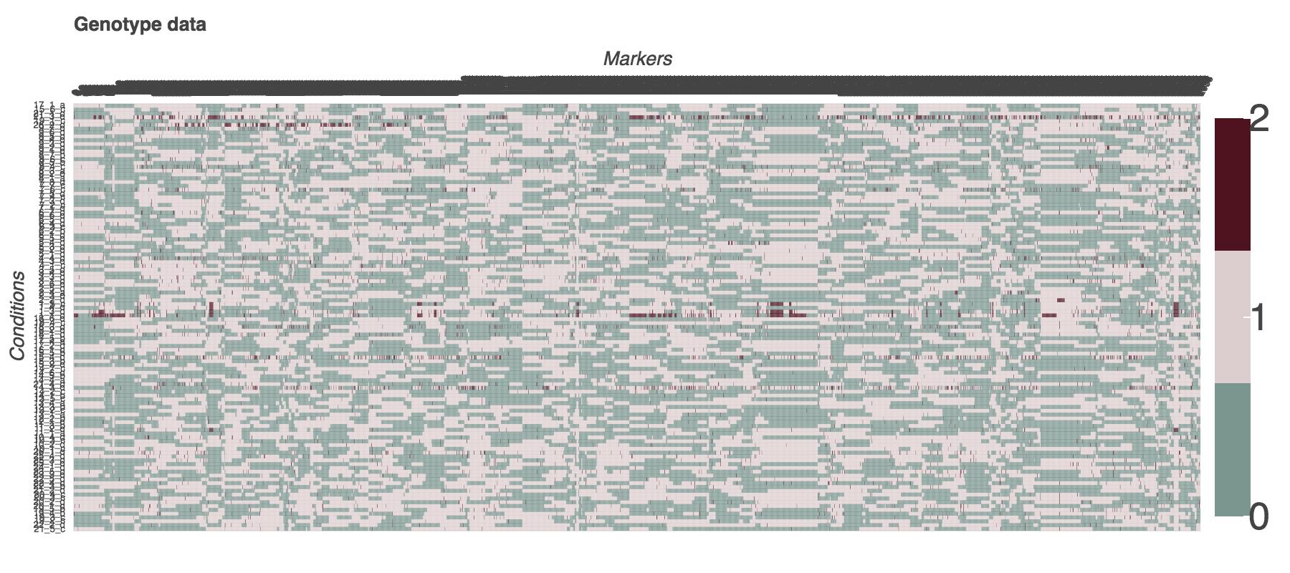

Slide 13
Motivation

Slide 14
Rationale
SNPs within transcription factors (TF)
Might fall into regions crucial for TF activity
May improve or interfere with function of TF
May result in up/down regulation of TF targets

Slide 15
Goals
De novo identification of transcription factors
De novo identification of transcription factor targets
De novo identification of SNPs within transcription factors that are important for their function

Slide 16
Data preprocessing

Slide 17
Missing Tables
Generated many tables required for validation and analysis
E.g. tables linking microarray spot ID and canonical gene name

Slide 18
Starting Point
Genes that are not differentially expressed considered as candidate TF
We have found 1139 such genes and 2105 candidates SNPs

Slide 19
Methods

Slide 20
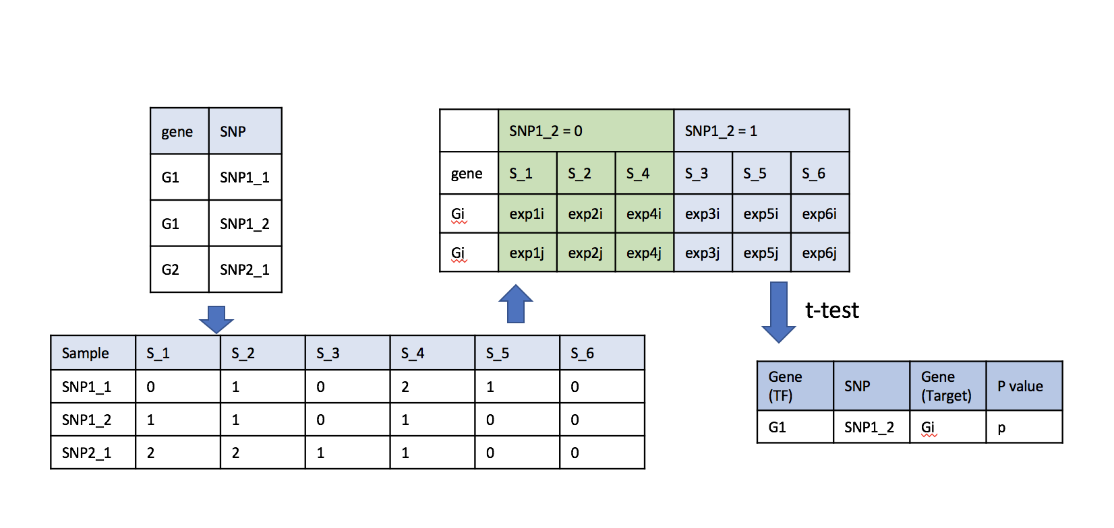
Marker Regression
Single SNP-Single Gene Expression Association

Slide 21
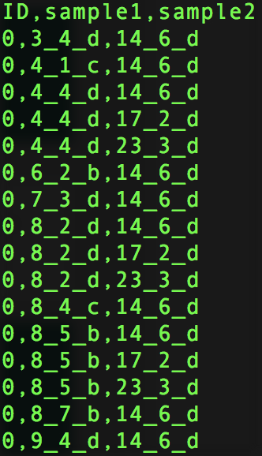
Allele Transition Bias
Target upregulation ⇔ Allele Transition
Find genes (putative targets) upregulated across pairs of conditions (transition)
Upregulation - 2 fold increase in expression
Gene: [condition1 → condition2, condition → condition 4…]

Slide 22
Allele Transition Bias
Match every SNP and its allele (0/1/2) with every gene transition of every upregulated gene
If gene containing SNP (putative transcription factor) is also upregulated or downregulated
⇒ ignore transition

Slide 23
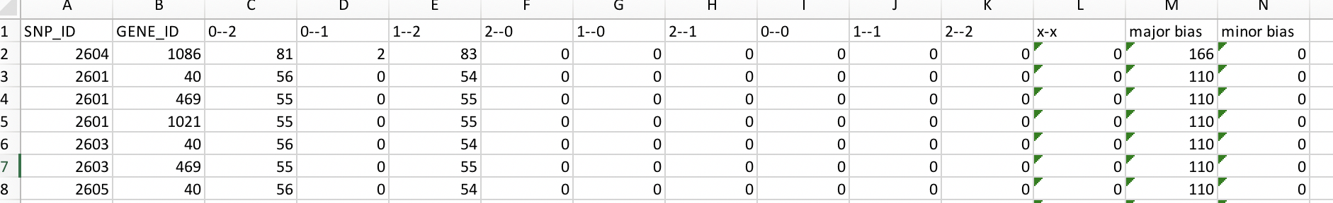
Allele Transition Bias
For every upregulated target create a list of corresponding SNP transition
⇒ get counts of each transition type (e.g. 0 → 0, 0 → 2)

Slide 24
Allele Transition Bias
Rationale:
If gene is upregulated with a strong bias for specific type of SNP transition
⇒ SNP is likely important and might be part of a transcription factor

Slide 25
Random Forest Regression
49 TFs with SNPs investigated, across 112 conditions
Output (ground truth) data:
expression of direct targets
Three cases of input data:
expression of TFs
expression of TFs + all unique SNPs within TFs
Expression of TFs + all important SNPs within TFs

Slide 26
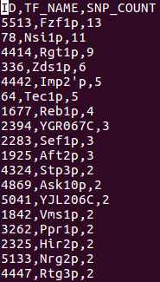
Validation
Results checked against a database of known TF interactions (YEASTRACT)
Total of 313 known TFs
Only 49 of those have SNPs in our data

Slide 27
Results

Slide 28
Marker Regression
49 transcription factors (TFs) with SNPs in their coding regions
3 TFs differentially expressed across their SNPs
Not considered in analysis

Slide 29
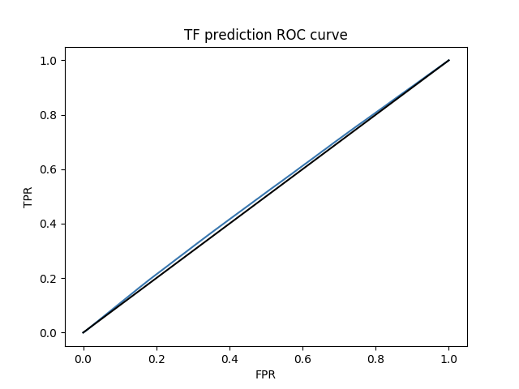
Marker Regression - De Novo TF prediction

Slide 30
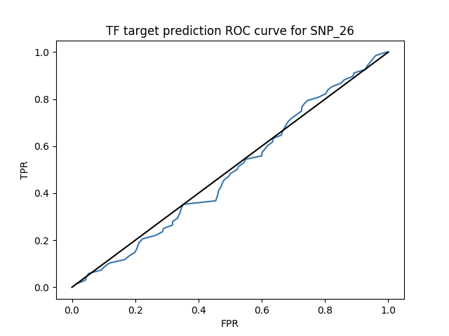
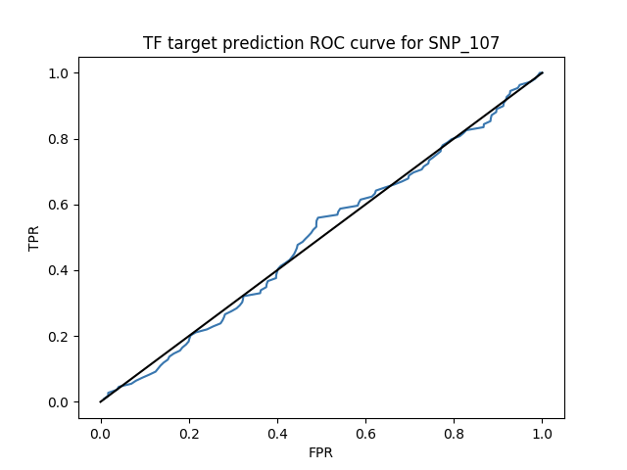
Marker Regression - De Novo target prediction

Slide 31
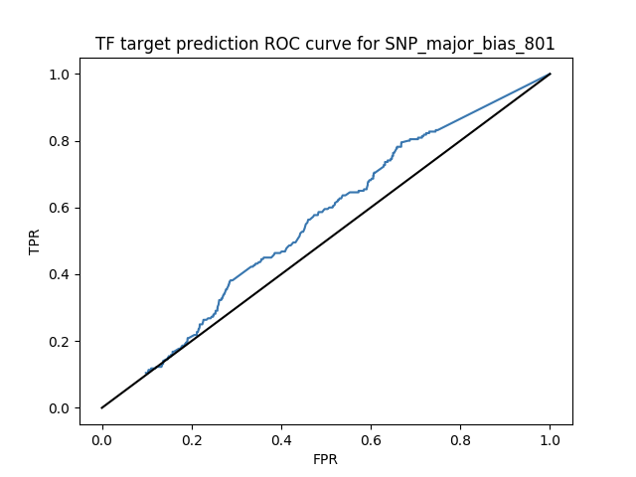
Allele Bias Transition - De Novo target prediction

Slide 32
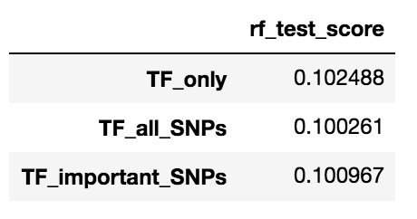
Random Forest Regression - Testing Score
k-fold validation (k=10)
Average R² score calculated

Slide 33
Random Forest Regression - Feature Importance
One SNP particularly important
SNP with id 25, belonging to the Nsi1 gene
8th in the order of importance following 7 transcription factors.
SNP is exactly the same as 14 other SNPs (LD)
Nsi1 (10 SNPs) and three others

Slide 34
Random Forest Regression - Feature Importance
Other SNPs ranked below all of the TFs.
8 other SNPs selected in decreasing order of importance
Can performance be increased?
Not really
1 SNP identified with no copies (LD)
SNP with id 1643, belonging to Cup2 gene.
Cup2 gene only contained this SNP
This SNP falls within DNA binding domain of Cup2

Slide 35
Future Direction and Lessons

Slide 36
Future Direction
Attempt more complex models that account for regulatory interaction
Divide SNPs into silent, missense and nonsense mutations
Investigate influence of SNPs in genes other than TFs
there are much more of these

Slide 37
What Did We Learn
Data is not your friend
Do not trust it
Example: if it looks like a unique value that could be used as a primary key.... is it really?
Pandas is your friend
But a really bad one (in operator, concatenation…)
Do a small scale check before commencing genome wide analysis
If possible, check the viability of hypothesis before commencing work
Existence of eQTL does not necessarily equate regulatory interaction

Slide 38
What Would We Do Differently
Start with simpler analyses first and build up
Validate findings of the original paper first
Make models to predict expression data first
Spend more time making sure that idea is sound and testable

