Slide 1
Advanced eQTL analysis for
identification of regulatory factors and
their target genes
Wenjie Qi, David Filipovic

Slide 2
Background

Slide 3
Regulatory factors
Proteins that affect the expression of other transcripts (mRNA, protein)
The level of transcript production is affected
Can activate and repress protein expression
Interact with elements of transcription machinery
DNA (promoter, enhancer)
Cofactors
RNA polymerase

Slide 4
Regulatory targets
Proteins whose expression is regulated
Most have many regulators
Status of regulators affects regulation (expression)
Active vs. inactive regulators
Expressed vs. non-expressed regulators

Slide 5
eQTL - Expression Quantitative Trait Loci
QTL
Genotypes related to phenotypes
Genomic loci that contribute to (explain) the phenotype
eQTL
Phenotypes are expression levels

Slide 6
Data

Slide 7
Yeast - Model Organism
Inbred
Almost no genetic variation within strains
Well behaved
Will mate
Will produce genetically mixed offspring

Slide 8
Yeast Experiment (Brem and Kruglyak, 2005)
S. Cerevisiae (baker’s yeast)
Total of 112 samples of F1 progeny
Parent strains
BY4716 aka S288c [lab strain]
RM11-1a . [wild isolate strain from a California vineyard]

Slide 9
Microarray Expression Data
Isolated nuclear content split into wells (containing ORF probes)
Each well detects quantities of specific mRNAs present in the cell
One well <=> open reading frame (ORF)
Simultaneous light intensity measurements
Parent strain (635 nm) vs F1 progeny strain (532 nm)
Background intensities subtracted from both
Log2 ratio calculated (parent/progeny)
Total 7084 wells
Only 6611 capture S. Cerevisiae ORFs
Others: control, blanks, etc.

Slide 10
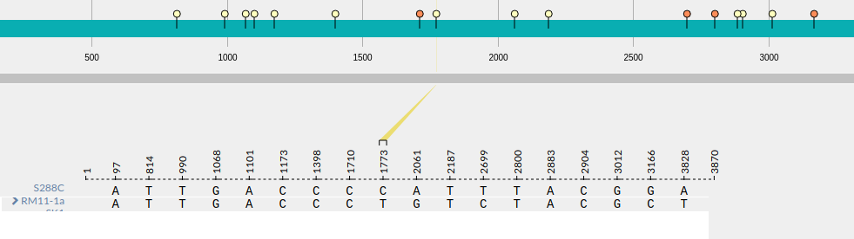
SNP Data
SNPs occurring within Open Reading Frames (ORFs)
Minor and major allele (in terms of frequency)
Haploid organism (two copies of each chromosome)
BB/AB/AA genotypes coded as values: 0/1/2

Slide 11
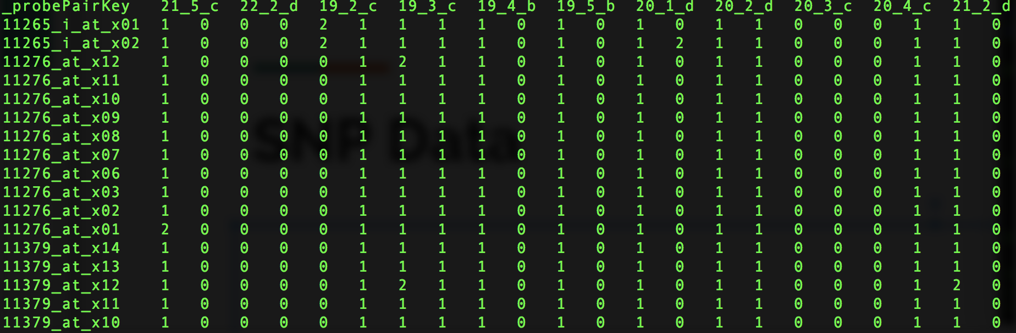
SNP Data

Slide 12
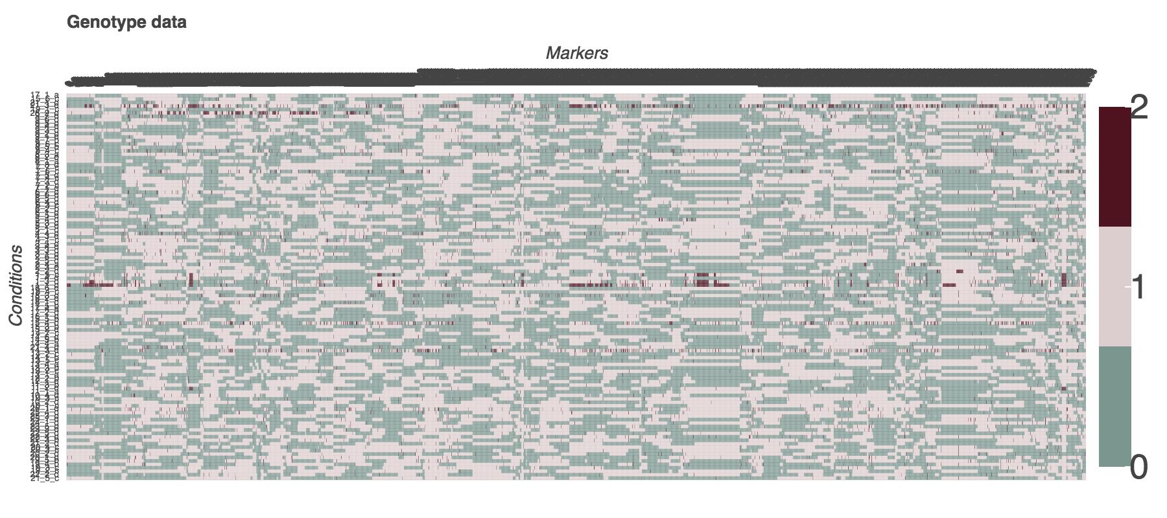

Slide 13
Motivation

Slide 14
Rationale
SNPs within transcription factors (TF)
Might fall into regions crucial for TF activity
May improve or interfere with function of TF
May result in up/down regulation of TF targets

Slide 15
Goals
Develop and test an eQTL method adapted to complement existing tools
De novo discovery of regulatory factors and their targets

Slide 16
Data preprocessing

Slide 17
Missing Tables
Generated many tables required for validation and analysis
E.g. tables linking microarray spot ID and canonical gene name

Slide 18
Starting Point
Genes that are not differentially expressed considered as candidate TF
We have found 1139 such genes and 2105 candidates SNPs

Slide 19
Methods

Slide 20
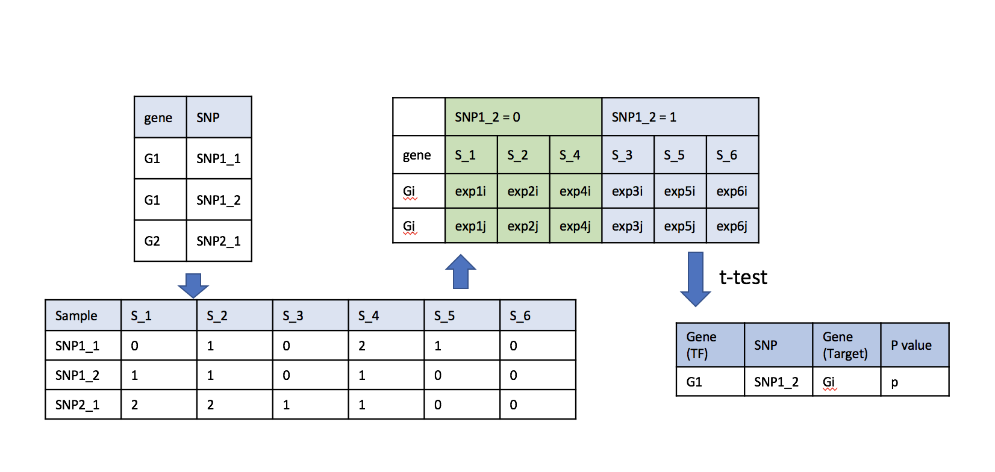
Single SNP-Single Gene Expression Association
Modified marker regression

Slide 21
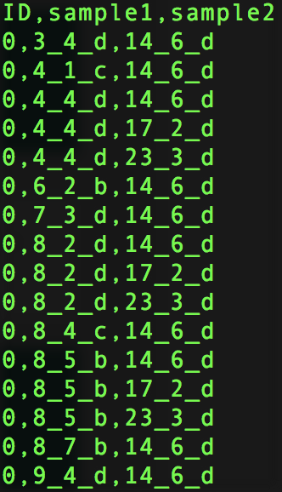
Reverse: Target Upregulation-Allele Transition
Find genes (putative targets) upregulated across pairs of conditions (transition)
Upregulation - 2 fold increase in expression
Gene: [condition1 → condition2, condition → condition 4…]

Slide 22
Reverse: Target Upregulation-Allele Transition
Match every SNP and its allele (0/1/2) with every gene transition of every upregulated gene
If gene containing SNP (putative transcription factor) is also upregulated or downregulated
⇒ ignore transition

Slide 23
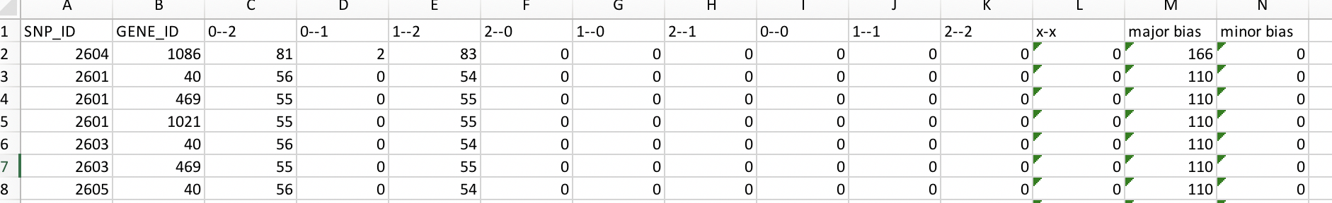
Reverse: Target Upregulation-Allele Transition
For every upregulated target create a list of corresponding SNP transition
⇒ get counts of each transition type (e.g. 0 → 0, 0 → 2)

Slide 24
Reverse: Target Upregulation-Allele Transition
Rationale:
If gene is upregulated with a strong bias for specific type of SNP transition
⇒ SNP is likely important and might be part of a transcription factor

Slide 25
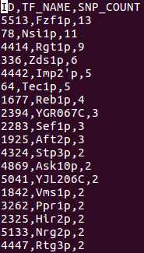
Validation
Results checked against a database of known TF interactions (YEASTRACT)
Total of 313 known TFs
Only 49 of those have SNPs in our data

Slide 26
Results

Slide 27
Single SNP-Single Gene Expression Association
49 transcription factors (TFs) with SNPs in their coding regions
3 TFs differentially expressed across their SNPs
Not considered in analysis
True positives: 45 out of 46 TFs (98%)
False negatives: 1 out of 46 TFs (2%)
True negatives: 18 out of 1121 genes (1.6%)
False positives: 1103 out of 1121 genes (98.4%)
With multiple hypothesis adjustment

Slide 28
Reverse: Target Upregulation-Allele Transition
Data not completely analyzed
SNPs in known TFs selected for manual validation
No targets were successfully identified
All false positives

Slide 29
Future Direction and Lessons

Slide 30
Future Direction
Attempt more complex models that account for regulatory interaction
Use knowledge of existing interactions
Find important SNPs in known TFs by association with known TF targets

Slide 31
What Did We Learn
Data is not your friend
Do not trust it
If it looks like a unique value that could be used as a primary key.... is it really?
Do a small scale check before commencing genome wide analysis
If possible, check the viability of hypothesis before commencing work
Existence of eQTL does not necessarily equate regulatory interaction

Slide 32
What Would We Do Differently
Start with simpler analyses first and build up
Validate findings of the original paper first
Make models to predict expression data first
Spend more time making sure that idea is sound and testable

