Slide 1

Real-Time Detection of Diabetes via ECG signals and Deep Neural Networks
PES’s Modern College of Engineering, Shivajinagar, Pune-5.
Department of Electronics and Telecommunication
2024-25
Names of the students:
Pranav More
Ganesh Shivshankar
Ved Shringarpure
Name of the Guide: Ms. P. M. Chavan

Slide 2
Overview
Real-time monitoring
Non-Invasive Health Monitoring
Automatic Feature Learning
Telemedicine and Virtual Consultations
Ensure accuracy and robustness

Slide 3
Introduction
Diabetes affects a multitude of people worldwide
Early detection necessary
Conventional methods require drawing of blood to test
Electrocardiography (ECG) is non-invasive
Opens up the possibility of 24 hours analysis and real-time remote
surveillance.

Slide 4
Literature Survey
Sr. No. | Year | Title & Authors | Methodology | Perf. Parameter Values | Limitations/Gap
1 | 2020 | IGRNet: A Deep Learning Model for NonInvasive, Real-Time Diagnosis of Prediabetes Authors: Livana Wang, Yao Mu, Jina Zhao, Xiaova Wana and Huilian Che | Deep learning model: IGRNet. IGRNet compared against models (AlexNet and GoogLeNet) & three algos SVM, RF, K-nn | Accuracy = 97.33% Sensitivity = 95.65% Specitivity = 98.36% F1 score = 97% | Data dependency, interpretability
2 | 2018 | Automated detection of diabetes using CNN and CNN-LSTM network and heart rate signals Authors: Swapna G, Soman KP, Vinavakumar | CNNs to extract features from the preprocessed ECG signals. CNN-LSTM model is used to classify the extracted features as sleep apnea or non-sleep apnea. | Accuracy of 97.5% in detecting sleep apnea syndrome using ECG signals. | Generalizability, Clinical validation
3 | 2020 | A Pilot Study on Deep Learning for Hypoglycemic Events Detection based on Authors: Mihaela Porumb. Saverio Stranges. Antonio Pescape. Leandro Pecchia | A personalized approach that used artificial intelligence to automatically detect nocturnal hypoglycemia using a few heartbeats of raw ECG signal. | Sensitivity = 87.5% Specitivity = 97.2% Accuracy = 95.8% | Limited sample size, lack of validatio n in people with diabetes, potential for false positives

Slide 5
Literature Survey
Sr. No. | Year | Title & Authors | Methodology | Perf. Parameter Values | Limitations/Gap
4 | 2017 | Reduction of Overfitting in Diabetes Prediction Using Deep Learning Neural Network Authors: Akm Ashiauzzaman. Abdul Kawsar Tushar. Md. Rashedul Islam. Jona-Mvon Kim | Prediction system for diabetes, issue of overfitting is minimized by using the dropout Method. DLNN is used, both fully connected layers followed by dropout layers. | Supervised learning with sensor data. | DLM susceptible to overfitting, large amounts of data, hard to interpret
5 | 2022 | A Decision Support System for Diagnosing Diabetes Using Deep Neural Network (Authors: Rabie. Danival Alahazzawi. Junaid Asahar. Furaan Khan Saddozai, Muhammad Zubair Asahar) | A deep learning-based decision support system (DSS), utilizing bidirectional long/short-term memory (BiLSTM) | Accuracy = 93.07% Precision= 93% Recall = 92% F-score = 92% | Computational Complexity, Overfitting
6 | 2020 | Deep learning approach for diabetes prediction using PIMA Indian dataset (Author: Huma Naz. Sachin Ahuia) | Functional classifiers - Artificial Neural Network (ANN), Naive Bayes (NB), Decision Tree (DT), DL | Accuracy (%) 98.07 Precision (%) 95.22 Recall (%) 98.46 F-Measure (%) 96.81 Specificity (%) 99.29 | Data requirements, interpretability, computational costs, overfitting

Slide 6
Literature Survey
Sr. No. | Year | Title & Authors | Methodology | Perf. Parameter Values | Limitations/Gap
7 | 2022 | Machine Learning Based Diabetes Classification and Prediction for Healthcare Applications (Authors: Umair Muneer Butt, Sukumar Letchmunan, Mubashir Ali, Fadratul Hafinaz Hassan, Anees Baqir, Hafiz Husnain Raza Sherazi) | Diabetes classification -random forest (RF), multilayer perceptron (MLP), logistic regression (LR). Predictive analysis -Long short-term memory (LSTM), moving averages (MA), linear regression (LR). | Accuracy 1) MLP = 86.08% 2) LSTM = 87.26% 3) J48 = 67.9% 4) K-mean = 70.5% 5) FFNN = 71.8% 6) RB-Bayes = 72.9% 7) Naive Bayes =76.3% 8) Artificial neural network = 85.09% | DLM susceptible to overfitting, large amounts of data, hard to interpret
8 | 2022 | Diabetes detection using deep learning techniques with oversampling and feature augmentation (Authors: Marla Teresa, Garcia-Orda, Carmen Benavides, Jose Alberto, Benitez-Andrades, Hector Alaiz-Moretona, Isalas Garcia-Rodriouez) | Includes data augmentation using variational autoencoder (VAE), feature augmentation using a sparse autoencoder (SAE) and a convolutional neural network for classification. | 1) SAE with CNN: (M = 92.31, SD = 1.04) 2) SAE with MLP (M = 85.71, SD = 0.66), | Computa -tional loss, loss of ground truth, limited effectiveness

Slide 7
Literature Survey
Sr. No. | Year | Title & Authors | Methodology | Perf. Parameter Values | Limitations/Gap
9 | 2015 | A Wearable Context-Aware ECG Monitoring System Integrated with Built-in Kinematic Sensors of the Smartphone (Authors: Fen Miao, Yavu Cheng, Yi He. Qinavun He. Ye Li) | Using the smartphone's built-in sensors to collect data on physical activity and combining data with ECG signals from a wearable sensor to provide information for ECG monitoring. | Discrimination Ability 1) BG = 0.34% 2) TBG = 0 3) SA = 0 4) MB = 0.345% | Noise, Battery life, security, clinical validation
10 | 2022 | A Decision Support System for Diagnosing Diabetes Using Deep Neural Network (Authors: Rabie. Danival Alahazzawi. Junaid Asahar. Furaan Khan Saddozai, Muhammad Zubair Asahar) | A deep learning-based decision support system (DSS), utilizing bidirectional long/short-term memory (BiLSTM) | Accuracy = 93.07% Precision= 93% Recall = 92% F-score = 92% | Computational Complexity, Overfitting

Slide 8
Market Survey
Sr. No. | Year | Title & Authors | Name of device/component | Cost (in INR) | Application
1 | 2021 | Diabetes Detection Using ECG Signals and DNN Authors: Smith et al. | Arduino Uno/Nano/ESP32 | 500 - 1500 | Central processing for capturing ECG signals
2 | 2020 | ECG Sensors for NonInvasive Diabetes Monitoring (Authors: Kumar et al.) | AD8232 ECG Sensor Module | 350 - 1000 | Captures ECG signals used for diabetes detection
3 | 2019 | ECG Electrode Design and Wearable Health Solutions (Author: Li and Zhang) | Electrodes and Gel Pads | 150 - 300 | Captures electrical signals from the body (ECG)
4 | 2020 | Wireless ECG Transmission Using Bluetooth (Author: Sato et al.) | HC-05 Bluetooth module | 200 - 300 | Transmits ECG data wirelessly to computer/mobile

Slide 9
Market Survey
Sr. No. | Year | Title & Authors | Name of device/component | Cost (in INR) | Application
5 | 2020 | Prototyping ECG Circuits: An Arduino-Based Approach (Author: John et al.) | Breadboard / PCB | 100 - 150 | Used for testing and connecting components like wires, sensors
6 | 2020 | ADC Enhancement for ECG Signal Accuracy (Authors: Park et al.) | ADS1115ADC Module | 250 - 500 | Converts analog ECG signals to digital for better processing
7 | 2021 | ECG Data Logging Using MicroSD Storage (Author: Anand et al.) | MicroSD card module | 150 - 300 | Stores captured ECG data for later analysis
8 | 2020 | Powering Portable ECG Systems Using Li-Po Batteries (Author: George and Menon) | Li-Po Battery (9V or 3.7V) | 200 - 400 | Provides power for portable ECG capturing setups

Slide 10
Market Survey
Sr. No. | Year | Title & Authors | Name of device/component | Cost (in INR) | Application
9 | 2020 | Real-Time ECG Display on OLED Screens (Author: John et al.) | LCD or OLED display (opt | 100 - 150 | Used for testing and connecting components like wires, sensors
10 | 2020 | ADC Enhancement for ECG Signal Accuracy (Authors: Park et al.) | ADS1115ADC Module | 250 - 500 | Converts analog ECG signals to digital for better processing
7 | 2021 | ECG Data Logging Using MicroSD Storage (Author: Anand et al.) | MicroSD card module | 150 - 300 | Stores captured ECG data for later analysis
8 | 2020 | Powering Portable ECG Systems Using Li-Po Batteries (Author: George and Menon) | Li-Po Battery (9V or 3.7V) | 200 - 400 | Provides power for portable ECG capturing setups

Slide 11
Summary of Literature Survey
Key Findings
ECG signals reflect changes associated with diabetes.
Heart rate variability differs.
CNN widely used as they automatically learn features.
DLM outperform traditional ML in detecting anomalies.
Noise in ECG reduce accuracy.
Common Approaches
Heart Rate Variability (HRV) analysis
Hybrid Models (CNN + LSTM)
CNN models
Data augmentation

Slide 12
Summary of Literature Survey
Benefits
Non-invasive monitoring
Real-time detection
Scalable
Challenges Ahead
Data Quality and Noise
Limited and Imbalanced Datasets
Generalizability
Interpretability
Complexity

Slide 13
Market Survey
Competitor Analysis & Market Growth
ECG-based monitoring market is a mix of established players and emerging startups.
Medical device manufacturers, wearable devices, health based startups
Current Industry Solutions
Apple Watch Series 4 and later allow users to take ECGs directly from their wrist.
AliveCor KardiaMobile, a portable ECG device captures a medical-grade ECG in 30 seconds by using a smartphone.
Common Approaches
Wearable sensors and devices
Signal processing techniques

Slide 14
Component Survey
Sensor | Options | Selected Sensor | Why?
ECG sensors | AD8232, MAX30003 | AD8232 | MAX30003 designed for clinical grade operations
Heart rate sensors | AD8232, REES52, MAX30003 | AD8232 | Already being used
Wifi module | Arduino Wifi Shield, ESP32, ESP8266 | ESP32 | In-built module

Slide 15
System Specifications
Hardware Specifications:
ECG sensor: Capture electrical signal from heart, convert to digital signals for processing
Heart rate sensor: Provide detailed heart activity
Wifi module: Connect wireless networks
ESP32: Wide range of applications, low power uses, in-built wifi module

Slide 16
System Specifications
Software Specifications:
Deep Learning Models: Enable feature learning, pattern recognition
Real-Time Monitoring: Instant health updates
Cloud Integration: Secure data storage
User Dashboard: Visual health insights

Slide 17
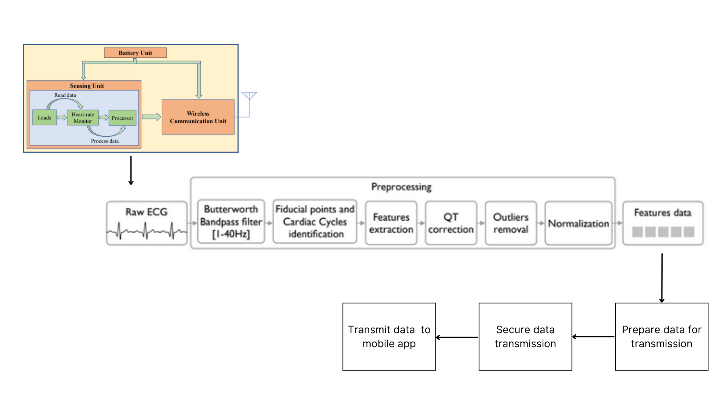
Block Diagram

Slide 18
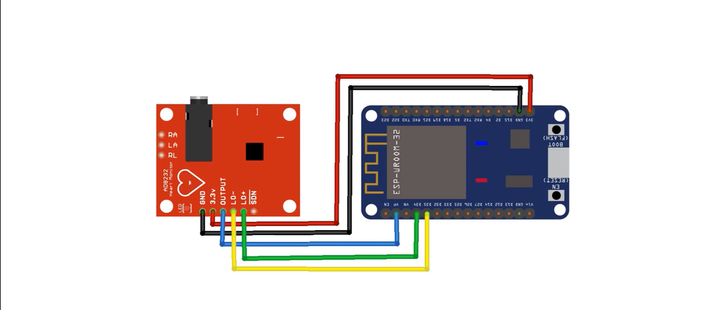
Hardware Diagram

Slide 19
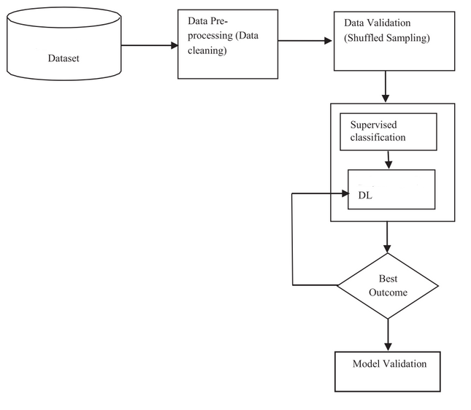
Software Design

Slide 20
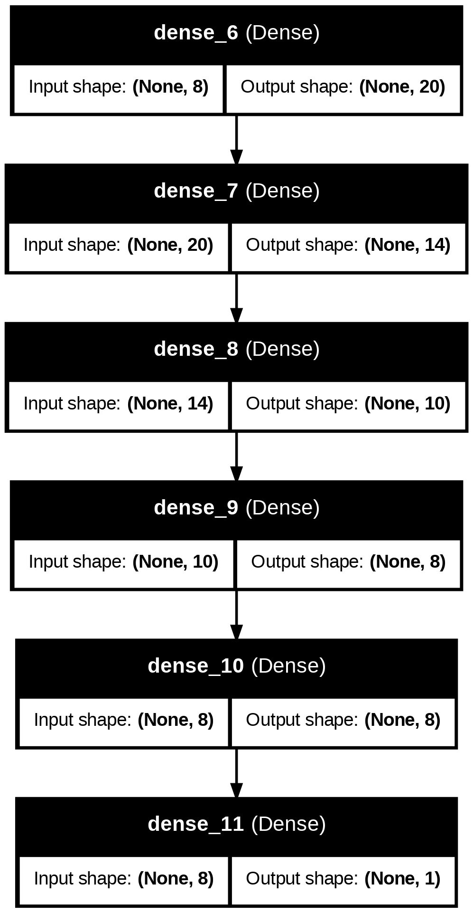
Results

Slide 21
Applications
Patient Monitoring | Continuous monitoring of ECG and other vital signs allows for tracking changes in health status
Data Fragmentation | Centralize patient data from various sources, ensuring healthcare providers have access to comprehensive health information.
Patient Engagement | Encourages proactive health management and enhances patient awareness regarding their diabetes status.
Early Diagnosis | Facilitates early detection of diabetes, enabling timely interventions and reducing complications.

Slide 22
Future Scope
1. Integration with Wearable Devices:
Enhance real-time monitoring
Continuous data collection and analysis
2. AI-Driven Decision Support Systems:
Assist healthcare professionals in diagnosing and managing diabetes
Improve clinical decision-making, streamline workflows
3. Expansion to Other Chronic Diseases:
Detect and monitor other chronic conditions
Broaden the project's impact and utility in healthcare

Slide 23
Conclusion
Deep learning integration, improving efficiency and accuracy
Mobile app accessibility improving ease of diabetes management
Future scalability for further interoperability

Slide 24
References
Zanelli, S.; Ammi, M.; Hallab, M.; El Yacoubi, M.A. Diabetes Detection and Management through Photoplethysmographic and Electrocardiographic Signals Analysis: A Systematic Review. Sensors 2022, 22, 4890. https://doi.org/10.3390/s22134890
P. P. San, S. H. Ling and H. T. Nguyen, "Deep learning framework for detection of hypoglycemic episodes in children with type 1 diabetes," 2016 38th Annual International Conference of the IEEE Engineering in Medicine and Biology Society (EMBC), Orlando, FL, USA, 2016, pp. 3503-3506, doi: 10.1109/EMBC.2016.7591483.
Chaki, Jyotismita & Ganesh, S. Thillai & Cidham, S.K & Srinivasan, Anandatheertan. (2020). Machine Learning and Artificial Intelligence based Diabetes Mellitus Detection and Self-Management: A Systematic Review. 10.1016/j.jksuci.2020.06.013.
Husain, K.; Zahid, M.S.M.; Hassan, S.U.; Hasbullah, S.; Mandala, S. Advances of ECG Sensors from Hardware, Software and Format Interoperability Perspectives. Electronics 2021, 10, 105. https://doi.org/10.3390/electronics10020105
Kumar, R., Swarnkar, M., Singal, G., & Kumar, N. (2022). IoT Network Traffic Classification Using Machine Learning Algorithms: An Experimental Analysis. In IEEE Internet of Things Journal (Vol. 9, Issue 2, pp. 989–1008). Institute of Electrical and Electronics Engineers (IEEE). https://doi.org/10.1109/jiot.2021.3121517
Panwar, Madhuri & Gautam, Arvind & Dutt, Rashi & Acharyya, Amit. (2020). CardioNet: Deep Learning Framework for Prediction of CVD Risk Factors. 10.1109/ISCAS45731.2020.9180636.
Swapna G, Soman Kp, Vinayakumar R, Automated detection of diabetes using CNN and CNN-LSTM network and heart rate signals, Procedia Computer Science, Volume 132, 2018, Pages 1253-1262, ISSN 1877-0509, https://doi.org/10.1016/j.procs.2018.05.041.

Slide 25
References
[8] Osama R. Shahin, Hamoud H. Alshammari, Ahmad A. Alzahrani, Hassan Alkhiri, Ahmed I. Taloba, A robust deep neural network framework for the detection of diabetes, Alexandria Engineering Journal, Volume 74, 2023, Pages 715-724, ISSN 1110-0168, https://doi.org/10.1016/j.aej.2023.05.072.
[9] Rabie Osama , Alghazzawi Daniyal , Asghar Junaid , Saddozai Furqan Khan , Asghar Muhammad Zubair, A Decision Support System for Diagnosing Diabetes Using Deep Neural Network, Frontiers in Public Health,10,2022,https://www.frontiersin.org/journals/public-health/articles/10.3389/fpubh.2022.861062, 10.3389/fpubh.2022.861062
[10] María Teresa García-Ordás, Carmen Benavides, José Alberto Benítez-Andrades, Héctor Alaiz-Moretón, Isaías García-Rodríguez, Diabetes detection using deep learning techniques with oversampling and feature augmentation, Computer Methods and Programs in Biomedicine, Volume 202, 2021, 105968, ISSN 0169-2607, https://doi.org/10.1016/j.cmpb.2021.105968.
[11] Wang, L.; Mu, Y.; Zhao, J.; Wang, X.; Che, H. IGRNet: A Deep Learning Model for Non-Invasive, Real-Time Diagnosis of Prediabetes through Electrocardiograms. Sensors 2020, 20, 2556. https://doi.org/10.3390/s20092556
[12] https://doi.org/10.48550/arXiv.1707.08386
[13] Naz H, Ahuja S. Deep learning approach for diabetes prediction using PIMA Indian dataset. J Diabetes Metab Disord. 2020 Apr 14;19(1):391-403. doi: 10.1007/s40200-020-00520-5. PMID: 32550190; PMCID: PMC7270283.

