Slide 1






PES’s Modern College of Engineering, Shivajinagar, Pune-5.
Department of Electronics and Telecommunication
2024-25
Chronic Kidney Disease Detection
And Guidance
Names of the student
1. Vedant Dindore
2. Anurag Ganvir
3. Varad Gondkar
Guided By : Dr. Prof. Mrs. Deepali Adhyapak

Slide 2



PES’s Modern College of Engineering, Shivajinagar, pune-5.
Department of Electronics and Telecommunication
Overview :
Introduction
Literature Survey (Market, Literature, Technological and Research Survey)
System Specifications
Block Diagram
Hardware Design
Software Design
Results (Photo / Audio-Visual / Video Results)
Applications
Future Scope
Conclusion
References

Slide 3
PES’s Modern College of Engineering, Shivajinagar, pune-5.
Department of Electronics and Telecommunication
Introduction :
Chronic Kidney Disease (CKD): A progressive loss of kidney function, early detection is key for better outcomes.
Role of Machine Learning: ML analyzes medical data to find patterns and develop predictive models for CKD.
Project Objectives: Build an efficient ML model to accurately detect CKD and improve early diagnosis.

Slide 4
PES’s Modern College of Engineering, Shivajinagar, pune-5.
Department of Electronics and Telecommunication
Traditional Method :
Physical Examination & Medical History: Initial assessment often involves reviewing the patient’s medical history, symptoms, and risk factors (e.g., diabetes, hypertension).
Urine and Blood Tests: Commonly used to check for markers like proteinuria, elevated serum creatinine, and abnormal glomerular filtration rate (GFR).
Imaging: Ultrasounds or CT scans help visualize kidney structure, but they do not directly assess function or disease severity.
Biopsy: Sometimes performed for a definitive diagnosis but is invasive and generally used only in uncertain cases. Takes more than 6hrs.

Slide 5
Literature Survey
Sr. No. | Year | Title & Authors | Methodology | Perf. Parameter Values | Limitations/Gap
1 | 2020 | Chronic Kidney Disease Prediction Using Machine Learning Methods | Data preprocessing involved filtering out attributes with over 20% missing values, followed by handling remaining missing data through Little's MCAR test to confirm randomness and address potential bias. | Accuracy = 97.33% Sensitivity = 95.65% Specitivity = 98.36% F1 score = 97% | Filtering out attributes with more than 20% missing values might discard useful data that could impact predictive performance.
2 | 2021 | Chronic Kidney Disease Prediction using Machine Learning Ensemble Algorithm | Four ensemble algorithms were used to diagnose CKD, with AdaBoost and Random Forest showing the best performance, achieving 100% AUC and Mathew Correlation Coefficient. | Accuracy of 97.5% in detecting signals using two algorithms single time. | Using multiple ensemble algorithms can increase computational complexity and resource requirements for model training and deployment.
3 | 2023 | Revolutionizing Chronic Kidney Disease Management with Machine Learning and Artificial Intelligence | This study explores using machine learning and neural networks to revolutionize CKD management by enabling faster, accurate diagnosis through automation, reducing manual analysis time. | Sensitivity = 87.5% Specitivity = 97.2% Accuracy = 95.8% | Implementation requires significant technological investment and infrastructure, which may not be feasible in all healthcare settings.
Chronic Kidney Disease Detection

Slide 6
Literature Survey
Sr. No. | Year | Title & Authors | Methodology | Perf. Parameter Values | Limitations/Gap
4 | 2017 | Reduction of Overfitting in Diabetes Prediction Using Deep Learning Neural Network Authors: Akm Ashiauzzaman. Abdul Kawsar Tushar. Md. Rashedul Islam. Jona-Mvon Kim | The study used a Chronic Kidney Disease dataset from UCI. Seven machine learning classifiers (ANN, C5.0, CHAID, etc.) were applied. | Supervised learning with data. | Logistic regression and KNN did not perform well, with lower accuracy and poor handling of unbalanced datasets. 2. The study relies on a single dataset, which may limit generalizability
5 | 2016 | Detection of Chronic Kidney Disease and Selecting Important Predictive Attributes | The study used a dataset of 400 individuals (250 with CKD) and applied three machine learning classifiers (k-nearest neighbors, random forest, and neural networks) for CKD detection. Feature selection with wrapper and LASSO methods reduced attributes from 24 to 5, creating a cost-effective method. | Accuracy = 93.07% Precision= 93% Recall = 92% F-score = 92% | The dataset had noisy and missing values, which required robust classifiers and techniques to handle them. 2. The evaluation is limited to a single dataset, which may affect the generalizability of the findings.
6 | 2016 | Prevalence of Chronic Kidney Disease in Population-based Studies: Systematic Review | A systematic review of population-based studies assessing CKD prevalence using the standardized methodology. | Accuracy (%) 98.07 Precision (%) 95.22 Recall (%) 98.46 F-Measure (%) 96.81 Specificity (%) 99.29 | Variability in study designs and GFR estimation methods limits comparability. 2. Some populations, like elderly or specific ethnic groups, may be underrepresented.
Chronic Kidney Disease Detection

Slide 7
Market Survey
Sr. No. | Year | Heading | Currrent Market Scenario | Impact of this project
1 | 2024 | Rise of AI in Healthcare | Growing integration of AI for diagnostics in healthcare but still limited in nephrology. | Positions the project as a leading solution in AI-driven nephrology, aligning with the AI trend in healthcare.
2 | 2024 | Personalized Treatment Demand | Rising patient demand for customized treatment options. | Supports personalized medicine by identifying patient-specific risk factors for CKD..
3 | 2024 | Healthcare Costs | High treatment costs for CKD, especially in later stages. | Lowers healthcare costs by enabling early intervention, potentially reducing the need for dialysis.
4 | 2024 | Regulatory Focus on Preventive Care | Increasing government focus on preventive care to lower chronic disease rates. | Aligns with public health initiatives, potentially attracting support and funding for prevention-focused tools.
Chronic Kidney Disease Detection

Slide 8
Market Survey
Sr. No. | Year | Heading | Currrent Market Scenario | Impact of this project
5 | 2024 | Growing CKD Incidence | Increasing CKD cases worldwide due to aging populations and lifestyle diseases. | Early detection could reduce disease burden and improve patient outcomes.
6 | 2024 | Demand for Early Diagnosis | Limited early detection methods; often diagnosed in later stages. | Provides a tool for early and accurate detection, helping in timely treatment and management.
7 | 2024 | Healthcare Costs | High treatment costs for CKD, especially in later stages. | Lowers healthcare costs by enabling early intervention, potentially reducing the need for dialysis.
8 | 2024 | Limited Access to Nephrologists | Shortage of specialized doctors, particularly in rural and underserved areas. | Machine learning models can assist general practitioners, improving accessibility to CKD detection.
Chronic Kidney Disease Detection

Slide 9
PES’s Modern College of Engineering, Shivajinagar, pune-5.
Department of Electronics and Telecommunication
Literature Survey :
1. Technological Survey :
Machine Learning Techniques :
Using Algorithms like Random Forest, Decision Trees, Neural Networks.
Data Sources and Tools :
Decision testing as verified datasets from Kaggle. Open Source data from UCI Machine Learning Repository (ICS UCI).
Current Technology Trends:
Advancements in data analytics, cloud computing, and AI that facilitate the development of robust CKD detection models.

Slide 10
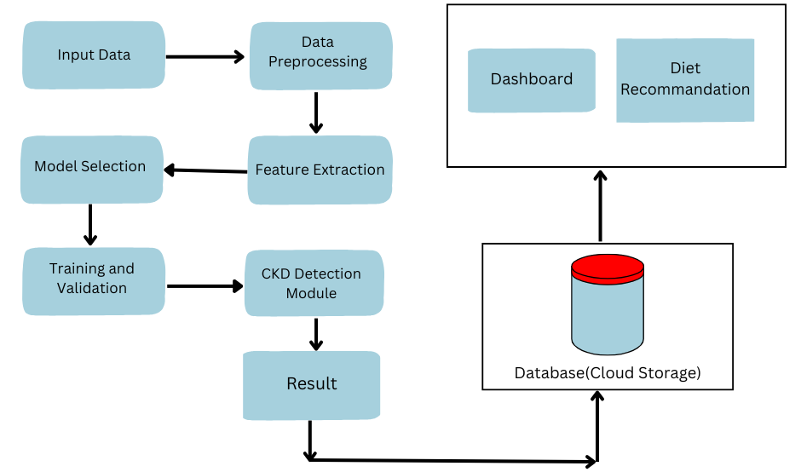
PES’s Modern College of Engineering, Shivajinagar, pune-5.
Department of Electronics and Telecommunication
System Specifications :
Block Diagram:

Slide 11
PES’s Modern College of Engineering, Shivajinagar, pune-5.
Department of Electronics and Telecommunication
System Specifications :
1. Hardware Components:
Arduino Microcontroller.
LCD Display (16x2 or 20x4).
Wi-Fi Module (e.g., ESP8266).
Power Supply.
2. Software Components
Cloud Platform.
Python (major) and CPP (for small robust application)
Communication Protocol : REST API.
Matlplotlib, Pyplot, Seaborn (for visualizing data)
Sklearn (for imputations), Decision Tree, Random Forest.

Slide 12
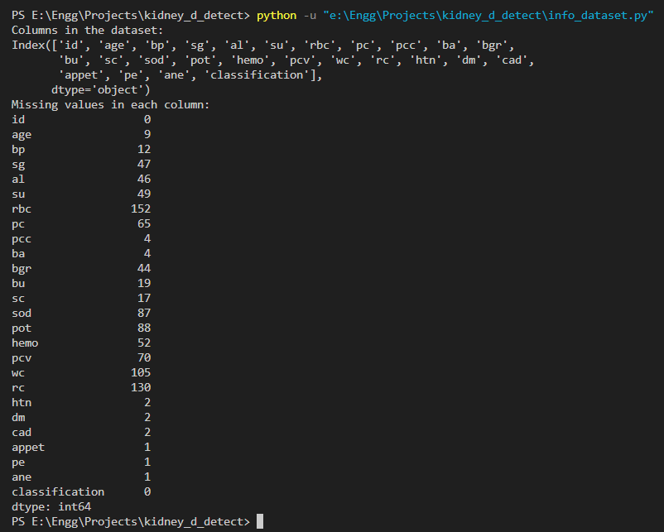
PES’s Modern College of Engineering, Shivajinagar, pune-5.
Department of Electronics and Telecommunication
Results :

Slide 13
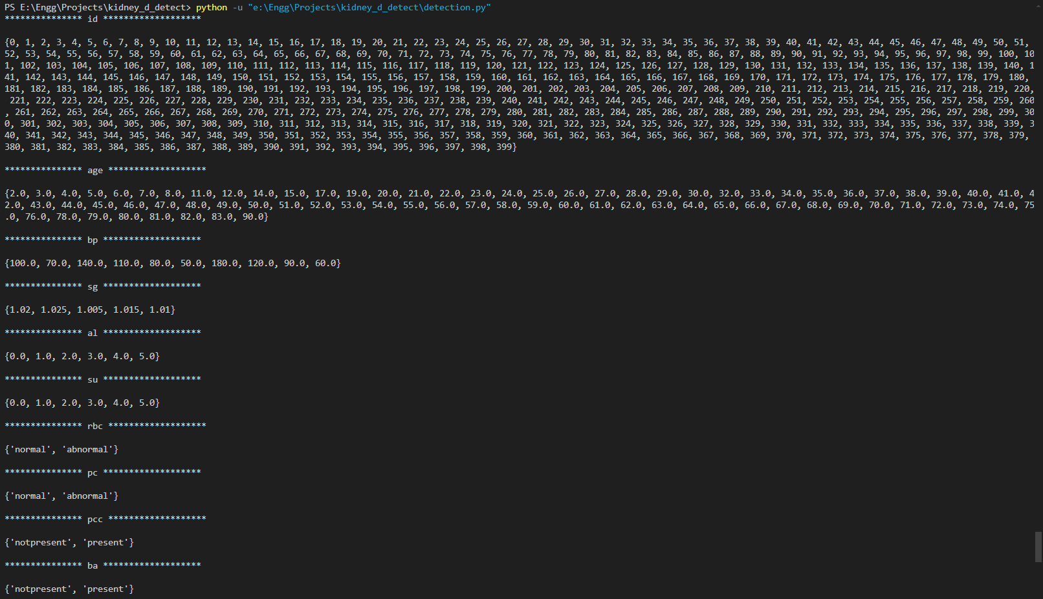
PES’s Modern College of Engineering, Shivajinagar, pune-5.
Department of Electronics and Telecommunication
Results :

Slide 14
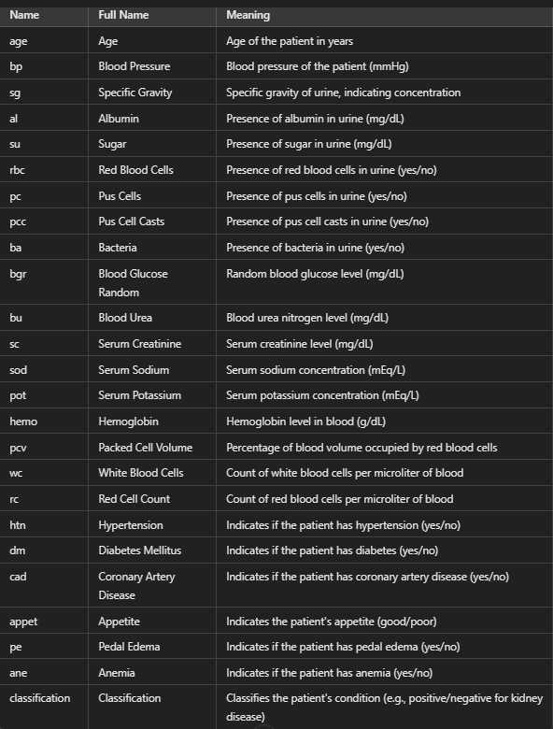
PES’s Modern College of Engineering, Shivajinagar, pune-5.
Department of Electronics and Telecommunication
Terminologies :

Slide 15
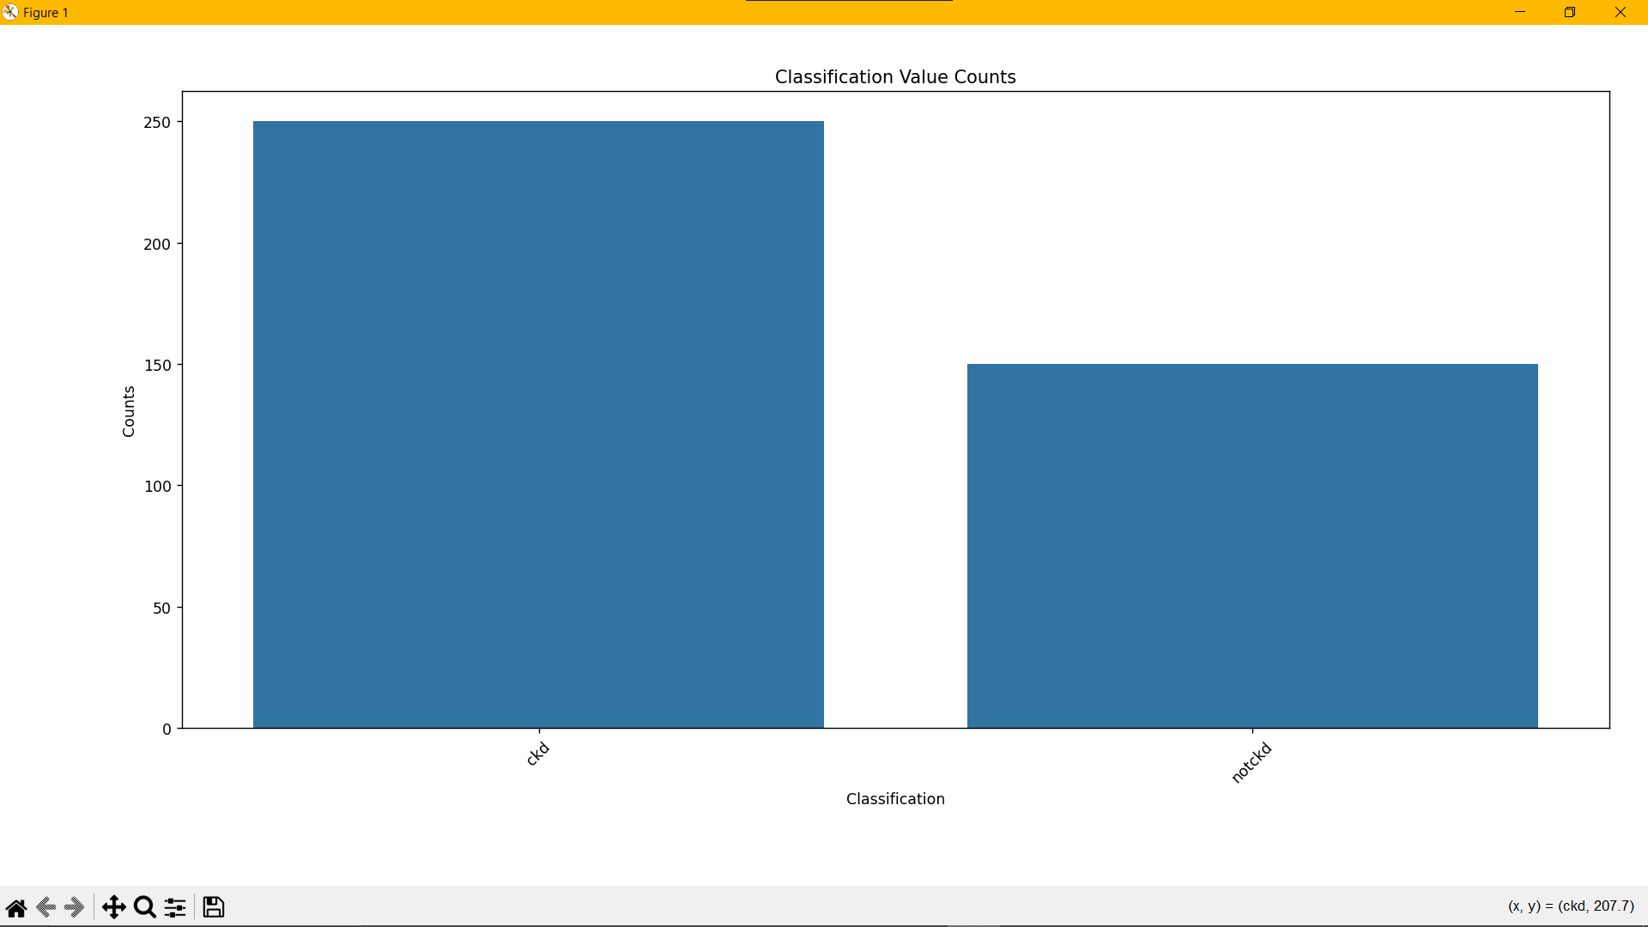
PES’s Modern College of Engineering, Shivajinagar, pune-5.
Department of Electronics and Telecommunication
Results :

Slide 16
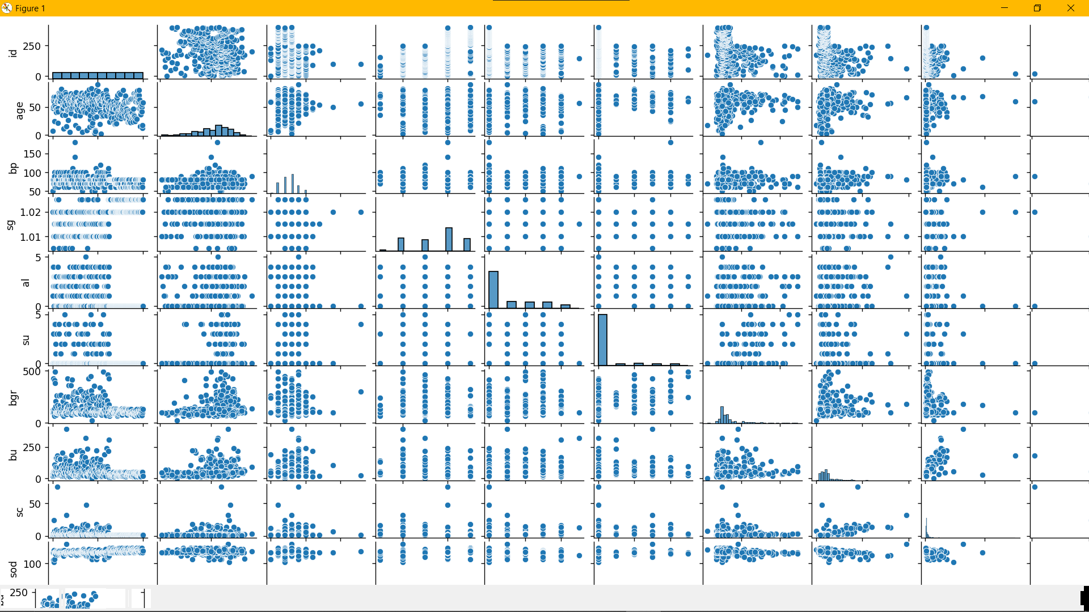
PES’s Modern College of Engineering, Shivajinagar, pune-5.
Department of Electronics and Telecommunication
Results :

Slide 17
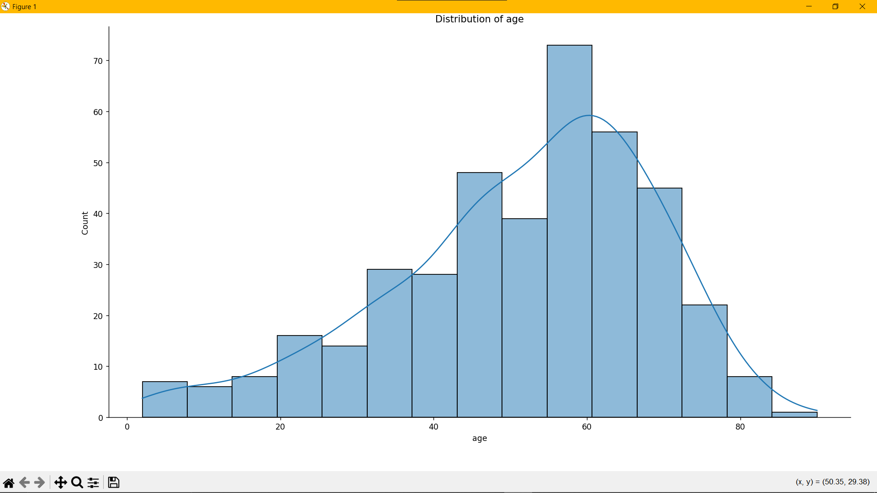
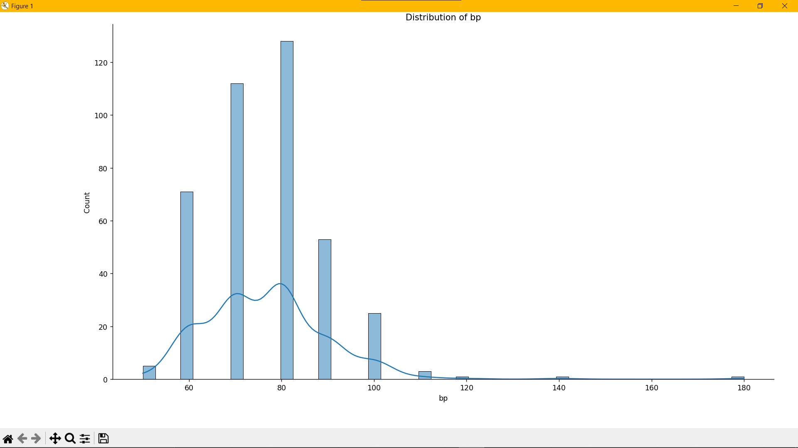
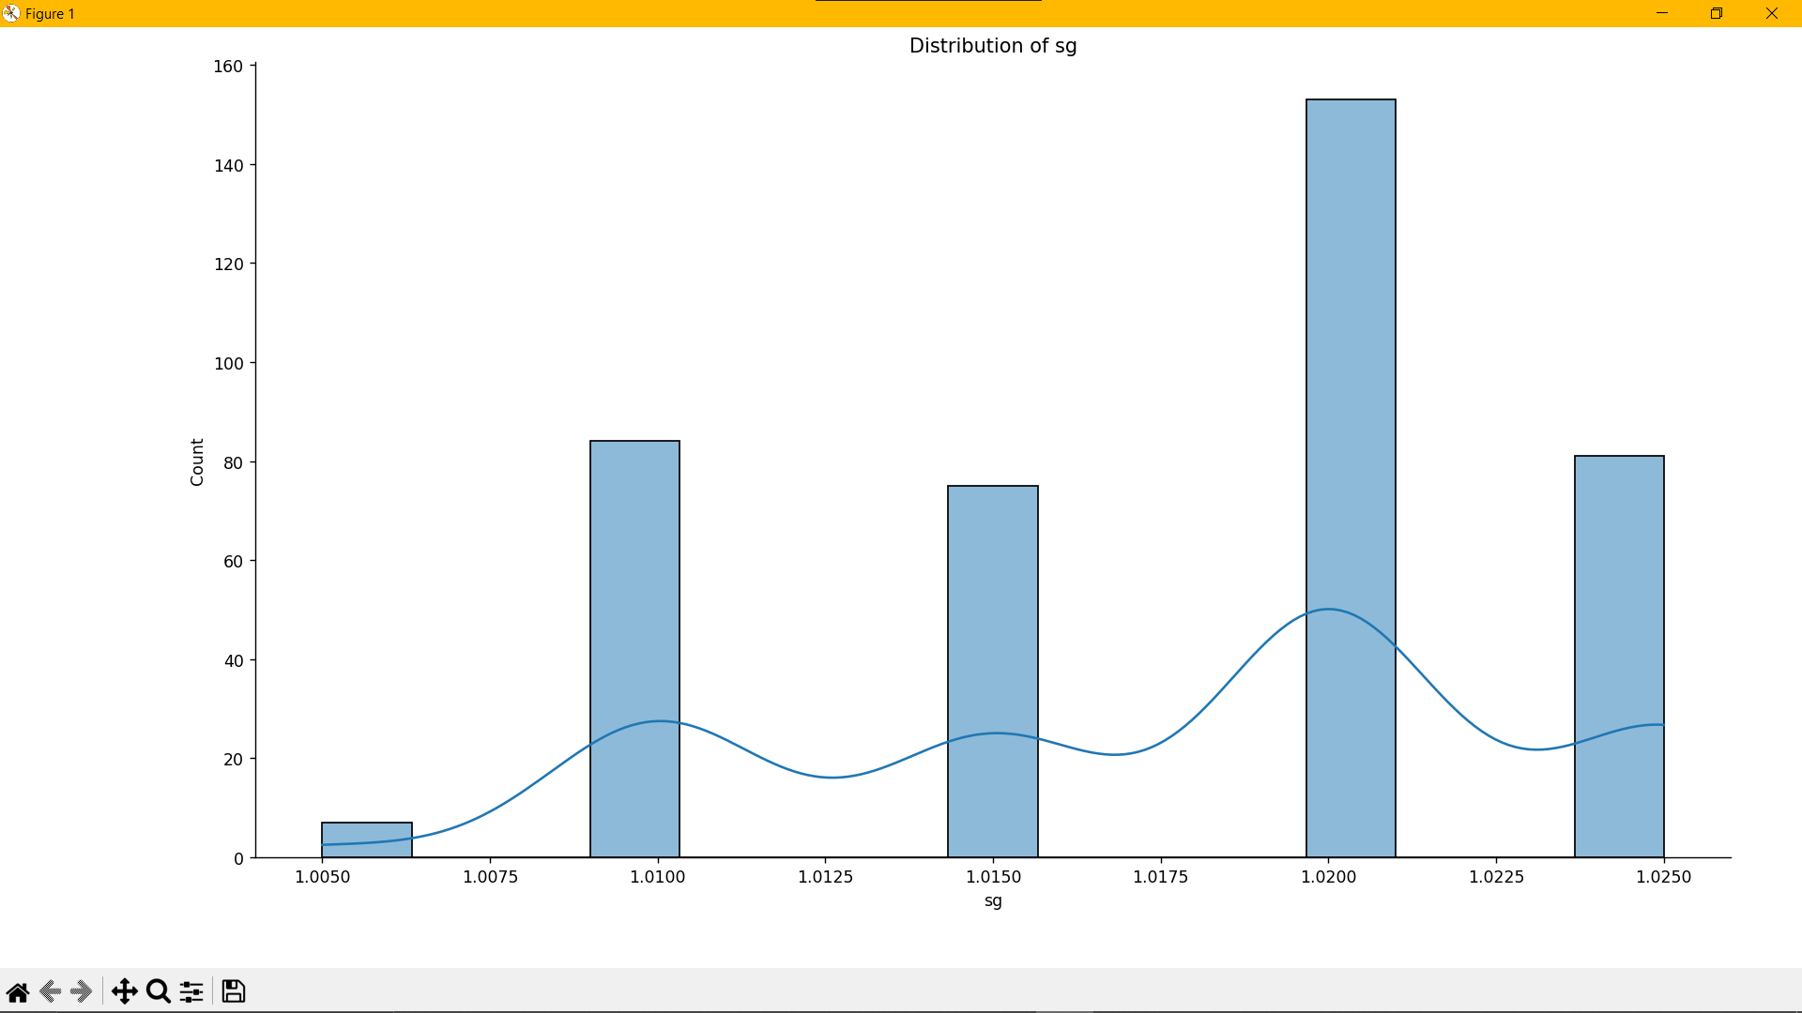
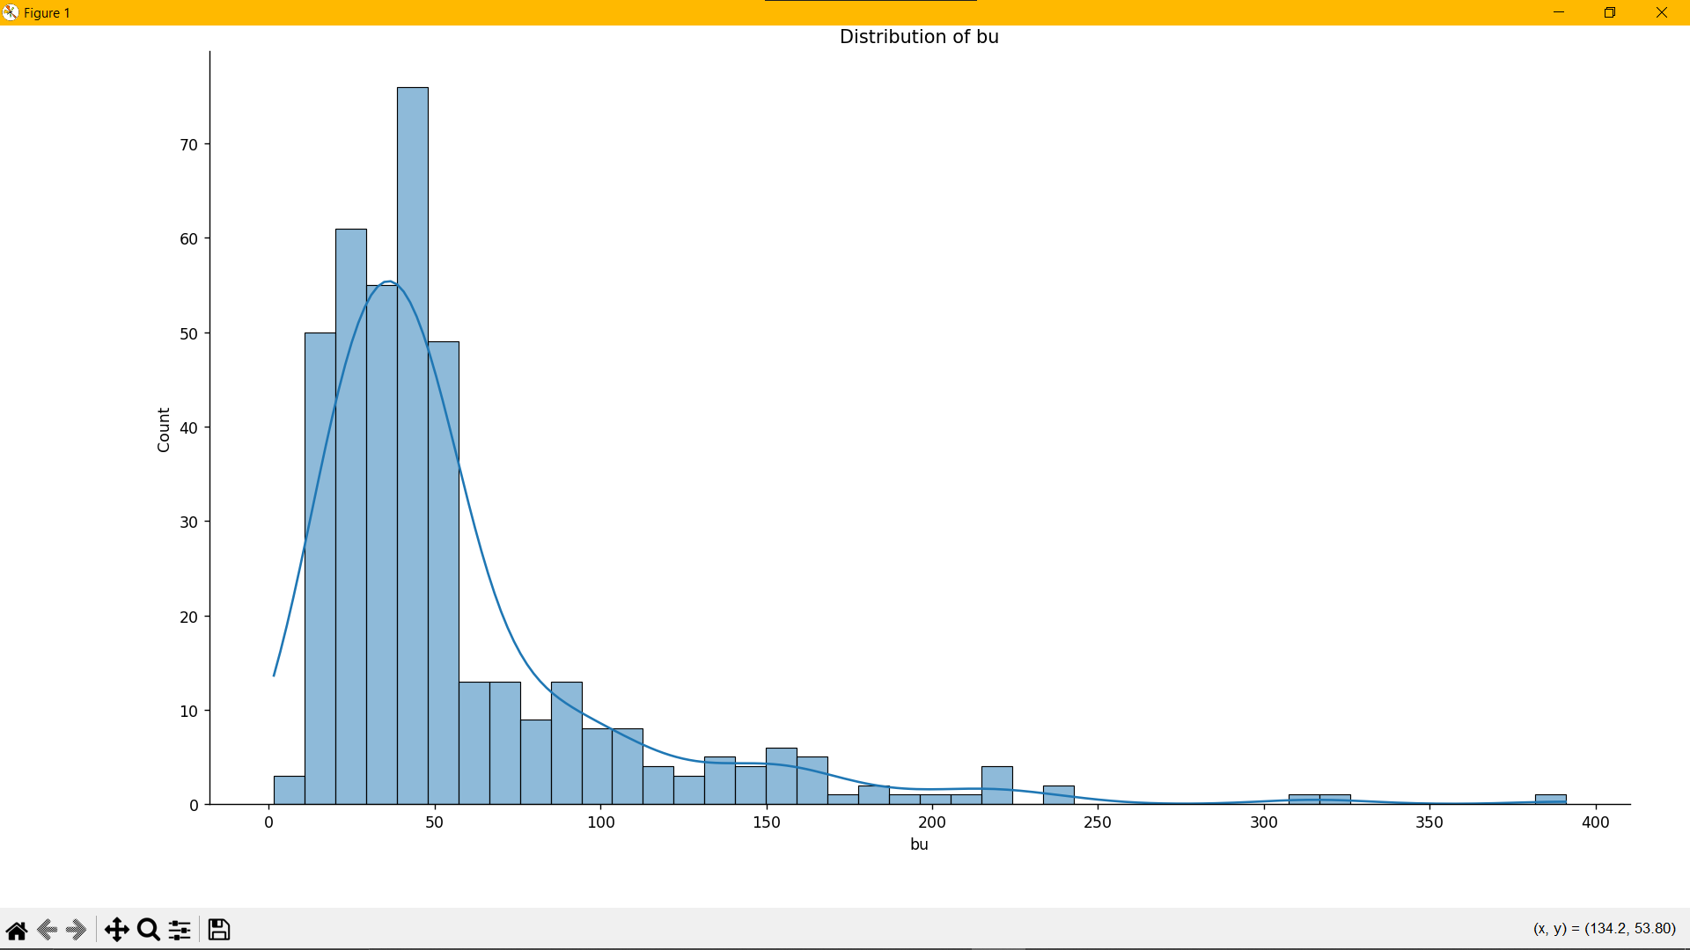
PES’s Modern College of Engineering, Shivajinagar, pune-5.
Department of Electronics and Telecommunication
Results :

Slide 18
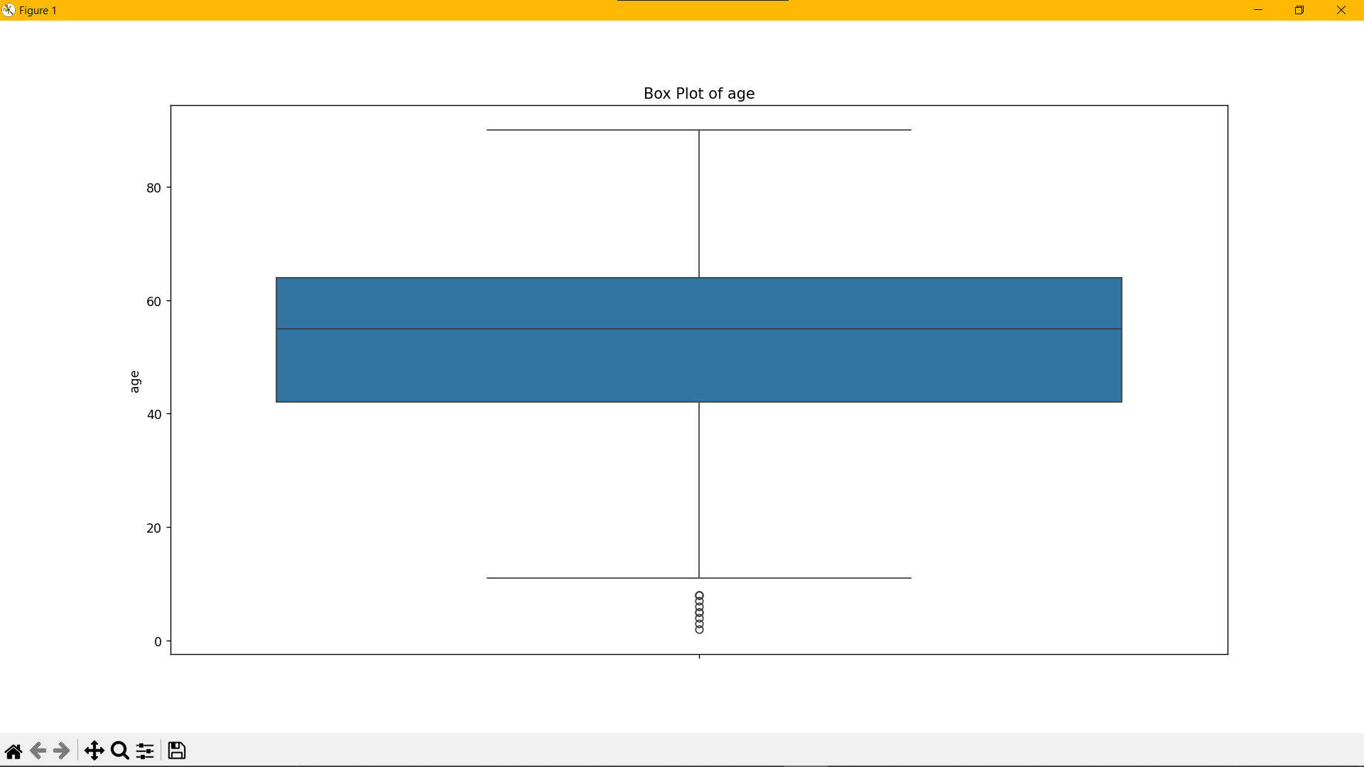
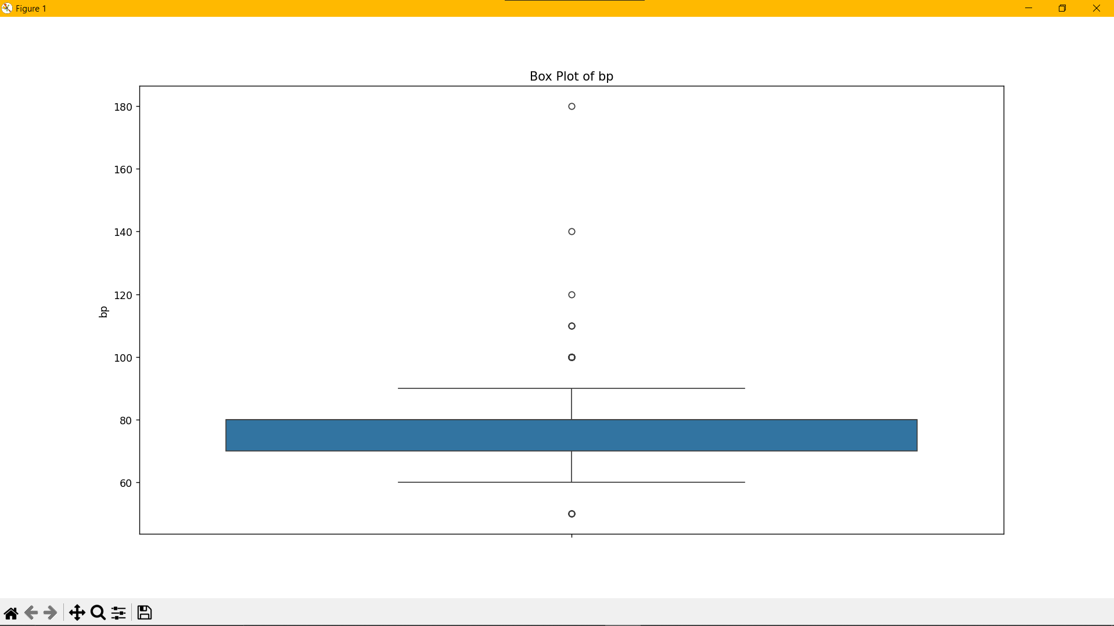
PES’s Modern College of Engineering, Shivajinagar, pune-5.
Department of Electronics and Telecommunication
Results :

Slide 19
PES’s Modern College of Engineering, Shivajinagar, pune-5.
Department of Electronics and Telecommunication
Applications:
Early Diagnosis in Healthcare.
Remote Patient Monitoring.
Personalized Treatment Plans.
Real-Time Alerts for Patients.
Integration with Wearable Technology.
Data-Driven Decision Making.
Cost-Effective Screening.
Support for Telemedicine.
Reducing time by 72.3%.

Slide 20
PES’s Modern College of Engineering, Shivajinagar, pune-5.
Department of Electronics and Telecommunication
Future Scope :
Improvement in Prediction Accuracy.
AI-Based Decision Support System.
Scalability for Global Improvement.
Advanced Iot & Wearable Integration.
Regulatory Approval & Clinical Integration.
Enhancing Computing Power.
Patient Centric Health Platforms.

Slide 21
PES’s Modern College of Engineering, Shivajinagar, pune-5.
Department of Electronics and Telecommunication
Conclusion :
This CKD detection system using machine learning combines real-time monitoring with cloud-based analysis to provide an efficient and cost-effective solution for early diagnosis. By leveraging hardware like Arduino and AWS’s cloud services, it enhances healthcare outcomes. With future improvements in accuracy and scalability, it has the potential to revolutionize CKD management, especially in remote and underserved areas.

Slide 22
PES’s Modern College of Engineering, Shivajinagar, pune-5.
Department of Electronics and Telecommunication
References:
[1] Imesh Udara Ekanayake, et al., &quot;A Machine Learning-Based System for Predicting Chronic
Kidney Disease (CKD) Focused on Early Detection through Clinical Data,&quot; Journal of Medical
Systems, 2021.
[2] Nikhila, et al., &quot;Machine Learning-Based System for Predicting Chronic Kidney Disease (CKD)
Using Ensemble Algorithms,&quot; International Journal of Engineering and Advanced Technology, 2020.
[3] Pankaj Chittora, et al., &quot;Exploring Machine Learning Techniques to Predict Chronic Kidney
Disease (CKD) with a Deep Neural Network,&quot; International Journal of Computer Applications, 2021.

Slide 23
PES’s Modern College of Engineering, Shivajinagar, pune-5.
Department of Electronics and Telecommunication
References:
[4] Asif Salekin, John Stankovic, &quot;A Machine Learning-Based Approach to Detect Chronic Kidney
Disease (CKD) Using 24 Predictive Attributes,&quot; Health Information Science and Systems, 2021.
[5] Rajeshwari, H.K. Yogish, &quot;Predicting Chronic Kidney Disease (CKD) Using Machine Learning
Techniques for Early Diagnosis,&quot; Journal of King Saud University - Computer and Information
Sciences, 2020.
[6] Chilakamarthi Prem Kashyap, Gollapudi Sai Dayakar Reddy, M. Balamurugan, &quot;Timely
Diagnosis of Chronic Kidney Disease (CKD) Using Machine Learning Techniques,&quot; Biomedical
Engineering Letters, 2022.

