Slide 1


FINAL-YEAR ENGINEERING PROJECT
Panopta
Data quality monitoring and
AI-assisted incident investigation
State Engineering Degree in Big Data and Artificial Intelligence
ISGA Casablanca, Academic year 2025-2026
PRESENTED BY
SUPERVISED BY
JURY
Mounir Gaiby
Pr. Hanine Mohamed
Pr. Hanine Mohamed
Pr. Samake Adama
Pr. Ben Darkawi Zakaria
Notes:
SCRIPT
Good morning. My name is Mounir Gaiby. I am presenting Panopta, my final-year engineering project at ISGA Casablanca. Panopta is a multi-tenant SaaS for data quality monitoring and AI-assisted incident investigation. The project grew from a concrete concern in payment systems, where a database can remain available while the data inside it becomes unusable.
SOURCES
CLAUDE.md. Rapport PFE Panopta.

Slide 2
OPENING
Presentation structure
01
Context
Oyster, problem, objective
02
Design
Architecture, runtime, database
03
Product flow
Sources, tables, monitors, incidents
04
Evidence
Big Data, AI, validation
05
Demo and conclusion
Running application and next work
02
Notes:
SCRIPT
I will begin with the professional context and the problem. I will then explain the functional scope, the architecture, the asynchronous runtime, and the database model. After that, I will follow the product itself, from a connected source to a table profile, a monitor, an incident, and an operational response. I will finish with governance, validation, and the demonstration.
SOURCES
Presentation structure prepared from the final PFE report.

Slide 3
CONTEXT
Oyster and my role in Payments
Software Engineer
Payments team
Professional employment
context, not an internship
A database can be available while the payment data inside it has already failed.
03
Notes:
SCRIPT
I work at Oyster as a Software Engineer in the Payments team. This is a professional role, not an internship. Payment work depends on tables that describe amounts, currencies, statuses, references, and settlement dates. A service may answer normally while one of those fields becomes stale or empty. That gap between system availability and data reliability motivated Panopta.
SOURCES
User-provided employment context. Oyster logo asset stored in docs/pfe/assets.

Slide 4
CONTEXT
The silent data failure
8,500
100%
orders returned normally
payment_status null rate
Infrastructure monitoring sees an available database.
The business sees orders that cannot be trusted.
04
Notes:
SCRIPT
Consider an orders table with 8,500 rows. The database responds, the API remains online, and no infrastructure alarm fires. Yet payment_status is null for every order. Operational dashboards become misleading, reconciliation loses meaning, and engineers discover the damage late. Panopta focuses on this exact class of failure, where the system runs but its data no longer supports the business process.
SOURCES
Synthetic public.orders PFE fixture. docs/pfe/screenshots/action-2026-09-12.

Slide 5
CONTEXT
Project objective and scope
Panopta turns a data defect into an investigation record.
IN SCOPE
BOUNDARY
Connect sources
Profile selected tables
Evaluate rules and detectors
Open incidents and route alerts
No automatic repair of customer data.
No claim that an AI hypothesis proves root cause.
No compliance certification.
05
Notes:
SCRIPT
The objective is to make a data problem visible, explainable, and assignable. Panopta connects to a source, discovers its schema, profiles selected tables, evaluates quality rules, and opens an incident when evidence crosses a defined threshold. The platform also routes alerts and stores the investigation history. It does not repair customer data automatically. The engineer remains responsible for diagnosis and remediation.
SOURCES
CLAUDE.md. docs/architecture.md.

Slide 6
PROJECT
Three-month development plan
JUNE
JULY
AUGUST
SaaS foundation and security
Sources, profiling, and detectors
Typed monitors and incidents
Governance, evidence, and report
ONGOING AFTER AUGUST
Scale evaluation, production recovery, and continued product development
06
Notes:
SCRIPT
The PFE development period ran from June through the end of August. June established the SaaS foundation, authentication, source connections, and profiling. July concentrated on detectors, monitor execution, and incident handling. August added the typed DSL, stronger connector contracts, AI governance, validation, and report evidence. Panopta remains an ongoing product, so performance studies and production hardening continue after the academic period.
SOURCES
docs/tracking.md. Notion 7-Day Build Log.

Slide 7
DESIGN
Panopta functional workflow
01
02
03
04
05
06
Connect
Discover
Profile
Evaluate
Investigate
Respond
Encrypted source
Schema and table
Compact metrics
Rules and models
Evidence and AI
Owner and alert
The same order now structures the technical explanation and the product demonstration.
07
Notes:
SCRIPT
This workflow provides the structure for the rest of the presentation. First, an organization connects a source. Panopta discovers tables and stores the selected monitoring configuration. Profiling then produces compact measurements. Rules and detectors evaluate those measurements. A failure creates or updates an incident. Finally, the platform explains the evidence, assigns ownership, and sends the alert to the configured operational channel.
SOURCES
CLAUDE.md core data flow. docs/architecture.md.

Slide 8
DESIGN
System architecture
USER LAYER
APPLICATION LAYER
PERSISTENCE
React interface
JWT workspace session
FastAPI
validation and tenancy
PostgreSQL
29 application tables
EXECUTION LAYER
Data source connectors
bounded read-only work
APScheduler, Celery, Redis
asynchronous execution
LLM provider
structured incident narration
08
Notes:
SCRIPT
The React interface communicates with an asynchronous FastAPI backend. PostgreSQL stores tenants, source metadata, profiles, monitor revisions, runs, incidents, and governance evidence. APScheduler decides when tables are due. Celery workers execute profiling, detection, narration, and alert tasks through Redis. Source connectors perform bounded read-only operations. The language model receives structured incident context only after Panopta has persisted the observed checks.
SOURCES
CLAUDE.md technology stack and core data flow. backend/app/main.py. backend/app/tasks.py.

Slide 9
DESIGN
Asynchronous monitoring execution
API
Worker
Source connector
PostgreSQL
1. Queue profile or monitor run
2. Execute bounded plan
3. Return measurements
4. Persist profile and run
5. Update incident and alerts
09
Notes:
SCRIPT
A request does not hold the browser open while a large table is profiled. The API validates the request and queues a job. The worker loads the organization and source context, executes one aggregate profile query, persists the snapshot, and runs the configured checks. If those checks fail, Panopta updates the incident, generates the AI narration, and dispatches alerts. Every stage leaves a database record that can be inspected later.
SOURCES
backend/app/tasks.py. backend/app/scheduler.py. CLAUDE.md core data flow.

Slide 10
DESIGN
Database structure
29
7
Identity and tenancy
organizations, users, roles, keys, invites, teams
5
Monitoring setup
sources, tables, SQL monitors, typed monitors, revisions
ORM tables
4
Observation and runtime
profiles, check results, runs, evaluation state
4
Operations
incidents, alerts, preferences, on-call schedules
9
AI governance
systems, versions, data uses, manifests, evidence, controls
10
Notes:
SCRIPT
The application database contains 29 ORM tables grouped into five domains. Identity and tenancy manage organizations, users, roles, keys, and invitations. Monitoring configuration covers sources, tables, and monitor definitions. Observation tables preserve profiles, check results, runs, and evaluation state. Operations store incidents, alert routes, notification preferences, and on-call ownership. The governance domain stores versioned AI systems, manifests, approvals, evidence, controls, and governance incidents.
SOURCES
backend/app/models. CLAUDE.md database schema.

Slide 11
DESIGN
Core monitoring relationships
Organization
DataSource
MonitoredTable
TableProfile
CONFIGURATION AND OBSERVATION
Monitor
MonitorRevision
MonitorRun
Incident
IMMUTABLE RULE AND EXECUTION HISTORY
CheckResult links each profile to the evidence that can open or update an incident.
11
Notes:
SCRIPT
At the center of the model, an organization owns data sources. A source exposes monitored tables. Each profile belongs to one table and contains row count, freshness, schema fingerprint, and column metrics. Check results reference the observed profile. A typed monitor points to an immutable revision, while each run records the exact revision it executed. Failed evidence reaches an incident, which can accumulate repeated checks without creating duplicate open incidents.
SOURCES
backend/app/models. backend/app/services/incident.py.

Slide 12
DESIGN
Tenant isolation and credential security
Workspace A
Organization A
Rows scoped by org_id
per-organization credentials
FastAPI
resolved organization context
Workspace B
Organization B
Rows scoped by org_id
separate encrypted config
JWT workspace sessions. Role checks. Separate staff portal. HKDF-derived encryption keys.
12
Notes:
SCRIPT
Every protected request resolves an organization from the user session. Queries then scope customer records with org_id. Roles separate owners, administrators, and members, while staff authentication uses a different portal. Panopta encrypts each source configuration with a key derived from the master secret and the organization identifier. This prevents one tenant from decrypting another tenant's source credentials through an ordinary application path.
SOURCES
backend/app/auth.py. backend/app/services/crypto.py. CLAUDE.md auth pattern.

Slide 13
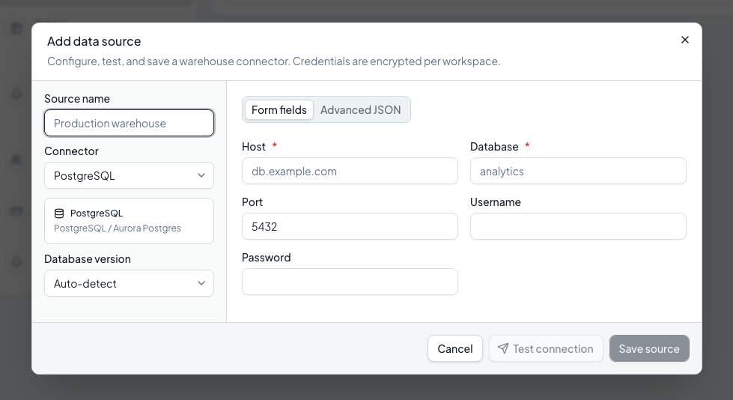
PRODUCT FLOW 01
Sources and connector maturity
SOURCE
PostgreSQL is the stable demonstration path. Other connectors expose capability-based maturity rather than identical promises.
13
Notes:
SCRIPT
The product journey begins with a source. Panopta has adapters for relational databases, warehouses, document stores, Cassandra, and Redis. The catalogue does not pretend that every connector has the same maturity. PostgreSQL is the stable path used in this defense. DuckDB and SQLite are beta. The remaining implemented adapters are marked experimental until their operational promotion gates are satisfied.
SOURCES
CLAUDE.md connector registry. frontend connector catalogue.

Slide 14
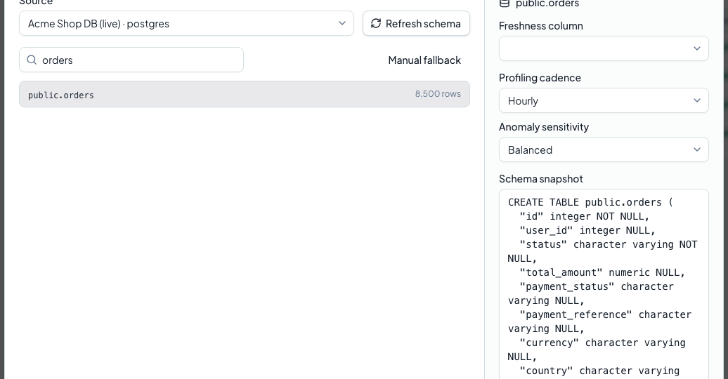
PRODUCT FLOW 02
Connection and schema discovery
DISCOVER
The operator tests the connection, refreshes the schema, and selects the exact table to monitor.
14
Notes:
SCRIPT
After storing the encrypted connection configuration, the operator tests the live connection. Panopta then discovers schemas and tables through the connector. The user selects public.orders, and the captured schema confirms that created_at is available for freshness monitoring. The table configuration stores the cadence, sensitivity, and freshness field. Discovery is the first product action built on top of the connector and tenant model.
SOURCES
docs/pfe/screenshots/action-2026-09-12/04-discovery.png. backend/app/routers/sources.py.

Slide 15
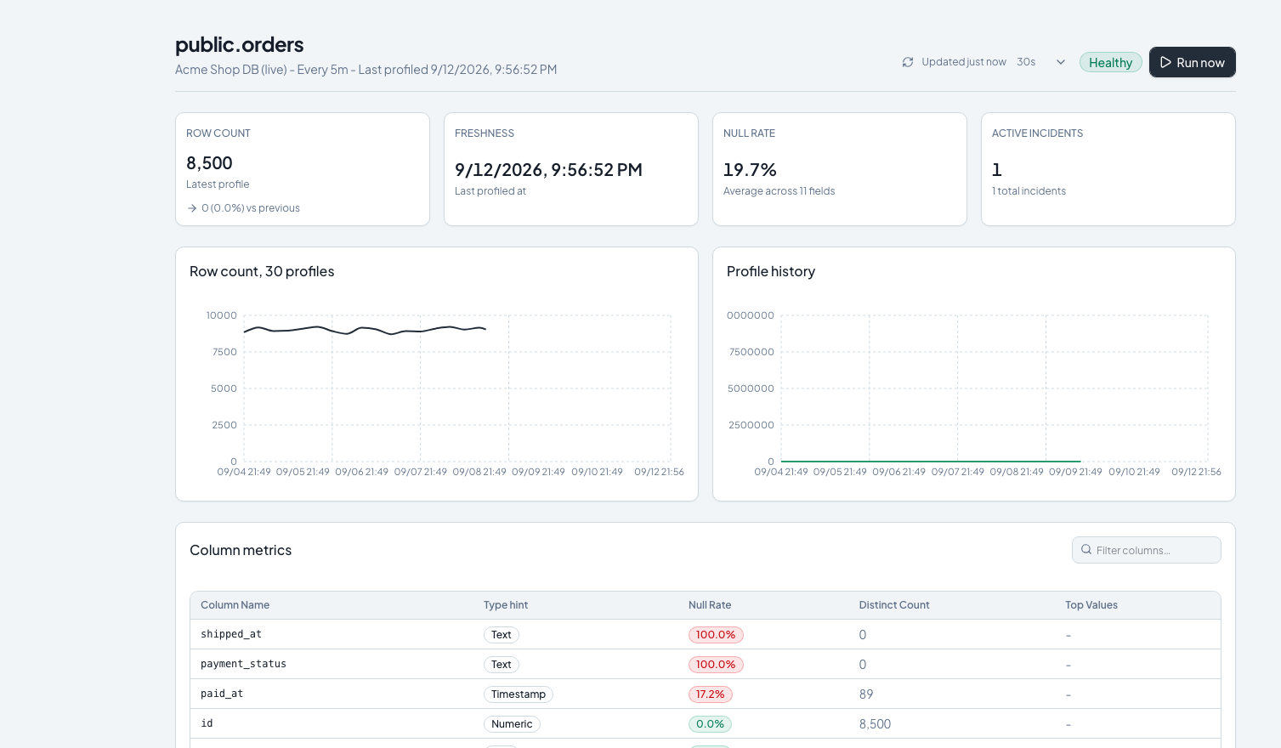
PRODUCT FLOW 03
Table profiling
PROFILE
One source-side aggregate query becomes a compact historical snapshot. Raw table rows stay in the source.
15
Notes:
SCRIPT
Once the table is registered, Panopta profiles it. The profiler builds a single aggregate query rather than loading rows into the application. It collects row count, freshness, null rates, distinct counts, numeric summaries, timestamp ranges, and text-length metrics. The application stores a compact snapshot for historical comparison. In this scenario, public.orders contains 8,500 rows and payment_status has reached a 100 percent null rate.
SOURCES
backend/app/services/profiler.py. docs/pfe/screenshots/action-2026-09-12/05-profile.png.

Slide 16
PRODUCT FLOW 04
Data quality detection
RULES
Z-SCORE
Empty table
Freshness breach
Schema drift
Current metric versus
recent profile history
Immediate checks
7 profiles minimum
ISOLATION FOREST
STL
Multivariate outlier
across profile features
Seasonal baseline versus
unexpected residual
21 profiles minimum
21 daily profiles
16
Notes:
SCRIPT
Panopta combines explicit expectations with historical detection. Rule checks catch empty tables, freshness breaches, schema drift, and large null-rate changes immediately. Z-scores compare current metrics with recent profiles. Isolation Forest looks for multivariate outliers after enough history exists. STL separates seasonal structure from unexpected residuals on daily series. The engine records the observed value, expected range, status, and deviation score for every check.
SOURCES
backend/app/services/anomaly.py. CLAUDE.md detection methods.

Slide 17
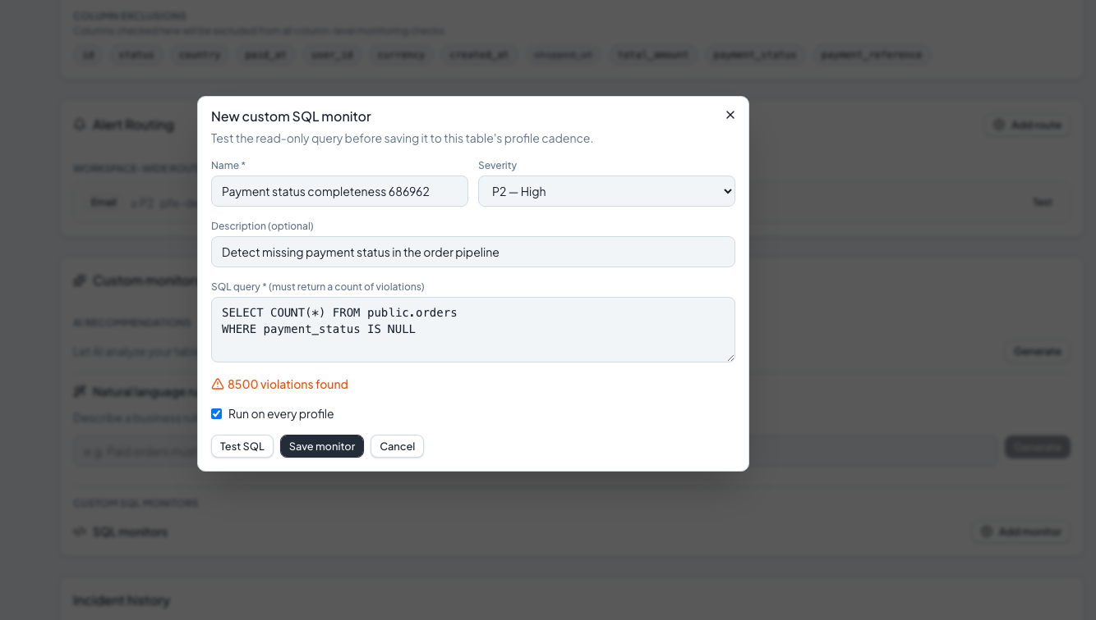
PRODUCT FLOW 05
Read-only SQL monitors
SQL
A restricted scalar query expresses a business rule. Testing returned 8,500 real violations before the rule could be saved.
17
Notes:
SCRIPT
Some quality expectations are easiest to express with SQL. This monitor counts orders where payment_status is null. Panopta accepts a restricted, read-only scalar query and requires the current SQL to pass a test before saving. During the recorded run, PostgreSQL returned 8,500 violations. The rule can execute on demand and after each scheduled profile, but it cannot modify the source database.
SOURCES
backend/app/services/legacy_sql_monitor.py. docs/pfe/screenshots/action-2026-09-12/09-sql-test.png.

Slide 18
PRODUCT FLOW 06
Typed monitor definition
MEASUREMENT
OPERATIONAL POLICY
metric: null_rate
field: payment_status
Severity
P2
Breach
1 failing run
Recovery
2 passing runs
BREACH CONDITION
null_rate > 0.01
Cooldown
60 minutes
Trigger
After each profile
The compiler validates the field against the captured schema before activation.
18
Notes:
SCRIPT
The typed DSL provides a safer alternative to free-form SQL. This definition binds the null_rate metric to payment_status and marks a breach above 0.01, which means one percent. The policy sets P2 severity, requires one failing run, requires two passing runs for recovery, and applies a 60-minute cooldown. The compiler validates the field against the captured schema before activation.
SOURCES
backend/app/services/monitor_dsl.py. docs/pfe/screenshots/action-2026-09-12/13-dsl-preview.png.

Slide 19
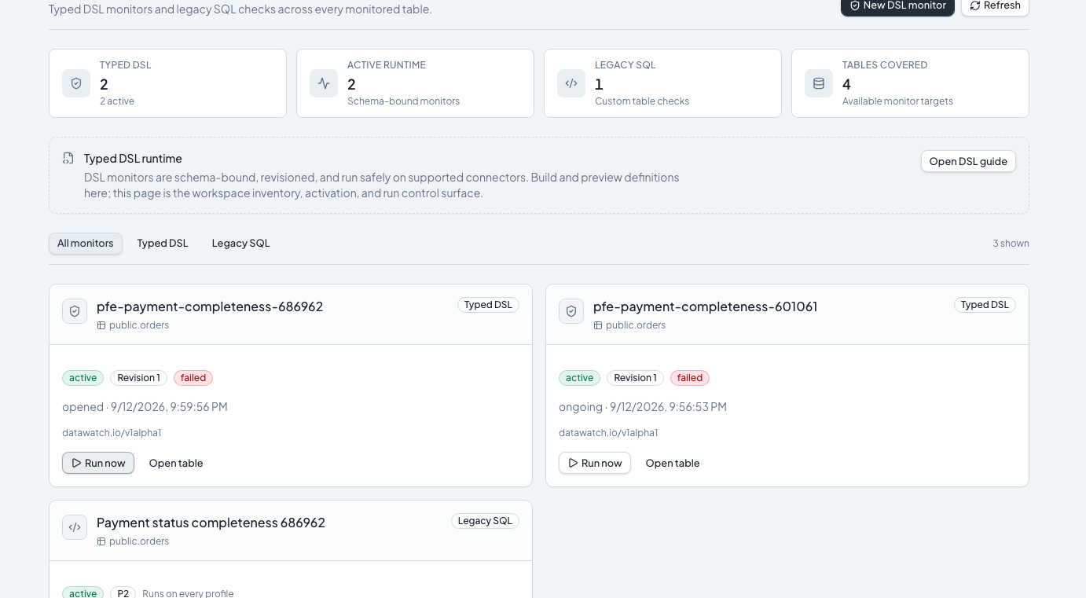
PRODUCT FLOW 07
Monitor revisions and traceable runs
EXECUTE
Activation freezes revision 1. Each run keeps the revision identity, compiled plan, status, and measured result.
19
Notes:
SCRIPT
Validation produces a canonical definition and a stable hash. Activation freezes that document as revision 1 and points the monitor to it. A run records the revision, connector plan, idempotency key, timing, status, and measurements. This design lets an engineer answer two precise questions later. Which rule ran, and what evidence did that exact rule produce?
SOURCES
backend/app/models/monitor.py. backend/app/services/monitor_runtime.py.

Slide 20
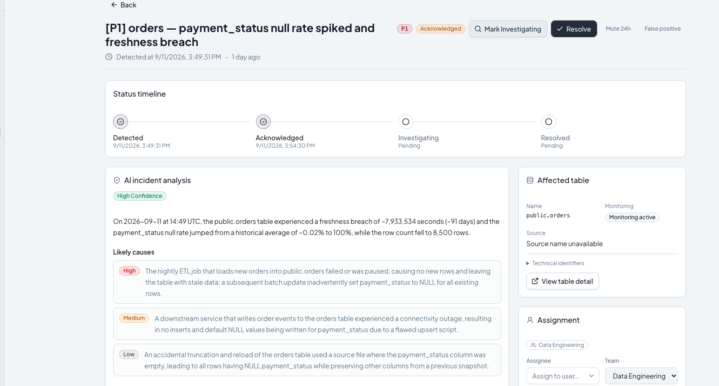
PRODUCT FLOW 08
Incident evidence and lifecycle
INCIDENT
Detected, acknowledged, investigating, resolved. The timeline records responsibility without claiming that acknowledgement repaired the data.
20
Notes:
SCRIPT
A failed check becomes operational through the incident lifecycle. Panopta opens one active incident per table, then appends repeated evidence instead of flooding the team with duplicates. Severity depends on the failed checks. The detail view shows the affected table, observed signals, status history, and ownership. Acknowledgement means that someone has taken responsibility. Resolution requires later recovery evidence or an explicit operational decision.
SOURCES
backend/app/services/incident.py. docs/pfe/screenshots/action-2026-09-12/17-incidents.png.

Slide 21
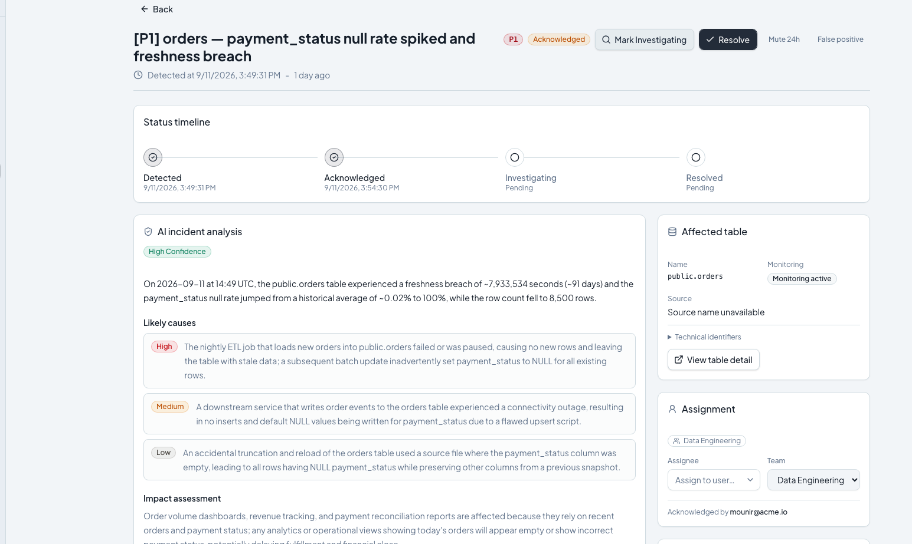
PRODUCT FLOW 09
AI-assisted incident analysis
EXPLAIN
The model receives structured evidence and returns a validated explanation, likely causes, impact, and diagnostic actions.
21
Notes:
SCRIPT
For P1 and P2 incidents, Panopta builds a compact context from the table profile and fired checks. The language model returns structured JSON containing a summary, probable causes, impact, and recommended diagnostic actions. The backend validates that structure before storing it. These causes remain hypotheses. The model helps the engineer read the evidence faster, but it does not claim that a suggested cause has been proven.
SOURCES
backend/app/services/llm.py. docs/pfe/screenshots/action-2026-09-12/19-ai-analysis.png.

Slide 22
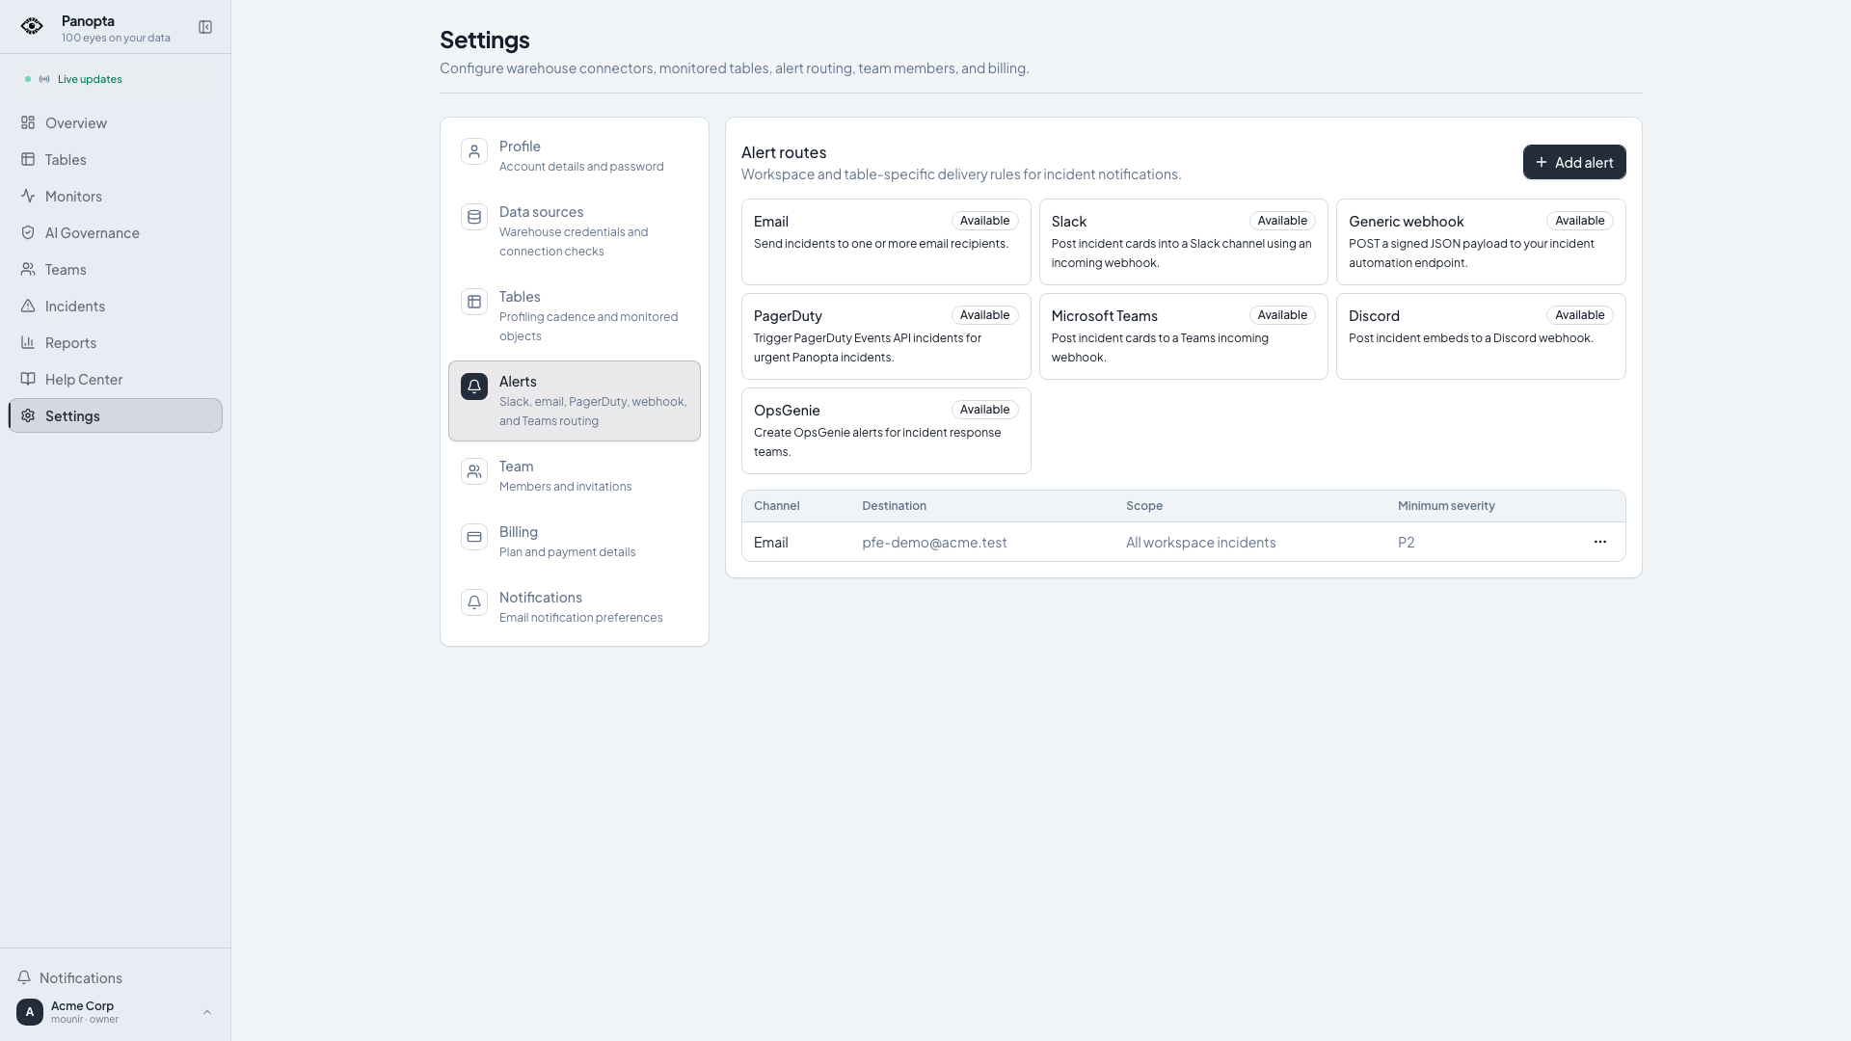
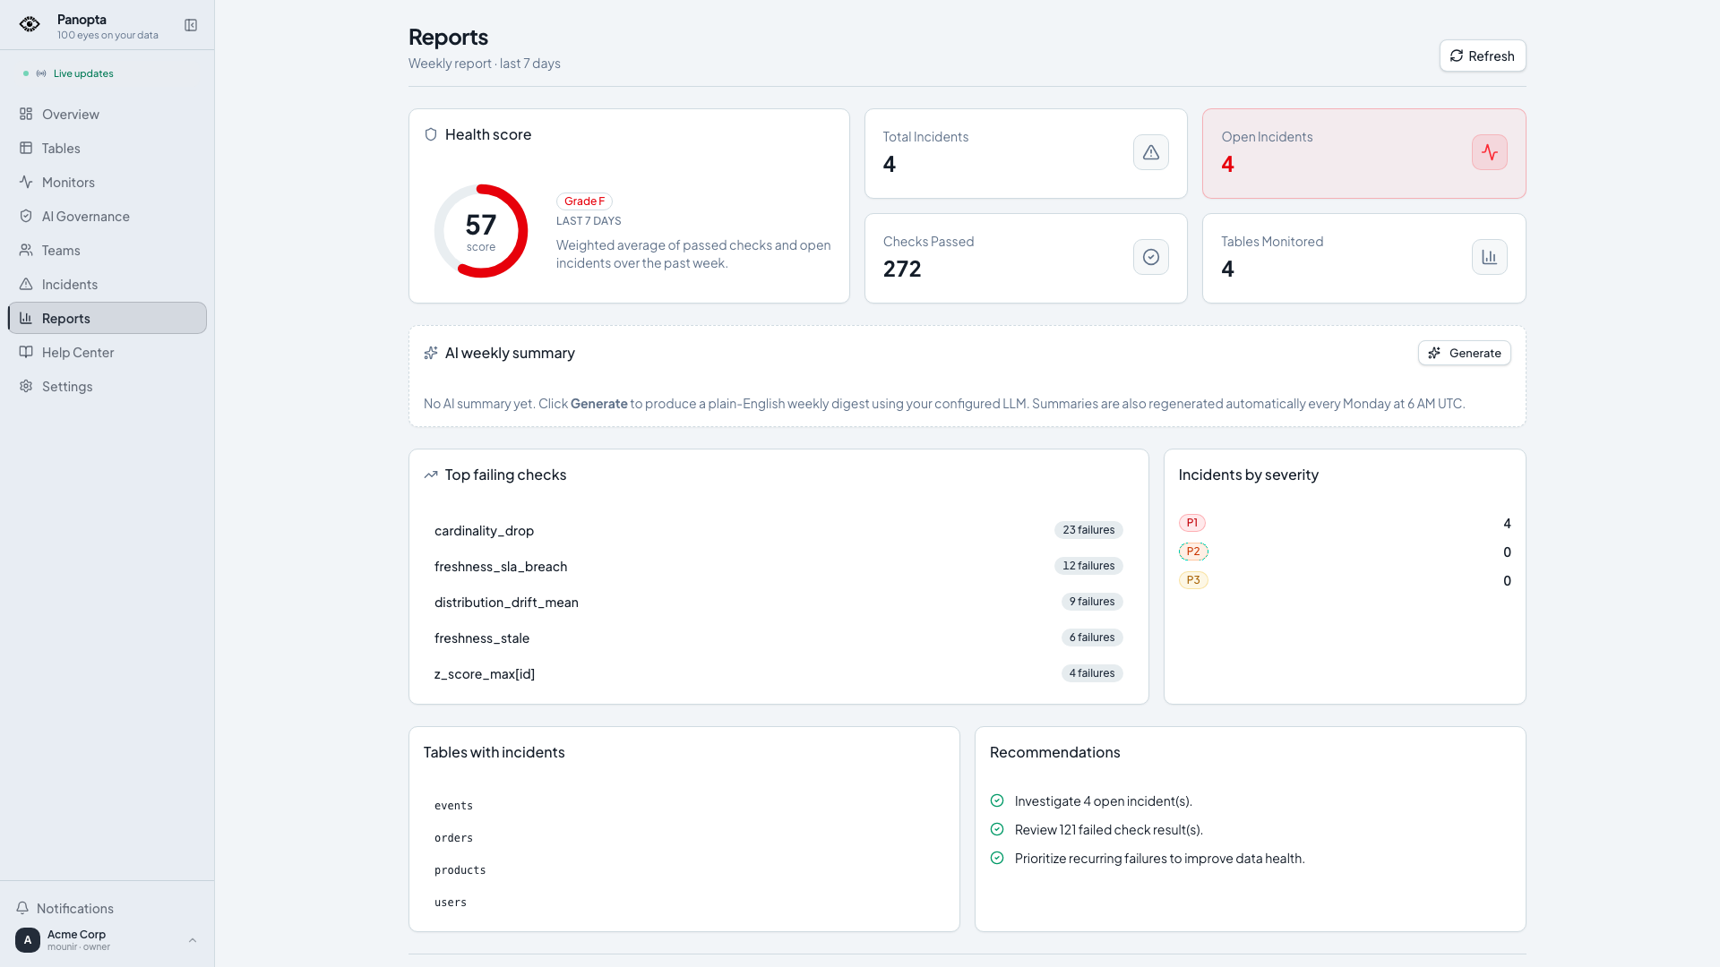
PRODUCT FLOW 10
Operational response
ALERT ROUTES
REPORTS
Detection decides when evidence fails. Routing, ownership, and reporting decide what the team does next.
22
Notes:
SCRIPT
The incident must reach a person who can act. Alert routes support email, Slack, PagerDuty, and signed webhooks with severity thresholds. Teams and on-call schedules define responsibility. Notification preferences control delivery without changing the detector itself. Reports then summarize health and incident history across the workspace. In the local demonstration, Panopta delivers a real alert to MailHog without contacting an external customer.
SOURCES
backend/app/services/alert.py. docs/pfe/screenshots/action-2026-09-12/22-alerts.png. docs/pfe/screenshots/action-2026-09-12/24-reports.png.

Slide 23
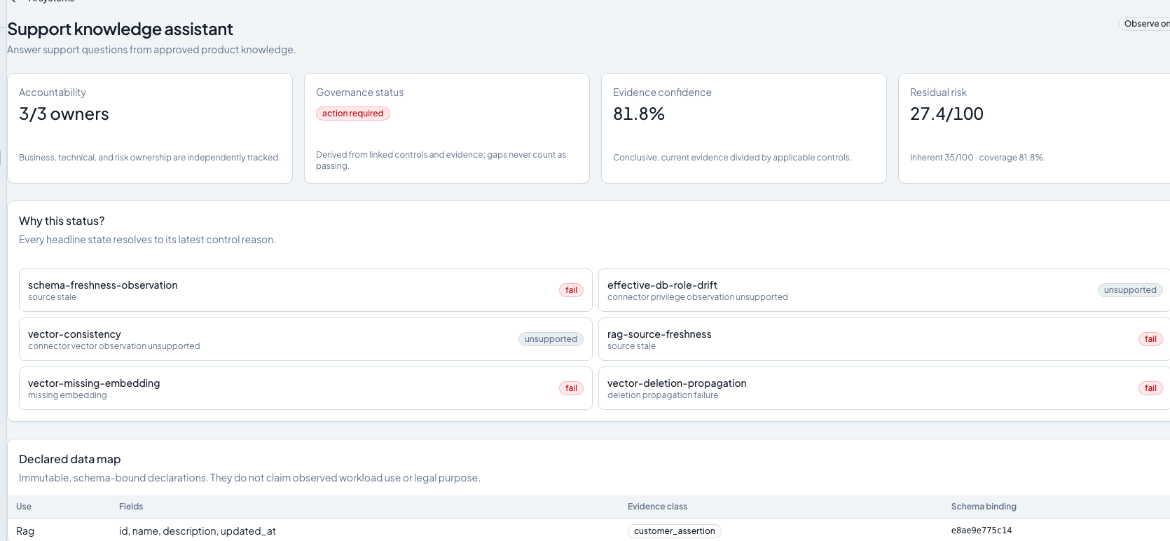
PRODUCT FLOW 11
AI governance prototype
GOVERN
The prototype inventories AI systems, versions, declared data uses, evidence, controls, approvals, and deployments in observe-only mode.
23
Notes:
SCRIPT
Panopta also contains a small AI governance prototype. It records an AI system, its version, declared data uses, release manifests, deployments, approvals, evidence, and control evaluations. The interface calculates evidence confidence and residual risk from the available records. This module operates in observe-only mode. It surfaces missing or failed evidence and can create an incident, but it does not certify legal compliance and it does not block a deployment.
SOURCES
docs/ai-governance.md. backend/app/models/ai_governance.py. docs/pfe/screenshots/action-2026-09-12/27-governance.png.

Slide 24
EVIDENCE
Big Data, AI, and validation evidence
67
26
0
0
targeted backend tests
validated presentation slides
browser page errors
failed Panopta API responses
BIG DATA
ARTIFICIAL INTELLIGENCE
Source-side aggregation and asynchronous connector execution
Anomaly detection, structured LLM narration, and evidence-oriented governance
Local PFE evidence. These numbers are validation results, not production SLA claims.
24
Notes:
SCRIPT
The Big Data contribution lies in connector-aware, source-side aggregation and asynchronous execution. Panopta stores measurements rather than copying full customer tables. The AI contribution combines anomaly detection with a structured LLM explanation layer and an evidence-oriented governance prototype. For this delivery, 67 targeted backend tests passed. The 26-slide package passed integrity and geometry checks. The recorded browser journey produced zero page errors and zero failed Panopta API responses.
SOURCES
Local validation on 2026-09-12. Commit 1060b1d. docs/pfe/DEFENSE_STUDY_GUIDE_EN.md.

Slide 25
DEMONSTRATION
Product demonstration
SOURCE
TABLE
MONITOR
INCIDENT
RESPONSE
Real local application
Synthetic e-commerce data. SQL and DSL execution. Incident evidence. AI analysis. Alert delivery. Governance.
Open Demo_Panopta_PFE_Action.mp4
25
Notes:
SCRIPT
I will now show the complete path in the running application. The demonstration uses a synthetic e-commerce workspace. It starts with the source and table, creates SQL and typed monitors, executes them, opens the incident, reviews the AI analysis, and finishes with alerting and governance.
SOURCES
output/pfe/Demo_Panopta_PFE_Action.mp4.

Slide 26
CONCLUSION
Conclusion and next work
A source measurement becomes
an owned investigation.
Next work
Controlled scale tests. Detector precision and recall.
Production recovery. Broader governance evidence.
Thank you
26
Notes:
SCRIPT
Panopta proves the complete chain from a source measurement to an owned investigation. The current prototype connects real databases, profiles tables, evaluates explicit and statistical controls, preserves monitor revisions, opens incidents, and produces AI-assisted explanations. The next work is measurable. I need controlled scale tests, detector precision and recall studies, production recovery exercises, and broader governance evidence coverage. Thank you for your attention.
SOURCES
docs/pfe/DEFENSE_STUDY_GUIDE_EN.md.

