Slide 1


FINAL-YEAR ENGINEERING PROJECT
Panopta
Data quality monitoring
and AI-assisted incident investigation
State Engineering Degree
Big Data and Artificial Intelligence
Presented by
Mounir Gaiby
Supervised by
Pr. HANINE MOHAMED
ISGA Casablanca
2025-2026
Notes:
SAY
Good morning. I am Mounir Gaiby, a Big Data and Artificial Intelligence student at ISGA Casablanca. I also work as a Software Engineer in Oyster’s Payments team. Today I will present Panopta, a data quality monitoring platform that combines configurable controls, anomaly detection and AI-assisted investigation. I thank Allah, my supervisor Professor HANINE MOHAMED, and everyone who supported this project.
PRESENTER CUE
Introduce yourself. Pause before naming the project.
UNDERSTAND
This is your final-year project, informed by your employment context. The demonstration uses synthetic data, not Oyster payment records.
LIKELY QUESTION
Is Panopta deployed at Oyster?
This defense demonstrates an academic prototype locally. I do not claim an Oyster production deployment.
SOURCES
Report introduction and professional context. Original ISGA and Oyster assets in docs/pfe/assets. Oyster media kit: https://www.oysterhr.com/media-kit

Slide 2
OVERVIEW
Defense outline
01
The problem
Payment data can become unreliable while the database stays online.
02
The engineering
Sources, profiles, SQL and typed DSL monitors, detection and AI.
03
The demonstration
Configure a control, inspect its result and investigate an incident.
02
Notes:
SAY
I will explain the problem and the main engineering choices, then show the application in action. The demonstration focuses on monitoring rather than a tour of menus. I will finish with the prototype’s limits and the next steps.
PRESENTER CUE
Keep the agenda brief. Detailed explanations come later.
UNDERSTAND
The order follows the report: context, analysis and design, implementation, validation and conclusion. Slides 21 to 25 are optional reserves.
LIKELY QUESTION
What is the main contribution?
A traceable monitoring workflow that links source measurements, configurable checks, incident handling and structured AI explanations.
SOURCES
docs/pfe/report_source.json and scripts/pfe/build_rapport_word.py

Slide 3
PROFESSIONAL CONTEXT
Oyster and my Payments role
Software Engineer
Payments team
A professional role.
A concrete data-reliability problem.
A payment depends on the quality of the data that describes it.
03
Notes:
SAY
At Oyster, I work as a Software Engineer in the Payments team, handling payment-related tasks. That context made data reliability a concrete engineering concern for me. A missing status can leave a payment difficult to interpret even when the system responds normally. Panopta explores how a monitoring tool can make those problems visible.
PRESENTER CUE
Say employment, not internship. Connect your work to the problem without sharing confidential systems.
UNDERSTAND
Oyster is the professional context. Acme is the synthetic demonstration workspace. They are not the same organization.
LIKELY QUESTION
Did you use company data?
The recorded scenario uses local synthetic data. It illustrates payment-quality issues without exposing company records.
SOURCES
User-provided professional role. Report section 1.1. Logo from https://www.oysterhr.com/media-kit

Slide 4
PROBLEM STATEMENT
Bad data can fail silently
payment_status
The database responds.
Payment statuses are missing.
How can an engineer detect the change, inspect the evidence
and decide what to do next?
04
Notes:
SAY
Consider the payment_status column. The table can remain available while an unusual number of values become null. Availability monitoring would miss that distinction. I need to observe the contents, compare them with explicit expectations or previous profiles, and preserve enough evidence for an engineer to investigate.
PRESENTER CUE
Point to the column name. Explain availability versus quality.
UNDERSTAND
A database health check answers whether the service responds. A quality monitor asks whether its data satisfies a rule or behaves as expected.
LIKELY QUESTION
Why not check the application logs?
Logs explain application events, but they do not necessarily detect missing or inconsistent data produced by another pipeline or source. These checks complement logs.
SOURCES
scripts/quickstart.py, backend/app/services/anomaly.py

Slide 5
ANALYSIS
Requirements that shape the product
01
Observe the data
Connect a source, select tables and configure the profiling cadence.
02
Define expectations
Use statistical checks, targeted SQL or a typed monitor definition.
03
Support investigation
Preserve results, explain incidents and assign operational ownership.
05
Notes:
SAY
The main user is an engineer responsible for a dataset. They need a connection that works, controls they understand, and a useful incident when something fails. Around that workflow, I added organization isolation, team ownership, notifications and reports. Those requirements determine both the data model and the interface.
PRESENTER CUE
Describe a user’s job, not a list of technologies.
UNDERSTAND
Functional requirements describe actions. Nonfunctional requirements include isolation, bounded execution, traceability and responsiveness.
LIKELY QUESTION
What makes this a SaaS architecture?
Organizations share the platform while access and records remain scoped to a workspace. Roles, plans and staff administration support that shared-service model.
SOURCES
Report analysis and architecture chapters, backend/app/models, frontend/src/App.jsx

Slide 6
PROJECT ORGANIZATION
Three months of development, then continued work
JUNE
JULY
AUGUST
Scope and SaaS foundation
Connectors and detection
Monitors and AI governance
Validation and report
SEPTEMBER AND BEYOND
Demonstration, scale evaluation and continued product development.
06
Notes:
SAY
The report covers June through the end of August. I organized the work in increments, starting with the SaaS foundation and moving into profiling, detection, monitors and validation. The overlapping bars reflect iterative work. Panopta continues beyond that three-month period, especially around measurement and production readiness.
PRESENTER CUE
Show June to August, then point to the continuation line.
UNDERSTAND
This is a work-package summary, not a daily time sheet or a claim that every milestone finished on an exact date.
LIKELY QUESTION
Why iterative development?
Each increment produced something testable, such as a migrated model or a browser flow. Feedback could influence the next implementation step.
SOURCES
Report project organization, Git history and docs/tracking.md

Slide 7
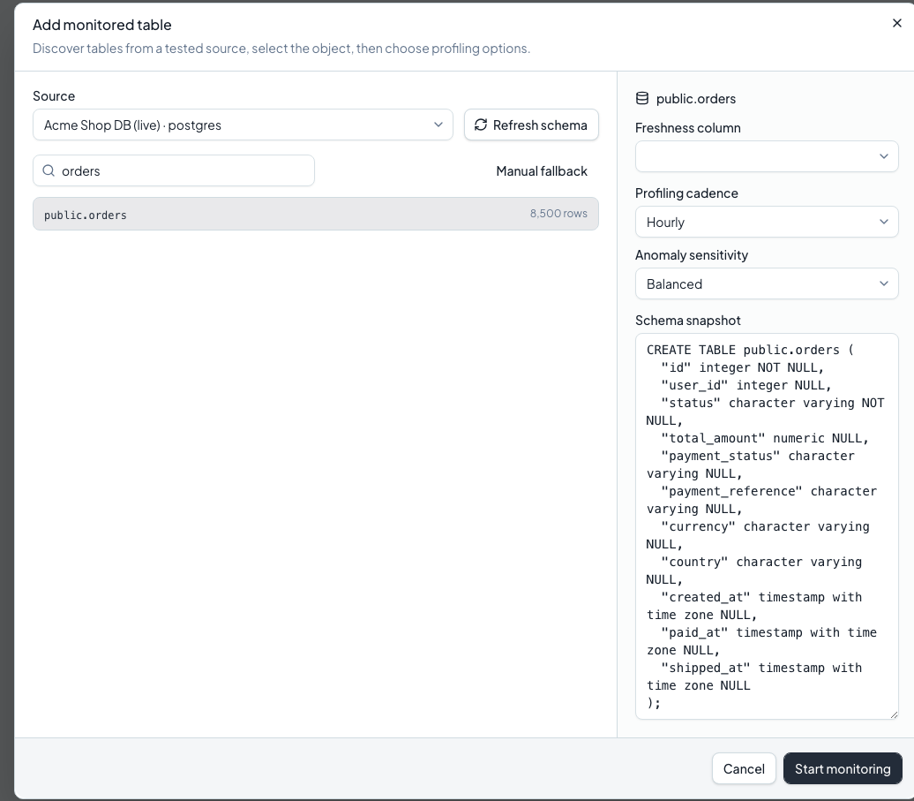
IMPLEMENTATION
Source connection and discovery
The monitoring boundary
Test the connection.
Discover schemas and tables.
Choose what to monitor.
07
Notes:
SAY
Monitoring begins at the source. The connector tests access and discovers the available structure. I then choose the tables and configure their cadence and freshness column. Capabilities are explicit because different database engines support different operations. PostgreSQL is the reference source in this demonstration.
PRESENTER CUE
Point to the discovered tables. Do not claim every advertised connector was tested in the video.
UNDERSTAND
Connection testing, discovery, profiling and typed execution are separate connector capabilities. A catalogue entry is not proof of production readiness.
LIKELY QUESTION
How would you add another database?
Implement its connector contract, declare supported capabilities, test discovery and profiling, then validate execution and operational limits against a real instance.
SOURCES
backend/app/connectors, backend/app/routers/sources.py, report implementation chapter, local screenshot

Slide 8
DESIGN
Architecture and asynchronous execution
React interface
FastAPI
PostgreSQL
Profiles and incidents
Data sources
Connectors
Celery + Redis
Background execution
LLM provider
Structured explanation
The scheduler triggers profiling according to each table’s cadence.
08
Notes:
SAY
React calls the FastAPI application. PostgreSQL stores organizations, monitored assets and their history. Long-running profiling work goes to Celery through Redis, so the browser does not wait for a full source scan. The worker calls the connector, saves the profile and evaluates the checks. A language model contributes an explanation after detection. This separation keeps the user interface independent from background execution.
PRESENTER CUE
Trace browser, API, worker, source and persistence in that order.
UNDERSTAND
Redis is the broker and cache. PostgreSQL is the durable application database. Celery workers execute tasks. The scheduler determines when profiling work starts.
LIKELY QUESTION
Why Celery instead of Kafka?
The implemented workload is scheduled background work. Celery fits that requirement. Kafka would need a justified event-streaming use case and additional operational design.
SOURCES
docker-compose.yml, backend/app/tasks.py, backend/app/scheduler.py, backend/app/worker.py

Slide 9
DATA ENGINEERING
A SQL check for missing payment statuses
SELECT COUNT(*) AS violations
FROM public.orders
WHERE payment_status IS NULL
0
Source-side calculation.
One aggregate result.
Read-only execution.
No missing status
> 0
Rows to investigate
09
Notes:
SAY
Here is a concrete business rule. This SELECT counts rows with a missing payment status. The legacy SQL monitor expects one nonnegative integer, so zero means no violations. The application validates the SQL structure and restricts its scope before execution. The aggregate stays close to the source. I receive a measurement rather than copying the entire business table into Panopta.
PRESENTER CUE
Read the query in plain language. Explain zero versus a positive count.
UNDERSTAND
The legacy SQL path is distinct from the typed DSL. It does not have the same immutable revision and run-history architecture.
LIKELY QUESTION
Can users execute arbitrary SQL?
The supported rule is a restricted read-only SELECT with structural validation and source constraints. It is not a general SQL console.
SOURCES
backend/app/routers/custom_monitors.py, backend/tests/test_legacy_sql_monitor.py

Slide 10
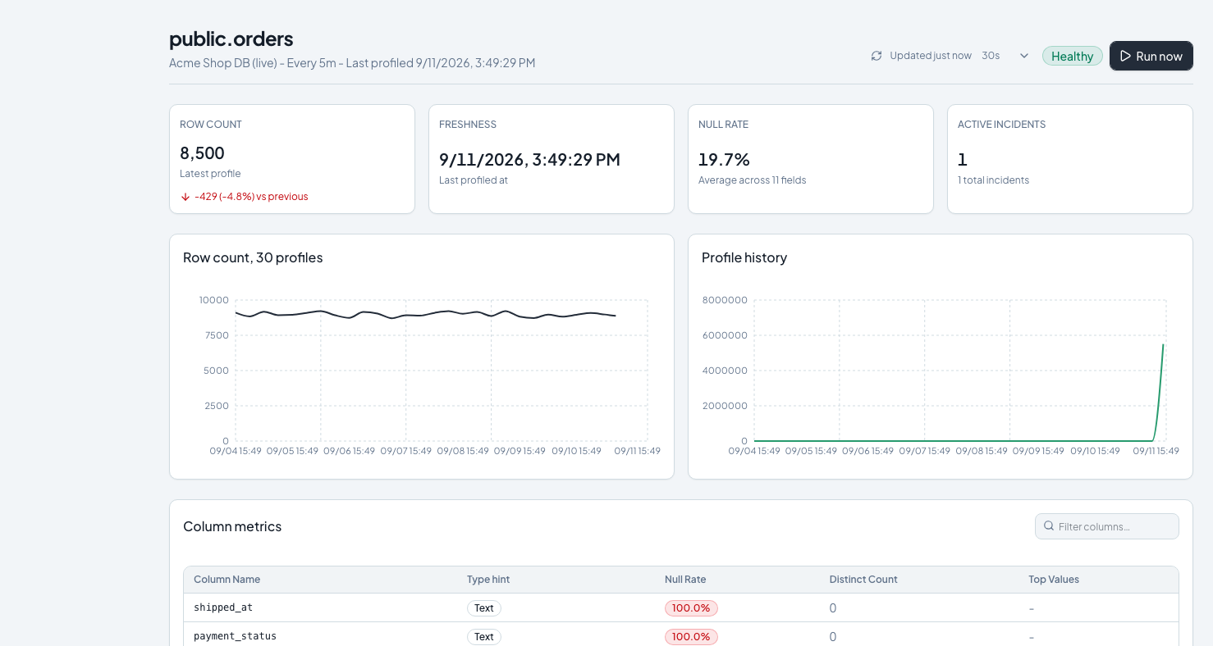
PROFILING
Profiles preserve the table’s history
Measured over time
Volume and freshness.
Null rates and cardinality.
Column distributions.
10
Notes:
SAY
A profile is a snapshot of measured properties, including row count, freshness and column statistics. Keeping those snapshots gives the table a history that the detectors can compare. The source performs aggregate work where possible. Some distributions need additional queries, so I do not claim that every profile always uses exactly one query.
PRESENTER CUE
Point to a trend and a column metric. Explain what the metric measures.
UNDERSTAND
Null rate is missing values divided by rows. Cardinality describes distinct values. Freshness measures time since a configured timestamp, subject to the source and timestamp semantics.
LIKELY QUESTION
Does profiling copy all customer rows?
The main persisted evidence is aggregate profiles and metadata. Some profiling paths read bounded distributions. That differs from replicating the full source table.
SOURCES
backend/app/services/profiler.py, backend/app/models/table_profile.py, local screenshot

Slide 11
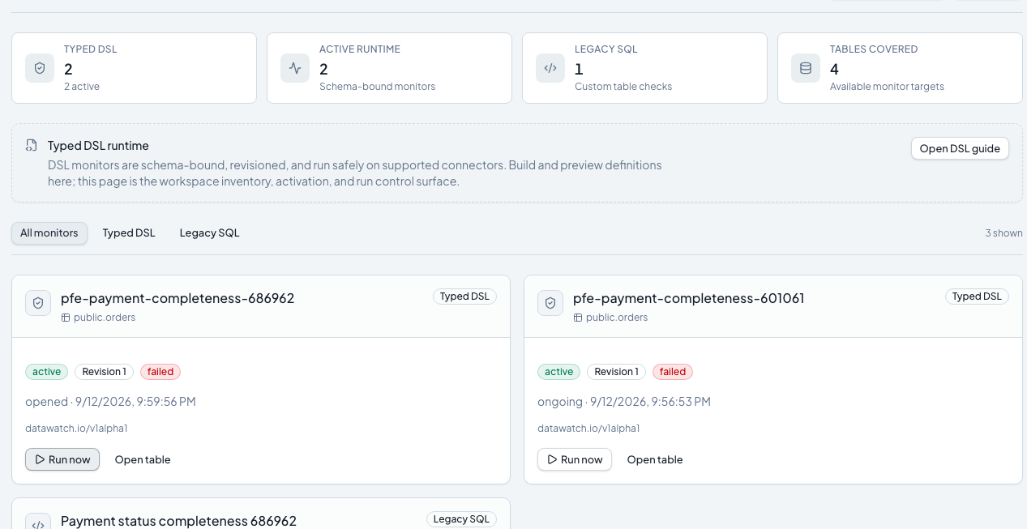
CONFIGURABLE MONITORING
Typed monitors and traceable runs
A controlled lifecycle
Typed definition.
Schema-bound plan.
Active revision.
Persisted run result.
11
Notes:
SAY
The DSL expresses a monitor as structured data. It separates the measurement, the breach condition and the operational policy. Preview validates and compiles a plan linked to the observed schema. It does not execute the data query. Activation pins a revision. An actual run then evaluates that revision and preserves its measurements and outcome. This makes a rule change explainable after the fact.
PRESENTER CUE
Clearly distinguish Preview, Activate and Run.
UNDERSTAND
DSL means domain-specific language. Here it is an allow-listed typed document, not Python or JavaScript execution. Track mode records outcomes without producing alert incidents.
LIKELY QUESTION
What happens if I edit an active monitor?
A new draft revision does not silently replace the active revision. Activation is a separate action, so runs remain linked to the definition they used.
SOURCES
backend/app/routers/monitor_dsl.py, backend/app/services/monitor_dsl.py, backend/tests/test_monitor_dsl_persistence_api.py

Slide 12
ARTIFICIAL INTELLIGENCE
Detection combines rules, statistics and ML
Business rules
Statistics
ML and time series
Empty table
Freshness breach
Schema change
Z-score
Cardinality changes
Volume growth
Isolation Forest
STL decomposition
Explicit expectations
Comparison with history
Enough history required
12
Notes:
SAY
Different defects leave different signals. Rules catch explicit conditions such as an empty table or a freshness breach. Statistical checks compare measurements with history. Isolation Forest adds a multivariate view when enough profiles exist. STL separates trend and seasonal structure before examining residuals. These methods produce signals for the incident workflow. Their presence alone does not establish accuracy. Precision and false positives still need an annotated evaluation.
PRESENTER CUE
Explain one example per family. Keep the deeper maths for questions.
UNDERSTAND
Z-score is a standardized deviation. Isolation Forest is unsupervised anomaly detection. STL is time-series decomposition. Its configured period is seven observations, not automatically seven days.
LIKELY QUESTION
Is this supervised learning?
Isolation Forest does not require labeled anomaly examples for fitting. Labels would still be needed for an honest evaluation of detection quality.
SOURCES
backend/app/services/anomaly.py and backend/tests/test_anomaly.py

Slide 13
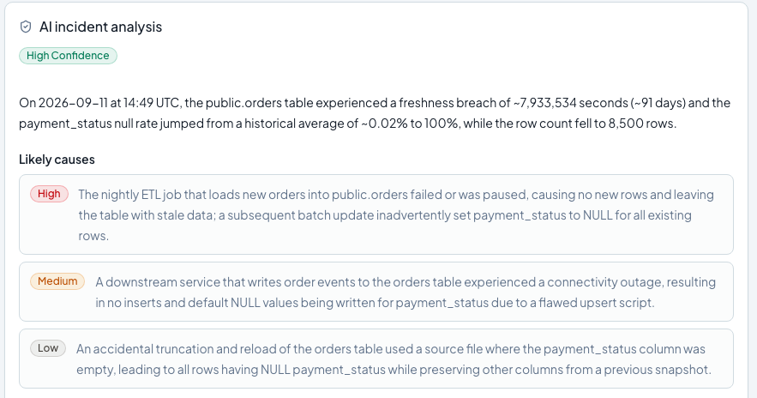
AI ASSISTANCE
The LLM supports investigation
Evidence before explanation
Measured context.
Possible causes.
Actions for an engineer to verify.
13
Notes:
SAY
Once the checks identify an incident, the narration service constructs a context from the available evidence. The language model returns a structured explanation with possible causes and recommended actions. The application validates that response. I treat the proposed cause as a hypothesis. The engineer still needs to inspect the pipeline or source and confirm what happened.
PRESENTER CUE
Point to a concrete recommendation and describe it as a next investigative step.
UNDERSTAND
Detection and narration are different components. The LLM does not establish the original failure by guessing from a screenshot.
LIKELY QUESTION
What if the model hallucinates?
The prompt is grounded in measured context and the response has a validated structure, but that does not eliminate hallucinations. Human verification remains necessary.
SOURCES
backend/app/services/llm.py, backend/tests/test_llm.py, local screenshot

Slide 14
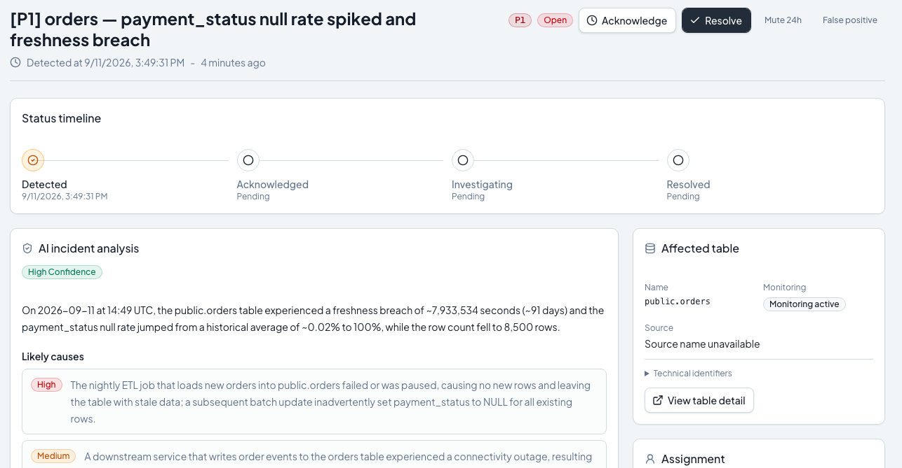
OPERATIONS
An incident connects evidence to ownership
A complete investigation
Observed signals.
AI analysis and history.
Assignment and acknowledgement.
14
Notes:
SAY
The incident page brings the evidence and the operational response together. I can inspect the signals, return to the affected table, read the analysis and assign responsibility. Acknowledgement means someone has taken notice. It does not prove that the data has recovered. That distinction matters when interpreting the incident state.
PRESENTER CUE
Point to signals, then ownership. Avoid equating acknowledgement with resolution.
UNDERSTAND
Deduplication limits repeated incident noise. Source measurements, run outcomes and incident lifecycle state answer different questions.
LIKELY QUESTION
How do you avoid repeated alerts?
The incident and monitor policies use deduplication, consecutive-breach or recovery rules and cooldown behavior where supported. The exact policy belongs to the monitor path.
SOURCES
backend/app/services/incident.py, frontend/src/pages/IncidentDetail.jsx, local screenshot

Slide 15
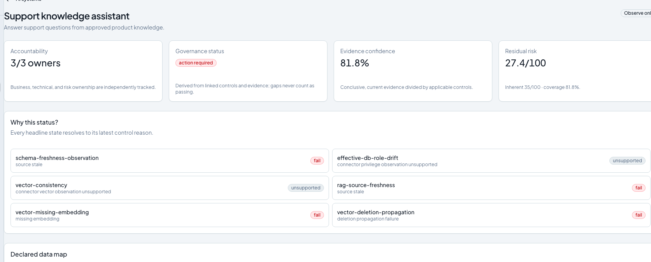
SCOPE AND ACCOUNTABILITY
AI governance is an exploratory prototype
Observe-only
System inventory.
Declared data uses.
Evidence and control results.
No runtime blocking.
15
Notes:
SAY
AI governance asks who owns an AI system, which version is in use, what data use is declared and what evidence supports the controls. In Panopta, this is a small observe-only prototype. It connects an inventory with versioned records, evidence and explainable control results. It does not certify compliance, measure fairness or block a model at runtime. Its purpose here is to test traceability and make missing evidence visible.
PRESENTER CUE
Lead with the purpose, then the prototype boundary. Do not apologize for a clearly scoped experiment.
UNDERSTAND
An evidence coverage score is not the probability that a model is safe. A declared data use is a customer assertion, not proof of actual runtime behavior.
LIKELY QUESTION
How is this different from your LLM feature?
Narration uses AI to explain data incidents. Governance stores and evaluates information about AI systems and their supporting evidence. One consumes a model, the other tracks accountability.
SOURCES
docs/ai-governance.md, backend/app/services/ai_governance.py, local screenshot

Slide 16
SAAS ARCHITECTURE
Organization isolation and access control
Organization A
Workspace A
API
Organization context
PostgreSQL
Records scoped by org_id
Organization B
Workspace B
Roles, encrypted source credentials and a separate staff portal.
16
Notes:
SAY
Each customer works within an organization context. The API uses authenticated identity and organization filtering to scope access. Roles control privileged operations, and the staff portal is separate from the customer workspace. Source credentials are encrypted with organization-derived keys. This is an application isolation design that must be tested with cross-organization requests, not assumed from the subdomain alone.
PRESENTER CUE
Separate routing, authentication, authorization and data scoping.
UNDERSTAND
A subdomain identifies the workspace but is not sufficient authorization. JWT claims need verification. A compromised master encryption key remains a serious compromise.
LIKELY QUESTION
Do tenants have separate physical databases?
The application uses shared tables with organization scoping. The demo does not claim one physical application database per tenant.
SOURCES
backend/app/auth.py, backend/app/routers/auth.py, backend/app/services/crypto.py

Slide 17
VALIDATION
Verification at several levels
01
Unit and contract tests
Check detector behavior, DSL validation and structured LLM output.
02
A real local workflow
Connect, configure, execute and inspect persisted results.
03
Explicit evidence limits
Local success does not establish production load or ML accuracy.
17
Notes:
SAY
I use different checks for different questions. Unit tests exercise calculations and contracts. The browser demonstration verifies visible actions against the local stack. Integration tests are needed for persistence, authorization and background execution. I keep those forms of evidence separate. A successful local walkthrough does not establish a production service level or the accuracy of a detector.
PRESENTER CUE
Do not quote a historical count as a new full-suite result.
UNDERSTAND
Skipped tests are not passing feature evidence. Validation counts in the report have a date, environment and scope.
LIKELY QUESTION
How would you test the detectors properly?
Use labeled scenarios and time-ordered evaluation, then report precision, recall, false positives and detection delay. Test different data shapes and drift conditions.
SOURCES
backend/tests, frontend/playwright, docs/evidence and report validation chapter

Slide 18
LIVE PRODUCT WORKFLOW
Panopta in action
Monitoring, from setup to investigation
Source and profiles. SQL and DSL controls.
Execution, incident evidence and operational response.
Real local application, synthetic demonstration data
Demo_Panopta_PFE_Action.mp4
18
Notes:
SAY
I will now show the monitoring workflow in the application. The data is synthetic. Watch how a configured rule becomes an executed result, then how the incident supports investigation and ownership.
PRESENTER CUE
Start Demo_Panopta_PFE_Action.mp4. Use DEMO_SCRIPT_EN.md for the timed narration. Resume at slide 19.
UNDERSTAND
Keep the video beside the PPTX. The slide contains a relative link. Open the MP4 directly if PowerPoint blocks it.
LIKELY QUESTION
Is this a simulated interface?
The recording captures the local application and real actions on synthetic demo data. It is not a rendered product mockup.
SOURCES
scripts/pfe/record_demo.mjs and the recorded demo manifest

Slide 19
DISCUSSION
What the prototype still needs
To measure
To harden
Detector precision and recall.
Profile throughput and concurrency.
LLM quality, cost and latency.
Experimental connectors.
Production operations and recovery.
AI governance evidence coverage.
The project continues beyond the June-to-August PFE development period.
19
Notes:
SAY
The next work is measurable. I need an annotated evaluation for the detectors, realistic concurrency tests for profiling, and more operational evidence for experimental connectors. The governance prototype needs broader controls and stronger evidence collection. Those tasks continue after the PFE period. They are also how I would judge whether Panopta is ready for a real customer workload.
PRESENTER CUE
Name the next evaluation, not just a feature wish list.
UNDERSTAND
Production readiness includes security, backups, monitoring of the monitoring service, failure recovery and operating costs.
LIKELY QUESTION
What would you prioritize first?
Validate one complete customer workflow under realistic load, with tenant-isolation tests, source budgets and clear recovery behavior. Then expand capabilities based on measured needs.
SOURCES
Report limitations and perspectives, README.md, docs/connector-catalogue.md

Slide 20
CONCLUSION
A foundation for reliable data operations
Measured data quality.
A documented investigation.
Thank you for your attention
Mounir Gaiby
20
Notes:
SAY
Panopta brings data engineering, anomaly detection and AI assistance into one investigation workflow. The contribution is the connection between measured data quality, configurable controls, traceable execution and an engineer’s response. The prototype gives me a working foundation and a clear set of measurements for the next stage. Thank you. I am ready for your questions.
PRESENTER CUE
Stop here. Open reserve slides only when they answer a question.
UNDERSTAND
Your central claim is a demonstrated prototype workflow, with explicit engineering choices and limitations.
LIKELY QUESTION
What did you learn?
How to connect source-level data checks with asynchronous execution, durable evidence and an interface that helps an engineer act on a failure.
SOURCES
Report conclusion and demonstrated application workflow

Slide 21
RESERVE A
The core database relationships
Organization
id, slug, plan
DataSource
org_id, type, encrypted config
MonitoredTable
source_id, cadence
Incident
severity, status, narration
CheckResult
type, status, observation
TableProfile
volume, freshness, metrics
One organization owns multiple sources and their monitoring histories.
21
Notes:
SAY
An organization owns sources. A source has monitored tables. Each table accumulates profiles, check results and incidents. Foreign keys connect those records, while organization scope constrains access. Additional families cover user access, alert routing, versioned monitors and AI governance. The study guide lists the complete application schema and its responsibilities.
PRESENTER CUE
Use this when asked about the database. Distinguish source data from Panopta metadata.
UNDERSTAND
PostgreSQL stores operational evidence and configuration. JSONB stores flexible structured metrics, while relational columns and constraints carry identities and relationships.
LIKELY QUESTION
Why JSONB and relational tables together?
Column metrics vary by data type, which suits JSONB. Ownership, identity and lifecycle relationships need relational constraints and joins.
SOURCES
backend/app/models, backend/alembic, docs/pfe/database_evidence.json

Slide 22
RESERVE B
A monitor run keeps its execution context
User / API
Worker
Source connector
Persistence
1. Queue a pinned revision
2. Execute the typed plan
3. Return measurements
4. Save run and evaluate policy
Revision identity and run evidence remain available after the execution.
22
Notes:
SAY
The user activates a validated revision, then requests a run. The API enqueues execution. The worker loads the pinned definition, uses the supported connector plan and persists measurements and evaluation state. Incident behavior then follows the policy. Keeping revision and plan identity lets me explain which rule produced a particular result.
PRESENTER CUE
Describe each stage without claiming exactly-once delivery.
UNDERSTAND
Queue delivery, idempotency and transactional persistence are related but different. A retry must not create contradictory duplicate state.
LIKELY QUESTION
Why keep definition and plan hashes?
They identify the exact content and compiled plan associated with a run. They support comparison and audit, but are not a substitute for access control.
SOURCES
backend/app/routers/monitor_dsl.py, backend/app/tasks.py, backend/app/models/monitor.py

Slide 23
RESERVE C
The rule, threshold and operational policy
Measurement
Operational policy
metric: null_rate
field: payment_status
Severity: P2
Breach: 1 failing run
Recovery: 2 passing runs
Cooldown: 60 minutes
Trigger: on profile
Breach condition
null_rate > 0.01
Illustrative excerpt. The full typed document includes identity and schema context.
23
Notes:
SAY
This example measures the null rate of payment_status. A rate above one percent is a breach. The policy independently determines severity, consecutive breaches, recovery passes and cooldown. That separation matters because a measurement is a fact, while alerting behavior is an operational decision. The schema and supported connector capabilities still constrain execution.
PRESENTER CUE
Explain that 0.01 means one percent. The excerpt is illustrative and omits the outer document.
UNDERSTAND
The full document also needs the API version, kind, metadata and actual table identity. The internal datawatch.io/v1alpha1 namespace remains a compatibility identifier.
LIKELY QUESTION
Why not let users write Python?
A typed, allow-listed document limits the executable surface and makes validation, compilation and audit more predictable. Arbitrary code would require a different isolation model.
SOURCES
backend/app/services/monitor_dsl.py and backend/tests/test_monitor_dsl_persistence_api.py

Slide 24
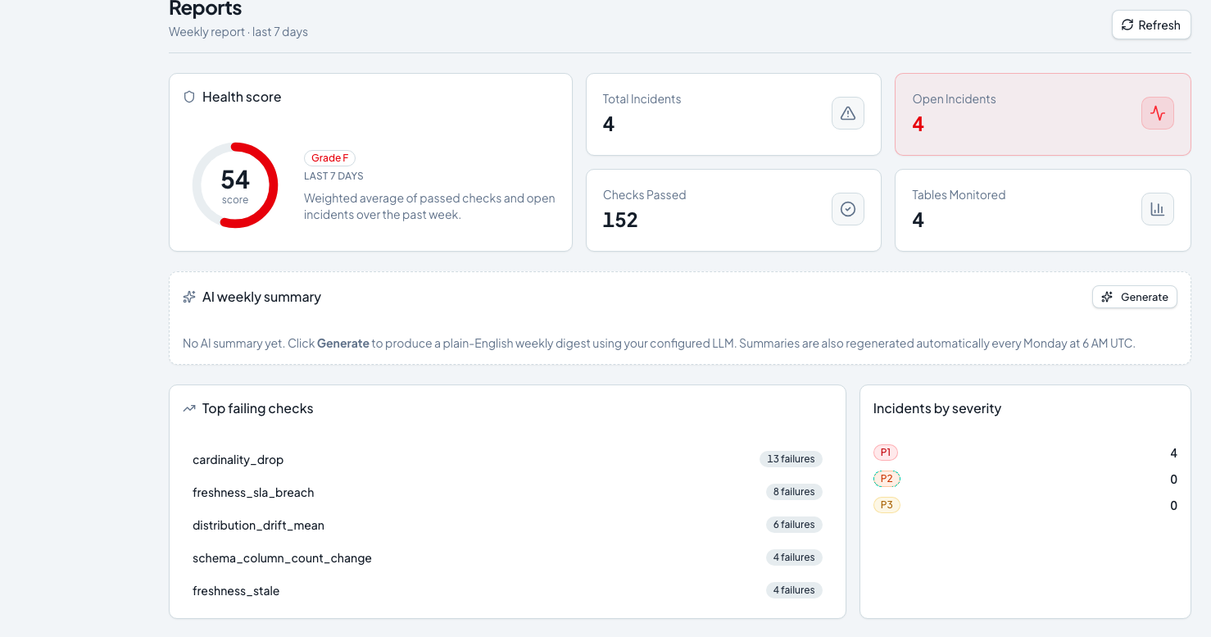
Collaboration and operational follow-up
Beyond one incident
Reliability reports.
Teams and ownership.
Alert routing and local email delivery.
24
Notes:
SAY
The surrounding features support the operational workflow. Reports summarize reliability, teams make ownership explicit, and routing determines where an alert goes. MailHog provides local email-delivery evidence in the demonstration. That local receipt is useful verification, but it does not prove production email deliverability.
PRESENTER CUE
Use the video or app for detailed options rather than expanding the main presentation.
UNDERSTAND
Each integration needs its own delivery evidence. A visible channel option alone does not prove a live external integration.
LIKELY QUESTION
What happens when an alert destination fails?
Delivery failures should remain visible and isolated from the stored incident. The incident evidence should not disappear because an external service is unavailable.
SOURCES
backend/app/services/alert.py, frontend/src/pages/Reports.jsx, local screenshots

Slide 25
RESERVE E
The Big Data and AI contribution
01
Data engineering
Heterogeneous sources, source-side aggregates and asynchronous execution.
02
Detection
Rules, statistical comparisons and unsupervised anomaly detection.
03
AI assistance and accountability
Structured incident explanations and an observe-only governance prototype.
25
Notes:
SAY
The project fits Big Data and AI through its processing choices and model use. Aggregation near the source reduces data movement. Asynchronous workers separate collection from the interface. Historical profiles support statistical and multivariate detection. The LLM helps interpret incidents, while governance explores traceability around AI systems. I have not yet demonstrated distributed big-data throughput at production scale.
PRESENTER CUE
Explain the mechanism before naming a technology.
UNDERSTAND
Kafka is not implemented in this version. Large-scale processing suitability and measured large-scale performance are different claims.
LIKELY QUESTION
Why call it Big Data if the demo is small?
The work applies relevant engineering patterns to heterogeneous data and monitoring workloads. The demo verifies behavior. A separate controlled benchmark is needed to establish scale.
SOURCES
Report architecture and conclusion, backend/app/connectors, backend/app/services/anomaly.py, docker-compose.yml

