Slide 1







IBM Data Analyst Capstone Project: Analysis on Technology Skills and Trends
Ing. Anna Rývová
April 2024

Slide 2



OUTLINE
Executive Summary
Introduction
Methodology
Results
Visualization – Charts
Dashboard
Discussion
Findings & Implications
Conclusion
Appendix

Slide 3

EXECUTIVE SUMMARY
We use data analysis to analyze the current state of technology used in IT and the trends for the next year.
Data was gathered from a Stack overflow survey, IBM site and Github job postings. It was collected, cleaned, subjected to exploratory analysis and visualized on Cognos dashboards.
Findings:
The most used DB is MySql and the Javascript programming language.
Next year, most users want to learn PostgreSql database and javascript programming language.
Majority of the respondents are males from USA, 28 years of age.

Slide 4

INTRODUCTION
Using data analysis, we defined current and future trends in the necessary knowledge in the field of programming languages, databases, development platforms and web frameworks.
The following inquiries were investigated using the data:
Point3
What is the most used programming language today?
What is the most used database today?
What are currently popular development platforms and web frameworks?
The work is intended for IT professionals, HR managers and all other interested parties in the IT sector who are interested in current and future requirements for IT skills.

Slide 5

METHODOLOGY
Data in several formats were gathered using the Github jobs API on Python.
To obtain the names of the programming languages and their yearly salaries, the IBM website was scrapped. The dataset from a 2019 Stack Overflow developer survey was downloaded and saved.
Python was used to clean and analyze the data.
Exploratory data analysis was performed to assess data distribution, presence of outliers, and correlation between different columns in the data set.
Charts, graphs and dashboards were created using Python and Cognos analytics to visualize the data.

Slide 6
RESULTS

Slide 7
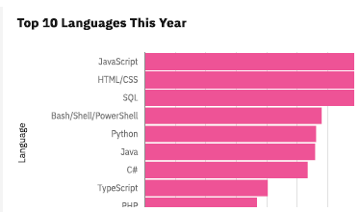
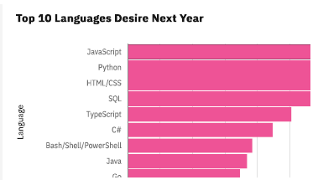
PROGRAMMING LANGUAGE TRENDS
Current Year
Next Year

Slide 8
PROGRAMMING LANGUAGE TRENDS - FINDINGS & IMPLICATIONS
Findings
Javascript, HTML/CSS and SQL are the most used currently
The most desired next year languages are Javascript, Python, HTML/CSS and SQL
In the last 10th place is currently PHP, next year Go, the other 9 languages are the same just in a different order
Implications
The greatest interest will continue to be in javascript and HTML/CSS
Python will become more prominent in the future
Interest in Bash/Shell/PowerShell scripts will decline in the future

Slide 9
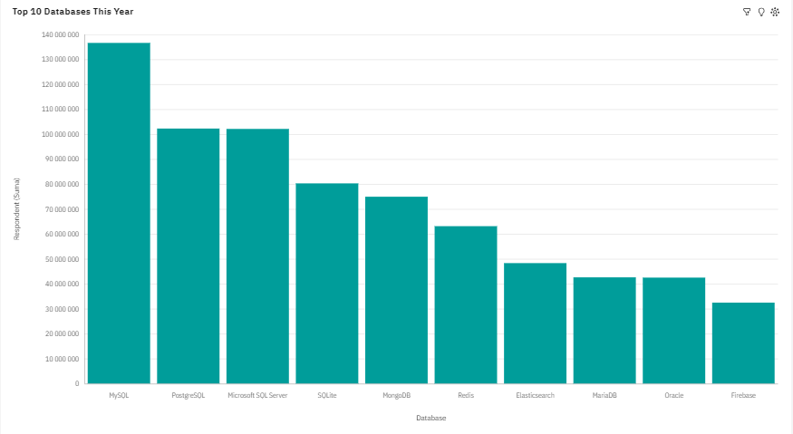
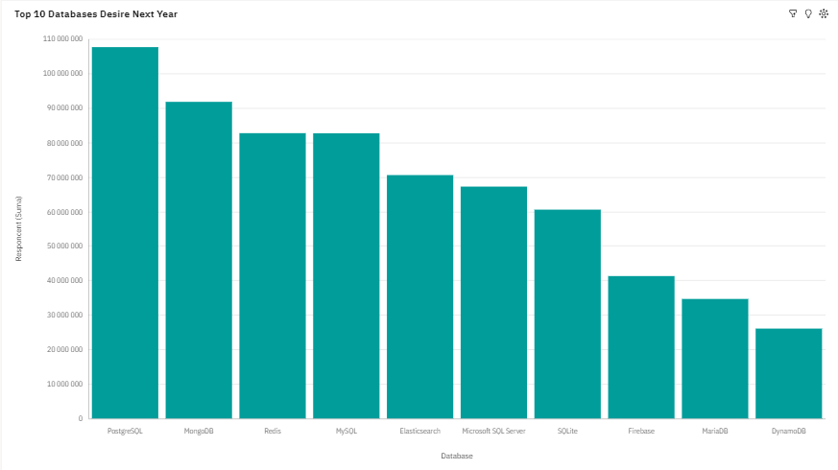
DATABASE TRENDS
Current Year
Next Year

Slide 10
DATABASE TRENDS - FINDINGS & IMPLICATIONS
Findings
Currently, the most used DBs are MySQL, PostgreSQL and Microsoft SQL Server.
In the future, the greatest interest is in DB PostgreSQL, MongoDB, Redis and MySQL.
In the future, the relatively new DB systems Redis and Elasticsearch will come to the fore, and on the contrary, the traditional Oracle DB will drop out of the TOP 10.
Implications
SQL DB will continue to be the TOP tool for data analysts.
The greatest interest is and will continue to be in open source systems.
Microsoft SQL Server and Oracle DB will lose influence, Oracle will even drop out of the TOP 10

Slide 11

DASHBOARD
https://eu2.ca.analytics.ibm.com/bi/?perspective=dashboard&pathRef=.my_folders%2FIBM%2BData%2BAnalyst%2BCapstone%2BProject&action=view&mode=dashboard&subView=model0000018e8a2d3775_00000000

Slide 12
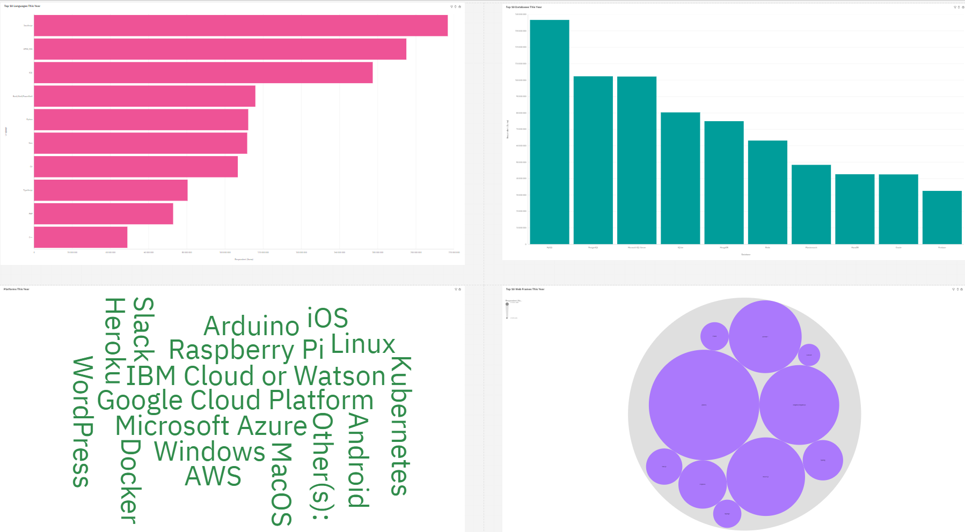
DASHBOARD TAB 1

Slide 13
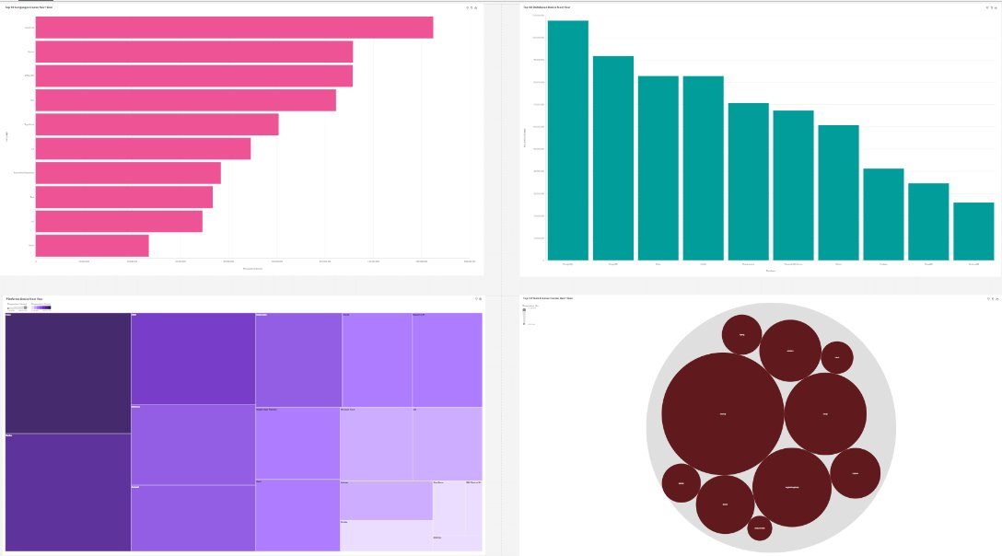
DASHBOARD TAB 2

Slide 14
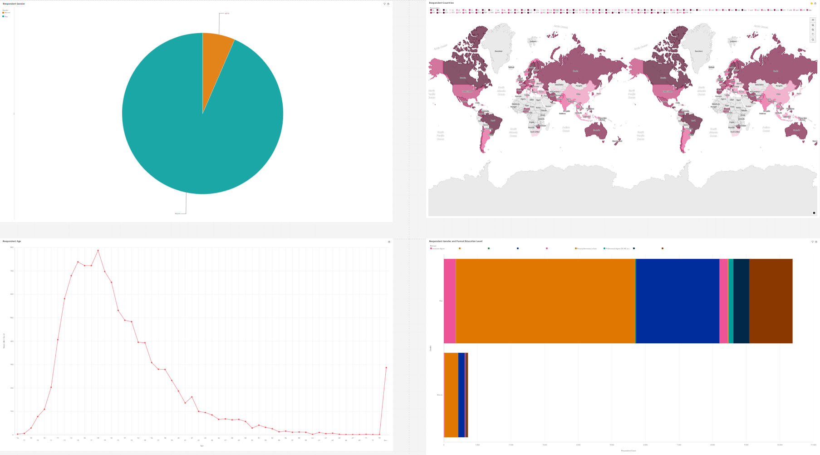
DASHBOARD TAB 3

Slide 15
DISCUSSION
The rising popularity of mobile app development – Kotlin
What will be the importance of Oracle in the future?
Pay attention to education and development in Africa, Southeast Asia and some areas of Europe.
Wide gender gap in the Technology sector.

Slide 16
OVERALL FINDINGS & IMPLICATIONS
Findings
Most respondents are aged 24-28
The most popular languages are for web development
Most users are under 40 years old
Most users want to learn javascript, Python, PostgreSQL and Mongo DB in the future.
Implications
Web development remains very lucrative
It is important to master SQL DB (PostgreSQL) and NoSQL DB (Mongo DB)Implication 2
The need to support education in less developed countries

Slide 17

CONCLUSION
Due to the constant development of trends in the Tech sector, it is very important to always follow the development trends.
The need to support education in less developed countries
Wide gender gap in the Technology sector.
Traditional DB systems (Microsoft SQL Server, Oracle DB) are losing their position (Oracle even drops out of the TOP 10)

Slide 18

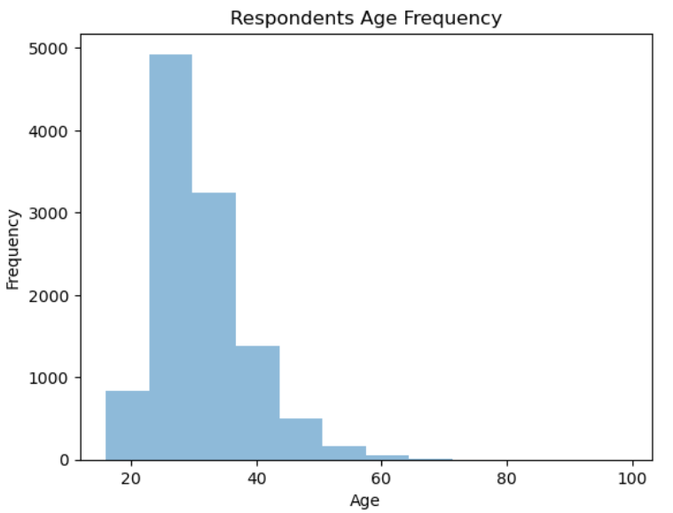
APPENDIX

Slide 19
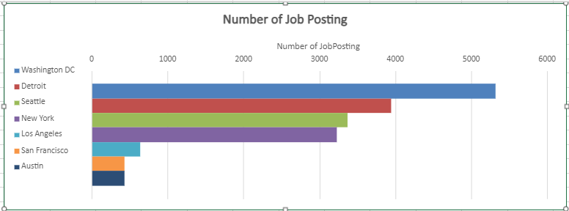
JOB POSTINGS

Slide 20
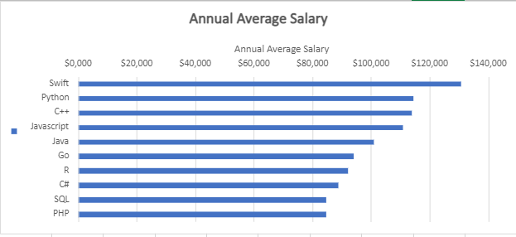
POPULAR LANGUAGES

