Slide 1
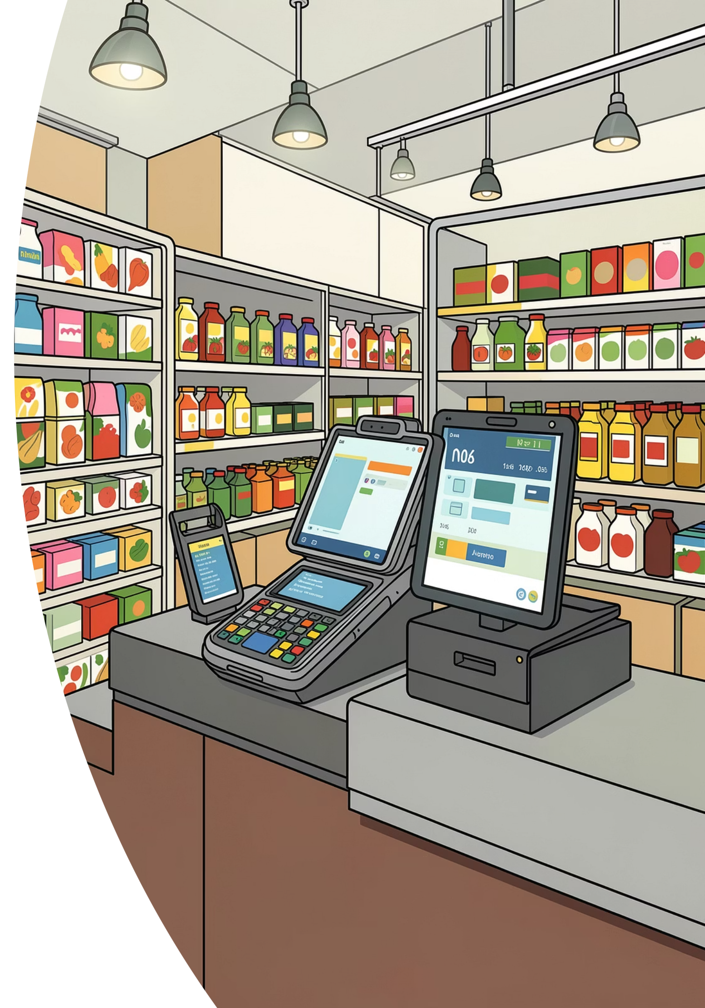
Valoryx
One App. Entire Shop. Online or Offline.
A complete POS & business suite for retail shops, supermarkets, and multi-outlet chains — works online or offline with automatic cloud sync. Billing, stock, transfers, suppliers, staff, and reports, all in one place.

Slide 2
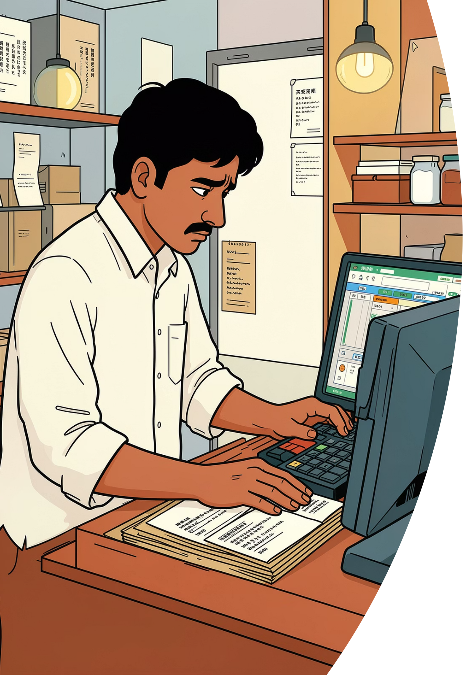
The Problem Shops Face Every Day
Internet Drops = Sales Stop
Most billing apps go silent when the connection drops — and the counter stops with them.
Too Many Tools
Shop owners juggle paper, Excel, and 3–4 different apps for billing, stock, suppliers, and payroll.
Untrustworthy Numbers
Returns, pending payments, and expenses live outside the system — month-end figures are always a guess.
Wrong Fit
Cheap mobile apps are slow on a real counter; full ERPs are heavy, expensive, and hard to learn.

Slide 3

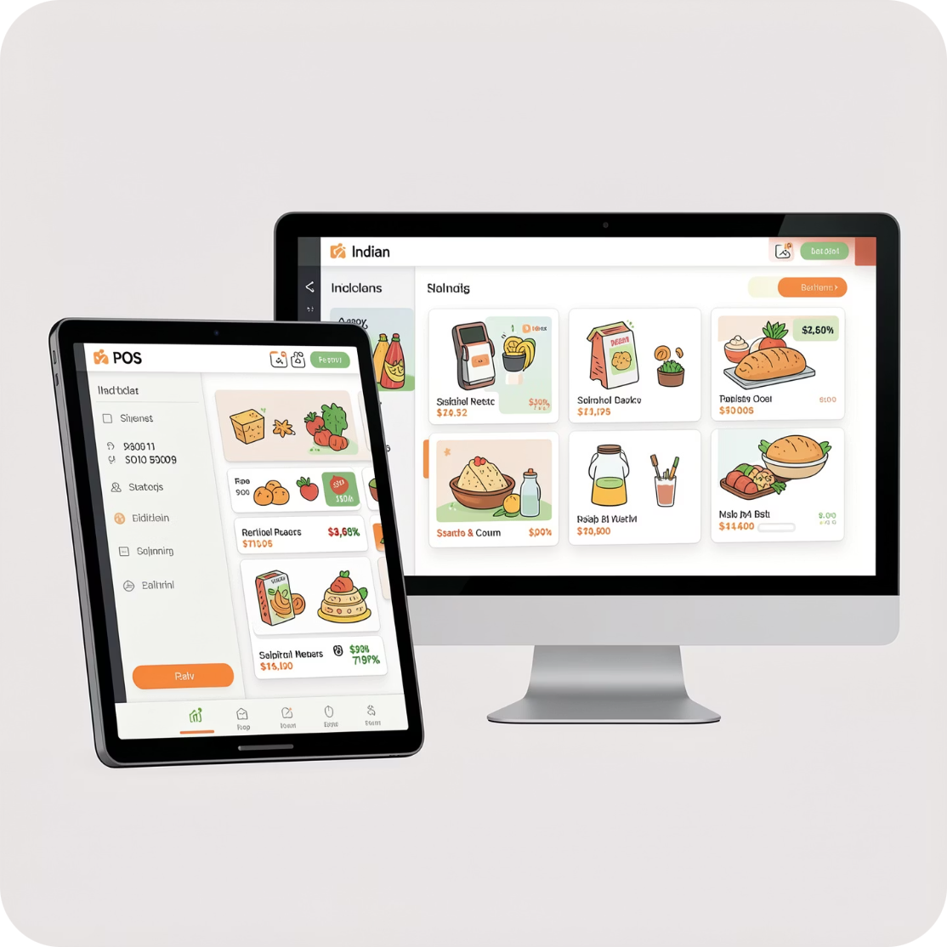

Introducing Valoryx
A single, offline-first platform that runs your entire shop end-to-end — without ever opening Excel.
Works Online or Offline
Every Device, One System
Run on the cloud or fully offline — bills save instantly and sync automatically both ways, with no data loss.
Desktop (Windows/Linux), web, tablet, and mobile — same data everywhere.
Secure by Design
ERP-Grade, Shopkeeper-Friendly
Multi-tenant architecture with fully isolated shop data and role-based access.
Powerful workflows without the complexity, cost, or learning curve of a traditional ERP.

Slide 4




Everything Your Shop Needs
Billing & POS
Pending Bills & Khata
GST & non-GST invoices, thermal printing, UPI QR with pre-filled amount, barcode scanning.
Invoice now, collect later. Partial payments and per-customer credit tracking.
Inventory, Stock & Transfers
Suppliers & Purchases
Branch-aware stock, branch-to-branch transfers with in-transit tracking, and barcode label printing.
Supplier master, delivery notes, auto-numbered purchase orders, one-click stock receipt.
Customers & Payroll
Reports & Dashboard
Customer master with loyalty, employee attendance, advances, and payroll with trend charts.
Real-time sales, profit margins, top products, and peak-hours analytics.

Slide 5









Built for Trust — Security & Reliability
Always Available
Blazing Fast
Hardened Security
Run online or fully offline — the counter keeps billing during outages and syncs automatically when the connection returns.
Routes respond in 1–20 ms vs. 3–9 seconds on always-online competitors.
2FA, IP & session tracking, forced password change, and a security regression test suite.
Full Audit Trail
Every create, update, and delete is logged per shop. Nothing is silently destroyed.

Slide 6
How It Works — 5 Simple Steps
Install
1
One desktop install or open in a browser. Works instantly, online or offline.
Set Up
2
Add products, customers, and suppliers — or import existing data.
Sell
3
Fast counter billing with barcode, UPI QR, and thermal printing.
Manage
4
Stock, suppliers, expenses, staff, and payroll all in one place.
Grow
5
Real-time reports and dashboards turn daily data into better decisions.

Slide 7
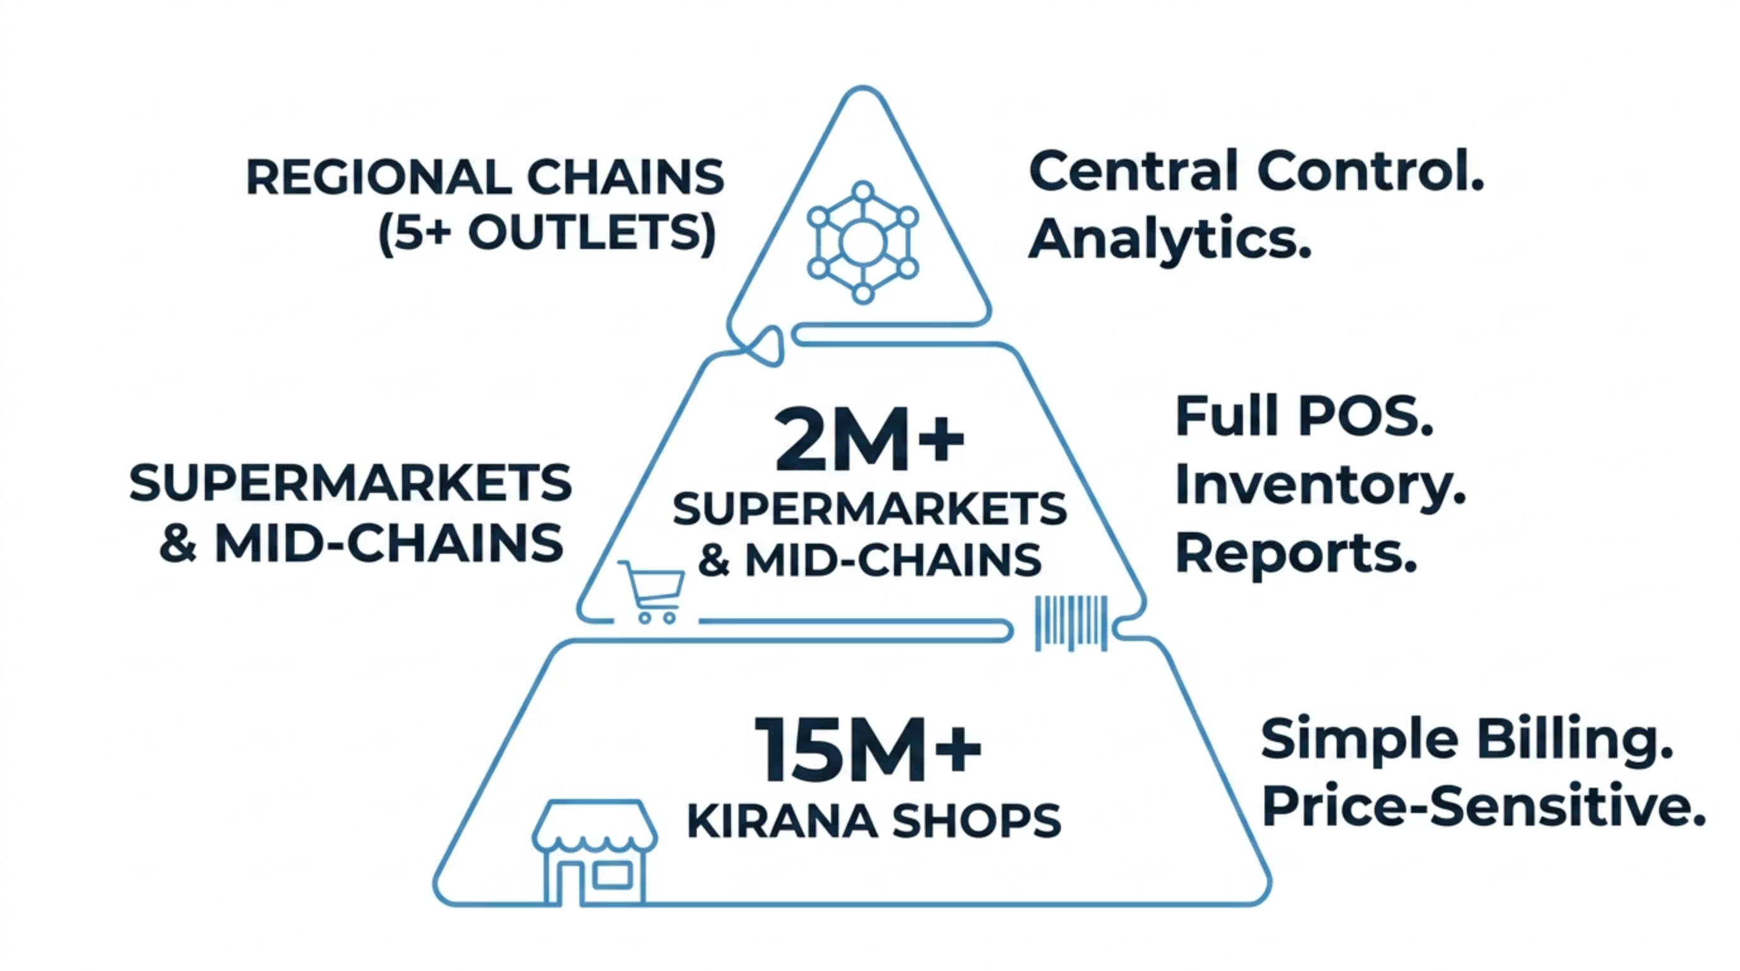
The Market — Who This Is For
15M+
2M+
5+
Independent Retailers
Growing Retail Stores
Multi-Outlet Chains
Single-counter shops and standalone stores across India.
Multi-counter stores and supermarkets — our primary focus ⭐
Regional chains needing centralized control across outlets.
India's retail digitization is accelerating — GST compliance, UPI adoption, and the shift away from paper are powerful tailwinds. The sweet spot: businesses that have outgrown a basic billing app but don't want a heavy, complex ERP.

Slide 8

How We Compare
Valoryx combines the simplicity of a billing app with the depth of an ERP — without the complexity.
Solution
Online + Offline
All-in-One Suite
Fast & Simple
Vyapar / myBillBook
❌ Cloud only
⚠️ Billing only
✅ Simple
Marg ERP / Tally
⚠️ Partial
✅ Yes
❌ Complex
GoFrugal / Ginesys
⚠️ Partial
✅ Yes
⚠️ Heavy
Valoryx ⭐
✅ Both
✅ Full suite
✅ Fast & easy
Our edge: works online or offline, bills in 1–20 ms, and one all-in-one suite — billing, stock, transfers, suppliers, staff, and reports.

Slide 9
Why Valoryx Wins
🔌 Online or Offline
⚡ 10–100× Faster
Run on the cloud or fully offline — competitors go dark when the internet drops, Valoryx keeps billing.
1–20 ms response vs 3–9 seconds on always-online apps. The counter never lags.
🧩 One App, Not Four
🏷️ ERP Depth, Shop Price
Billing, stock, suppliers, staff, and reports in one system — not stitched-together tools.
Enterprise-grade workflows without the cost, weight, or learning curve of Tally or Marg.
🔄 Multi-Branch & Transfers
🔒 Trust Built-In
Move stock between branches with approval and in-transit tracking — built for multi-outlet businesses.
Full audit trail, role-based permissions, and 2FA — secure out of the box.

Slide 10
The Value to Your Business
💰 Stop Losing Sales
The counter never goes down — even during an internet outage, every customer still gets billed.
📊 Numbers You Can Trust
Returns, pending payments, and expenses all flow into true, accurate month-end profit.
⏱️ Less Manual Work
No more paper or Excel reconciliation — one system runs billing, stock, staff, and suppliers.
🛡️ Lower Risk
A full audit trail and role-based permissions protect against theft and costly mistakes.
📈 Scales With You
Start with one counter and grow to multiple outlets — all on the same system.
From a single counter to a multi-outlet chain, Valoryx grows with your business — not against it.

Slide 11
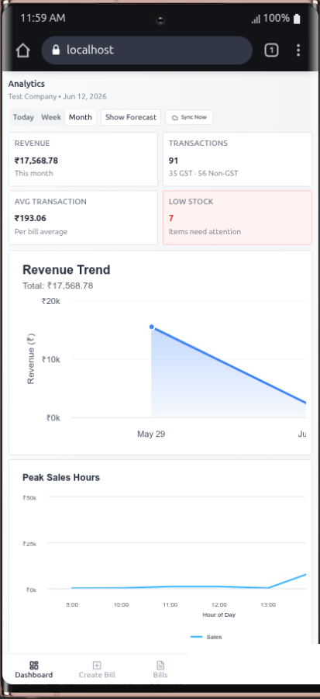
Run Your Shop From Anywhere
📱 Pocket POS
🔄 Same Data Everywhere
Bill customers from a phone or tablet — perfect for the counter, the aisle, or a pop-up stall.
Start a bill on desktop and finish it on mobile — every device stays in sync, automatically.
👆 Built for Touch
🏃 Manage On the Go
A fast, finger-friendly layout designed for small screens — not a shrunk-down desktop.
Check sales, stock, and reports from anywhere — even when you're away from the shop.
📶 Offline on Mobile Too
🖨️ Print & Share Instantly
Keep billing on your phone with no signal; everything syncs the moment you're back online.
Thermal-print or share a bill on WhatsApp straight from your mobile in one tap.

Slide 12
Turn Shoppers Into Regulars
🎟️ Membership Cards
⭐ Points on Every Bill
Enrol customers into a loyalty program that gives them a reason to keep coming back.
Customers earn points automatically as they shop — no extra steps at the counter.
🏆 Tiers & Rewards
💸 Redeem at Checkout
Recognise your best customers with higher tiers and perks they actually value.
Points come straight off the next bill — a reward customers can see and feel instantly.
📈 More Repeat Business
🤝 Know Your Customers
Loyalty turns one-time buyers into regulars and quietly lifts your average sale.
Every membership is linked to its bills, so you always see who your top customers are.

Slide 13
Our Roadmap — Path to 200 Customers
A phased go-to-market plan, from first pilots to 200 paying shops.
Phase 1 · Validate (Now)
Phase 2 · Soft Launch
5 pilot shops at 50% off — collect testimonials and real case studies.
Free tier goes live; direct outreach to 100 shops across 2 cities.
Phase 3 · Scale
Next · Product Roadmap
Full pricing, field sales, and referrals → 200 paying customers in 6 months.
Deeper multi-outlet analytics, e-way bill support, and a polished mobile app.

Slide 14

Valoryx at a Glance
1–20 ms
Billing Speed
Every bill saves instantly — even fully offline.
100%
Works Offline
Keep selling with no internet; data syncs automatically.
8+
All-in-One Modules
Billing, stock, transfers, suppliers, staff, reports & more.
14 days
Free Trial
Try every feature free — no card required.
One app to run your entire shop — fast, offline-ready, and built for Indian retail. See it live at your counter.
🌐 valoryx.ryxtech.in
📧 ryxtechie@gmail.com
🚀 14-day free trial — start today

Slide 15
See Valoryx at Your Counter
Book a free live demo and run a real day on Valoryx — no commitment, no risk.
📅 Book a Demo
🎁 Free Pilot
A 20-minute walkthrough using your own products and counter flow.
Join the Phase-1 pilot — 5 shops live now at 50% off the first year.
🤝 Setup & Training
📞 Get in Touch
We install Valoryx and train your staff right at your shop.
valoryx.ryxtech.in · ryxtechie@gmail.com

