Slide 1
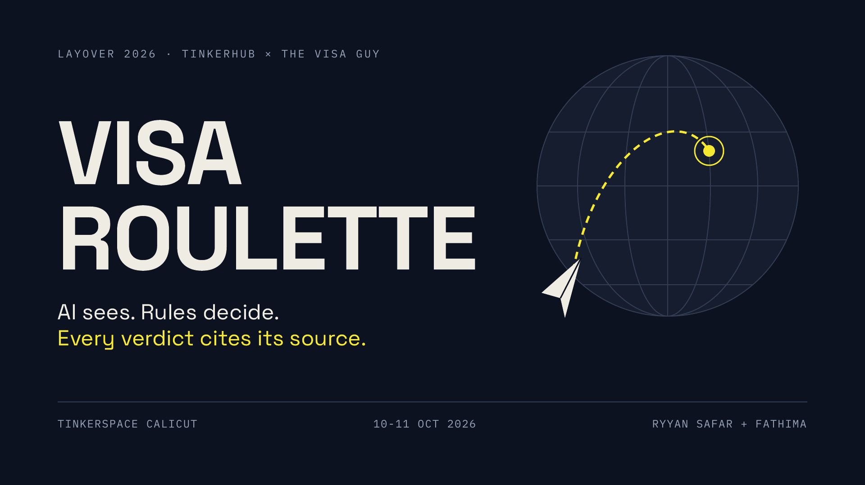
Notes:
TIME: 0:00 to 0:08 (8 s). Whole talk is 2:00. Say: "Visa Roulette. A travel booth you can play. AI sees, rules decide, and every verdict cites its source." Then go straight to the story. No introductions beyond your name.
DEMO CUE: Have the booth laptop already on the Visa Roulette home screen, the sample passport on the desk, the ESP32 paper plane next to it, and the hardware demo video queued in a tab as a backup.
IF YOU ONLY GET 2 MINUTES (the PLAN.md finalist slot): fold slide 4 into the demo and cut the hardware slide to one sentence. Keep: hook, idea, live demo, trust, thank you.
Q and A prep lives on the last slide (the last slide) and in its notes.

Slide 2
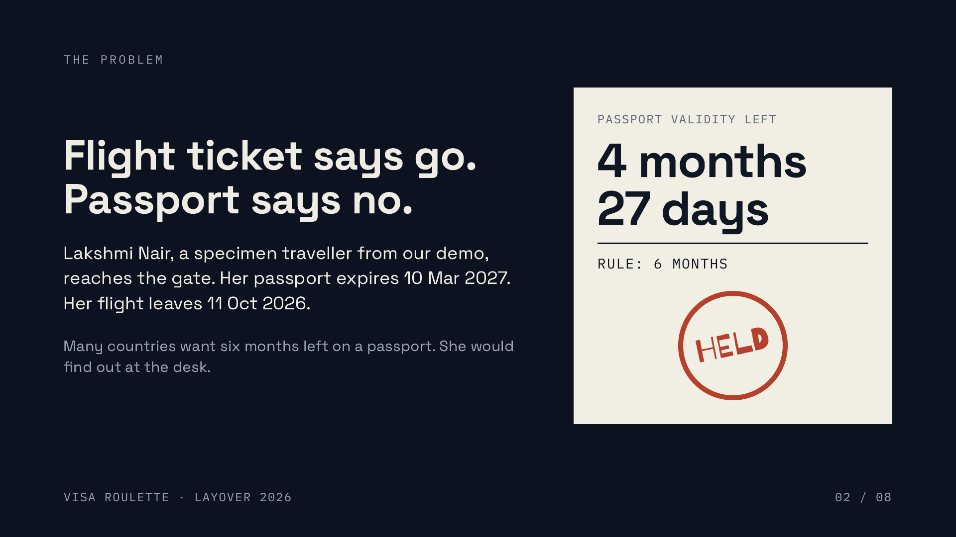
Notes:
TIME: 0:08 to 0:26 (18 s).
SAY: "Meet Lakshmi, a specimen traveller we made for the demo. Flight ticket in hand, she reaches the gate. Her passport has four months and twenty-seven days left. Many countries want six. She finds out at the desk, with the queue behind her. Visa rules live in scattered PDFs, and they change." (About 45 words, 18 s.)
KEY POINT: the pain is finding out too late, at the border. Everything we built moves that moment earlier.
FACT CHECK (so you stay honest): Lakshmi is one of three specimen travellers in the repo (fixtures/manifest.json): Lakshmi is HELD for under six months of validity, Arjun is CLEARED, Shafeeq is HELD for a hotel name that differs from his passport. The six-month rule is a demo checklist rule (R-PP-VALIDITY-6M), unverified, and the slide says "many countries", not "all".
DEMO CUE: none yet. Hold the live demo for slide 5.
Q AND A:
Q: Is Lakshmi real? A: No. All passports and flight tickets are SPECIMEN props with checksum-valid MRZ and IATA barcodes but made-up airline and people.

Slide 3
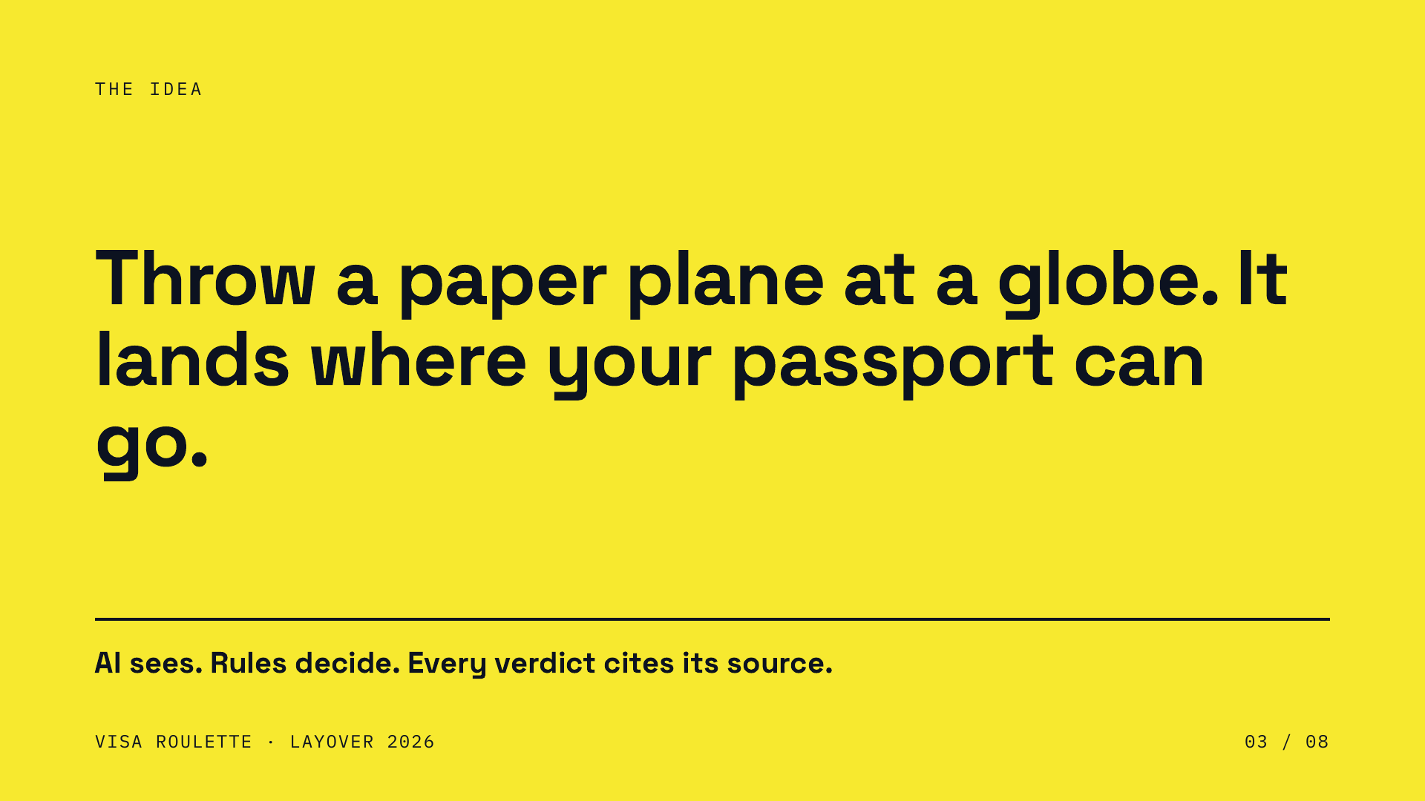
Notes:
TIME: 0:26 to 0:34 (8 s). This is the one-line pitch. Slow down and say it once, cleanly.
SAY: "Visa Roulette. You throw a paper plane at a globe, and it lands where your passport can actually go. Then it tells you what you need to get there."
WHY THIS SLIDE IS THE ACCENT SLIDE: it is the single memorable metaphor. Winning pitches have one sentence a judge can repeat in the corridor afterwards. Ours: "the paper plane that checks your visa".
DEMO CUE: none. Do not demo yet.
Q AND A:
Q: Is it a game or a tool? A: Both, on purpose. The booth is a game wrapper around a genuinely useful question: what does my passport need for this place? The verdicts come from a rules engine with cited sources, so the game is fun but the answer is serious.

Slide 4
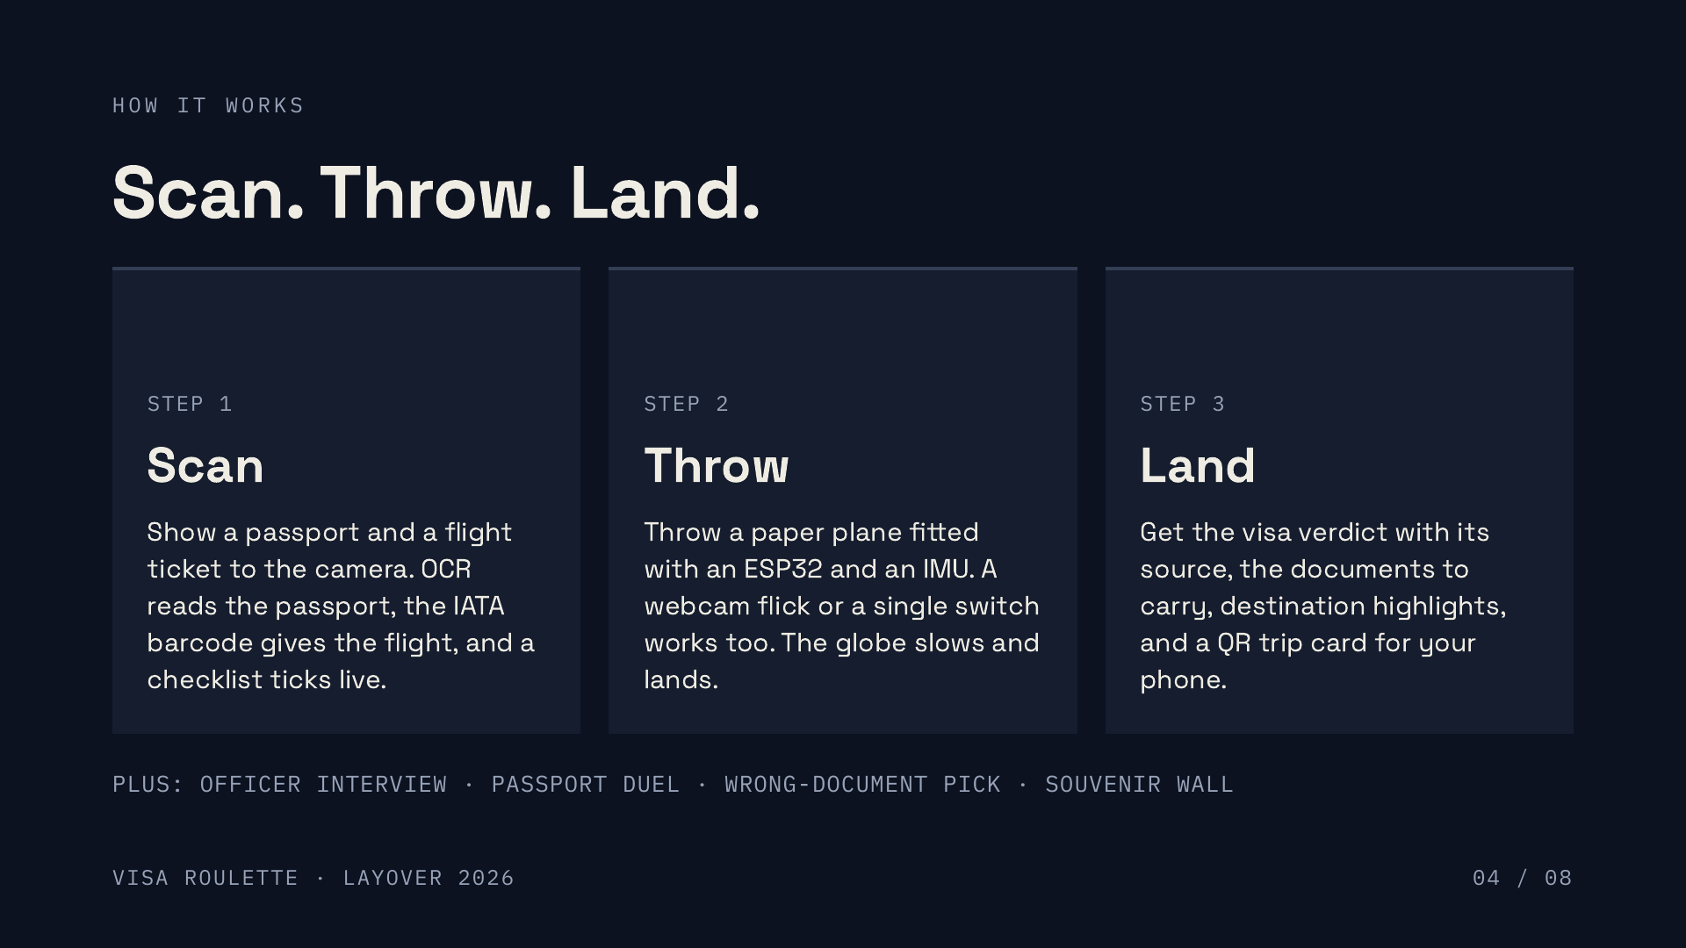
Notes:
TIME: 0:34 to 0:44 (10 s).
SAY: "Three steps. Scan: the camera reads your passport and flight ticket, and a checklist ticks live. Throw: a paper plane with a sensor inside. Land: the globe picks a country and you get the verdict." (About 35 words, 10 s: speak briskly, or drop the middle step.)
FACTS BEHIND EACH STEP (for Q and A):
Scan: Tesseract OCR reads the passport MRZ (machine readable zone) and zxing reads the flight ticket IATA BCBP barcode. Both are validated with check digits. Three sample travellers are included.
Throw: the ESP32 plus MPU-6050 board streams IMU samples over WebSocket. Flick (webcam) and single-switch (Space key) inputs feed the same flight model.
Land: rules in rules/visa_rules.json and rules/checklist_rules.json, curated highlights for 11 destinations in rules/destinations.json, QR hand-off served from the laptop over the local network.
The extras line (officer interview, passport duel, wrong-document pick, souvenir wall) is in the README. Mention it in one breath only if time allows. Do not claim any extra beyond those.
DEMO CUE: end this slide with "Let me show you," and click to the demo slide. Switch to the booth laptop.
Q AND A:
Q: Does a judge have to bring their own passport? A: No. Use a sample traveller or the specimen props. The booth is built for fake and sample passports only.

Slide 5
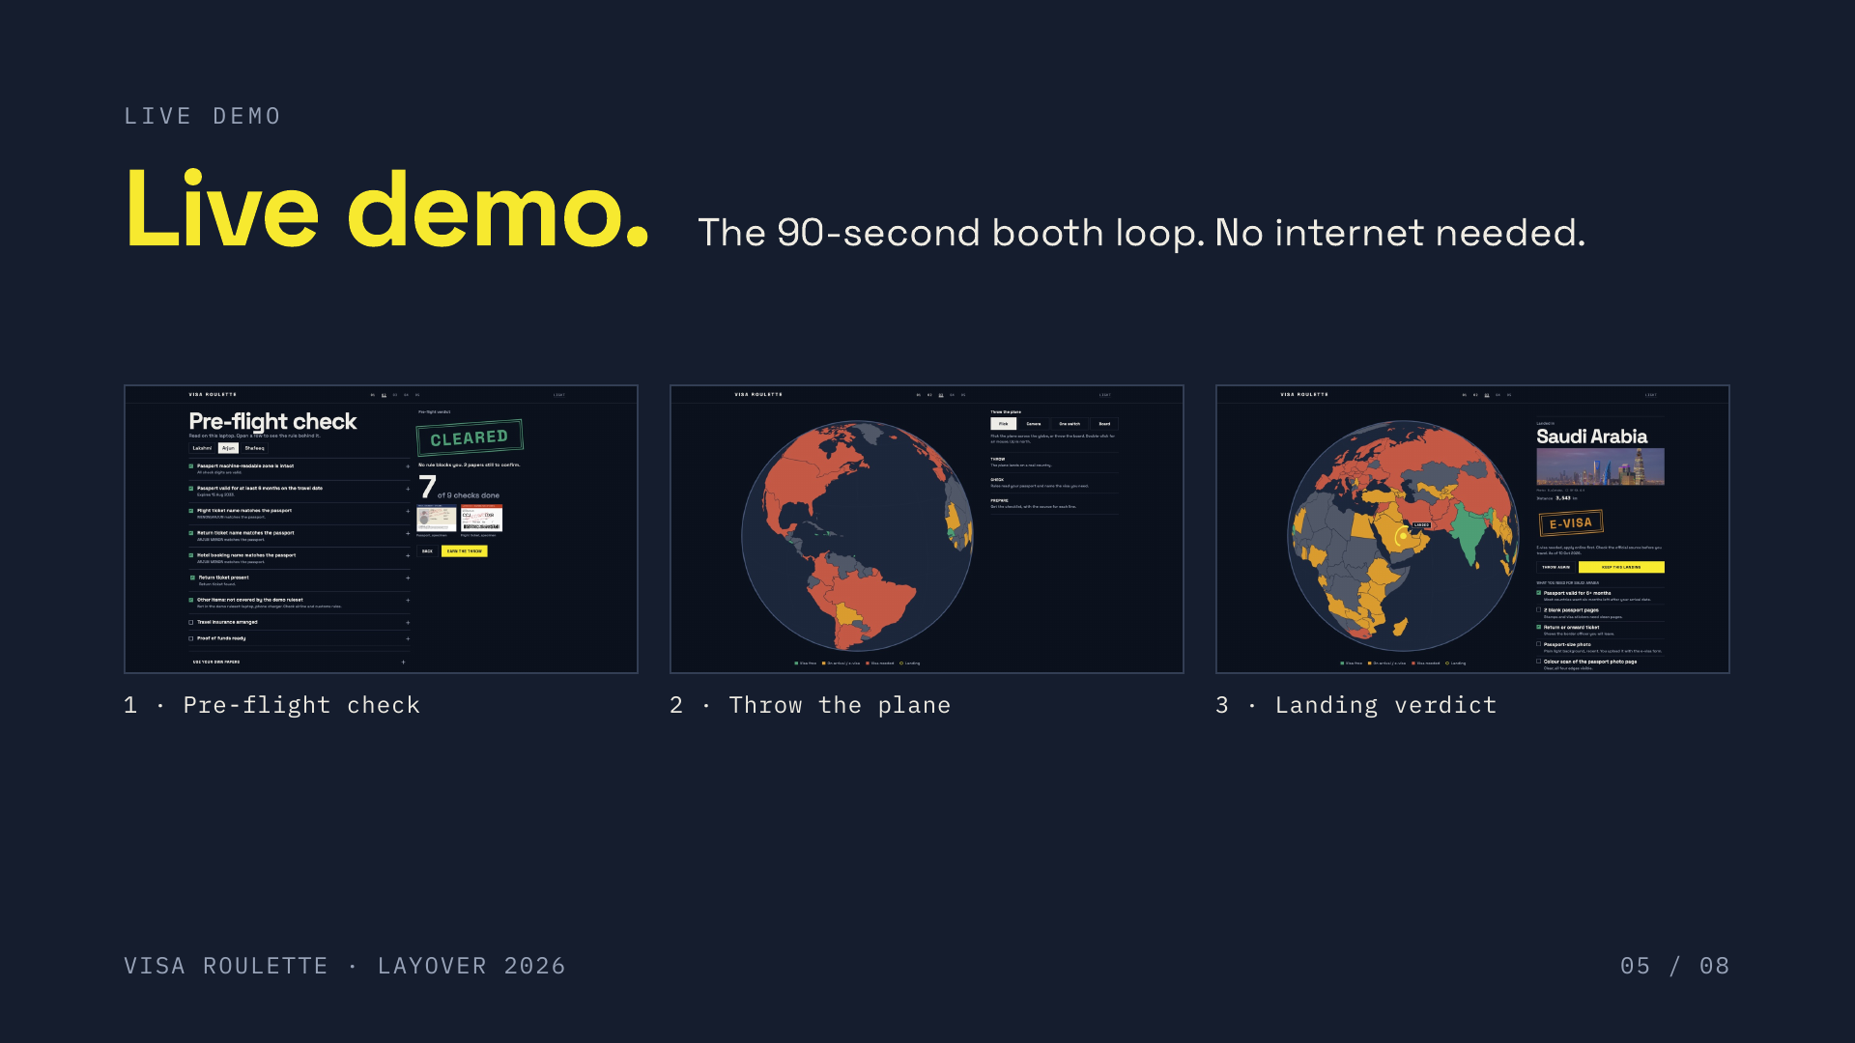
Notes:
TIME: 0:44 to 1:24 (40 s live). This is the heart of the pitch. Demo first, talk second.
DEMO CUE: switch to the booth laptop. The list on this slide is the order of the 90-second script in docs/FATHIMA_AIRPORT_EXPERIENCE_PROMPT.md: pick passport, checklist, throw, landing, duel, Wrong-Document Pick, QR, pin on the wall. In 40 seconds do the first FOUR beats and the QR if time allows; the rest is the 90-second booth loop for judges walking the floor.
Beat by beat, narrate in one short sentence each:
1. Pick the Lakshmi sample passport. "The camera reads the machine readable zone. Check digits validate it."
2. Checklist: she is HELD for short passport validity. Tap the red item: "Here is the rule, its ID, its source and its as-of date."
(Option: switch to Arjun, who is CLEARED, to unlock the throw.)
3. Throw the ESP32 paper plane. "Freefall tells us the release. The gyro measures tumble."
4. Landing: "UAE. E-visa for an Indian passport under our demo rules, with the documents to carry."
5. QR: "The landing spot becomes a QR code. The phone opens a trip card from the laptop. No internet."
IF HARDWARE FAILS: flick the plane at the webcam, or press Space twice for the single-switch throw (lock heading, lock power). If the booth fails entirely: open the hosted demo at layoverhackathon.vercel.app (sample travellers only, no hardware) or play the hardware video from the Drive folder.
IF OCR HESITATES: tap the sample traveller button. The sample images are known to the system, so it never dead-ends.
Q AND A:
Q: Is this a recording? A: No, it is the booth running on this laptop. Judges are welcome to throw it themselves.

Slide 6
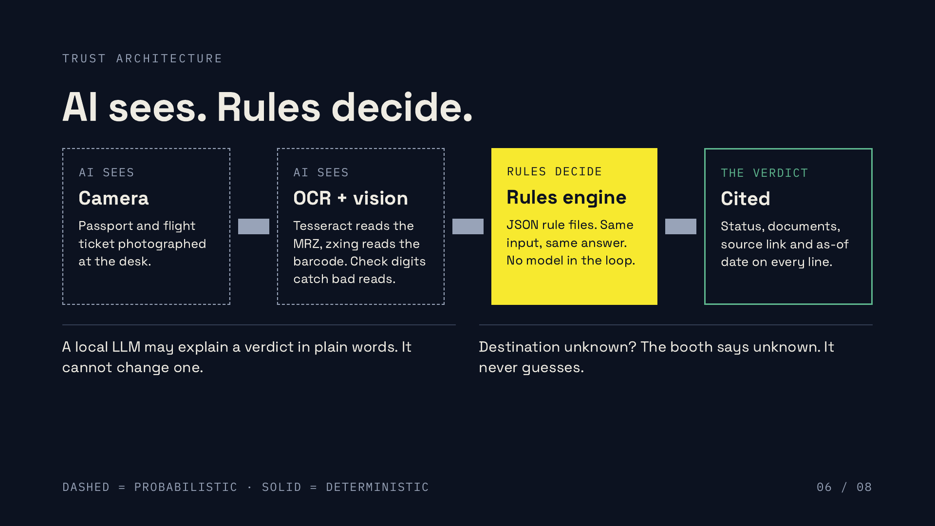
Notes:
TIME: 1:24 to 1:38 (14 s).
SAY: "Here is why you can trust it. The AI only sees: it reads the document. The rules decide: a deterministic engine over JSON rule files. Same input, same answer. And every verdict carries its source and its as-of date. The local language model can explain a verdict in plain words, but it can never change one."
KEY POINT: separating perception (probabilistic, dashed boxes) from judgement (deterministic, solid box) is the design decision. Say "AI sees. Rules decide. Every verdict cites its source." as your closing line for this slide.
FACTS (all in the repo):
- Rule files: rules/visa_rules.json and rules/checklist_rules.json. Every checklist item carries a rule id, source link, as-of date and a verified flag.
- visa_rules.json states: "A destination with no entry is reported as unknown, never guessed."
- The booth operator is a local Ollama model (default gemma3n:e4b). Its replies are trimmed to two plain sentences and fall back to a rules template if the model is slow, down, or says anything the rules do not contain.
- The immigration interview: the backend owns the questions and the stamp. The stamp is always the rules engine verdict with source and as-of date.
DEMO CUE: if you skipped it in the live demo, tap the red checklist item now to show the evidence drawer (rule id, source, date).
Q AND A:
Q: Is the AI deciding visas? A: No. Vision and OCR only read the document. A deterministic rules engine produces the verdict from JSON rule files, with a source and as-of date. The LLM only phrases an explanation and is bound to the rules facts; if it strays, a template replaces it.

Slide 7
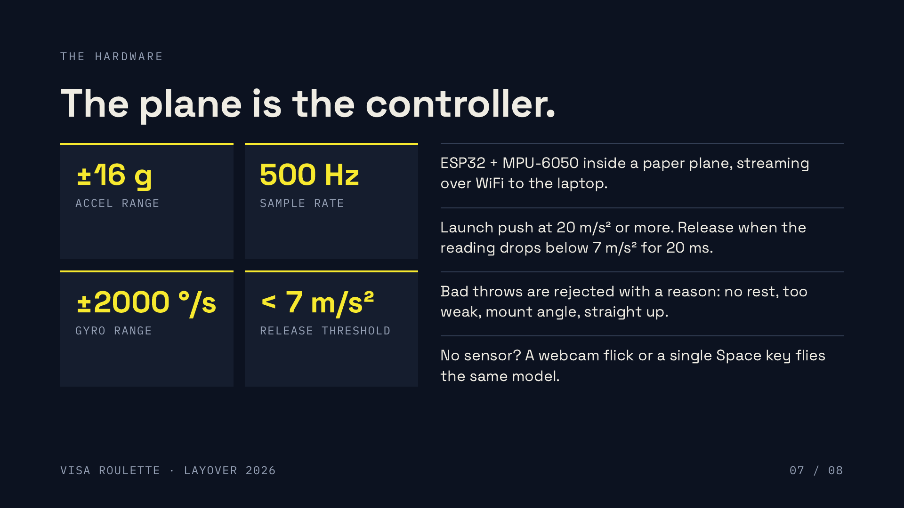
Notes:
TIME: 1:38 to 1:56 (18 s).
SAY: "The plane is the controller. An ESP32 and a motion sensor ride inside it and stream 500 samples a second. We detect the push, then the release, when the sensor feels freefall. Bad throws are rejected with a reason." (About 35 words.)
DEMO CUE: if the plane was not thrown live, play the hardware video (Drive link on the thank-you slide). Do not describe a throw you have not shown.
FACTS (docs/HARDWARE_MPU6050.md, backend/visa_roulette/throw.py):
- MPU-6050 configured for +/-16 g and +/-2000 deg/s, sampled at 500 Hz, sent in 25-sample WebSocket batches.
- Launch push: at or above 20 m/s2. Release: reading below 7 m/s2 for 20 ms (freefall). Gyro magnitude gives tumble.
- Rejection codes: no_rest, too_weak, mount_angle, straight_up.
- Webcam flick and single-switch (Space: lock heading, lock power) feed the same flight model.
- The hosted Vercel demo has NO hardware and no live sensor; say so if asked.
Q AND A:
Q: What if the hardware dies on stage? A: Three fallbacks that use the same flight model: webcam flick, single-switch Space key, and the recorded hardware video. The demo never dead-ends.
Q: How reliable is the throw detection? A: Thresholds are tuned on our own throws and covered by unit tests in backend/tests/test_throw.py. It is a hackathon sensor build, not calibrated lab hardware, and it rejects ambiguous throws rather than guessing.

Slide 8
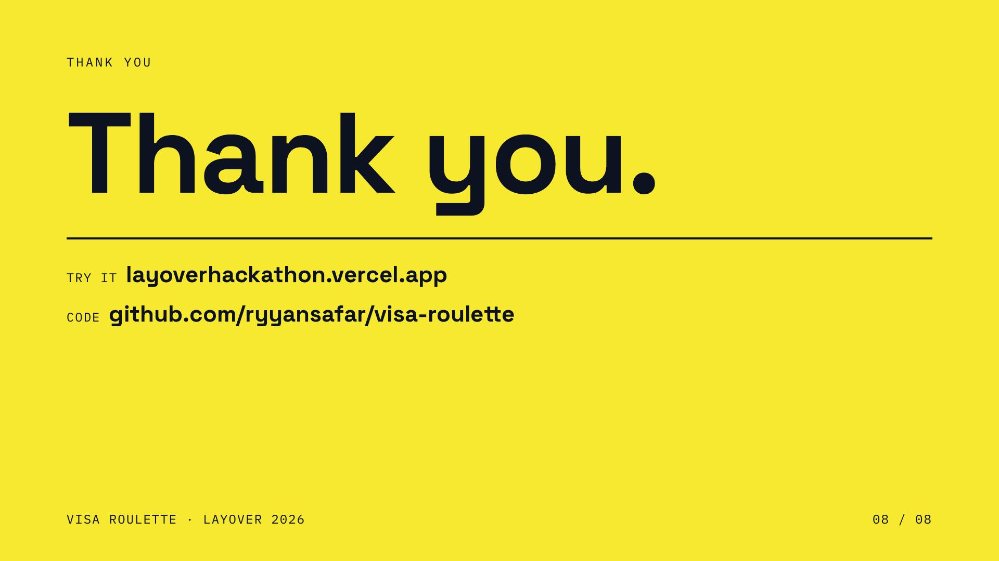
Notes:
TIME: 1:56 to 2:00 (4 s).
SAY: "Thank you. Come throw the plane."
DEMO CUE: leave the booth on the globe. Invite judges to throw.
Q AND A:
Q: Where can I try it? A: At the booth, or at layoverhackathon.vercel.app with sample travellers. The hardware video and the code are in the repo README.

Slide 9
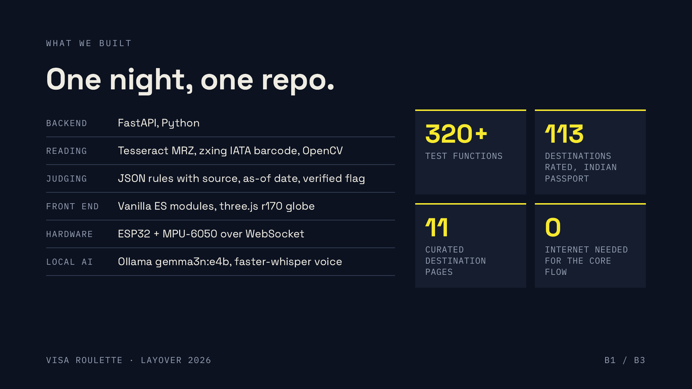
Notes:
TIME: BACKUP. Outside the 2 minute pitch. Use only if a judge asks.
SAY: "Built at the hackathon: a FastAPI backend, OCR and barcode readers with check digits, a JSON rules engine, a three.js globe, the ESP32 plane, and a local language model and voice that run offline. More than three hundred tests. Fathima built the airport experience; I built the engine and hardware."
CREDITS: Ryyan Safar built the backend, rules, hardware and integration. Fathima built the airport UI. Say both names.
FACTS (verify before the pitch if the repo changed):
- 320 test functions under backend/tests (counted with a grep for def test_). Say "more than three hundred", not an exact figure.
- Rules: 113 destinations listed for an Indian passport; 11 curated destination pages.
- Core flow is offline-first: local Ollama operator (template fallback), local faster-whisper, QR hand-off over the laptop LAN.
- Hosted demo: https://layoverhackathon.vercel.app (sample travellers only). Repo: https://github.com/ryyansafar/visa-roulette
Q AND A:
Q: What is original versus a library? A: The libraries are Tesseract, zxing, OpenCV, three.js and Ollama. What we wrote: MRZ and BCBP parsing with check digits, the rules engine and its evidence trail, the throw detection and flight model, and the booth flow.
Q: Did you build all this in one hackathon? A: The repo history is the evidence: it was built during LAYOVER. Do not claim anything beyond what the commit log shows.

Slide 10
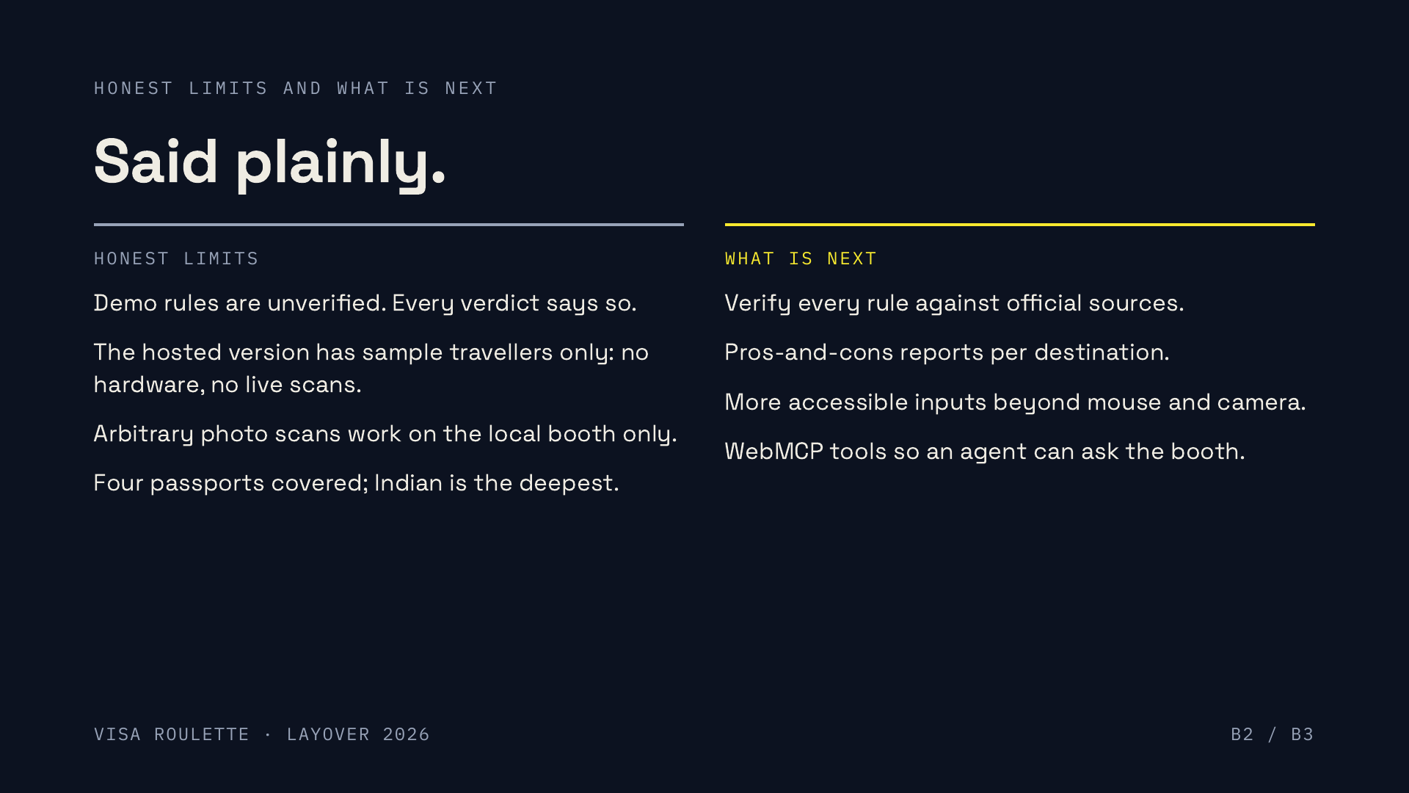
Notes:
TIME: BACKUP. Outside the 2 minute pitch. Use only if a judge asks.
SAY: "Honest limits: the rules are demo rules, and the hosted version has no hardware. Next: verify every rule against official sources, then reports and wider accessibility."
WHY THIS SLIDE EXISTS: judges trust a team that names its limits. It also pre-empts the hardest questions.
FACTS:
- rules/visa_rules.json: verified false, as_of 2026-10-10.
- Hosted demo (https://layoverhackathon.vercel.app) runs sample travellers only. Arbitrary photo scans run on the local booth.
- Four nationalities in the rules: IND, USA, GBR, ARE.
- The "what is next" list is intent, not shipped. Say "next", never "we have".
Q AND A:
Q: What is the first thing you would do with another month? A: Verify rules against official government sources and show the verified flag on every verdict.

Slide 11
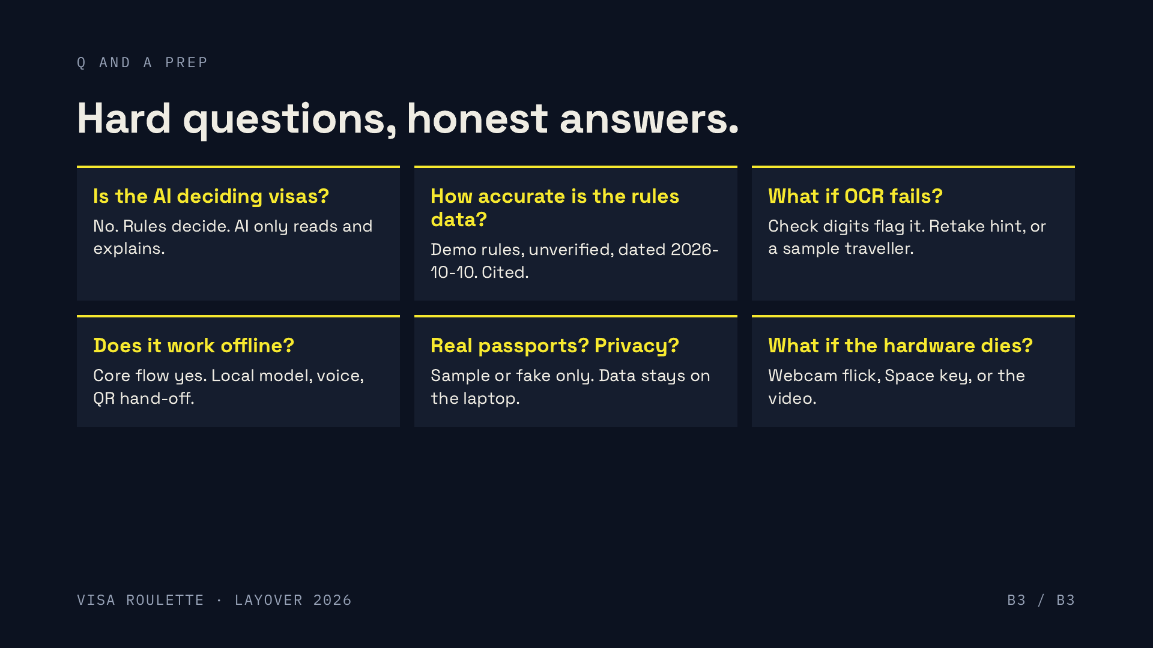
Notes:
Q AND A PREP. Full answers, say them in this order of confidence.
1. Is the AI deciding visas?
No. Vision and OCR only read the document. A deterministic rules engine reads JSON rule files and produces the verdict, with a source link and an as-of date. A local LLM may rephrase an explanation in two plain sentences; if it says anything the rules do not contain, a template replaces it. A destination with no rule is reported as unknown, never guessed.
2. How accurate is the rules data?
These are demo rules: visa_rules.json has as_of 2026-10-10 and verified false, and the UI says so. They are curated from public information with a source URL per rule. They are not legal advice. The design makes verification a data task: check each rule, flip its verified flag. That is our first next step.
3. What if OCR fails?
The MRZ has check digits, so a bad read is caught rather than trusted, and the booth shows a retake hint. If the room is bad, tap a sample traveller: the sample passports are known to the system, so the flow never dead-ends. Arbitrary photo scans are a local-booth feature; the hosted demo uses sample travellers only.
4. Does it work offline?
The core flow is offline-first: local Tesseract and zxing, local rules, a local Ollama model with a template fallback, local faster-whisper voice, and a QR hand-off served from the laptop over its LAN. The hosted demo needs internet by nature and has no hardware.
5. Do you handle real passports? What about privacy?
The booth is built for sample or fake passports. We say so on screen. Data stays on the laptop for the local flow; we do not send passport data to a cloud model. Do not ask judges to scan real documents.
6. What if the throw is unreliable or the hardware dies?
The detector rejects ambiguous throws with a reason instead of guessing (no_rest, too_weak, mount_angle, straight_up). Fallbacks feed the same flight model: webcam flick, single-switch Space key, and the recorded hardware video.
BONUS (if asked): Who built what? Ryyan Safar: backend, rules, hardware, integration. Fathima: airport UI. Is Lakshmi real? No, a specimen traveller. Is this a game or a tool? Both, deliberately.
TIME: BACKUP. Outside the 2 minute pitch. Use only if a judge asks.

