Slide 1
Codes of Right Conduct, Common good and Greatest good

Slide 2
Operating with integrity and with reference to codes of right conduct is playing an increasingly significant role for sustainable business today. This means businesses must operate using good and morally acceptable policies and practices.
COMMON VS. GREATEST GOOD
The common good is that principle that whatever serves the most number of members in a community is considered good. The common good is usually whatever rules or actions are required to reduce the disharmony in the community.

Slide 3
While the greatest good is the principle that there is a standard that people must cooperatively strive for to maximize the harmony in the community.
The common good is normally good under every system of objective or subjective measure.
Paying taxes in exchanges for services, or following laws and social norms in order not to break other people’s enjoyment are examples of common good.

Slide 4
The greatest good is the higher order of good. It can be used for good purposes to address areas where the common good is not inclusive of groups of people.
Individually, people contribute on a daily basis to the common good like when people wait for their turns, when they don’t take more than they need and leave some for others, when they work cooperatively on common or group goals, when they treat others as they treat themselves.

Slide 5
Individually, people can also contribute to a greatest good like when they undertake an action that provides an example for others to follow because of the obvious benefits or improvement for the common good.

Slide 6
Environmental Policy
Common Good: Implementing regulations to reduce air and water pollution, which benefits everyone in the community by promoting a healthier environment and better quality of life.
Greatest Good: A government deciding to invest in renewable energy sources, aiming to mitigate climate change effects that threaten the majority of the population's future, thereby benefiting a larger segment of society compared to more localized but less impactful environmental initiatives.

Slide 7
Social Welfare
Common Good: Implementing a basic social safety net that provides support for all community members in need, such as food assistance programs that help ensure everyone has access to nutritious meals.
Greatest Good: A targeted relief program that gives larger benefits to the most impoverished families, resulting in the greatest overall reduction in poverty levels, even if some other groups receive less support.

Slide 8
Education
Common Good: Ensuring that every student has access to school resources like books, clean classrooms and. fair treatment from teachers.
Greatest Good: Allocating most school funds to the top-performing students to boost the school’s academic reputation, even if it means fewer resources for struggling students.

Slide 9
Common Good: Public Education
The government funds schools so everyone can study, rich or poor.
Even if it’s expensive, it promotes equal opportunity.
Goal: No one is left behind.
Greatest Good: Building a highway
A new road reduces traffic and helps millions.
But some families may lose homes due to construction.
Goal: Most people benefit, even if a few are affected.

Slide 10
Urban Planning
Public Health

Slide 11
CODE OF CONDUCT
Every organization must have a code of right conduct. A code has value just like an internal guideline and an external statement of corporate values and commitments.
A well-written code of conduct spells out an organization’s mission, values and principles, connecting them with standards of professional conduct. The code expresses the values the organization desires to promote in leaders and employees.

Slide 12
EXAMPLE OF CODE OF CONDUCT
Policy elements
Company employees are bound by their contract to follow our Employee Code of Conduct while performing their duties.
Compliance with Law
All employees must protect the company’s legality. They should comply with all environmental, safety and fair dealing dictations of local and international laws. employees should also respect our company’s policy for social corporate responsibility.

Slide 13
Respect in the Workplace
All employees are bound by our company’s equal opportunity policy. They should behave in a respectful manner towards their colleagues. Any kind of discriminatory behavior, harassment or victimization is prohibited. This applies to all aspects of our workplace from recruitment and evaluation processes to interpersonal relations between employees.

Slide 14
Protection of Company Property
All employees should treat our company’s property, whether material or intangible, with respect and care.
Professionalism
All employees must show integrity and high quality professionalism in the workplace:
Personal Appearance
Corruption
Job duties and authority
Absenteeism and Tardiness
Conflict of Interest

Slide 15
Unethical Behavior vs Ethical Behavior
Unethical Behavior
A worker ignores a struggling colleague and focuses only on their own tasks even if they have spare time.
Ethical Behavior
A worker offers help to a colleague who is struggling when they have time available.
Notes:
‹#›

Slide 16
Unethical Behavior
An employee takes office supplies (pens, paper, etc.) for personal use at home without permission.
Ethical Behavior
An employee uses company resources only for work and asks permission if something is needed.
Notes:
‹#›

Slide 17
Unethical Behavior
A worker spreads rumors or gossip about colleagues in the office.
Ethical Behavior
A worker maintains professionalism and respects the reputation of colleagues.
Notes:
‹#›

Slide 18
Unethical Behavior
An employee shares confidential company information with outsiders.
Ethical Behavior
An employee protects and keeps confidential company information secure.
Notes:
‹#›

Slide 19
Unethical Behavior
A worker blames a colleague for a mistake they actually made.
Ethical Behavior
A worker takes responsibility for their mistakes and works to correct them.
Notes:
‹#›

Slide 20
Unethical Behavior
An employee uses work time to do personal business or browse social media excessively.
Ethical Behavior
An employee manages time responsibly and focuses on assigned tasks during work hours.
Notes:
‹#›

Slide 21
Two Types of Moral Theory
Consequentialist – focuses on the outcomes of actions, settling on whether or not an action is good by knowing the results.
Non-consequentialist – centers on the principle that an action is good based on the principle people follow and regardless of the results of the action.

Slide 22
Utilitarianism
Utility is any net benefits produced by an action. The principle of utility affirms that actions or behaviors are right if they encourage happiness or pleasure, wrong if they generate unhappiness or pain.
Utilitarianism says that the RESULT or the CONSEQUENCE of an act is the real measure of whether it is good or bad. It attempts to answer the question about what a man ought to do. The answer to this is that he ought to act to create the best consequences. These consequences includes all of the good and bad. (actions are right if they are useful or for the benefit of the majority)

Slide 23
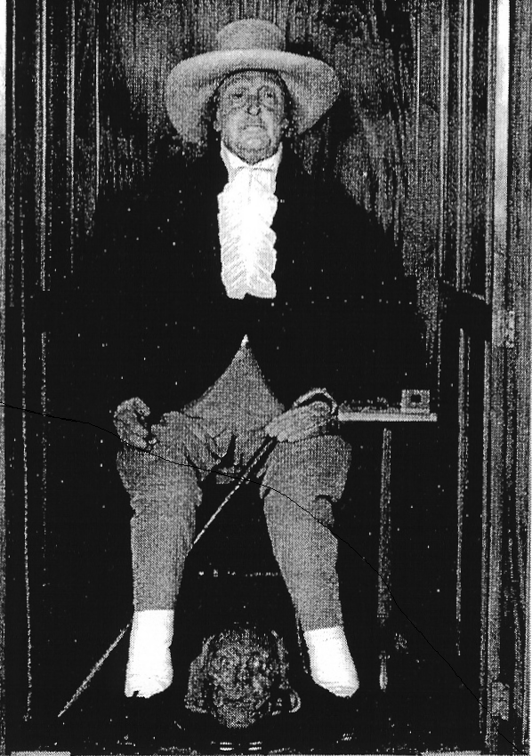
Jeremy Bentham
Notes:
‹#›

Slide 24
Bentham’s Formulation of Utilitarianism
Man is under two great masters, pain and pleasure.
The great good that we should seek is happiness.
Those actions whose results increase happiness or diminish pain are good. They have “utility.”
Notes:
‹#›

Slide 25
Application of Utilitarian Theory
B) You attempt to help an elderly man across the street. You stumble as you go, he is knocked into the path of a car, and is hurt.
Conclusion: The Act was a bad act.
A) You attempt to help an elderly man across the street. He gets across safely.
Conclusion: the Act was a good act.
Notes:
‹#›

Slide 26
Application of Utilitarian Theory
If you can use eighty soldiers as a trap in war, and thereby attack an enemy force and kill several hundred enemy soldiers, that is a morally good choice even though the eighty might be lost.
If lying or stealing will actually bring about more happiness and/or reduce pain, Act Utilitarianism says we should lie and steal in those cases.
Notes:
‹#›

Slide 27
Criticisms of Bentham’s theory
Bentham’s theory could mean that if 10 people would be happy watching a man being eaten by wild dogs, it would be a morally good thing for the 10 men to kidnap someone (especially someone whose death would not cause grief to many others) and throw the man into a cage of wild, hungry dogs.
Notes:
‹#›

Slide 28
John Stuart Mill’s Adjustments to Utilitarianism
Mill argues that we must consider the quality of the happiness, not merely the quantity.
For example, some might find happiness with a pitcher of beer and a pizza. Others may find happiness watching a fine Shakespearean play. The quality of happiness is greater with the latter.
Notes:
‹#›

Slide 29
Criticisms of Utilitarianism
If I am to bring the greatest happiness to the greatest number, not putting my own happiness above others, that may lead to a dilemma. I live in a neighborhood where 83% of my neighbors use drugs. I could make them most happy by helping supply them with cheap drugs, but I feel uncomfortable doing that. What should a utilitarian do?
Notes:
‹#›

