Slide 1

RESEARCH QUESTION:
DOES INCOME HAVE AN EFFECT ON OVERALL HAPPINESS IN EUROPE?
A DATA MINING ANALYSIS BY:
CHRIS GARVIN(x16442896)
RYAN JOHNSTON(X17437624) DARRAGH BRENNAN(x17469074)

Slide 2
Chris Garvin (x16442896)
Introduction
Data
Inspiration

Slide 3
INTRODUCTION
“Does income have an effect on overall happiness in Europe?"
Why we chose this topic?
We chose this topic as we feel happiness is of the utmost importance in today's society.
We want to find out how much of an effect someone's income can have on how happy they are, as people with more money would usually tend to have higher living standards.
What was our motivation?
In today's Covid-ridden world, we have seen suicide rates rise significantly, as well as income dropping drastically, so we feel there was no better time to perform this analysis.
Mental health has become the forefront of today's society due to it being of such increasing prevalence in especially but not specifically our younger generation, many famous people have come out about their own mental health issues recently, it has become such a huge problem, and as of right now is one of the biggest murderers in the world.

Slide 4
DATA
Datasets
World Happiness Report – We found this global happiness report from Kaggle, which is an online data science community, one of the most popular sources of datasets worldwide at the moment. We decided to use just Europe for our study.
List of European countries by average wage - We found this on Wikipedia, which is a free online encyclopaedia whose articles are written by experts.
Why we chose this data.
We chose the World Happiness Report as it's gained global recognition from leading experts around the world across many fields of study. It uses data from the Gallup World Poll which is a telephone survey carried out worldwide to thousands of individuals annually.
The List of European countries by average wage dataset was chosen due to it's simplicity as well as importance. It gave us the most accurate reading of net average monthly salaries for solely Europe. It is essentially a map and list of European countries by monthly average wage, valued in euros for ease.

Slide 5
INSPIRATION
K-means clustering.
In an approach, "Economic Inequality, Happiness and Human Development" (Irina Georgescu, Jani Kinnunen, Armenia Androniceanu and Ane-Mari Androniceanu (2020)), they used k-means clustering to obtain four clusters of 21-26 countries, which we learnt from based on the distribution of our own data.
Regression
In a study named "Absolute income, relative income, and happiness" (Kateryna Chernova & Richard Ball (2007)) we were inspired by how they used regression in order to find a mean happiness rating. It portrayed the difference between regression and association very well.
Visualisation
We were thoroughly inspired visually by the works of "The relationship between Age and Happiness Varies by Income" (Dimiter Tochkov (2021)). Although not exactly what we had proposed, Dimiter 's visualisation was staggering and gave us a phenomenal understanding of how we should visualise our work.

Slide 6
Ryan Johnston (x17437624)
Methodology
Implementation

Slide 7
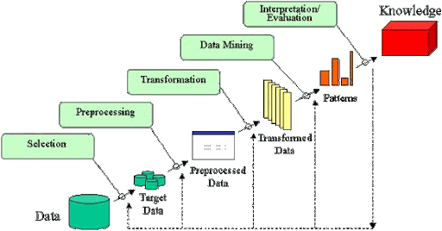
METHODOLOGY
The KDD Methodology was used
DATA SELECTION
Multiple datasets were read into the R Studio environment using the read.csv command.
countries_income <- read.csv(file = '/Users/ryanjohnston/development/r/datamining/countries.csv')
year1 <- read.csv(file = '/Users/ryanjohnston/development/r/datamining/year1.csv’)
year2 <- read.csv(file = '/Users/ryanjohnston/development/r/datamining/year2.csv’)
The loaded datasets required more selection to target the right data:
countries_income <- countries_income[-c(16,28,30,31,42,44,45),]
year1 <- year1[-c(48,35,14,49,22,34,29,46,32,12,18),]
year2 <- year2[-c(47,36,16,49,21,37,27,45,29,13,19),]
The code above removes areas of the year1 & year2 dataset that are not in Europe

Slide 8

PREPROCESSING
Renaming columns
names(year1)[1:10] <- c("Country","Region","Happiness_Rank", "Happiness_Score","GDP_Per_Capita","Family", "Life_Expectancy","Freedom","Corruption_Perception","Generosity")
Joining dataframes
joined_df <- left_join(year1, year2,
by = c("Country" = "Country"))
Creating variable to help remove unnecessary fields, and applying a query to remove them
Character fields were cast as numeric, as a correction to a default type
criteria <- c("Central and Eastern Europe", "Western Europe")
happiness <- happiness[happiness$Region.x %in% criteria, ]
happiness_factors$Happiness_Score < as.numeric(happiness_factors$Happiness_Score)
Removing columns
happiness <- happiness[ , -c(3,5,6,7,8,9,10,11,
12,13,14,16,17,18,19,20,21,22,23,24,25,27,28,29,30,31,32,33,34,35)]
Reordering columns to put an ID column first
Removing rows
joined_df <- joined_df[, c(9,1,2,3,4,5,6,7,8,10,11)]
year1 <- year1[-c(48,35,14,49,22,34,29,46,32,12,18),]

Slide 9

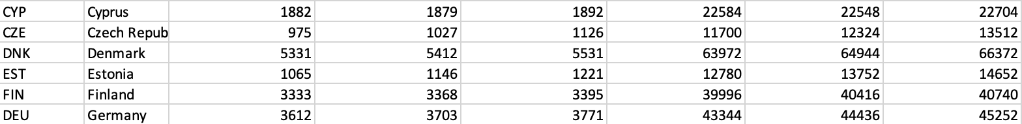

TRANSFORMATION
Income dataset was manually created in Excel
XLSX document was saved in Excel then changed to CSV once data import was fully complete
IMPLEMENTATION
R Script – automates the steps of the KDD process
The installation of required packages are installed directly within the code
install.packages("tidyverse")
library(tidyverse)

Slide 10
Darragh Brennan (x17469074)
Data Mining Techniques
Findings
Conclusions

Slide 11
Data Mining Techniques
Data Cleaning and Preparation
- To organise data so it is ready for analysis
- Removal of rows and columns
- Dataframes were combined
- Datasets, columns and rows were renamed
- Null values were dealt with
Modelling
- To test significance levels to determine which of the variables had the greatest
- impact on a constant
K-means Clustering
- Created to group data based on the relationship of two variables
Linear Regression
- To model the relationship between two variables
Visualisations
- To display information in a clear manner so that comparisons could be made

Slide 12
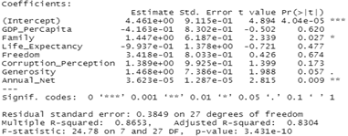
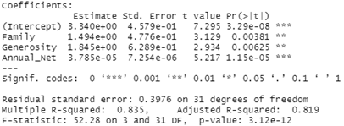
Findings
Modelling
Model 1
- The intercept value represents the overall happiness score
- Family, generosity and annual net income are all significant
- Adjusted R-squared = 0.8304
Model 2
- Annual net income has the greatest significance
- Adjusted R-squared = 0.819
The closer the Adjusted R-squared value is to 1 the better the model is. Therefore, Model 1 is a better than Model 2.

Slide 13
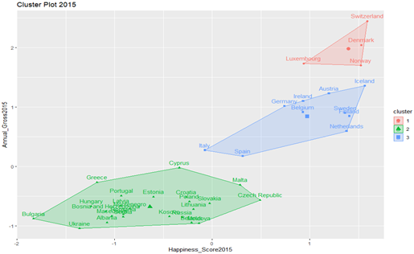
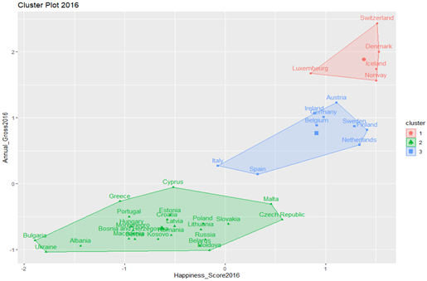
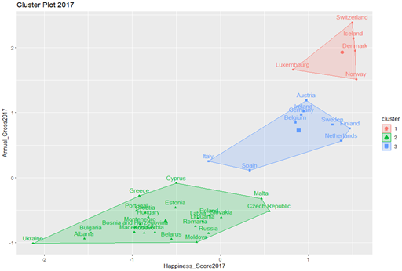
Findings
K-means Clustering
2015
2016
2017

Slide 14
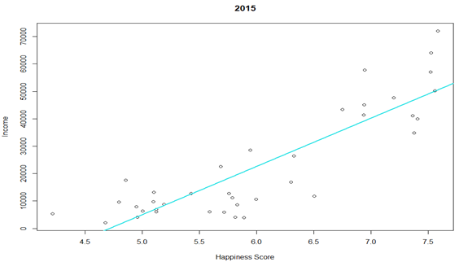
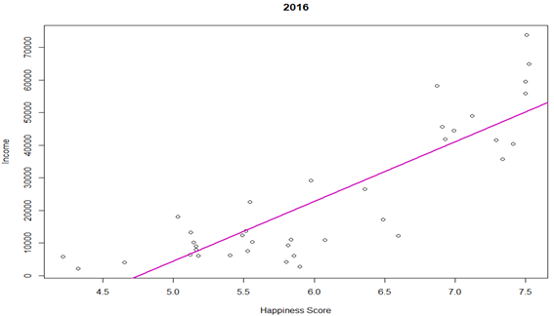
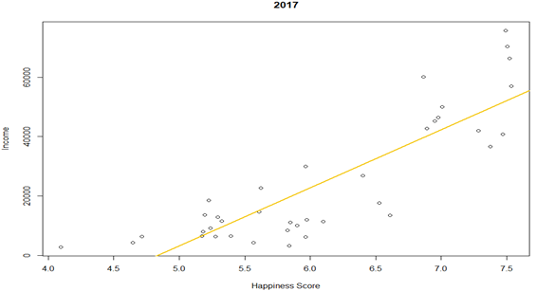
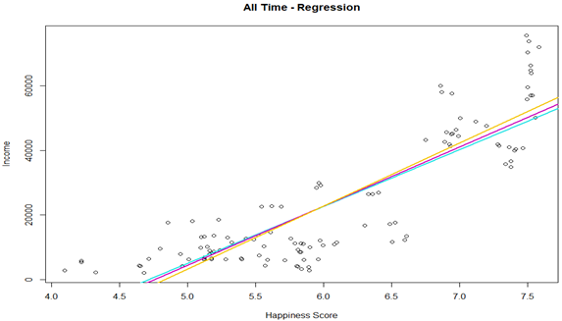
Findings
Linear Regression

Slide 15
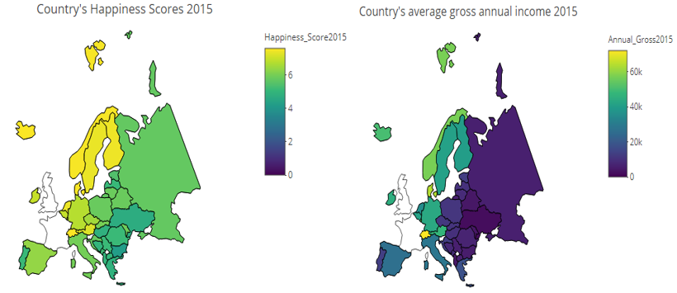
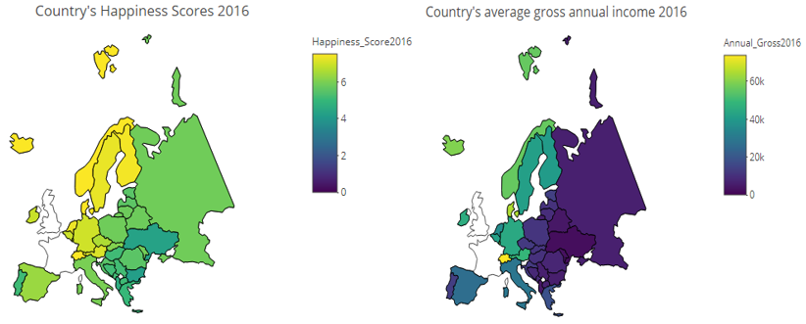
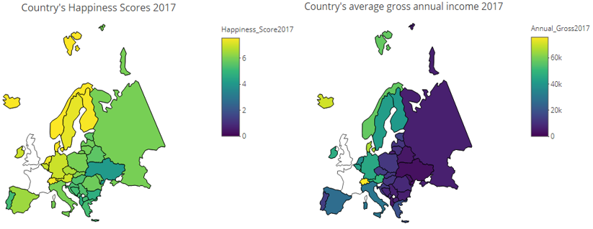
Findings
Visualisation
- Interactive choropleth maps were created for each year

Slide 16
Conclusions
The purpose of this analysis was to try and answer the research question “Does income have an effect on overall happiness in Europe?”.
Modelling showed that out of all the happiness factors annual net income had the greatest impact on the overall happiness score.
K-means Clustering showed that in the majority of cases the higher the average annual gross income is, the higher the overall happiness score.
Linear regression showed that as the average annual gross income increased over time so did the average overall happiness score.
The map visualisations made it easy to see that there does appear to be a direct link between overall happiness score and income.
After looking at the findings of the various data mining techniques it would indicate that income does appear to have an effect on overall happiness in European countries.

