Slide 1
Towards SDN Programming Language for the Real World
Leonid Ryzhyk

Slide 2
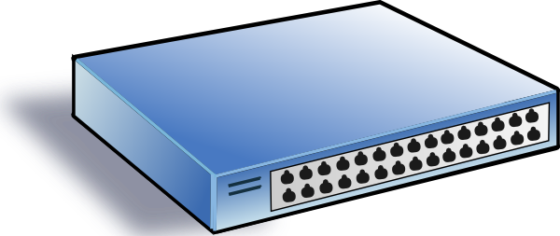
SDN: Towards Programmable Networks
Eth, ARP, RARP,
VLAN, STP, MPLS...
table 1
... | ...
... | ...
table 2
... | ...
... | ...
table 3
... | ...
... | ...
Legacy switch
SDN switch
  fixed set of (vendor-defined) functions
  configured, not programed
  lack of programmability hinders innovation
  exposes the low-level computational model (match-action tables)…
  … via a standard interface (e.g., OF)
  SDN controller—a centralized vantage point to observe and control the network
  network governed by SDN applications running on top of the controller

Slide 3
SDN in a Nutshell
Application
??
Java, Python, C++, ...
Controller
OpenFlow, P4, NetKAT, ...

Slide 4

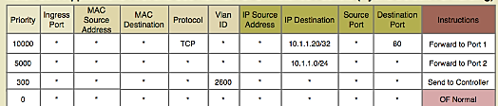

SDN Applications are Hard to Write
OpenFlow program
Configuration
DB
Application
Looks
like a compiler
Network Information Base (NIB)

Slide 5
Compilers are Hard to Write
IP router logic
SDN code that generates IP router logic
if (acl(pkt) == DENY) {drop};
pkt.dstMAC = nexthop(pkt.dstIP);
send RouterOut[router]
for rule in acl:
if rule.action == ACCEPT:
add_flow(t1, rule.match, goto t2)
else:
add_flow(t1, rule.match, drop)
for route in routes:
add_flow(t2, route.prefix,
dl_dst:=route.nexthop)
Table 2 (routing)
ip_dst=10.33.114.* | eth_dst:=00:0e:c6:e2:a3:5a; send
ip_dst=10.1.*.* | eth_dst:=9c:b6:d0:11:ae:c1; send
default | drop
Table 1 (ACL)
... | goto Table 2
... | drop
To make things worse, OpenFlow rules must be updated incrementally whenever the NIB or the configuration DB changes.

Slide 6
Real-World Implications
Giants like VMware and Google pull off SDN projects by putting massive engineering resource on them
Despite large investments, the complexity of SDN programming slows down innovation and complicates the introduction of new features

Slide 7
Research on SDN Languages
Previous DSLs failed to achieve adoption
Do not offer abstractions suitable for real-world SDN programming
  either very high-level abstractions that cannot be implemented efficiently
  … or domain-specific abstractions that do not generalize

Slide 8
Cocoon 2 by Example
IP router logic
SDN code that generates IP router logic
if (acl(pkt) == DENY) {drop};
pkt.dstMAC = nexthop(pkt.dstIP);
send RouterOut[router]
for rule in acl:
if rule.action == ACCEPT:
add_flow(t1, rule.match, goto t2)
else:
add_flow(t1, rule.match, drop)
for route in routes:
add_flow(t2, route.prefix,
dl_dst:=route.nexthop)

Slide 9
Cocoon 2 by Example
Cocoon code manipulates packets directly, as if it ran in the dataplane
Yet it has access to all the configuration state
(This is an instance of Tierless Network Programming pioneered in Maple and FlowLog)
Allows efficient compilation to OpenFlow
  no loops, recursion, memory allocation, ...
Allows a single parameterized implementation for a family of switches (aka role)
  A role takes a packet as implicit argument, modifies it and forwards to 0 or more other role instances
role Router[router in Routers] =
if (acl(pkt) == DENY) {drop};
pkt.dstMAC = nexthop(pkt.dstIP);
send RouterOut[router]

Slide 10
Cocoon 2 by Example
role Router[router in Routers] =
if (acl(pkt) == DENY) {drop};
pkt.dstMAC = nexthop(pkt.dstIP);
send RouterOut[router]
function nexthop(addr: ip4_addr_t): mac_addr_t =
select_first(rule in NextHop | ip4match(rule.subnet, addr)
order by subnet.mask desc) {
rule.mac
}
Forwarding decisions are made based on the database content

Slide 11
Cocoon 2 by Example
table Routes( subnet: ip4_netmask_t
, nhop: ip4_addr_t
, unique(subnet))
table ARP( ip: ip4_addr_t
, mac: mac_addr_t
, unique(ip))
view NextHop ( subnet: ip4_netmask_t
, mac: mac_addr_t)
NextHop(subnet, mac) :-
Routes(subnet, ip), ARP(ip, mac)
role Router[router in Routers] =
if (acl(pkt) == DENY) {drop};
pkt.dstMAC = nexthop(pkt.dstIP);
send RouterOut[router]
function nexthop(addr: ip4_addr_t): mac_addr_t =
select_first(rule in NextHop | ip4match(rule.subnet, addr)
order by subnet.mask desc) {
rule.mac
}

Slide 12


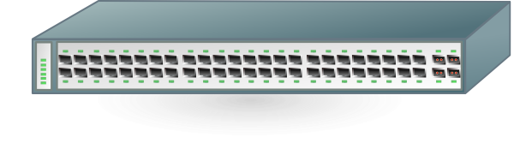
Compiling Cocoon 2
table Routes( subnet: ip4_netmask_t
, nhop: ip4_addr_t
, unique(subnet))
table ARP( ip: ip4_addr_t
, mac: mac_addr_t
, unique(ip))
role RouterIn[router in Routers] =
if (acl(pkt) == DENY) {drop};
pkt.dstMAC = nexthop(pkt.dstIP);
send RouterOut[router]
PostgreSQL
Table 1
Table 2
view NextHop ( subnet: ip4_netmask_t
, mac: mac_addr_t)
NextHop(subnet, mac) :-
Routes(subnet, ip), ARP(ip, mac)
In-memory
Datalog engine

Slide 13

desired
realized
NextHop
10.33.114.* | 00:0e:c6:e2:a3:5a
10.1.*.* | 9c:b6:d0:11:ae:c1
NextHop
NextHop
10.33.114.* | 00:0e:c6:e2:a3:5a
10.1.*.* | 9c:b6:d0:11:ae:c1
Table 2 (routing)
ip_dst=10.33.114.* | eth_dst:=00:0e:c6:e2:a3:5a; send
ip_dst=10.1.*.* | eth_dst:=9c:b6:d0:11:ae:c1; send
default | drop
Table 1 (ACL)
... | goto Table 1
... | drop

Slide 14
Datalog engine
desired
realized
NextHop
10.33.114.* | 00:0e:c6:e2:a3:5a
10.1.*.* | 9c:b6:d0:11:ae:c1
10.15.*.* | b1:d2:16:3c:de:f1
NextHop
– | 10.1.*.* | 9c:b6:d0:11:ae:c1
+ | 10.15.*.* | b1:d2:16:3c:de:f1
NextHop
10.33.114.* | 00:0e:c6:e2:a3:5a
10.1.*.* | 9c:b6:d0:11:ae:c1
10.15.*.* | b1:d2:16:3c:de:f1
NextHop
NextHop
10.33.114.* | 00:0e:c6:e2:a3:5a
10.1.*.* | 9c:b6:d0:11:ae:c1
Cocoon runtime
OpenFlow
Table 2 (routing)
ip_dst=10.33.114.* | eth_dst:=00:0e:c6:e2:a3:5a; send
ip_dst=10.1.*.* | eth_dst:=9c:b6:d0:11:ae:c1; send
default | drop
Table 2 (routing)
ip_dst=10.33.114.* | eth_dst:=00:0e:c6:e2:a3:5a; send
ip_dst=10.15.*.* | eth_dst:=b1:d2:16:3c:de:f1; send
default | drop
Table 2 (routing)
ip_dst=10.33.114.* | eth_dst:=00:0e:c6:e2:a3:5a; send
ip_dst=10.15.*.* | eth_dst:=b1:d2:16:3c:de:f1; send
default | drop
Table 1 (ACL)
... | goto Table 1
... | drop

Slide 15
Datalog engine
desired
realized
NextHop
10.33.114.* | 00:0e:c6:e2:a3:5a
10.1.*.* | 9c:b6:d0:11:ae:c1
10.15.*.* | b1:d2:16:3c:de:f1
NextHop
– | 10.1.*.* | 9c:b6:d0:11:ae:c1
+ | 10.15.*.* | b1:d2:16:3c:de:f1
NextHop
10.33.114.* | 00:0e:c6:e2:a3:5a
10.1.*.* | 9c:b6:d0:11:ae:c1
10.15.*.* | b1:d2:16:3c:de:f1
NextHop
NextHop
10.33.114.* | 00:0e:c6:e2:a3:5a
10.1.*.* | 9c:b6:d0:11:ae:c1
NextHop
Table 1 (routing)
ip_dst=10.33.114.* | eth_dst:=00:0e:c6:e2:a3:5a; send
ip_dst=10.1.*.* | eth_dst:=9c:b6:d0:11:ae:c1; send
default | drop
Table 2 (routing)
ip_dst=10.33.114.* | eth_dst:=00:0e:c6:e2:a3:5a; send
ip_dst=10.15.*.* | eth_dst:=b1:d2:16:3c:de:f1; send
default | drop
Table 2 (routing)
ip_dst=10.33.114.* | eth_dst:=00:0e:c6:e2:a3:5a; send
ip_dst=10.15.*.* | eth_dst:=b1:d2:16:3c:de:f1; send
default | drop
Table 1 (ACL)
... | goto Table 1
... | drop

Slide 16
Separation of Concerns in Cocoon
Configuration database (with Datalog engine)
  Enforces consistency constraints
  Maintains derived relations (views)
  Computes incremental configuration updates
Cocoon runtime
  Applies incremental updates to match-action tables

Slide 17
Some Key Points
Program dataplane behavior in an imperative language
Data model based on SQL schema
  Tables describe SDN configuration
  Constraints restrict valid configurations
Data manipulation using an embedded SQL dialect

Slide 18
Summary of Cocoon 2
Raises the level of abstraction from OpenFlow rules to programs defined over DB tables
The developer retains control over all aspects of network behavior
Decomposes SDN programming into configuration management and packet forwarding
  Offers suitable abstractions to deal with both

Slide 19
Not in this talk
Stateful dataplane
Design by refinement
Automatic verification
https://github.com/ryzhyk/cocoon/tree/2.0

