Slide 1
Corporate Intranet case study

Slide 2
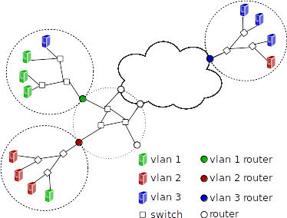
Corporate Intranet
* Based on [Sung et al. Towards Systematic Design of Enterprise Networks]

Slide 3
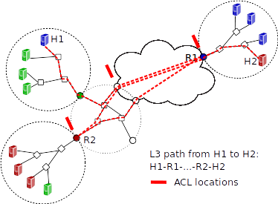

Slide 4
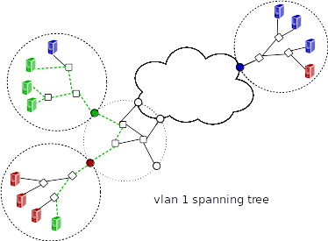

Slide 5
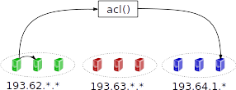
Spec 0

Slide 6
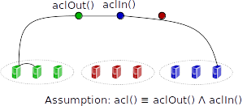
Spec 1

Slide 7
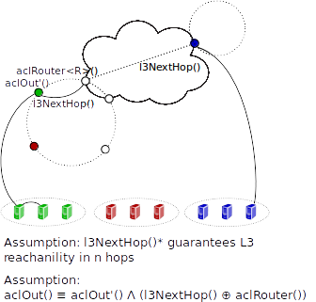
Spec 2

Slide 8
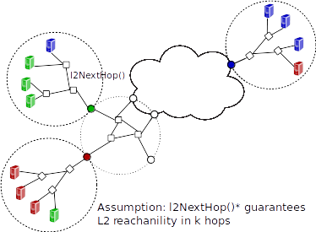
Spec 3

