Slide 1
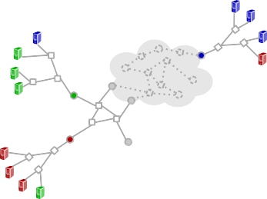
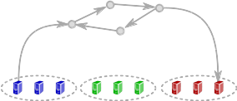

TOWARDS CORRECT-BY-CONSTRUCTION SDN
Leonid Ryzhyk Nikolaj Bjorner Marco Canini Jean-Baptiste Jeannin Nina Narodytska
Cole Schlesinger Douglas Terry George Varghese
22 August 2016

Slide 2
INTRODUCTION
Cocoon is a
  high-level SDN programming language
  SDN programming methodology
  verification tool
… based on the principle of correctness by construction

Slide 3



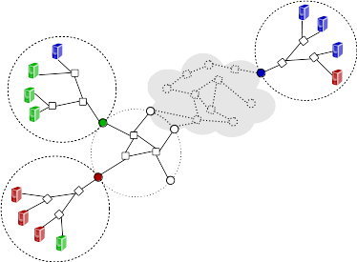



COCOON IN A NUTSHELL
Traditional SDN Verification Workflow
Design
Implement
Run on the
controller
Verify generated
network configuration
SDN verification with Cocoon
refine
refine
refine
spec
implementation
Correct by construction

Slide 4
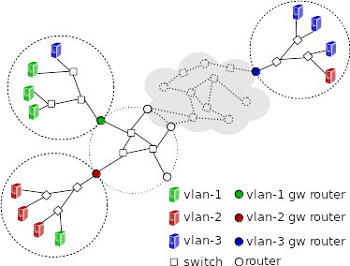
EXAMPLE: CAMPUS NETWORK
[Sung et al. Towards Systematic Design of Enterprise Networks]
L2 segment
Router
VLAN Gateway
Switch

Slide 5
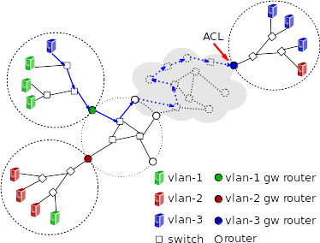
INTER-VLAN ROUTING: HOP1

Slide 6
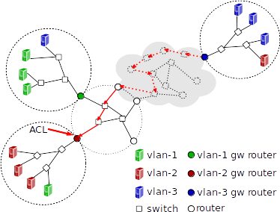
INTER-VLAN ROUTING: HOP2

Slide 7
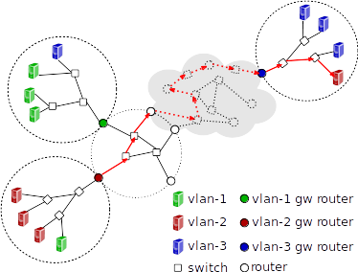
INTER-VLAN ROUTING: HOP3
This is messy:
  Large, ad hoc topology
  L2/L3 routing are mixed up
  Complex security policies
Typical bugs:
  ACL distribution
  Routing loops
  Black holes
Let’s try to untangle this design …

Slide 8
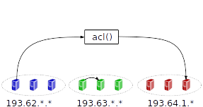
STEP 1: HIGH-LEVEL SPECIFICATION

Slide 9
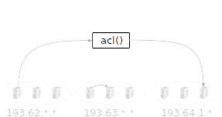
STEP 2: DISTRIBUTED ACLs

Slide 10
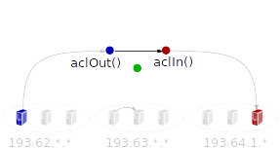
STEP 2: DISTRIBUTED ACLs
Assumption: acl() ≡ aclOut() Λ aclIn()

Slide 11
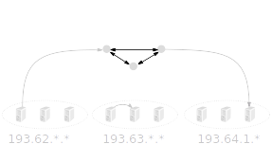
STEP 3: L3 ROUTING

Slide 12
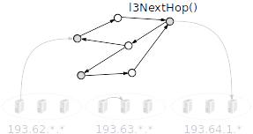
STEP 3: L3 ROUTING
Assumption: l3NextHop(GatewayIP)* = Gateway

Slide 13
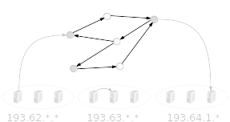
STEP 4: L2 SWITCHING

Slide 14
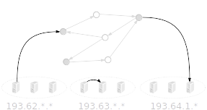
STEP 4: L2 SWITCHING

Slide 15
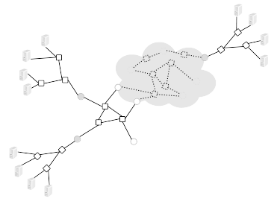
STEP 4: L2 SWITCHING
Assumption: l2NextHop(vlan)* = l3NextHop(vlan)

Slide 16
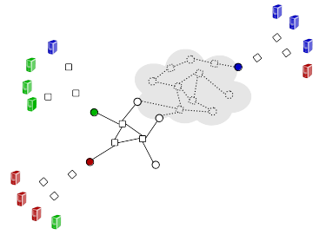
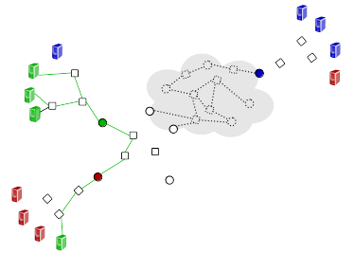
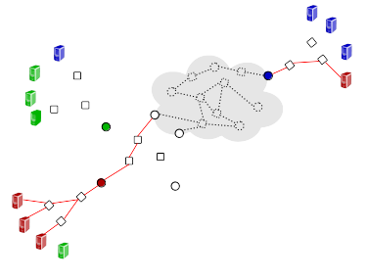
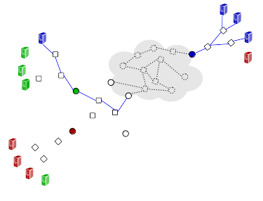
STEP 4: L2 SWITCHING
l2NextHop(vlan=0)
l2NextHop(vlan=green)
l2NextHop(vlan=red)
l2NextHop(vlan=blue)

Slide 17
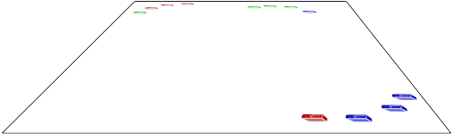
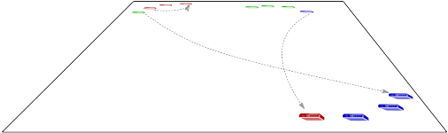

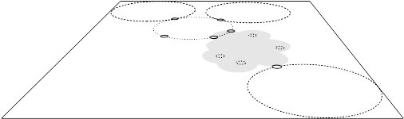

SEPARATION OF CONCERNS
High-level spec
Distributed access control
L3 routing
L2 switching

Slide 18
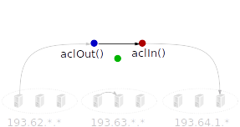
WOULDN’T IT BE GREAT TO BUILD SDNs
THIS WAY?
With Cocoon, you can!
  Language support for refinement-based programming
  Automatic compositional verification
  Parameterized specifications
    Spec may contain undefined functions, e.g., acl(), l2NextHop()
    Verification relies on assumptions
    Assumptions are validated when concrete definitions are provided (statically or at runtime)
  The Cocoon compiler supports P4 and OpenFlow (via NetKAT) backends

Slide 19
CASE STUDIES
Campus network
[Sung et al. Towards Systematic Design of Enterprise Networks]
F10
[Liu et al. F10: A Fault-Tolerant Engineered Network]
B4-style WAN
[Jain et al. B4: Experience with a Globally-Deployed Software Defined WAN]
iSDX (Software-defined Internet Exchange)
[Gupta et al. An Industrial-Scale Software Defined Internet Exchange Point]
NSX-style network virtualization framework
[Koponen et al. Network Virtualization in Multi-tenant Datacenters]
Stag (source-based routing + security labels for fat-tree topology)

Slide 20
PERFORMANCE
All case studies verified in ~10 sec,
  Compositional verification (1 refinement at a time)
  Parameterized verification amplifies the power of symbolic reasoning
Verification results apply to a family of topologies and all runtime configurations produced by the SDN app
No direct comparison with existing tools like NetKAT, HSA, but expect them to slow down for larger topologies

Slide 21
COCOON VS TRADITIONAL NETWORK VERIFICATION
Traditional | Cocoon
Obtaining correctness specification
Dedicated specs developed for verification purposes | Correctness spec developed during the network design process
Correctness guarantees enforced by verification
Property-based verification: reachability, isolation, loop-freedom | Functional equivalence
Verification time
Runtime verification: when a new configuration is installed | Static verification (only assumptions are validated at runtime)
Debugging support
Little help in understanding the cause of the bug | Bugs are localized to a specific refinement and network component

Slide 22
CONCLUSIONS
Correct-by-construction SDN:
  Enforces modular design
  Enables strong static correctness guarantees
  Scales to complex realistic networks

