Slide 1
<Anti-theft System>
<Group One>
<Xiaoxiang Zhang, xz2631>
<Minghao Li, ml4025>
<Ruimin Zhao, rz2390>
EECS E4764 Fall ‘17 IoT - Intelligent Connected Systems
Columbia university
Prof. Xiaofan (Fred) Jiang
1

Slide 2
_{Description}
_{What and Why}
What
We implement vibration sensors on the ground nearby the door to detect footstep pattern of the person who just entered the room
We implement ultrasonic sensors on the door frame to detect the figure of the person who just entered the room
We analyze the data collected by these two groups of sensors to decide whether the person who just entered room is a member of this family
Why
Importance: Home protection
Utility: Inexpensive and Real-time
Market Potential: Office protection
2

Slide 3
_{Feature Wish List}
Create a table with a wish list of all the features things you would like to implement in your project. It doesn’t matter if you will be able to implement those items, this is only a wish list. You will later assess the feasibility.
Feature | Description
Vibration Sensor | The vibration sensor can detect and collect data
Distance Sensor | The ultrasonic sensor can detect and collect data
Cloud Service | Data in database can be analyzed using the model we trained
3

Slide 4
_{Results / Outcome}
Describe the final results and outcome of your project
Level | Description
Bronze | Complete circuit configuration; Detect and collect data from vibration sensors as well as ultrasonic sensors; Simple signal processing on data
Silver | Identify the pattern for footstep vibration; Utilize could service to manipulate our database.
Gold | Train a model to detect the identification of the person who just entered
4

Slide 5
_{Description}
_{How}
State how does the project work, what are the main technical components
Embedded systems: vibration sensor, ultrasonic sensor
Cloud: AWS MongoDB
Algorithms: Deep Learning
Etc.
5

Slide 6
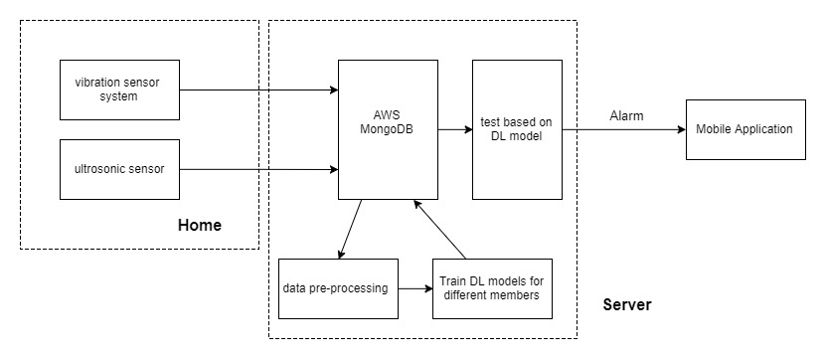
_{Block Diagram}
Draw a block diagram
Include the main blocks/components/modules
Include the high level signals/connectivity
Indicate the flow of data, signals tasks (this may require a second diagram)
6

Slide 7
_{Feasibility Study (Risks)}
challenge | rating | comment
Distance would influence the magnitude of the vibration | 2 | We implement ultrasonic sensors
More than one person entering the home at the same time | 5 | Paper Review required
Data analysis in terms of the selection of algorithm | 5 | Paper Review required
Sensor placement (allocation and combination) | 4 | Experiments with actual sensors required
Create a list/table with potential design challenges/risks in the process of implementation of the project. Indicate your assessment of the feasibility to execute key components of the project on the scale from 1-5 where 5 is the hardest.
This is one of the most critical parts of the project proposal. Some components of the projects may be undoable, or undoable in a reasonable amount of time.
Dedicate for this part a significant amount of time.
Use ALL source of information for your final decision: your own knowledge, faculty members, web, previous projects in the department, friends, family, etc.
7

Slide 8
Components/Resources and Budget
Create a list of required components/resources and the associated cost. Estimate the total cost.
Component | Units | Cost
Arduino UNO R3 | 3 | 24
Ultrasonic module | 1 | 8.86
breadboard | 1 | 10.99
Amplifier ICs | 1 | 5.95
Piezoelectric Disk Elements | 1 | 8.99
ADC | 1 | 3.75
Total | 8 | 62.54
8

Slide 9
_{Milestones and Timeline}
Create 4 milestones to complete the project. At the end of each milestone, check with TAs for feedback.
Milestone | Description
0 10.18-10.25 | Finalize the project idea
1 10.25-11.15 | Paper review and algorithm selection
2 11.15-11.29 | Hardware establishment, and cloud service implementation
3 11.29-12.13 | Data analysis
9

Slide 10
_{References}
List half a dozen or more critical references (papers, presentations, links).
http://ieeexplore.ieee.org/abstract/document/507414/
Carullo A.; Parvis M. (2001) An Ultrasonic Sensor for Distance Measurement in Automotive Applications. In: IEEE SENSORS JOURNAL, vol. 1 n. 2, pp. 143-147. - ISSN 1530-437X
10

