Slide 1
BBUser
File created on: 12/7/22 12:39:45 AM EST

Slide 2
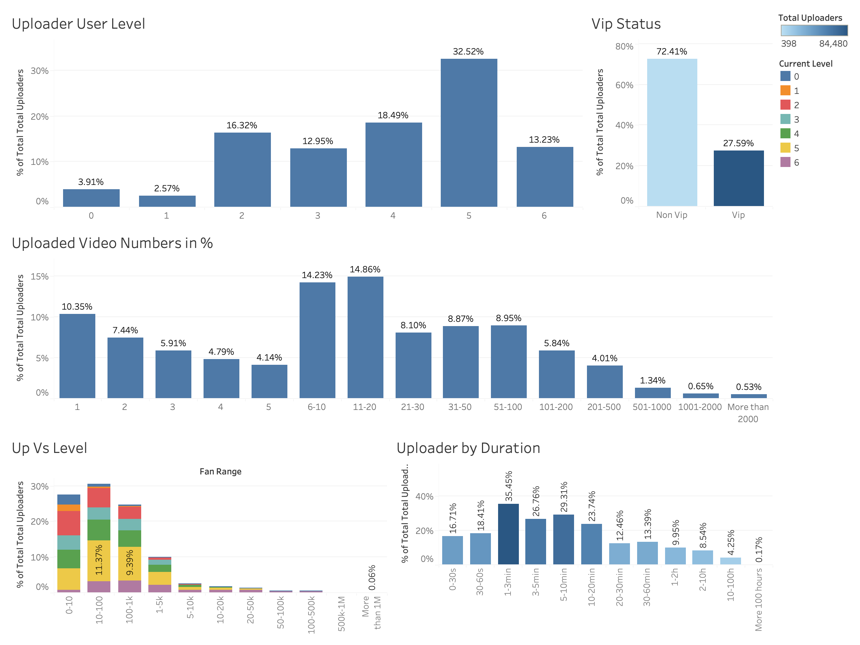

Slide 3
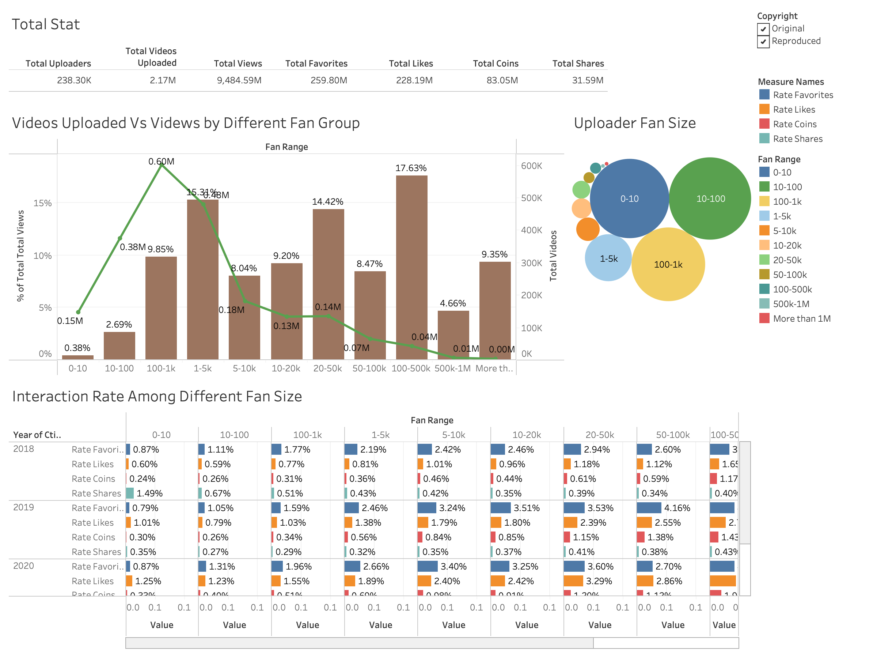

Slide 4
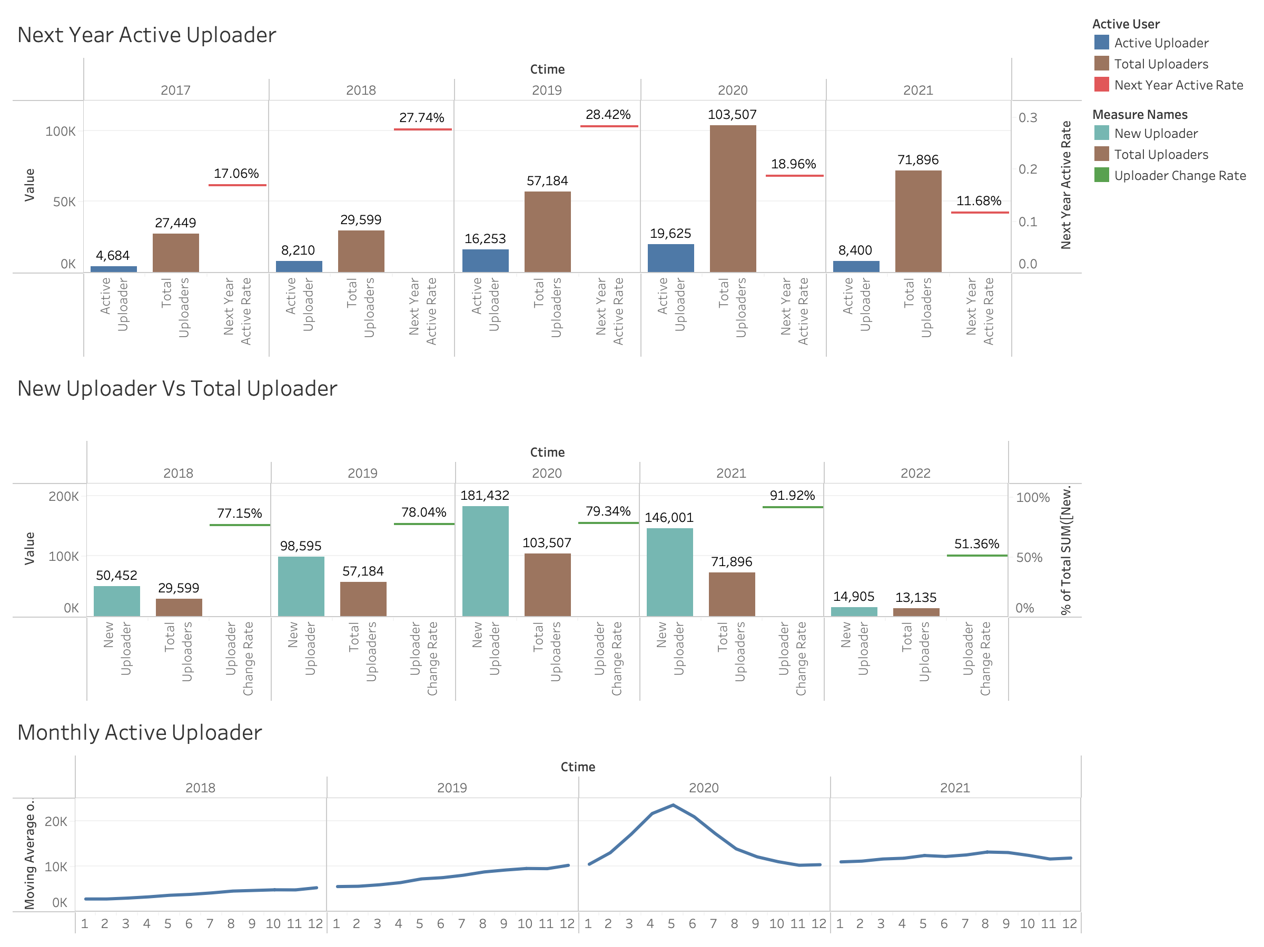

Slide 5
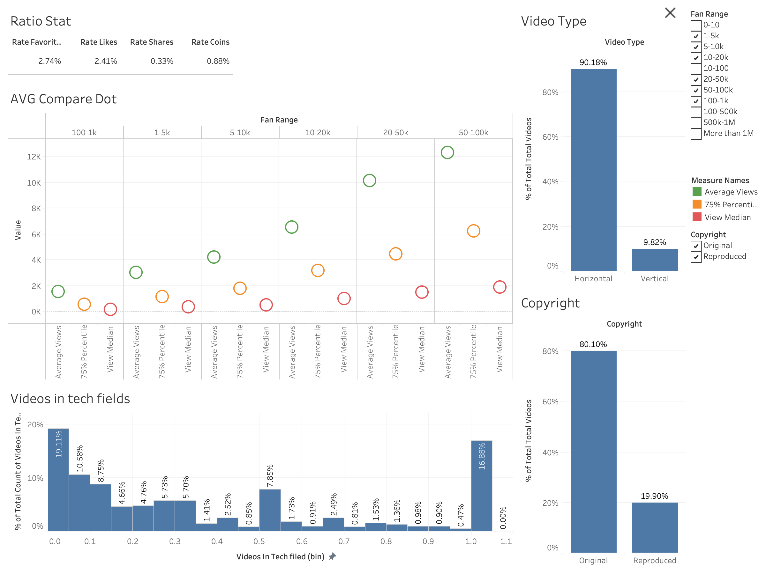

Slide 6
