Slide 1
Text Generation using Long Short Term Memory (LSTM)
Rida Zainab

Slide 2
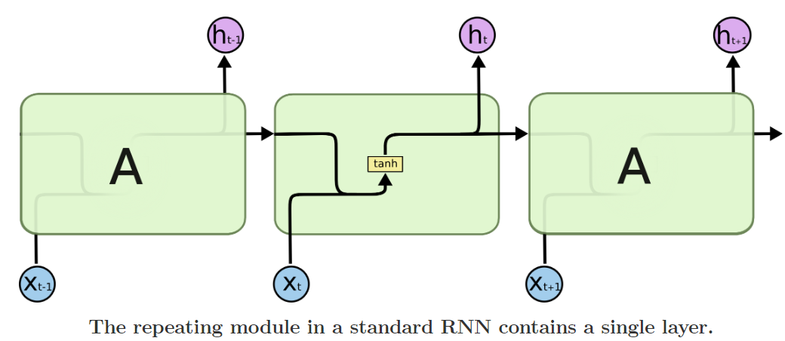
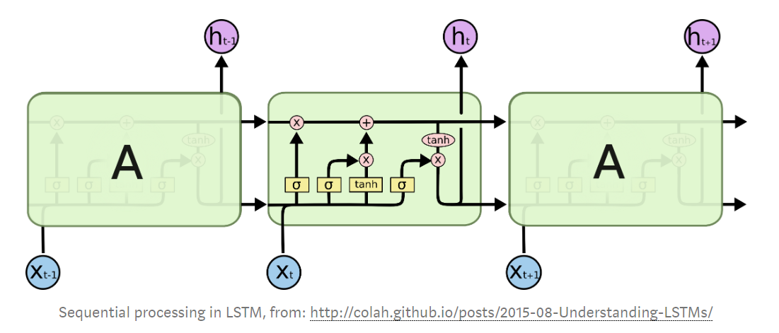
What is LSTM?
Long short-term memory (LSTM) is an artificial recurrent neural network (RNN) architecture for time series data classification and predictions

Slide 3
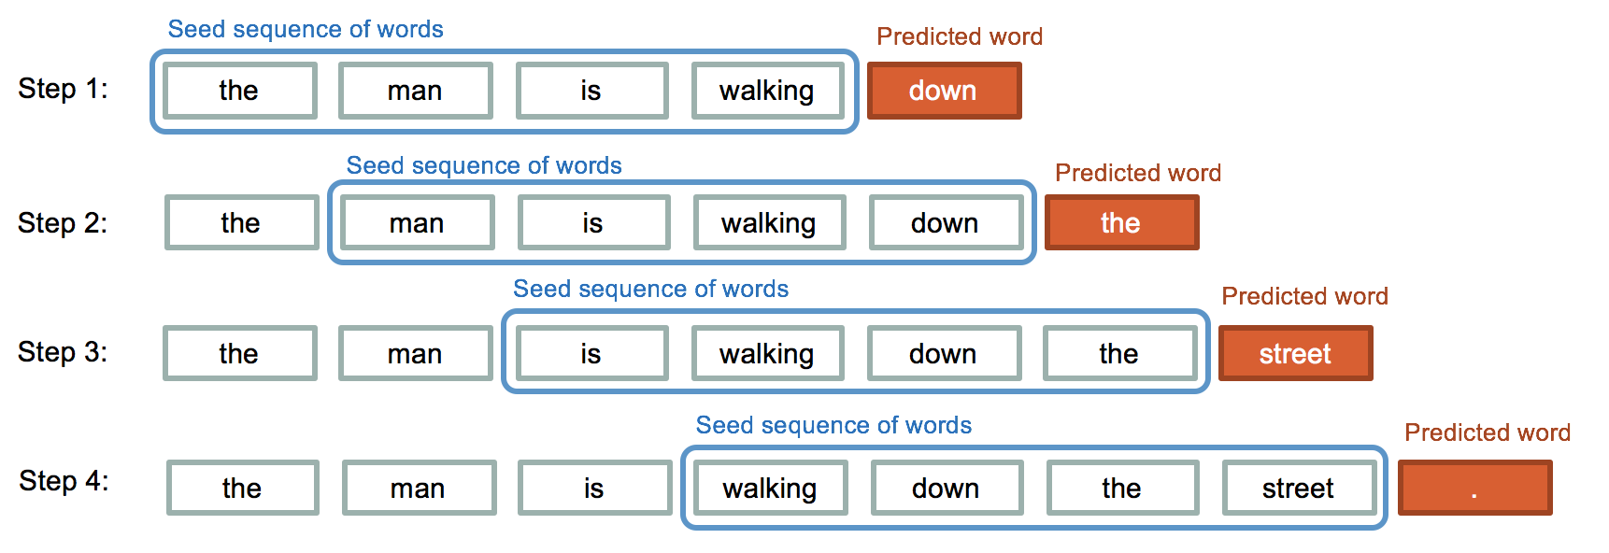
Text Generation using LSTM

Slide 4
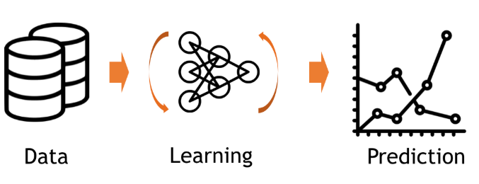
Text Generation
Model : LSTM Prediction : Word or Character Data : ?

Slide 5
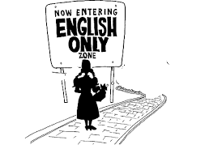
Not many Text Datasets != English Language A Gap in NLP Research

Slide 6
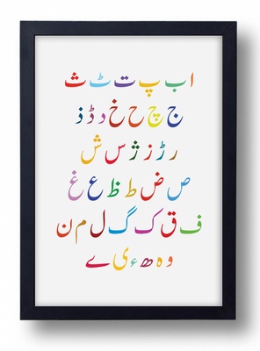
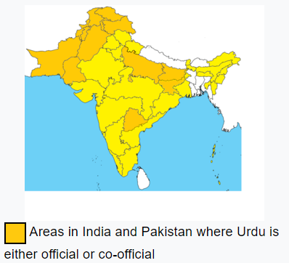
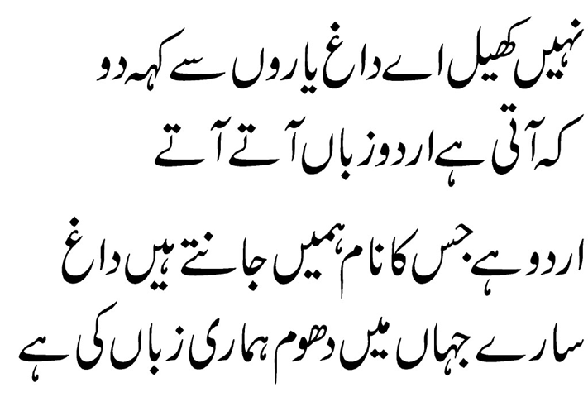
Text Data : Urdu Language

Slide 7
Urdu Language Dataset - Problems
No labelled dataset for supervised learning
Urdu text mixed with English words
Poor Quality - linguistic and typographical errors
Poor quality typefaces - spaces added or removed arbitrarily - difficult to get clean word boundaries
No Document Hierarchy - no idea where the text is from, when it was published, who wrote it, what part of the text it is (headings, paragraphs, lists, tables etc.)
Available Datasets
OpenSubtitles 2016 and 2018 corpora
XLNI
LDC2010T21, LDC2010T23 LDC corpora
Maḵẖzan (released on Nov 3, text donated by two renowned Urdu journals)

Slide 8
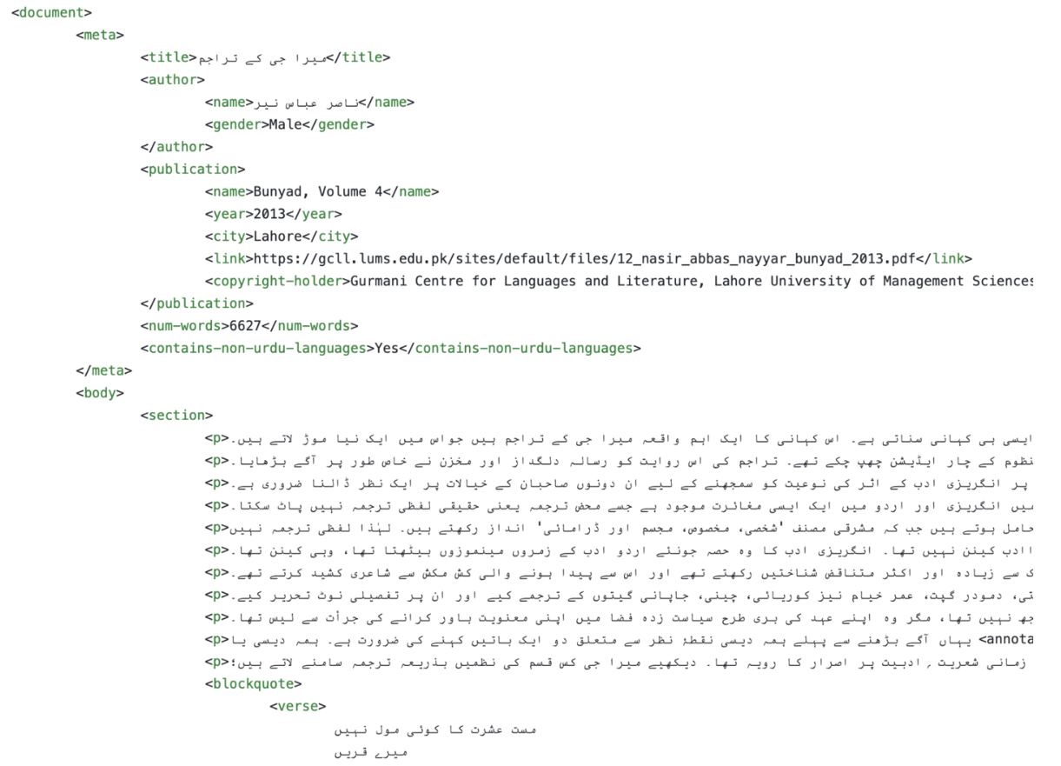
Urdu Preprocessing

Slide 9
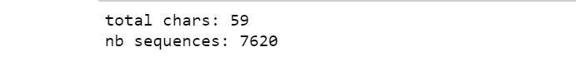
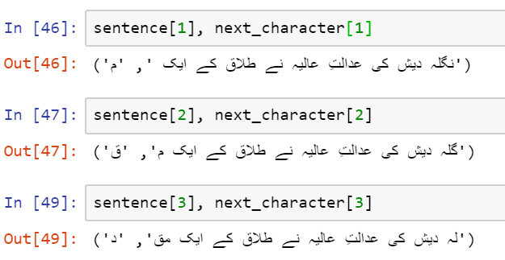
Pre Processing

Slide 10
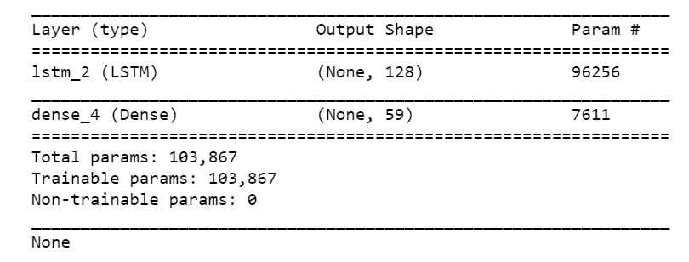
Model

Slide 11
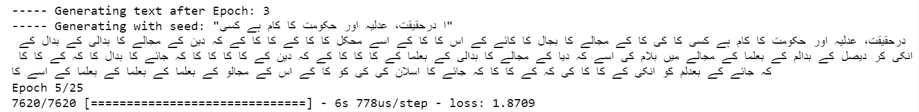
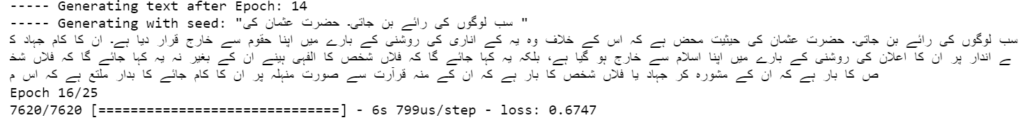
Text Generation using LSTM

Slide 12
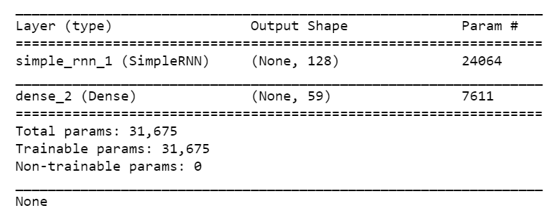
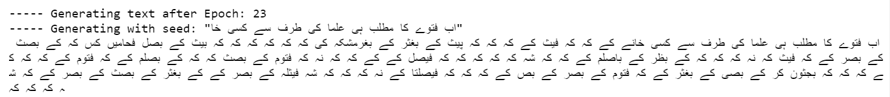
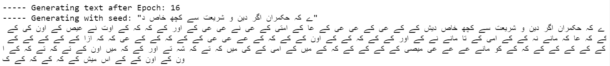
Using RNN instead of LSTM

Slide 13
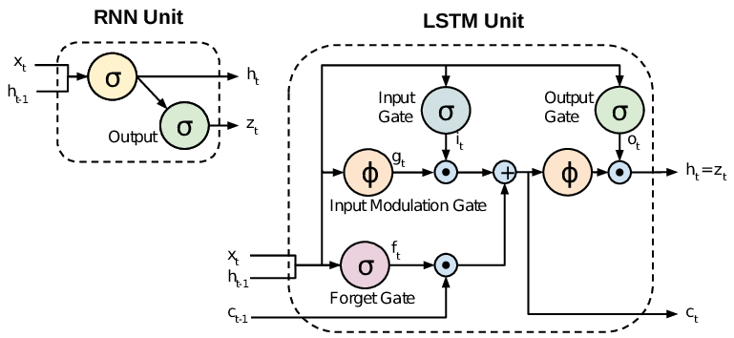
Why use LSTM instead of RNN?
RNNs suffer from problem of vanishing gradient

Slide 14
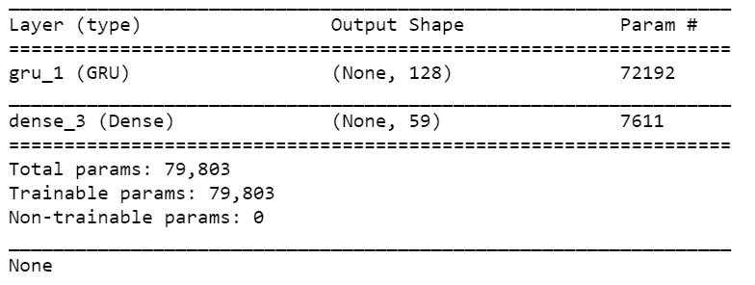
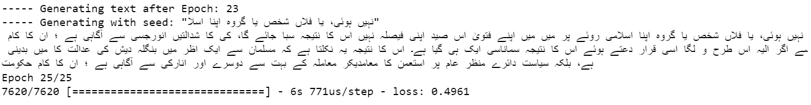
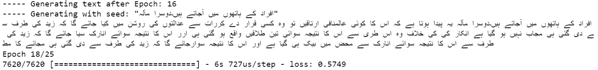
Using GRU instead of LSTM

Slide 15
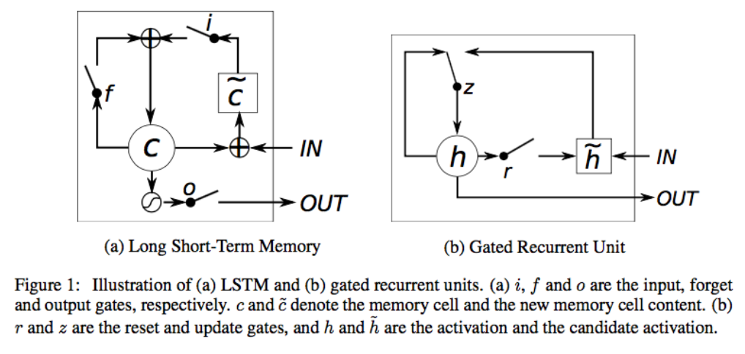
Using GRU instead of LSTM
Comparable Results

Slide 16


Slide 17


