Slide 1

Citrix Xenserver Vs VMware ESXi evaluation on basis of CPU,RAM and network
Rahul DHANDE
MSc Cloud Computing
X18182852

Slide 2

Server Virtualization
Allows abstracting a server's physical resources into logical resources, isolating a server into several virtual servers, or combining multiple servers into one server
Improve the usage of resources by the CPU, memory, I / O, disk and other dynamic hardware, so that device management is more versatile and simpler
It helps to reduce power and energy consumption, that's why it referred to as a server consolidation technique.
Vendors in the markets are VMware vSphere, KVM, Hyper-V, Oracle VM VirtualBox, Proxmox VE, Nuatnix Acropolis, XenServer, Oracle VM and RHEV
Top two market players in Server Virtualization
VMware ESXi
Citrix XenServer

Slide 3
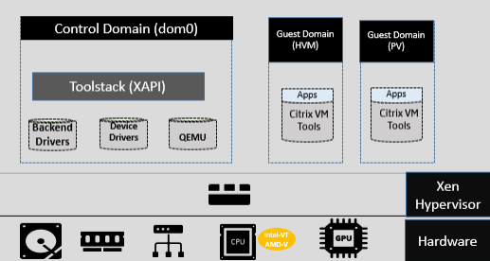
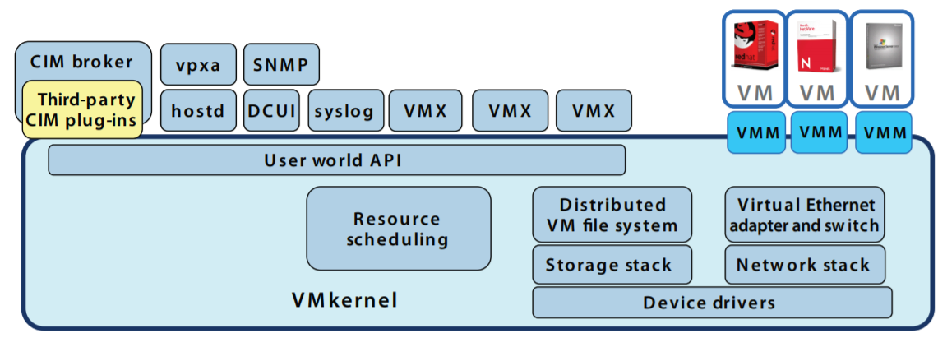
Citrix Xenserver Vs Vmware Esxi Architecture
Fig 1: Technical architecture of Citrix XenServer
Fig 2. Detailed view of VMware ESXi architecture

Slide 4

Problem Definition
The Both Citrix Xenserver and VMware Esxi are the bare metal type-1 hypervisors, top 2 players in server virtualization manage various types of workload, mixed operating systems, and storage or networking configurations
Both show certain limitations and issues in performance and network latency.
Novelty of research
Connect XenServer to Citrix center and ESXi to VMware vSphere client and Analyze and Compare performance on bases of CPU,RAM and Network using Sysbench and Netperf Benchmarking Tool.

Slide 5
Literature Review
Authors and used Hypervisors for comparison | Objective
2019, Jiang, C and Wang VMware ESXi and Microsoft Hyper-V | power and energy features
J. Torbic, I. Stankovic,2018 VMware ESXi and Microsoft Hyper-V | mathematical expressions for benchmark two workloads
B. Dordevic, V. Timcenko,2019 Vmware Esxi and Citrix XenServer, | comparison based on file system performance provide solution on the significant issue of hardware virtualization dependency on full virtualization
2016, V.K.Manik and D. Arora Xen, KVM, Hyper-v and ESXi. | Maintaining multiple computing resources and specific application programming interface features for specific virtualization platforms.
In 2019, L. Abeni and D. Faggioli Xen and KVM | analyse the real-time performance of hypervisor and evaluate through scheduling techniques
2017, D. Kumar and A. Magloire Xen, and KVM | providing solutions to Cloud technology and virtual environments allow much more effective and safer use.
The M. Polenov, V. Guzik 2018 Microsoft hyper-v, Xenserver,vSphere | Improve resource management.
Hypervisors | Benchmarking Tool
VMware ESXi and Microsoft Hyper-V | Filebench
Vmware Esxi and Citrix XenServer | HD Tune PRO and ATTO
Xen and KVM | Cyclictest
Microsoft hyper-v,Xenserver,vSphere | Netbook
Microsoft Hyper-V, Vmware vSphere, KVM | PassMark, UnixBench and DiskMark
Xen | Sysbench
Vmware Workstation | Netperf
TABLE I. Related work
TABLE II. Summary of Assessment tools

Slide 6
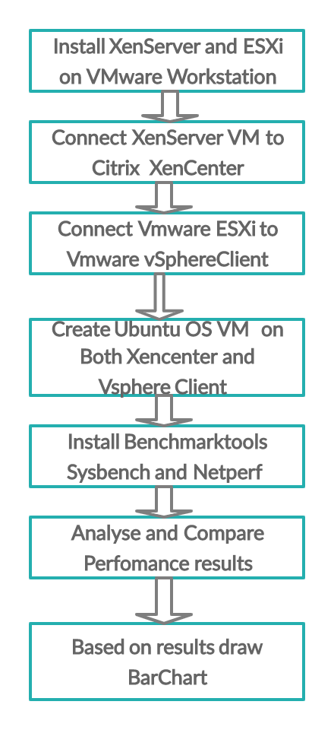
Experimental METHODOLOGY
CPU | Intel Core i5 8250U 1.80 GHz
RAM | 4 GB assigned both VM
No. of Cores | 2
No. of Processors | 1
OS type | 64-bit
Machine Name | ASUS
HDD Capacity | 1 TB
VM Hard Disk | 90 GB
Host OS | Windows 10 Home Single Language
Guest OS | XenServer and VMware ESXi
VMware workstation version | 15.5
XenServer Hypervisor Version | 6.2.0
VMware Hypervisor ESXi | 5.5
XenCenter Version | 6.2.0
VMware vSphere Client Version | 5.5
Guest OS on XenServer and vSphere Client | Ubuntu 18.04 LTS
Fig. 3: Plan Flow of Experiment
TABLE II: Configuration of System prerequisites

Slide 7
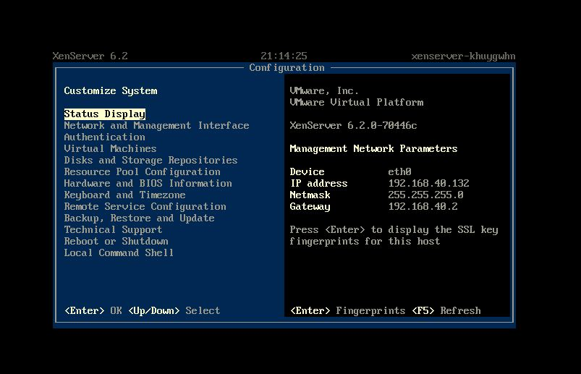
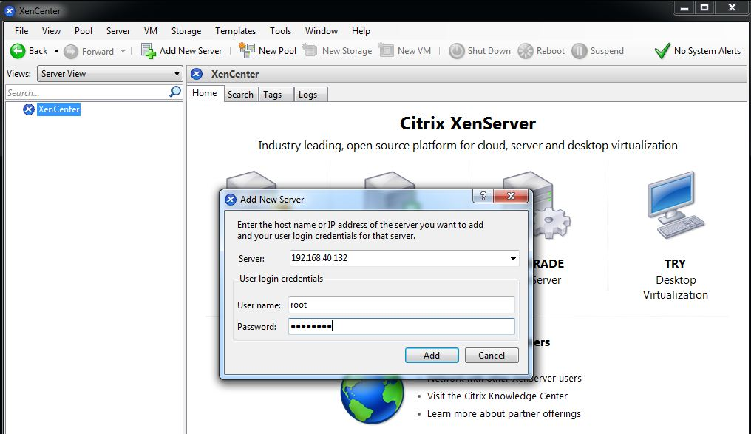
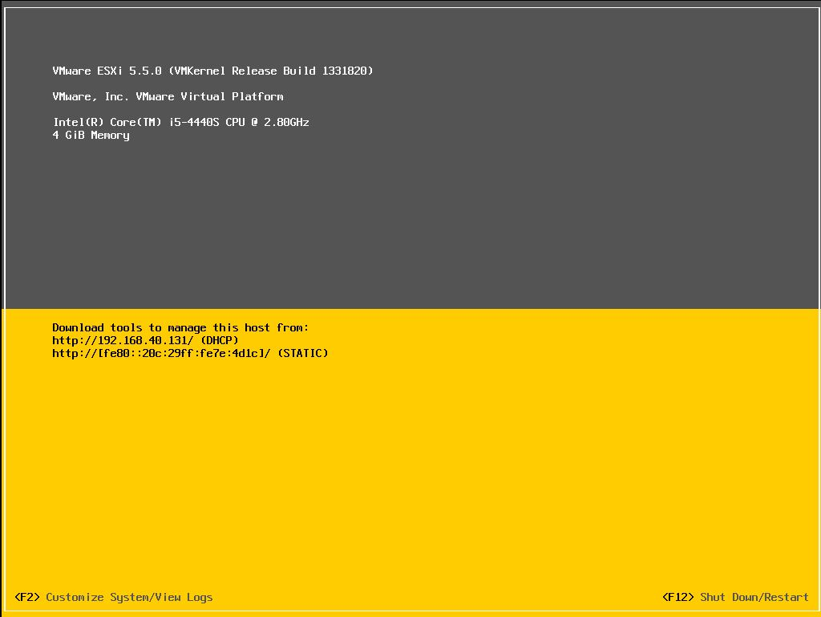
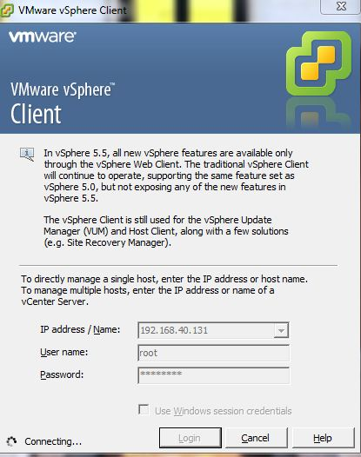
Experimental SETUP
Fig.5.
Adding XenServer on Citrix XenCenter
Fig.3. XenServer Configuration Control
Fig.4 VMware ESXi
Login ESXi Host on VMware vSphere Client

Slide 8
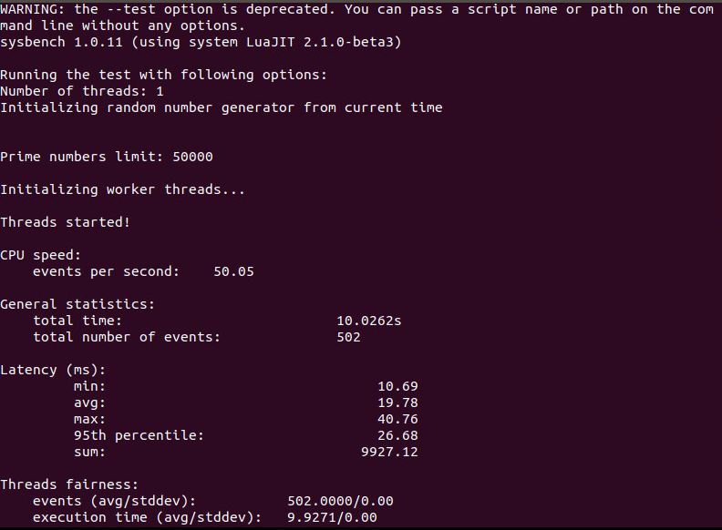
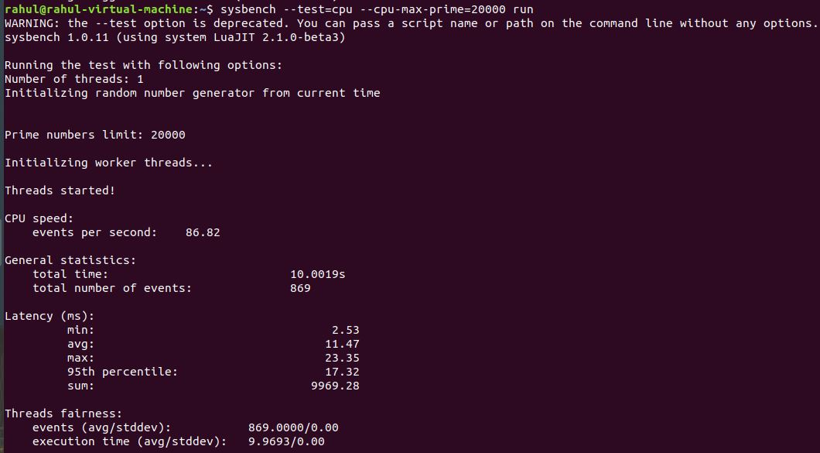
Experimental Results
Compare CPU Performance
Total Time with Thread 1, Prime number 20000
VMware ESXi
Citrix XenServer

Slide 9
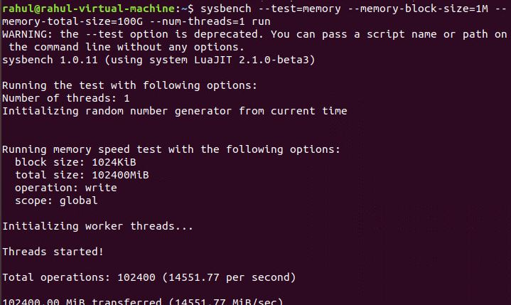
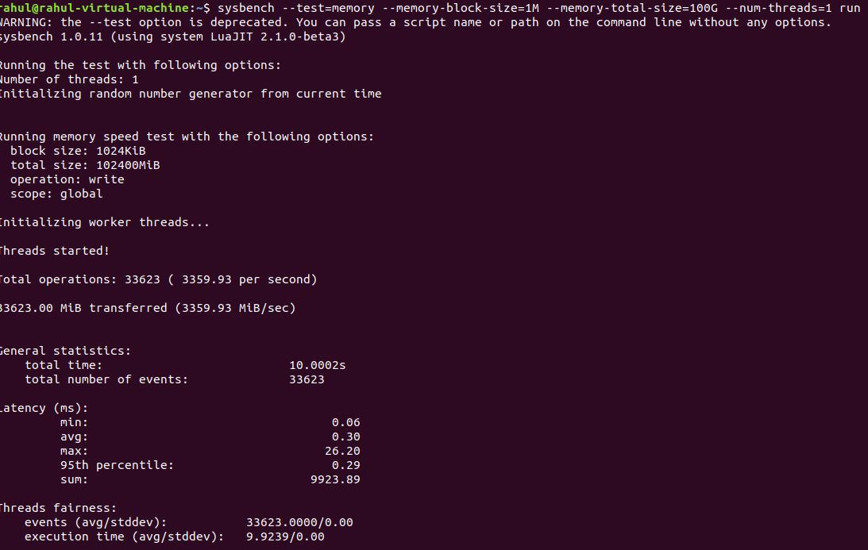
Experimental Results
Compare Memory Performance
Total Operations per second with Thread 1, Memory block Size 1024KiB,Total Memory Size 102400MiB
VMware ESXi
Citrix XenServer

Slide 10
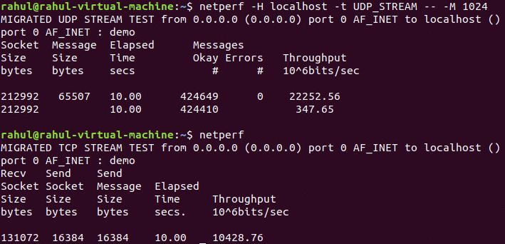
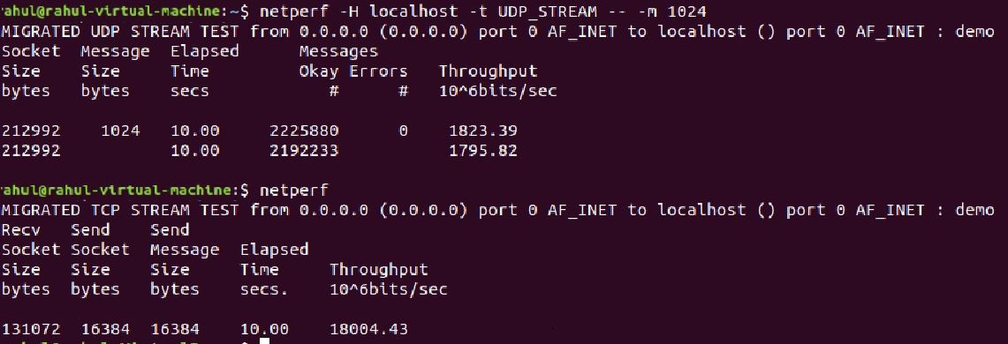
Experimental Results
Compare Network Performance
Throughput Receive from TCP Stream
VMware ESXi
Citrix XenServer

Slide 11
CONCLUSION
Server Virtualization is a powerful virtualization component that provides higher flexibility and reliability with massive savings in power consumption, as well as eliminating servers in cloud data centres saves the capital cost of many Industries.
In this research theme, We used a novel technique to evaluate the performance of type-1 hypervisors. We connect Xenserver to XenCenter and ESXi to vSphere Client and assess performance.
Additionally, we have successfully evaluated the performance of two hypervisors on the bases of CPU, Memory and Network using Sysbench and Netpef benchmarking tools.
The experimental results show XenServer performs well in terms of CPU than ESXi as well as ESXi performs well in Memory and network as compared to Citrix XenServer.

