Slide 1
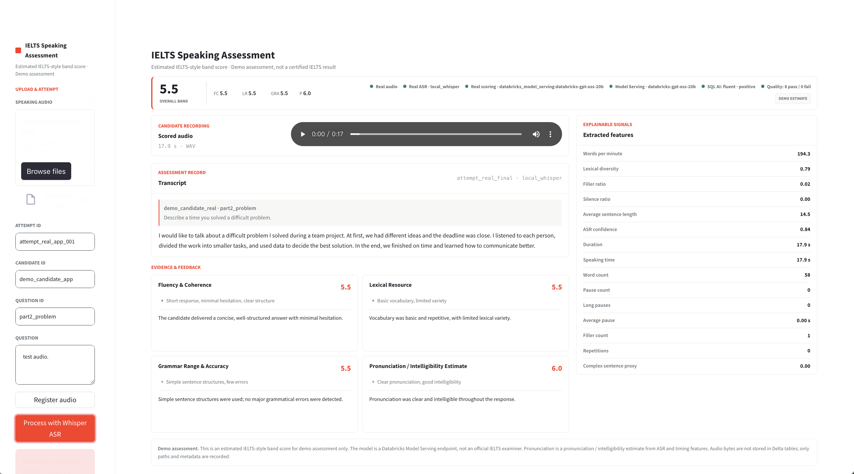
DATABRICKS CUSTOMER SOLUTION
AI-assisted speaking
assessment for
IELTS organizations
Automated first-pass scoring, explainable feedback and governed human review on Databricks.
REAL AUDIO / WHISPER ASR / MODEL SERVING / DELTA
Estimated IELTS-style band score. Demo assessment, not a certified IELTS result.
Notes:
Purpose: introduce a Databricks solution that helps IELTS organizations automate the first assessment pass while preserving human oversight.
Brand source: https://brand.databricks.com/
Brand guidelines: https://brandguides.brandfolder.com/databricks-extended-brand-guidelines
Product image: docs/assets/app-overview.png

Slide 2
WHY CHANGE
Speaking assessment is constrained by examiner capacity
01
Scarce examiner time
Feedback arrives
after the learning
moment.
Every score waits for a qualified reviewer; demand grows faster than capacity.
02
Rater variability
A band without a visible evidence trail is difficult to calibrate or defend.
03
Practice without diagnosis
Word counts and pace alone do not explain fluency, language range or intelligibility.
The recording already contains the signals. They are simply unscored, inconsistent and disconnected from action.
04
Costs scale with headcount
More candidates create more review hours, especially during peak periods.
The practical target is an automated first-pass assessment with human oversight, not a replacement for examiner judgment.
AI-assisted IELTS speaking assessment
2 / 7
Notes:
Use this slide to frame the operating constraint, not to criticize examiners.
Claims are qualitative and adapted from the supplied source deck. No unsupported cost or turnaround percentages are used.

Slide 3
SOLUTION WORKFLOW
One governed path from recording to review
Upload
Transcribe
Extract
Score
Review
1
2
3
4
5
Real candidate audio
registered to a new attempt
Whisper ASR produces
timestamped segments
16 explainable speech
and language features
Model Serving returns
structured rubric estimates
App combines audio, score,
evidence and provenance
LIVE DEMO PATH
Real audio + Whisper + Databricks Model Serving + Delta tables + Databricks App
Same contract, two execution paths
The App supports a one-step interactive assessment. A 10-task Lakeflow job supports repeatable batch and operational processing.
AI-assisted IELTS speaking assessment
3 / 7
Notes:
Sources: README.md, docs/architecture.md and resources/jobs.yml.
The deployed bundle defines 10 tasks: setup, ingest, transcribe, feature extraction, Model Serving scoring, feature publish, SQL AI, quality checks, MLflow logging and review.

Slide 4
REVIEWER EXPERIENCE
A reviewer gets one report: score and evidence together
The live App keeps the candidate recording, transcript, rubric estimates, features and model provenance in one view.
1
Overall band + four criteria
2
Audio playback + transcript
3
Explainable signals + provenance
Demo assessment. The score is an estimated IELTS-style band score, not a certified IELTS result.
AI-assisted IELTS speaking assessment
4 / 7
Notes:
Source image: docs/assets/app-overview.png.
Call out that the App supports listening to the scored audio directly and displays whether ASR and scoring are mock or real.

Slide 5
SCORING OUTPUT
The model produces four rubric-aligned estimates
Each dimension is supported by transcript evidence and explainable speech features.
5.5
Fluency &
coherence
Lexical
resource
Grammar range
& accuracy
Pronunciation /
intelligibility
5.5
5.5
5.5
6.0
OVERALL BAND
Estimated demo score
Pace, pauses and
response structure
Vocabulary range and
lexical diversity
Sentence variety and
error evidence
ASR confidence and
timing features
BAND MATH
(5.5 + 5.5 + 5.5 + 6.0) / 4 = 5.625 -> 5.5
Average the four dimensions, then round to the nearest 0.5. Pronunciation is an intelligibility estimate, not phoneme-level diagnosis.
AI-assisted IELTS speaking assessment
5 / 7
Notes:
Illustrative values are from the deployed demo report in docs/assets/app-overview.png.
Overall scoring rule follows AGENTS.md: average the four dimensions and round to the nearest 0.5.

Slide 6
DATABRICKS ARCHITECTURE
Databricks keeps data, model and review under one governance model
Unity Catalog and attempt_id lineage connect each layer from candidate audio to the final report.
Experience
Databricks App / 10-task Lakeflow job
VERIFIED IN DEMO
04
Interactive review and repeatable operations
Databricks App
RUNNING
03
AI & ML
Model Serving / MLflow / SQL AI
Structured scoring, experiment tracking and transcript enrichment
Model Serving
NON-MOCK
02
Features & quality
Feature Engineering / 16 features / 8 quality checks
Quality checks
Reusable signals, validation and active monitoring
8 / 8 PASS
8 Delta tables / Unity Catalog / Volume
Local test suite
01
Governed data
62 PASSED
Audio metadata, transcripts, features, scores and processing evidence
Candidate audio bytes stay in the governed Volume. Delta stores paths and metadata, keyed by attempt_id.
AI-assisted IELTS speaking assessment
6 / 7
Notes:
Sources: docs/architecture.md, docs/loop_state.md and notebooks/00_setup.sql.
Verified evidence in docs/loop_state.md: App RUNNING, non-mock Model Serving, 8 quality checks passed and 62 local tests passed.
Deployment status is time-sensitive and should be rechecked before a live customer meeting.

Slide 7
PILOT RECOMMENDATION
A 30-day pilot proves scoring quality before scale
Start with one cohort, benchmark against human raters and retain human review for edge cases.
1
2
3
DAYS 1-7
DAYS 8-21
DAYS 22-30
Align & scope
Build the pilot
Validate & decide
Confirm the business KPI
Connect real learner audio
Compare with human raters
Lock the rubric with academics
Run ASR and Model Serving
Assess turnaround and cost
Define audio sources and entities
Publish features and quality checks
Review edge cases and controls
Agree PII, retention and access
Track runs and ship the App
Define the production roadmap
Pilot one cohort. Compare criterion by criterion.
Scale only after scoring quality and governance are accepted.
DECISION: PILOT SCOPE + SUCCESS METRICS
AI-assisted IELTS speaking assessment
AI-assisted IELTS speaking assessment
7 / 7
7 / 7
Notes:
Recommendation adapted from the supplied source deck, with unsupported numerical benefit claims removed.
The pilot decision should define one cohort, a human-rater benchmark and explicit acceptance thresholds before production scale.

